Slide 1
Travel & Procurement Hot Topics
OGC Team Talk
Fiscal Compliance
2/22/2024

Slide 2
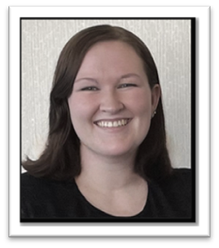
Introductions
Caroline Quane
Assistant Director Fiscal Compliance
Caroline.Quane@ucdenver.edu
Holly Day
Senior Fiscal Compliance Auditor
Holly.Day@udenver.edu

Slide 3
Agenda
Policy Overview
Travel
General Procurement
Resources
Questions

Slide 4
Policy Overview
“What do you mean we have a Procurement Policy? I didn’t know!”

Slide 5
APS 4014: Fiscal Roles & Responsibilities
If you are involved in purchasing, entering, or reviewing transactions, you are an individual with a fiscal responsibility.
Employees must understand and stay current on “applicable policies, laws, regulations, and rules; and contracts, grants, and donor restrictions, regardless of when the approval occurred.”
An employee may be held personally liable when policies & procedures are not followed regarding purchasing.

Slide 6
APS 4015: Propriety of Expenses
You must be able to answer “YES” to each of the questions on the right for it to be an allowable use of University Funds.
Additional Considerations:
Would a University outsider consider the expenditure to be a reasonable & necessary expense of public funds?
Is this expense allowable per the award agreement and is it in the budget & budget period?
Would you want others (ie. newspaper, radio, television) knowing & reporting about what you have decided?
Is the transaction…
For Official University Business
In the best interest of the University
The most effective way to accomplish University business
Compliant with laws, regulations, rules, policies, and restrictions
Within available resources
Directly beneficial to department
Reasonable
In Compliance with University Conflict of Interest Provisions
What procurement method is most appropriate for the expense?

Slide 7
Procurement Policies
Procurement Rules
Procurement Code of Ethics
Procurement Card Handbook
PPS: Travel
PPS: Travel Card Handbook
Accounting Handbook
FPS: Sensitive Expenses
FPS: Business Expense Substantiation & Tax Implications

Slide 8
Procurement Methods
Proper Procurement rules and procedures must be followed for University business expenses. The University is liable for charges incurred on Travel & Procurement Cards and pays the bills directly to the bank.
Mechanisms of Procurement (buying, purchasing, renting, leasing, or otherwise acquiring goods or services) for the University include:
Procurement Card: used to place small-dollar orders directly with suppliers
Travel Card: used to cover most University travel expenses
Airfare/Ghost Card: airfare booking through Concur/CBT
CU Marketplace: official procurement to pay system for the University
Reimbursement: cash out of pocket
Approving Officials within the University play a critical role in ensuring proper fiscal management of University resources. All expenses made using University funds must involve at least two different employees: a requestor and an approver.

Slide 9
Subaward Guidance
Subrecipients must follow their own travel and procurement policies.
Many of the audit findings on our subawards have been that the subrecipient did not follow their own policies.
Before processing travel or equipment, we should either:
Review the subrecipient’s policies to ensure compliance, or
Require the subrecipient to provide a certification they have followed their own policies

Slide 10
Travel

Slide 11
General Travel Process
Request Approval
All domestic and international travel must be approved prior to booking a trip
1
Reconcile Expenses
Use the Concur Travel & Expense System (Concur) to reconcile your Travel Card charges and/or get reimbursed for out-of-pocket expenses.
3
Book travel
Book travel on behalf of the non-employee using Concur. Authorize the non-employee to book their travel through CBT or to make their own travel arrangements and request reimbursement.
2
You cannot pre-charge travel to a grant that is going to end before the travel occurs.
Expenses should be reconciled and submitted before the award end date.
If traveling on a federal award and the individual booked their own travel, you must verify they are compliant with the Fly America Act before processing the charge. See Resource

Slide 12
Mileage
Mileage or other transportation expenses between employee’s home and primary work location are non-reimbursable. Employee’s who have chosen to live out of state are still based on primary work location (e.g. Anschutz, Denver).
Beginning 1/1/2024, standard reimbursement rate is $0.60/mile
Use the Mileage Calculator within the Concur Travel & Expense system to enter reimbursable miles – will assist in calculating and deducting the normal commute.
See “Calculating Reimbursable Mileage & Ground Transportation” for more details.
# of Miles Driven – Employee’s Normal Commute = Miles Reimbursed
Note: CU’s mileage reimbursement is more restrictive than the IRS. Always follow the more restrictive policy.

Slide 13
Per Diem
It is typically most advantageous to request per diem when traveling.
Reflects the maximum amount allowed for eligible meals (including meal tips) that you need to purchase during a University trip. Includes incidental amount to offset other trip expenses (ie. maids, bellhops, etc.)
Does not require submission of receipts to claim per diem.
Begin and End Dates – per diem cannot exceed 75% of the daily M&IE Rates.
Meals that are provided as part of a conference or travel stay should not be included in per diem. In Concur itinerary will be created to select which meals were provided.
If you chose to use Travel Card to pay meal expenses, you must identify those transactions on expense report as “Personal Travel Charge (not reimbursable)”. If Meal costs exceed Per Diem limits, you may need to reimburse University.
Continental U.S. Per Diem Rates (example below).
Foreign Per Diem Rates

Slide 14
General Procurement

Slide 15
Sensitive Expenses
Outlines the allowability of certain sensitive expenses, conditions, and related policies & procedures.
Sensitive Expenses are clear auditable areas. Must be able to support the expense and business purpose.
Included, but not limited to:
Beverage service
Consumables for personal consumption
Flowers - allowed for official functions
Donor Cultivation and Fundraising
Donations & Sponsorships
Food
Gift Cards
Alcohol
Official functions
Entertainment activities
Resource: Refer to the FPS: Sensitive Expenses policy full details.

Slide 16
Gift Cards
The purchase of gift cards must be preapproved by Fiscal Compliance.
Contact Fiscal Compliance at PCGC@ucdenver.edu
Permitted Uses:
Study Subject Compensation
Survey Incentives
Recognition
Honoraria
Prohibited Uses:
Student Academic Awards (Financial Aid Office)
Payments/Awards to non-US persons (IRS Withholding)
Training Requirement: All new custodians are required to complete the online Skillsoft training U00224 CU: Custodian Responsibilities – Gift Cards, Petty Cash, and Change Funds.
Resource: Refer to the FPS: Gift Cards policy full details.

Slide 17
Study Subject Payments
Policy
PPS: Study Subject Payment
Form
Study Subject Payment Form
Overview
Sets forth university requirements for processing study subject payments. These requirements include, when relevant, procedures to protect the privacy rights of individuals while still providing sufficient information to the University for IRS reporting. International payments have additional required documentation.

Slide 18
Documentation & Support
Business Purpose - Does the purpose/justification explain the Who, What, Why, When, Where, and How?
Supporting documentation should substantiate the business purpose of the expenditure. Source documentation must include:
Vendor Identification (Merchant Name)
Date of Purchase
Description & Quantity of each item(s) purchased (Itemized)
Cost per item(s) (if available)
Total cost per item(s)
Cardholder Name and/or Card Number Last Four Digits
Explanation of Purchase
Additional supporting documentation or required approvals (ie. Alcohol Authorization Form, Conference Itinerary, Attendee List, Sponsor Approval)
Sponsored Project/Gift Funds require information on how the purchase complies with funding source.

Slide 19
Inadvertent Personal Purchases
Cardholder should ask the supplier to credit the P-Card and charge their personal card instead.
If supplier issues credit and charges Employee’s personal credit card, cardholder must submit original expense as well as credit.
If supplier is unwilling to credit, cardholder needs to immediately reimburse the University with a check made out to the University of Colorado.
Check must be deposited using a Cash Receipt form and submitted to the Bursar’s Office.
The Validated Cash Receipt form must be attached with the transaction in Concur. A comment should be included to explain the situation.

Slide 20
Questionable Expenses
Approver/AO should request more information from preparer to approve.
Can send report back to employee with comments.
Returned report should include additional documentation and explanation in comments to better support the business purpose of the transaction.
Reject report; preparer can remove questionable expense and resubmit report without questionable expense line to allow for payment.
Contact fs-compliance@ucdenver.edu to discuss if necessary.

Slide 21
Business Expense Substantiation and Tax Implications
All University Business Expenses must be submitted and substantiated in an expense report within 30 days to ensure timely review and reporting to the University’s financial record.
As an Approving Official, you will receive various notifications of unsubmitted transactions for the employees under your approving authority. Keep a pulse on these unsubmitted transactions to ensure individuals are timely in submitting their expense reports.
New Procurement Card Transactions Posted for all Assigned Cardholders in Concur (Weekly)
Aging Travel Card and/or Airfare Transactions (30 Days past transaction date, then repeats/30)
Aging Procurement Card Transactions (30 Days past transaction date, then repeats/30)
Failure to submit an expense report within 90 days from the transaction date or 90 days of the trip end date will result in the amount of the related expense being reported as additional taxable income to the employee (BEX) per the University’s Accountable plan (FPS: Business Expense Substantiation & Tax Implications).

Slide 22
Contracts
General rule is Do Not Sign Contracts.
Expense Contracts*
Expenditure contracts of any dollar amount require Procurement Service Center approval.
PSC Purchasing Agents are the only individuals authorized to sign expenditure contracts for goods and services on behalf of the University.
*Please note that subcontracts and certain research contracts may go through OGC.
Revenue
Sponsored Projects/Research
FFS/Self-Funded Revenues/Auxiliary
Fundraising, Gift, Gift-in-Kind Revenue
Please see OGC Website for details on various contacts by topic.

Slide 23
Resources
Contacts
Denver & Anschutz Fiscal Compliance: fs-compliance@ucdenver.edu
Office of Grants and Contracts: OGC Website
Commercial Card Team: procurement.card@cu.edu
Procurement Service Center Service Desk: psc@cu.edu (procurement)
OUC Financial Services & Solutions: fss@cu.edu (finance)
Forms & Resources
PSC Knowledge Base – hub of how-to articles for navigating the PSC’s systems for Concur & CU Marketplace.
Violation Notification (VN) Form – used to document and report a transaction in violation of Procurement Card policies as described in the Procurement Card Handbook. Violations may result in card revocation.
CU EthicsLine – independent, anonymous way to report concerns or suspected misconduct.

Slide 24
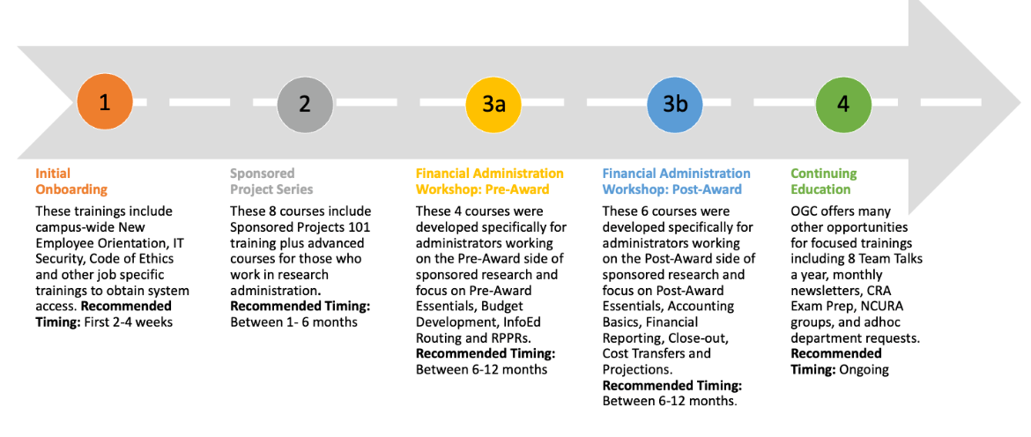
Sponsored Projects Trainings
Register for upcoming courses in Skillsoft
Contact Shane Jernigan (Shane.Jernigan@cuanschutz.edu) with questions on upcoming training courses.

Slide 25
Questions

