Slide 1
OGC Team Talks
March 26, 2025
Notes:
BEST PRACTICES & ACCESSBILITY STANDARDS:
”Save as” this template before you begin and rename it to the title of your presentation. This way, you will retain a copy of this blank template for future use.
Choose a title slide theme and then delete the other options
To add a new slide go to Insert in the navigation bar > New Slide and click the drop-down arrow to choose from different slide layouts and designs.
For body text keep font size at 18pts or larger. For headers keep font size at 24pts or larger.
For any new image or icon you add please add a description in the alt text. Right click image > click on View Alt Text > type in image description

Slide 2
Agenda
Welcome and Opening: Koffi
Upcoming Trainings: Shane and Liz
Sponsor updates: Other Updates - Garrett
Topic of the session: NIH PF5 - Garrett
Close: Koffi
Notes:
Toula added this slide – for basic copy/bulleted lists where you need as much space as possible.

Slide 3
Upcoming Training
Shane Jernigan and Liz
Notes:
BEST PRACTICES & ACCESSBILITY STANDARDS:
”Save as” this template before you begin and rename it to the title of your presentation. This way, you will retain a copy of this blank template for future use.
Choose a title slide theme and then delete the other options
To add a new slide go to Insert in the navigation bar > New Slide and click the drop-down arrow to choose from different slide layouts and designs.
For body text keep font size at 18pts or larger. For headers keep font size at 24pts or larger.
For any new image or icon you add please add a description in the alt text. Right click image > click on View Alt Text > type in image description

Slide 4
Upcoming Training
SP11B- Outgoing Funding/Subs
4/28 12:00 – 1:00
SP11A- Incoming Funding/Co-presented with CRAO
5/5 12:00 – 1:00
Notes:
Toula added this slide – for basic copy/bulleted lists where you need as much space as possible.

Slide 5
Other Federal Sponsor Updates
Notes:
BEST PRACTICES & ACCESSBILITY STANDARDS:
”Save as” this template before you begin and rename it to the title of your presentation. This way, you will retain a copy of this blank template for future use.
Choose a title slide theme and then delete the other options
To add a new slide go to Insert in the navigation bar > New Slide and click the drop-down arrow to choose from different slide layouts and designs.
For body text keep font size at 18pts or larger. For headers keep font size at 24pts or larger.
For any new image or icon you add please add a description in the alt text. Right click image > click on View Alt Text > type in image description

Slide 6
NIH Administrative Burden Reduction: LOIs and $500K Prior Approval Eliminated
This removes two long‑standing pre‑submission hurdles.
NIH no longer requires or accepts:
  Letters of Intent (LOIs)
  Prior IC permission for applications requesting $500K+ in direct costs
Applies to all NOFOs, effective immediately.
Reduces administrative friction but increases importance of internal review readiness.

Slide 7
NIH Funding Decision Framework: Paylines De‑Emphasized
Changes how faculty interpret scores and manage expectations.
NIH is moving away from published paylines.
Funding decisions now incorporate:
  Programmatic balance
  Public health need
  Strategic priorities
Strong scores still matter—but no longer guarantee funding.

Slide 8
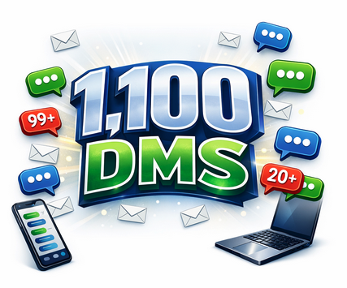
NIH Data management
NIH Notice NOT‑OD‑26‑046 updates the required elements and format of the NIH Data Management and Sharing (DMS) Plan
Based on NIH’s review of more than 1,100 DMS Plans since the policy took effect in 2023, the agency found that many plans contained unnecessary detail and exceeded recommended length

Slide 9
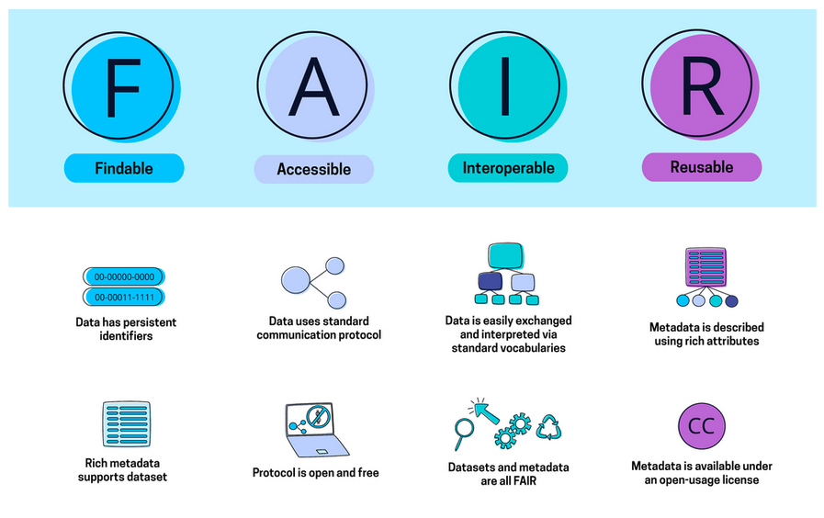
NIH Data management
NIH has streamlined the DMS Plan requirements and now mandates use of a standardized, simplified format that focuses only on compliance‑critical information and aligns with FAIR data principles

Slide 10
NIH Data management
Effective for applications with due dates on or after May 25, 2026, applicants and awardees must use the new DMS Plan format, which relies primarily on structured YES/NO questions (with brief explanations when answers are “NO”) addressing whether data will be shared, the timing of sharing, and the duration of data availability
NIH is implementing the new format as a pilot

Slide 11

DOW: Updates Fundamental Research Security Initiatives and Implementation
From NSF Secure Center
https://www.secure-center.org/rsb2-9
“Funds appropriated for the DoW may not be used for grants, contracts, other transactions or other assistance to an institution of higher education if the purpose is to conduct fundamental research in collaboration with, or using equipment from [emphasis added], any entity named on any of the ‘Prohibited Entity Lists’ below. This funding prohibition also extends to the employees of such institutions.”
2026 Department of War (DoW) Component Decision Matrix to Inform Fundamental Research
Notes:
Federal News & Updates
Department of War Issues Updated Risk Matrix
On March 9, 2026, the U.S. Department of War (DoW) released an updated version of the Department’s “Component Decision Matrix to Inform Fundamental Research Proposal Mitigation Decisions.” Pursuant to National Security Presidential Memorandum 33 (NSPM-33) and the DoW’s January 2026 memo, “Fundamental Research Security Initiatives and Implementation,” the updated Decision Matrix includes the notice that:
“Funds appropriated for the DoW may not be used for grants, contracts, other transactions or other assistance to an institution of higher education if the purpose is to conduct fundamental research in collaboration with, or using equipment from [emphasis added], any entity named on any of the ‘Prohibited Entity Lists’ below. This funding prohibition also extends to the employees of such institutions.”
“Prohibited Entity Lists” refers to a compilation of 13 U.S. Government (USG) entity lists now included in the DoW Decision Matrix, representing a significant increase from the four lists previously included. Examples include, but are not limited to:
DoW 1286 List (previously included)
DoW 1260H List (previously included)
The Office of Foreign Assets Control (OFAC) Non-SDN Chinese Military-Industrial Complex Companies List
The Bureau of Industry and Security (BIS) Entity List (previously included) and Denied Persons List
The Department of Homeland Security Uyghur Forced Labor Prevention Act (UFLPA) Entity List
In the updated Decision Matrix, the mitigation categories available for DoW Components has been reduced from five categories to three: Prohibited factors; Mitigation measures required; and No mitigation needed. Notably, risk factors that now require mitigation measures include:
Within the past five years, the covered individual’s co-author(s) on publications in science and engineering journals are affiliated with an entity on any Prohibited Entity List at the time of review
Within the past five years, the covered individual’s co-author(s) on publications in scientific and engineering journals are participants in a malign foreign talent recruitment program (MFTRP) meeting any of the criteria defined in section 10638(4) of the CHIPS and Science Act of 2022.
Per the introductory text “Collaborations between covered individuals and international researchers do not require mitigation if they do not involve any of the factors described in [the matrix].”
During the Feb. 24-26 ASCE (Academic Security and Counter Exploitation) meeting, Kris Gardner, Director of Science and Technology Protection, indicated the implementation timeline would be within 60 days after the publication of the new matrix and would be considered on an award-by-award basis. In subsequent outreach it was confirmed that the prohibition on equipment was at the project level, not applicable to universities broadly, and that it applied to future awards.
Additional information regarding the updated DoW Decision Matrix, and the Department’s implementation of it, will be provided in future Research Security Briefings, as it becomes available.

Slide 12
Featured Presentation
Garrett Steed
Notes:
BEST PRACTICES & ACCESSBILITY STANDARDS:
”Save as” this template before you begin and rename it to the title of your presentation. This way, you will retain a copy of this blank template for future use.
Choose a title slide theme and then delete the other options
To add a new slide go to Insert in the navigation bar > New Slide and click the drop-down arrow to choose from different slide layouts and designs.
For body text keep font size at 18pts or larger. For headers keep font size at 24pts or larger.
For any new image or icon you add please add a description in the alt text. Right click image > click on View Alt Text > type in image description

Slide 13
NIH Collaborative International Research Project (PF5)
Notes:
BEST PRACTICES & ACCESSBILITY STANDARDS:
To add a new slide, go to Insert in the navigation bar > New Slide and click the drop-down arrow to choose from different slide layouts and designs.
For body text keep font size at 18pts or larger. For headers keep font size at 24pts or larger.
For any new image or icon you add please add a description in the alt text. Right click image > click on View Alt Text > type in image description

Slide 14
Collaborative International Research Project (PF5)
CU Anschutz Research Administration Guidance Overview
NOFO: NIH PA-26-002: Collaborative International Research Project (PF5)
RA workflow
Department coordination
PI messaging

Slide 15
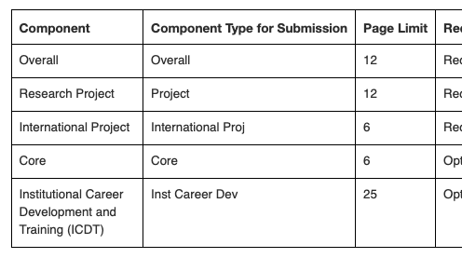
What is a PF5 application?
Multi-component collaborative international mechanism
Requires:
At least 1 domestic Research Project
At least 1 International Project (foreign organization)
Optional: Cores and Training ICDT components
Clinical trial: Optional
Uses multi-project (M) application structure
Key concept: Foreign partners are not subawards → they are separate International Project components

Slide 16
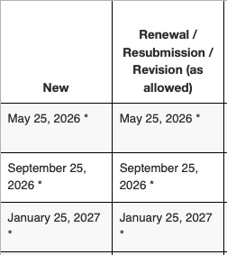
Key Dates
First due date: May 25, 2026
Standard NIH cycles thereafter
Earliest start: April 2027
CU Anschutz internal recommendation:
10–12 week lead time minimum (multi-component + foreign)

Slide 17
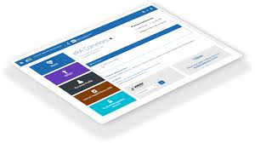
Why This Matters for CU Anschutz
More admin complexity, at first….
Multiple components = multiple budgets, sites, personnel
Foreign compliance + justification required
Different from standard R01 with foreign subaward
Risk areas:
  Budget structure errors
  Missing Foreign Justification
  Incorrect component setup in ASSIST or InfoEd
Notes:
Budget and Justifcation are Different

Slide 18
Required Application Structure
Overall Component
PI only listed
Foreign justification (overall)
Research Project Component(s)
Must be led by domestic organization
Domestic budgets in one section
International Project Component(s)
  One per foreign organization
  Contains foreign budget
  Biosketches reside in the section with the personnel
R&R/Key Person Profile
Overall – PI and any Multi-PD/PI
Research Project – List Domestic PI
International Project – International PI

Slide 19
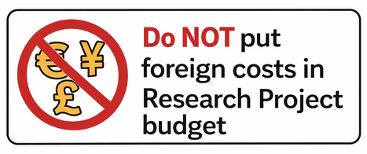
Critical Rule: No Foreign Subawards
Do NOT put foreign costs in Research Project budget
Foreign work must be its own International Component
Domestic subawards are allowed in Research Project budget
PHS 398: Activities outside of the United States or Partnerships with international collaborators: Answer 'Yes' to Field 6 only if the Research Project includes foreign involvement distinct from what is included in the International Project(s) components, such as foreign consultants or foreign travel by U.S. members of the research team for the purpose of gathering data.

Slide 20

Foreign Justification Requirements
Must:
Must include Foreign Letter of Support!
LOS are not LOI – must indicate foreign award willingness
Explain why work must occur outside the U.S.
IE: Describe unique:
  Populations
  Resources
  Facilities
  Expertise
Common error: Copy/paste justification across components

Slide 21
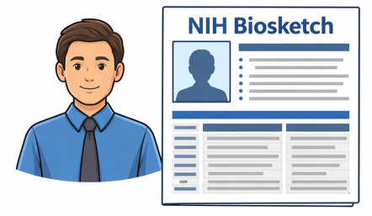
Personnel & eRA Commons
PD/PI Commons ID required in Overall
Project Leads listed in component as “Other – Project Lead”
Biosketch uploaded once per person across components
RA action: Track biosketch location to avoid duplicates

Slide 22
Budget Complexity
Each component has its own budget
Separate IDC calculations
Separate personnel
Foreign budgets only in International components
Overall has no budget
CU Anschutz tip: Use internal budget workbook by component no overall budget is submitted!

Slide 23
Compliance & Review Focus Areas
Reviewers assess:
Necessity of international work
Capability of foreign site
Human subjects / animals
Inclusion plans
Resource sharing
Authentication of key resources
Administrative impact: Early compliance review required

Slide 24
Registrations & Systems
All must be active before JIT submission:
SAM
UEI
eRA Commons
Grants.gov ([Simpler Grants][1])
Foreign sites: Often the timeline bottleneck

Slide 25

What Department Administrators Must Do
Start earlier than standard R01
Help PIs identify foreign scope and partners
Gather:
  Site details
  Project leads
  Effort by component
Route per component budgets
Monitor subrecipient vs international component rules
Validate Commons IDs (Need them, get them via OGC)
Confirm foreign org eligibility & registrations (Dept and OGC)

Slide 26
What PIs Need to Know
This is not a simple foreign subaward
Requires true international collaboration
You must justify why work cannot be done in U.S.
Multiple project leads and components
Longer preparation timeline
Strong coordination with RA required

Slide 27
CU Anschutz Internal Policy Recommendations
12-week lead time for PA-26-002
Pre-submission component mapping meeting
Central budget template for multi-project apps
Foreign registration checklist
Compliance pre-review (HS, animals, data sharing)

Slide 28
Timeline Example (Recommended)
12 weeks out: Foreign partner confirmed
10 weeks: Component structure + budgets
8 weeks: Foreign justification draft
6 weeks: Compliance review
4 weeks: ASSIST/InfoED build
3 weeks: Final budgets + routing
1-2 week: eRA Commons image review

Slide 29

When to Say No / Defer Submission
Foreign site not registered or not prepared
No clear justification for international work
PI treating as standard R01 with subaward
Insufficient time for multi-component assembly

Slide 30
Team Talks - Koffi
Notes:
BEST PRACTICES & ACCESSBILITY STANDARDS:
”Save as” this template before you begin and rename it to the title of your presentation. This way, you will retain a copy of this blank template for future use.
Choose a title slide theme and then delete the other options
To add a new slide go to Insert in the navigation bar > New Slide and click the drop-down arrow to choose from different slide layouts and designs.
For body text keep font size at 18pts or larger. For headers keep font size at 24pts or larger.
For any new image or icon you add please add a description in the alt text. Right click image > click on View Alt Text > type in image description

Slide 31
Upcoming Team Talks
April 23, 2026
Main Topic: Closeout Automation and ePERs
Presenter: Brittany & Lee
May 28, 2026
Main Topic: Cost Share Changes
Presenter: Koffi, Stephanie & Garrett

Slide 32
Thank you all

