Slide 1
OGC Accounts Receivable & Post Award Hot Topics
Team Talk – February 2025

Slide 2
AGENDA
Introduction
Incoming Payment Methods
Clinical Trial/Dept. Invoiced
Tools to Research Payments Received
On Account Payments
Questions
Contact information
Update
Challenges
Cash Flow and Payment Count
Post Award
Notes:
What AR does

Slide 3

Introduction
The OGC AR Team is responsible for all cash/payments received initially or for adjusting entries for any grant or contract coming into or out of the OGC clearing account daily.
Accounts Receivable Team
  Shanelle Roquemore –AR Manager
  Vickie Engels – AR Specialist/Set-Ups - Intakes
  Jessica Ardalan – Collections and AR Specialist
  Marie Halkic – AR Specialist
  Jamie Geary - AR Specialist
  Senior Cash Management – finalizing filing position
Notes:
OGC is continually looking a current resources and reallocating where we can create more efficiency

Slide 4
Incoming Payments Methods
There are four methods by which OGC receives payments:
Lockbox: checks sent to Wells Fargo; Wells Fargo deposits the checks into OGC bank account and retains a copy of the checks and associated backup
Electronic: EFT (Electronic Fund Transfer), ACH (Automated Clearing House) or Wire Transfer
Paper “live” checks
Journal Entry: payments received by campus partners, i.e., Central Departments, and other campuses.

Slide 5
Fiscal Year 2023 Cash Flow
Grand total $676M
Cash Flow by Payment Method Type

Slide 6

Fiscal Year 2023 Payment Count
Total Payment Count: 52,384

Slide 7
Department billed/non-federal clinical trials
Refresher from OGC Billing Team Talk September 2024
Office of Grants and Contracts maintains billing for all sponsored awards except non-federal/private clinical trials
For department-billed non-federal clinical trials, copy OGC.4Payments@ucdenver.edu on the submission.
For department-billed projects, the OGC AR Team will create an invoice in PeopleSoft 9.2 when payment is received.
Billing Team talk slides and recording are on the OGC website under News & Team Talks.

Slide 8
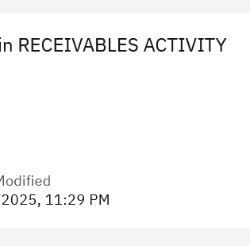
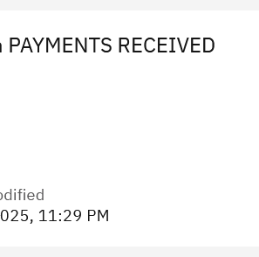
Tools to Research Payments
m-Fin reports in CU-Data:
  Payments Received – This report only shows payments applied via the AR module.
  Receivables Activity – This report also shows AR entries under a wider net; it will include payments posted directly to the project via Journal Entry *this is rare. This report also provides more information i.e. payment ID, both billing and payment activity.

Slide 9
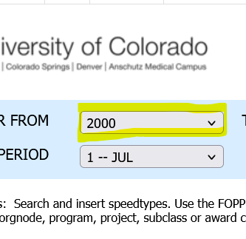
Tools to Research Payments continued
CU-Data: m-Fin PAYMENTS RECEIVED
Change Fiscal Year to oldest year to see all activity default is the current fiscal year

Slide 10
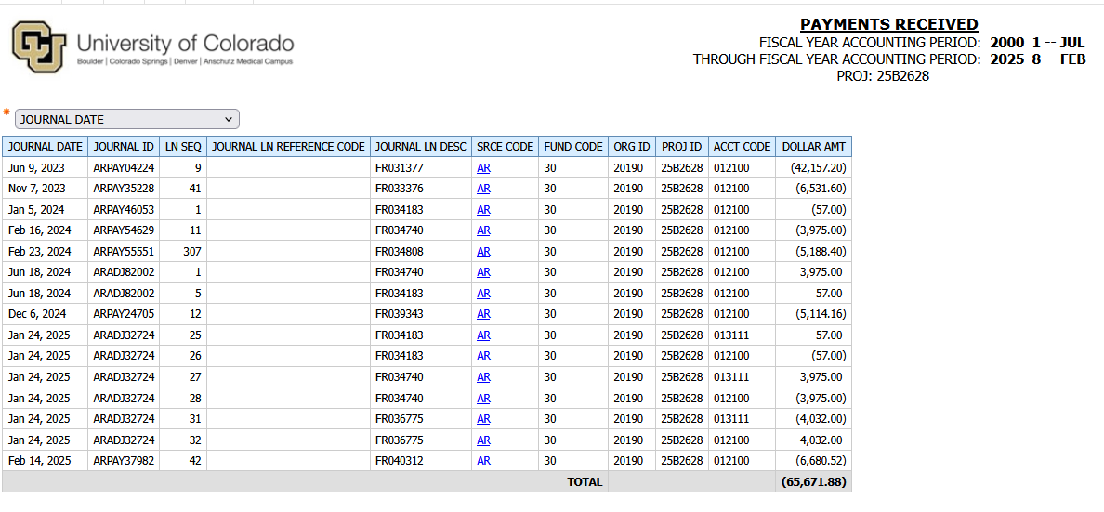
Tools to Research Payments continued
CU-Data: m-Fin PAYMENTS RECEIVED

Slide 11
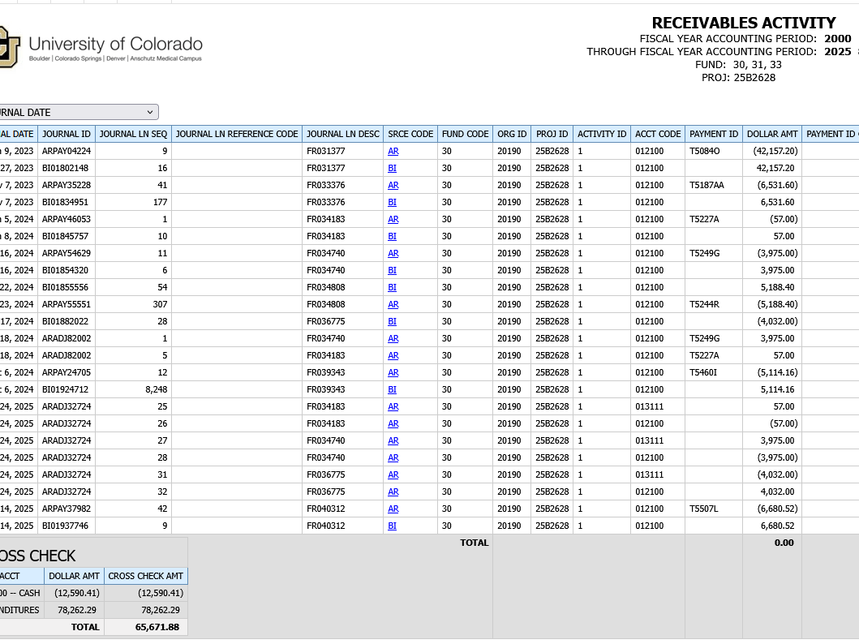
Tools to Research Payments continued
CU-Data: m-Fin RECEIVABLES ACTIVITY

Slide 12

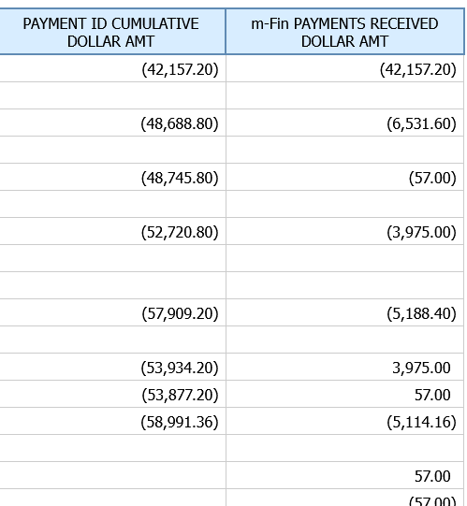
Tools to Research Payments continued
CU-Data: m-Fin RECEIVABLES ACTIVITY
Payment ID T5187AA
total amount received $48,688.80
$6,531.60 is the payment amount applied to the project

Slide 13
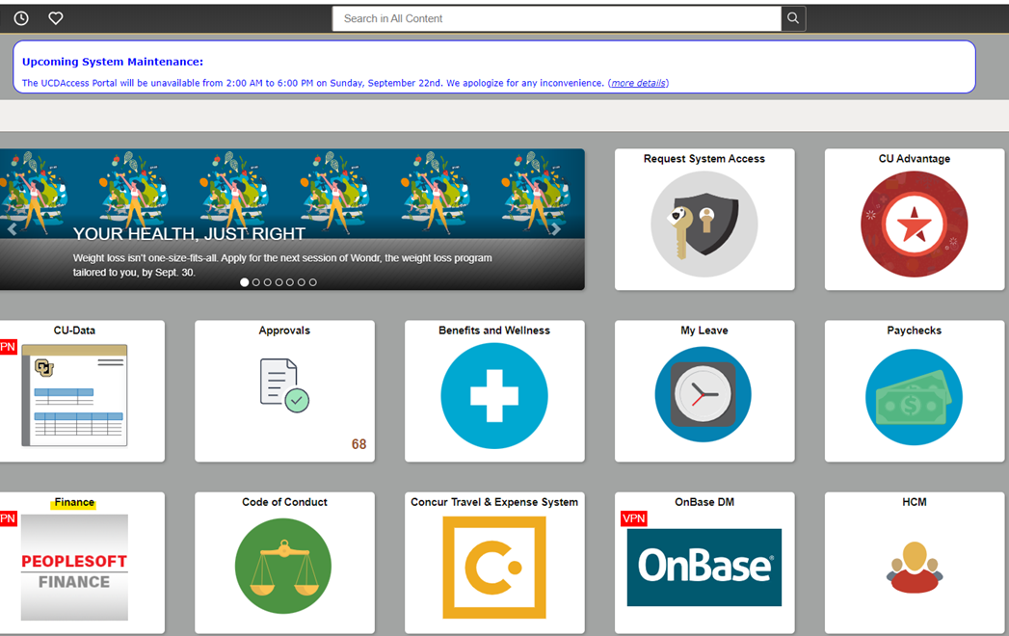
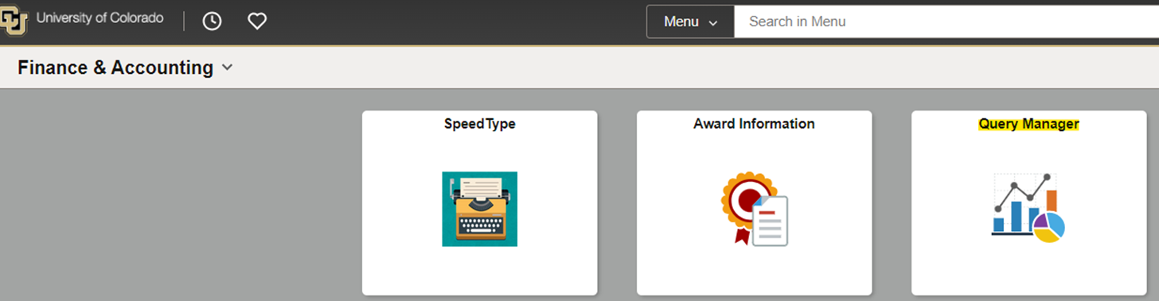
Tools to Research Payments continued
PS Query BILLING_INQUIRY_BY_PROJECT
From UCD Home Page, navigate to:
Finance/ PeopleSoft, then
Finance & Accounting Page, then
Query Manager
Notes:
Koffi

Slide 14
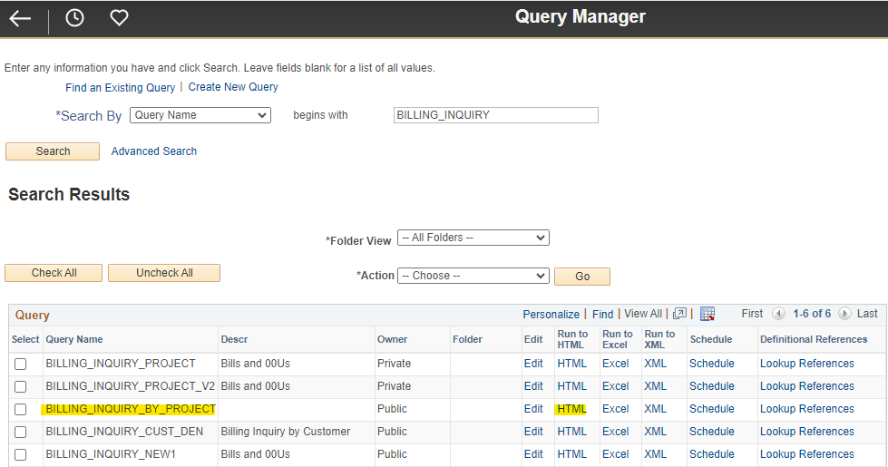
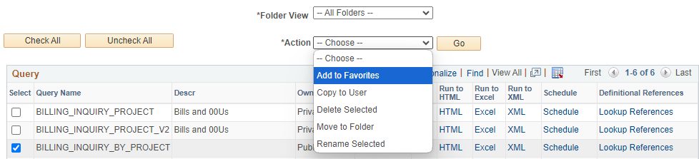
Billing Inquiry continued
From Query Manager, Search by Query Name
Type: Billing_Inquiry
Select BILLING_INQUIRY_BY_PROJECT
Run to HTML to view onscreen
Run to Excel to export
Add to Favorites for easier future searches

Slide 15
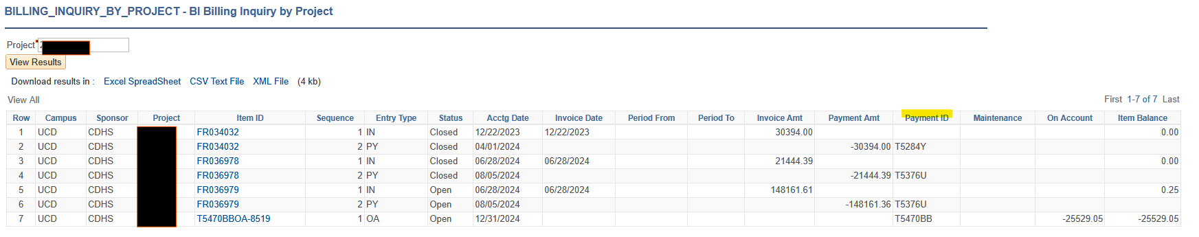
Billing Inquiry to Invoice pdf continue
Click on any invoice with blue highlight
If invoice isn’t highlighted, there is no link to drill-in
Notes:
Example of On Account payment in project

Slide 16
Billing Inquiry to Invoice pdf continue
Limitations
System invoice is not always what is submitted to the sponsor
Sponsor requires their template only
Manually merged invoices
View Invoice pdf is not available for the following awards:
Automatic Payments – Ginger is listed as Billing Specialist on Bill Plan
Department Invoices – UCDCT is listed as Billing Specialist on Bill Plan
Invoices prior to implementation of Billing Automation Phase III (NOV 2020)

Slide 17
On Account Payment
On-Account payment (OA): a payment that has been received but has not been identified where it should be applied (usually still in the Holding Account in OGC Clearing (AR MISC. 013100)) or at the time payment was received, there was no invoice to apply the payment to (usually in the project).
PS Query to review what OGC is clearing UCD_AR_OA_HOLDINGS
  *Same navigation as Billing Inquiry
Notes:
On account payment: Unidentified Payments or payments that cannot be applied to an invoice OA in clearing OA in project Define unidentified payments in the project . Add example and screenshots

Slide 18
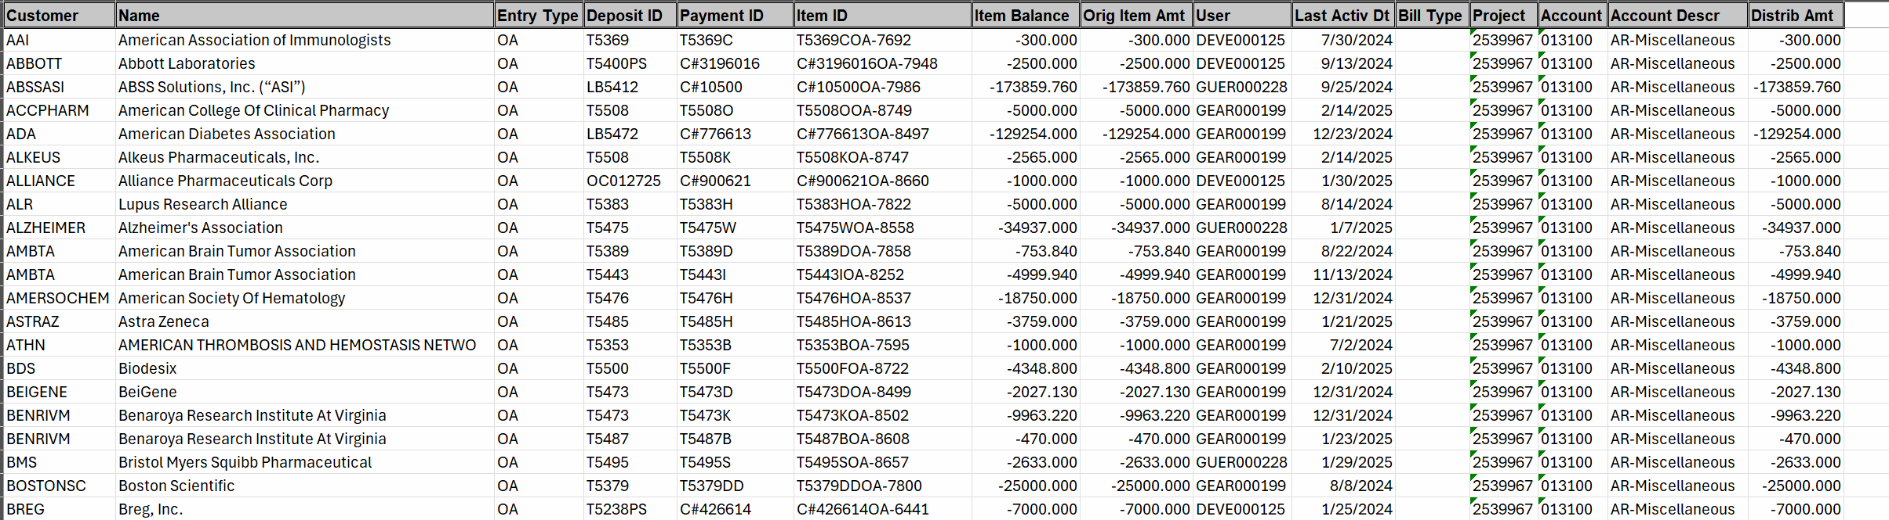
On Account Payments (OA) continue
UCD_AR_OA_HOLDINGS Query results
Notes:
*does not include payments that are OA in project

Slide 19

AR Team Challenges
Identifying payments
Electronic payments come with little to no identifying information
Shared Tax ID
Share sponsors/payors
Clinical trials, record sponsor and payor/CRO are different
Reimbursements on restricted funds
Cash Receipts dropped off to Bursar
Procurement- reconciling Concur
Notes:
Reimbursements and cash receipts and providing backup “Cost Transfer mind set”

Slide 20


*Forward a copy of invoices to OGC.4payments@ucdenver.edu
*Attach supporting documentation (Financial Detail Report, Concur Report) to the Cash Receipt.
Notes:
Reimbursements and cash receipts, providing backup “Cost Transfer mindset,” proactive with aging/collection efforts. If you have submitted an invoice and have not received payment, contact the sponsor/vendor/payor to confirm payment was sent. If payment was sent, where was it sent? Get as many details as possible. We can help find payment.

Slide 21
  Accounts Receivable Updates
Lockbox address change in June 2025
Notes:
Email for Office of the Treasurer 1/31/2025 Denver to Dallas address

Slide 22
Contact Information
OGC.4payments@ucdenver.edu
Payment inquiries: examples of payment backup documentation, confirming receipt of payment
Payment action requests: examples claim On-Account payment or request payment applied correction.
Request electronic banking information:
Information to forward to OGC.4payments ex: Department billed invoice; payment notifications received by departments
To help with researching payments, please provide as many details as possible! Examples
Payment amount
Project number
Proposal number
Award/Protocol number
Check number
PI Name
Sponsor name
Invoice number
Title of project
Date of when the payment was sent
How the payment was sent (check, EFT, wire, or Lockbox)

Slide 23


Slide 24
Post Award Hot topics

Slide 25
One-time Extension update
(1st NCE requests)
The button that allows my team to submit the NCE is now available.
Reminder: We can submit a One-Time extension within 90 days of the current budget end date.
Approval are coming back as normal expected process.
Please continue to send your request to the OGC.Postaward@ucdenver.edu

Slide 26
Preaward Notifications (Coming Soon)
The goal is to:
  Monitor and automate pre-awards for how long they have been pre-awarded.
    Currently we plan to send a notification for Preaward longer 90 days after the start of the project.
  Send notification to the department administrators to determine if the award was received or if there is an update in the status.
The advantages:
  Faster receipt of awards.
  Invoicing processes can begin.
  Less risk for spending on Speedtypes that may never get awarded.

Slide 27
Preaward Notification continues…..
Example/Possible email content.

Slide 28
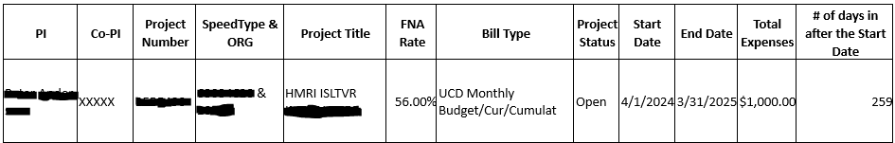
Preaward Notification continues …

Slide 29
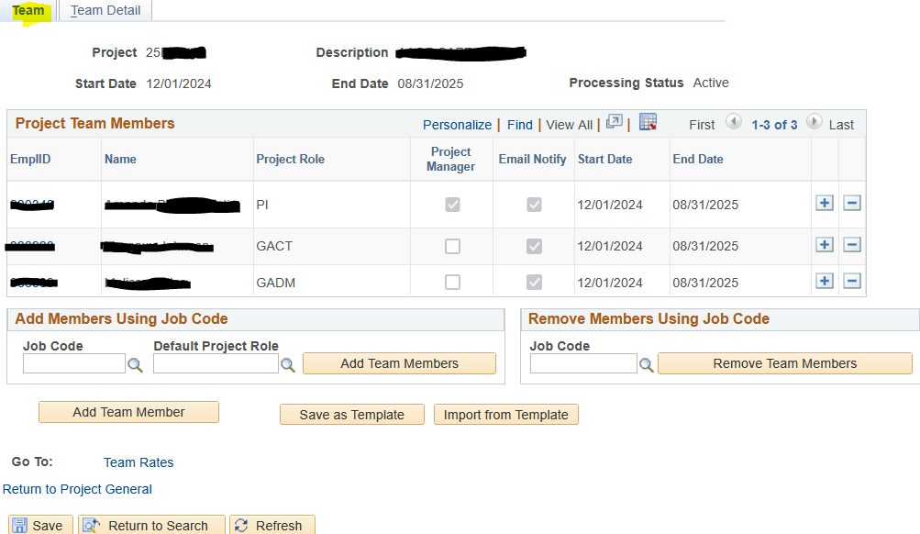
Fiscal Role Updates
It is important to update your fiscal Role in the PeopleSoft system because we will use the GADM to send the Preaward notifications along with other continued closeout notifications.
GADM project roles feeds to Speedtype Fiscal Manager role.

Slide 30
Fiscal Role update continues …
Please always request updates your Project team as needed so we can make updates in the PeopleSoft system.
To make changes visit our website for instructions. https://research.cuanschutz.edu/ogc/home/ogc-teams/award-set-up/fiscal-roles
Fiscal roles updates should be sent to ogc.fiscalroles@ucdenver.edu
We will start a mass update exercise in the next couple months to show your fiscal roles and request changes. Thank you in advance for your participation in this exercise.

