Slide 1
Subcontracts Team Talks T.K. Keith - Manager of Compliance, Training, and Real Estate University Financial Services

Slide 2
New Subcontracting Procedures
Collaborative effort by OGC subs team, Compliance team, OGC post award, and a Department Working Group
Goals:
Streamline processes,
Provide quicker turnaround times, and
Reduce administrative burden for Departments, OGC, and Subrecipients
All changes effective April 1st

Slide 3
Sub Commitment Form Changes
Risk Assessment/Commitment forms will be required only once per award
Forms may still be submitted at proposal or time of subcontract request
Joined the FDP Clearinghouse in August
2 new fillable PDF Forms
FDP Expanded Clearinghouse Members
Commitment Form (For Non-FDP Expanded Clearinghouse Members)
Audit Certification and Financial Status Questionnaire no longer required for subs without Single Audit

Slide 4
New Subcontract Request Forms
New forms in Formstack
3 Types of Forms
New Request
Amendment
Research Services Agreement
Required fields indicated
Budget templates and Contract Packets (for 3A/3B info) to be attached

Slide 5
No More PI Signature on Subs
Removing PI signature on Subcontracts
Reduce Administrative Burden
Faster Execution Time
Consistent with other Universities
You may request a confirmation email for your PI via Formstack Request forms

Slide 6
Subcontract Execution Changes
PIs and Departments provided with:
Risk Assessment
Subrecipient Monitoring Responsibilities Letter
Feel free to share with your PI
Executed Subcontract

Slide 7
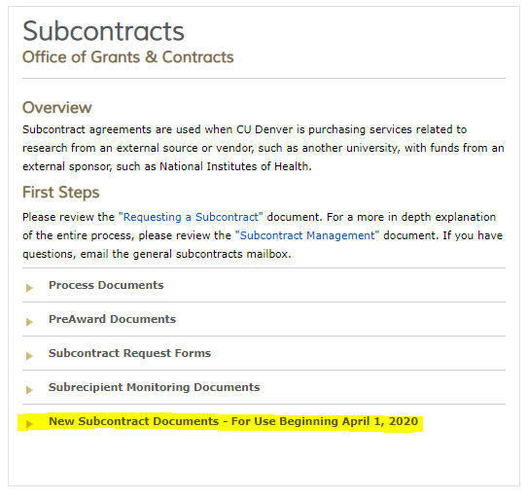
OGC Subcontract Page
http://www.ucdenver.edu/research/OGC/Pages/subcontracts.aspx

Slide 8
Form Links
Subcontract Request Form - https://ucdenverdata.formstack.com/forms/subcontract_request_form
Amendment Request Form https://ucdenverdata.formstack.com/forms/amendment_request_form
Research Services Request Form https://ucdenverdata.formstack.com/forms/research_services_agreement

Slide 9
Research Services Agreement
Two scenarios:
Paying for research but there is no prime award
Paying for research related services, but no actual research done by the subrecipient
Differences between RSA and Subcontracts:
Gift Accounts Manager for OGC reviews for Fund 34s and 35s (SOM Dean’s Office must approve Fund 35)
Submit marketplace requisition as a standard SPO, not as a subcontract SPO

Slide 10
Federal Subrecipient Monitoring
Required by 2 CFR 200.331
Must adequately document our monitoring
Contacts and meetings with subrecipients
Date of receipt and approval of invoices and progress reports
Document concerns regarding progress
Must have “reasonable assurance” that subrecipients are in compliance with the subaward’s terms and conditions
Sponsors and auditors can request subrecipient monitoring documentation

Slide 11
Problems with Subrecipients
Notify OGC as soon as possible regarding financial, programmatic, or administrative issues
Do not pay invoices if there are any concerns regarding financial or performance issues
We maintain the right to request additional financial information
Any changes to subcontract must come from OGC
Stop work orders
Terminations

Slide 12
Questions
Points of Contact for questions:
TK Keith (University-Financial Services); (Thomas.Keithiii@cuanschutz.edu)
OGC Subcontracts Team;
(OGC.Subcontracts@ucdenver.edu)

