Slide 1
OGC Team Talks Closeout (When and how should we close projects?)
November 29, 2023

Slide 2
Agenda
Types of Awards
Project Status
Basics and Best Practices for Preparing for Closeout by Type
Issues which may prevent/impact closeout by Type
Closeout Tools
Questions?

Slide 3
What type of award are your projects for?
Cost reimbursable (CR), letter of credit (LC), installment based (IB), & Fixed rate (FR)

Slide 4
Types:
Reimbursable Awards
These are awards where our revenue will be based on expenses up to the value of the contract.
Can be paid as invoiced –Cost Reimbursable(CR)
Can paid by installments - Installment Based(IB)
Can be Drawn from the Federal Government as expenses are booked – Letter of Credit(LC)
Hybrid IE Mixed Awards
These are awards where we have both a cost reimbursable component and a fixed component
Requires a project for each type.
Fixed Awards
These are awards where our revenue will be based on the payments received.
Can be paid based on Milestones/Tests/Patients or some other deliverable (FP)
If the fixed award is a clinical trial will be billed by department and based on completion of the work.
All other billed by OGC in conjunction with department to meet sponsor requirements and create system invoice.

Slide 5
Project Status
Be aware of your Project Status During Closeout….
S (Preaward) – Status used prior to Start Date
O (Open) – Status while between budget start and end date
E (Ended) – Status day 1 after end date to day 60 (Final invoices or Final draws should be completed during this period)
R (Reporting) – Status from day 61 until Closed while preparing reports (typically due 75-120 days after end date)
C (Close) – Goal to close as quickly as possible after all reporting and payments are received.

Slide 6
Billed Cost reimbursable (CR)
Billed by: OGC Billing Team
Net cash position at end of award: $0.00
Final Invoice Due Date
60 Days
State of Colorado: 45 Days
Some sponsors may be less.
Most common Billed are Federal flow-though and state awards.
Other Private and Non-Profit as well
Payment typically received within 30-60 days of final invoice

Slide 7
Billed Cost Reimbursable Closeout Best Practices
Before End Date
Know your final invoice due date.
Work to make sure all expenses are posted by project end date, with only exceptions posting in the end period or final subcontract invoices.
Review all Salary and make sure all PETS are completed prior to ended status. In ended status you risk not meeting a final invoice due date.
Review cash position via Summary Trial Balance and Billing Inquiry via PS query to make sure prior invoices have been paid.
After End Date
If you have subcontracts, work to make sure final invoice is received and paid promptly.
Work with your Post Award/Billing team to ensure all expenses are complete and final invoice is ready to go by due date.
Review EPERS by Project Report in CU Data to ensure all available Epers have been certified.

Slide 8
Billed Cost Reimbursable Risk/Issues
Deficit spending- once a project is overbudget we can no longer bill up to budget because the system does not allow us to manually choose expenses to create a balanced invoice.
Late payroll or PETS posted in same month a final invoice is due- this does not allow time for fringe allocations which only run at month end.
Allowing late subcontract invoices- If we hold our final for a subcontract, we may risk not getting paid.
Late award start without a Preaward speed type – does not allow expenses to be booked in time for final.
No Prior Monthly invoices- Final being only invoice sent and no prior receipt confirmation.
Late invoice – we have had sponsors not pay due to an invoice being only 10 days late. We must communicate with sponsors to request extensions when we can prior to the date the invoice is due.
Know your Prime, if your award is a Federal Flowthrough, this means our sponsor has draw deadlines and must have our invoices timely. We are seeing some shorten our due dates as Federal Sponsors are becoming stricter with expired funds.

Slide 9
Installment based (IB)
Payment is received on a time schedule –
Most Common as Association and Foundation Award.
What are the requirements for payment?
Net cash position at end of award: Often has a residual
Report of Expenditures (ROE) due date
Usually within 90 days of end date
Review Notice of Award (NoA) for specific deadlines.
Residual must be returned. (Some sponsors have a policy to carry forward or retain small residuals. )

Slide 10
Installment Based Closeout Best Practices
Before End Date
Know your final report due date and work to make sure all expenses are posted by project end date.
Review all Salary and make sure all PETS are completed prior to ended status. In ended status you risk meeting a final report due date. Note- moving salary will revise Epers and require a new certification.
Review cash position via m-FIN Trial Balance Summary to make sure payments have been received as expected.
Project future expenses to understand if you will have a cash balance at end of project.
After End Date
Work with your Post Award/Billing team to ensure all expenses are complete and final report ready to go by due date including subcontracts.
Ensure Final Progress reports are submitted.
If you are in deficit, remove deficit prior to report deadline.
If you have a positive cash position work with your post award to resolve
Return funds
Carryforward funds
Request Small Residual Retention from Sponsor
Review EPERS by Project Report in CU Data to ensure all available Epers have been certified.

Slide 11
Installment Based Risk/Issues
Late progress reporting- often payments for these awards are tied to reporting deadlines.
Payment Plan not being followed - Sponsor not making payments as planned and we don’t know why.
No Carry Forward - Not being able to retain carryforward causing potential deficit in future years.
Residual Refunds to Sponsor - Not returning unused funds in a timely manner, putting future awards at risk.

Slide 12
Federal Letter of Credit (LC)
Billed by: OGC AR team
Net cash position at end of award: $0.00
Federal Financial Report (FFR) due date
Annual: 90 days
Final: 120 days
Draw-down completed in Payment Management System (PMS), or agency portal
Payment posted within 7 days of draw-down

Slide 13
Federal Letter of Credit Closeout Best Practices
Before End Date
Work to make sure all expenses are posted by project end date, with only exceptions posting in the end period or final subcontract invoices.
Review all Salary and make sure all PETS are completed prior to ended status. In ended status you risk meeting a final DRAW date.
If you have multiple project numbers make sure budgets and expenses are aligned. One project may be over budget and utilizing authorization from that award total in error.
Review cash position via m-FIN Trial Balance Summary and make sure prior payments have been drawn.
After End Date
If you have subcontracts, work to make sure final invoice is received and paid promptly and in time for us to draw before document goes to expired in PMS.
Work with your Post Award/Billing team to ensure all expenses are complete and final financial report can be completed at 90 days after the end date.
Review EPERS by Project Report in CU Data to ensure all available Epers have been certified.

Slide 14
Federal Letter of Credit Risk/Issues
Late payroll or PETS- Late payroll posted in same month funds expire does not allow time for fringe allocations which only run at month end.
Allowing late subcontract invoices- If we hold our final for a subcontract, we may risk not being able to draw. *Note – Our Subcontract final invoice terms are typically within 60 days after our award end date.
Late expenses – Allowing late expenses to post in Ended and Reporting Status’ may not be finalized in time for regular draw process. OGC draws once per week. Expenses booked to project >90 days after end date must be coordinated with post award to ensure they are drawn before moving to expired funds.
Sponsors moving funds to expired before FFR is due- ACF, HRSA, and AHRQ cut off draws at 90 days even with FFR due at 120 days.

Slide 15
Fixed Rate (FR)
OGC bills fixed with Department Coordination. Only NON-Federal Clinical Trials are billed solely by department.
Should be tracked and monitored for receipt of payments
Send invoice details to ogc.4payments@ucdenver.edu to ensure correct posting
Net cash position at end of award: Often has a residual
Department initiates closeout with post award by submitting the following:
Request to close form
High cash balance form (if applicable)

Slide 16
Fixed Rate Closeout Best Practices
Note- not all fixed have budget dates – Department should work with Post award team when study is complete to close.
OGC sets up Clinical Trials for 3 years from the time of full execution. If more time is needed, please work with your post Award Admin to extend end dates.
To close a fixed price project, the following must be complete:
All expenses have been reviewed and are final.
All needed reports and outcomes are submitted.
All payments are received and final.
All EPERS available have been certified.

Slide 17
Fixed Price Risk/Issues
Lack of Payment Review - Projects being closed without payment review
With clinical trials OGC relies on the department to know what should have been received. Please always reconcile your study payments prior to requesting close.
Purpose for Residual - Not being able to justify why we have residual funds.
Residual Cash Transfer Requests - Delays in approval or non approval for federal flowthrough high cash balances.
High Cash Balance Forms - High Cash balances where we have priced the study.
Late Expenses - Failure to charge expenses properly during the life, resulting in late cash transfers and audit risk.

Slide 18
Summary Best Practices for closeout
Review cash balance frequently (m-Fin TBS/ Operating Summary)
Review expenditures regularly and submit cost transfers in a timely manner
All PETs should be completed within 30 days after the project end date. As a general practice salary should be reviewed and corrected within 90 days of a pay period date.
Meet with your Post Award Administrator on a regular basis

Slide 19
Closeout Tools
Monthly report burst to the GACT and GADM on the project.
GM01 Report BEFORE END DATE
GM02 and GM03 Report AFTER END DATE
CU Data Reports
Trial Balance Summary
Payments Received Report
EPERS status by Project CU Data
PS Query
Billing Inquiry by Project

Slide 20
Tools-GM Email Example

Slide 21
Tools-GM Report Example Summary
GM01- Projects prior to end
Date, shows # of days
Project is expiring in.
GM02 and 03 – Projects
AFTER end date, shows
# of days expired.

Slide 22
Tools-GM Report Detail
Each project listed has a Detail page. The detail shows the type.
Example:
Project Contract Type = FR
Grant Type: = GRANT_FIXED

Slide 23
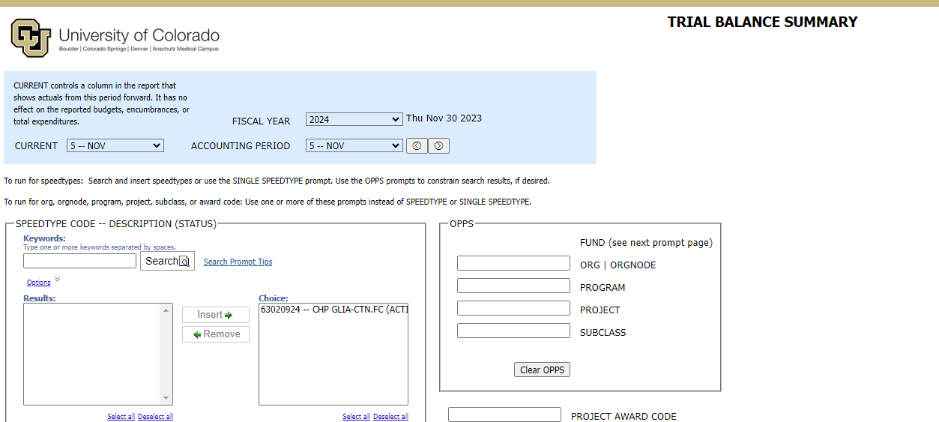
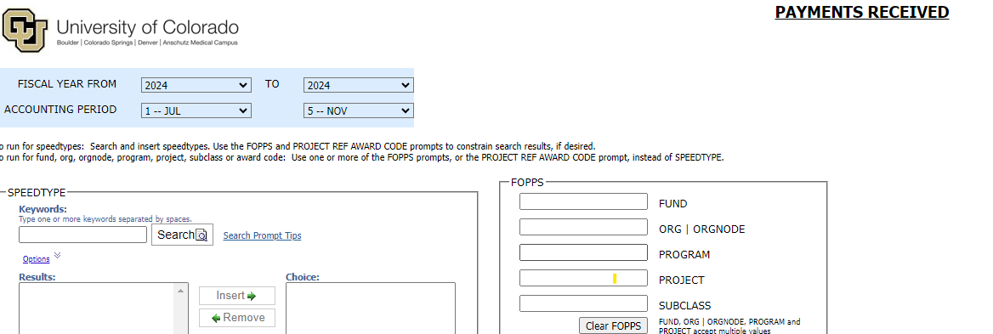
Tools-CU data Reports
Trial Balance Summary – Shows both cash section and revenue and expense summary
Payments Received Report – Shows all payments received over a specific time period.

Slide 24
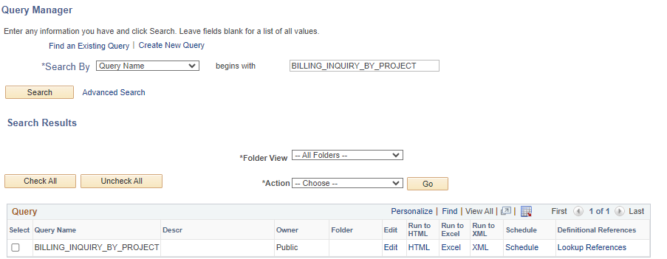
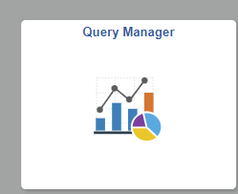
Tools-PS Query
Billing Inquiry by Project – this will show all invoices and payments for those invoices with payment details such as deposit and payment ID. Run by Project ID
PS query tile can be found in the Peoplesoft Finance in the Finance & Accounting Area

Slide 25
Questions

Slide 26
Thank you for attending and to Today's presenters
In order of Presentation....
Ginger Acierno
Julie Burger
Brittany Vits
Margaux Johnson
Stephanie Chandler-Thompson
Koffi Gnatsidji

