Slide 1
OGC Billing Team Talks
Introduction to Billing PeopleSoft Grants 9.2

Slide 2
AGENDA
Introduction to Billing via Contract Types
Project Costing and Billing
Awards Billed by OGC
Letter of Credit Billed by OGC
Clinical Trial Billing
Billing Hot Topics and Examples
Questions

Slide 3
Contract Types
Contract types are setup to align with contract terms and will dictate billing processes.
Contract types
CR – Cost reimbursable awards
Example of a cost reimbursable award will be a federal flow through contract that we invoice based on the expenses
LC – Letter of Credit awards
Letter of Credit is used for federal grants drawn under NIH, NSF, and Department of ED
IB – Installment Based awards
Example of an IB award is a foundation/ association grants where payments are scheduled
FR – Fixed Rate agreements
Example is a clinical trials or other fixed rate agreements

Slide 4
Contract Types
Navigation:
Trial Balance Summary

Slide 5
Contract Types/Billing Methods
Cost Reimbursable/ As Incurred- Billing is based on actual expenses incurred during the billing period
Letter of Credit/ As Incurred - Billing is a draw based on actual expenses incurred during the billing period
Installment/ Value Based - Billing is based on a predefined billing schedule
Time based, i.e. Monthly/ Quarterly
Fixed Rate/ Milestone – Billing per completed milestone, not based on expenses
Per Subject
Test Performed
Goal Achieved
Contract Level – At the contract level, the contract types are used in run controls for many billing processes and are used as a management tool for checking correct setup data
Project/Bill Plan Level – At the project level, the Contract Billing Methods define if bills are created based on expenses or some other value

Slide 6
Product Types
Cost Reimbursable- Billing is based on actual expenses incurred during the billing period
Letter of Credit - Billing is draw based on actual expenses incurred during the billing period
Installment/ Value Based - Billing is based on a predefined billing schedule that is time based
Fixed Rate – Billing per completed milestone, not based on expenses
Per Subject
Test Performed
Goal Achieved
Grant_Reimburse- Revenue is recognized based on expenses charged to the project
Grant_Fixed- Revenue is recognized based on invoice or payments received
Not tied to expenses
Product Types - Define how revenue is calculated

Slide 7
Project Costing and Billing
9.2 Grants Module includes Project Costing Ledger, this is a Ledger that is separate from the GL. Implementation of the Project Costing Ledger significantly changed the invoicing process for cost reimbursable awards.
Project Costing Ledger reflects the same expenses as GL, though may post differently
Expenses occurred same day w/same account code may be lumped into 1 BIL row
Expenses over billing limit are excluded from Revenue Recognition and not billable
Expenses not available to invoice until next business day
Links transactions together through all modules
i.e. Billing and AR
Notes:
GL & Project Costing ledgers talk to each other but are not the same. Project Costing Ledger drives what expenses are available to invoice

Slide 8
Project Costing and Billing
Transaction Life Cycle -Cost Reimbursable Projects
Expenses are Booked
GLE (General Ledger Expense)
Overnight Cost Collect and Pricing Jobs
Import expenses to PS/Finance
SFA (Sponsor F&A Expense)
BIL (Expense is within limit to be billed)
OLT (Expense is over the limit and not eligible to be billed)
Revenue is recognized for BIL expenses.
Revenue is NOT recognized for the OLT expenses.

Slide 9
Project Costing and Billing
Transaction Life Cycle - Cost Reimbursable Projects
Expenses/BIL rows are processed
Billed expense rows update from BIL to BLD
Invoice ID is generated
i.e. GC000001 for Cost Reimbursable
Payments are received and applied to invoices

Slide 10
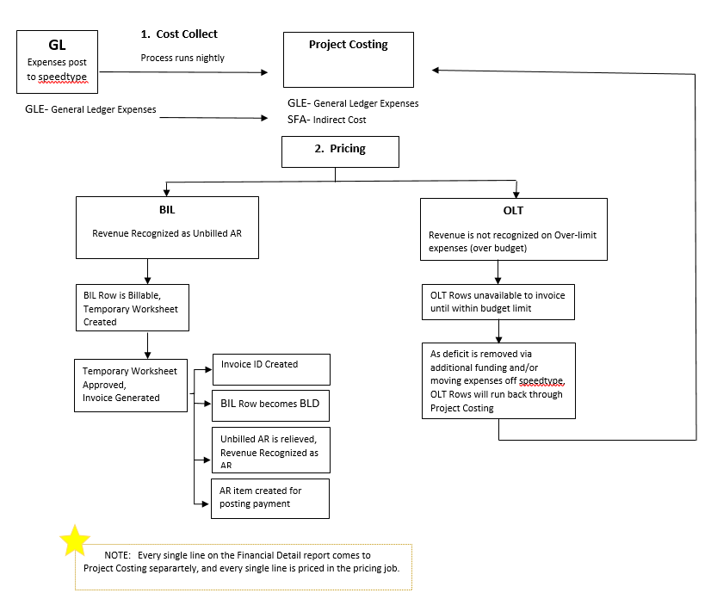
Grants and Contracts Expense Flow

Slide 11
Awards Billed by OGC
Cost reimbursable (All)
Billed based on expenses and schedule set by sponsor
All Fixed Rate contracts except Non-Federal Clinical Trial
OGC will invoice all fixed rate when the sponsor requires invoices
The revenue will be recognized when events are created under the bill plan
When the department invoices FR contract the revenue is recognized when payment is received from the sponsor
Value Based contract (Installment)
Sponsor is paying predefined amount regardless of expenses, revenue will still be based on expenses
Some sponsor require invoice before making a payment, and most autopay with no invoice required to receive payment. OGC must create system invoice in both cases in order to apply payments

Slide 13
Letter of Credit Federal Draws Cont.
LOC treated as Cost Reimbursable
All transaction are billable up to the limit even if OLT rows exist because a detail invoice is not required
LOC Projects- Budgets and Billing Limits
Budgets are booked at Project level
If multiple project exist for the same budget period, they will share a limit (Example: program project grant)
Limit is utilized first in first out. So, we will draw in the case of one budget being overspent if the sum off all projects is under the Total Limit
In this case you may see revenue and payments over the budget for an individual project. When expenses are moved that revenue and payment will follow.

Slide 15
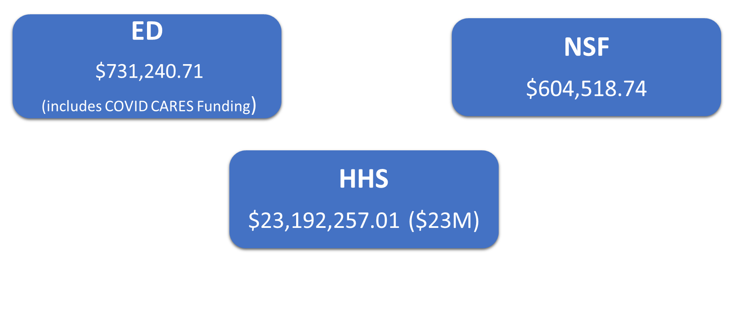
LOC Volume by Sponsor FY 2021 (Avg. per month)

Slide 16
NIH 120 Day Draw Notice
Notice: NOT-OD-21-102 (04/02/2021)
A recipient may draw funds up to the date that its Final Federal Financial Report (FFR) is due to NIH or up to 120 days past the period of performance end date (see NOT-OD-15-135); PMS will automatically reject any request made after 120 days past the period of performance end date.
Notes:
OIG audited NIH

Slide 17
Letter of Credit Contacts
HHS Billing- Morgan Hubbard
Morgan.Hubbard@cuanschutz.edu
ED or NSF Billing- Amy Nemecek
Amy.2.Nemecek@cuanschutz.edu

Slide 18
Clinical Trial Billing
OGC will invoice all clinical trials except non-Federal
All clinical trials are Fixed Rate
Invoices are based on milestones and actions rather than expenses
Revenue is based on invoicing and not based on expenses
For projects not billed by OGC, system invoices are created by OGC AR Team when payment is received

Slide 19
Billing Hot Topics
Final Invoices
Expenses over Budget
Billing Inquiry
Billing Automation

Slide 20
Final Invoice
The sponsor requires final invoice to be submitted typically 30, 45 or 60 days after the budget end date.
Contracts team will negotiate for 60 days unless sponsor will not allow
Crucial for department to closely monitor expenses for awards with short final invoice deadlines
Financial Detail is a great tool when reviewing expenses
Refer to 90/60/30 Day Report to monitor approaching end dates

Slide 21
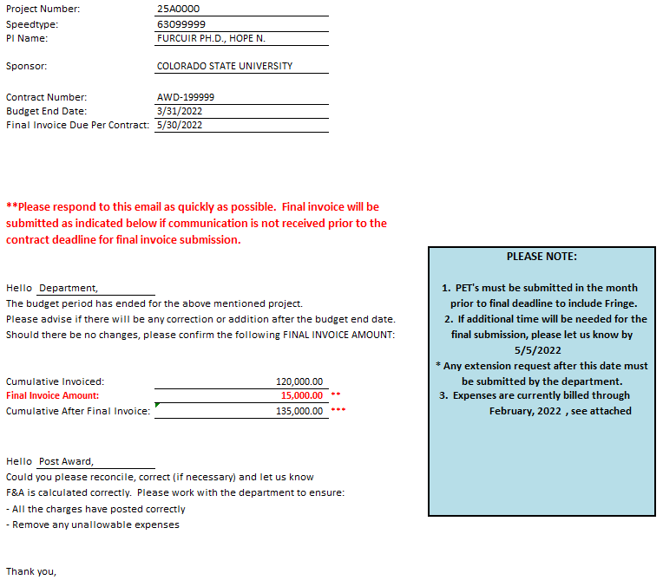
Final Invoice
After the budget period end date, the Billing team emails a request to confirm final invoice figures after month end closes
Provides reminders and deadlines
Notes:
Final Invoice Template Example

Slide 22
Final Invoice
All the allowable expenses need to be posted prior to the final invoice due date
PET’s, as needed, must post in month prior to final deadline to include fringe benefit. Fringe benefit allocation only runs at month end close.
All Unallowable expenses need to be removed one month prior to final invoice due date for the same reasons

Slide 23
Final Invoice
No Manual invoices. All the invoices have to be generated from the system. This means all expenses must be posted to the general ledger prior to billing.
Last-minute invoices where all the transactions are not posted to the GL on time will not be allowed. It is VERY important all transactions are complete prior to the final invoice deadline.
Exceptions can be made in rare instances and required a mutually agreed upon timeline for GL cleanup.

Slide 24
Over-limit Expenses –Impact of Budget Deficit
Expenses in excess of the billing limit are overspent, or over-limit
The system reflects expenses over-limit as OLT rows
OGC cannot control which transactions are designated OLT, thus the invoice amount by category will not be correct
F&A can show on bill but direct cost may go OLT, or Benefits show on bill and Salary to OLT
Invoices generated with over-limit expenses do not correctly align Direct and Indirect costs
For these reasons, OGC will not invoice an over-budget award until the budget deficit is cleared
Notes:
Refer to the pricing process in the previous slide.

Slide 25
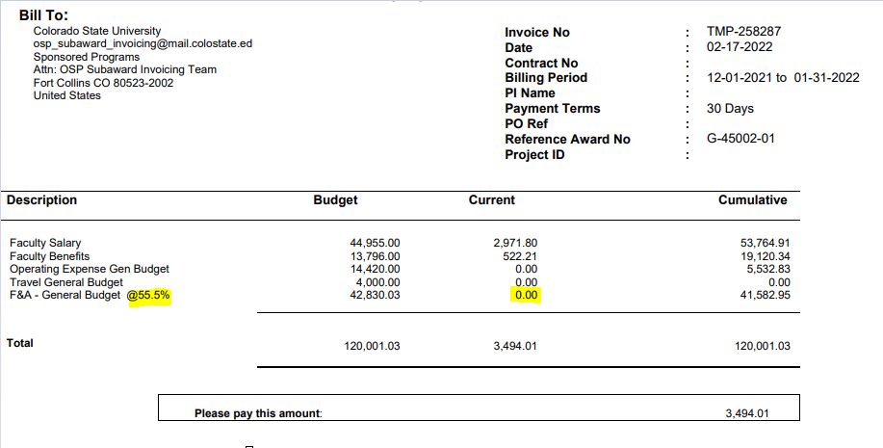
Over-limit Expenses –Impact of Budget Deficit
Direct Costs = $3,494.01
F&A @ 55.5% = $1,939.18
Due to OLT rows, F&A appears to
be charged 0%

Slide 26
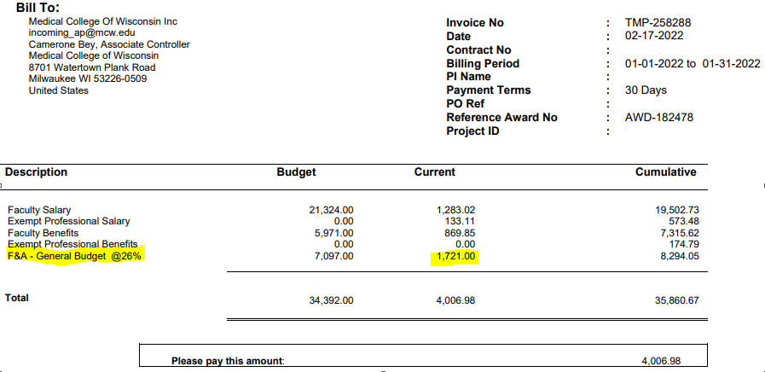
Over-limit Expenses –Impact of Budget Deficit
Direct Costs = $2,285.98
F&A @ 26% = $ 594.35
Due to OLT rows, F&A appears to
be charged > 75%

Slide 27
BILLING_INQUIRY_BY_PROJECT
Navigation:
Sponsored Project Admin→ Tools & Utilities → Query Manager

Slide 28
BILLING_INQUIRY_BY_PROJECT
Item ID: Is the invoice number
GC000001 for CR contracts
FR000001 for Fixed price contract
IN000001 for Installment base contract
Sequence: Order in which posting occurred on the item
Entry Type:
IN: Invoice
PY: Payment
MT: Maintenance
CR: Credit
DR: Debit
Navigation:
Sponsored Project Admin→ Tools & Utilities → Query Manager

Slide 29
BILLING_INQUIRY_BY_PROJECT
Status: Item is either Closed or Open
Accounting Date: The date the item is created
Invoice Date: The date listed on the invoice
Period From and Period To: The claim period covered by the invoice
Navigation:
Sponsored Project Admin→ Tools & Utilities → Query Manager

Slide 30
BILLING_INQUIRY_BY_PROJECT
Maintenance: Amount being offset by another item
On Account: Payment received but not yet applied to an invoice
Item Balance: Remaining balance left on the item
Navigation:
Sponsored Project Admin→ Tools & Utilities → Query Manager

Slide 31
BILLING_INQUIRY_BY_PROJECT
BILLING_INQUIRY_BY_PROJECT Navigation
Finance/PeopleSoft > Sponsored Project Admin >
Tools & Utilities > Query Manager > Search By Query Name >
BILLING_INQUIRY_BY_PROJECT

Slide 32
Billing Automation
Billing Automation leverages PeopleSoft to email invoices to the sponsor as part of the approval process.
Up to 50% of our cost reimbursable projects are eligible for billing automation.
Time savings ~ 1 minute per invoice
20-70 minutes/month per Billing Specialist
In 2021 our campus processed 3,826 invoices using billing automation
Equates to approximately 64 hours we could allocate to more difficult billing needs

Slide 33
Billing Automation
Additional features of Billing Automation
Billing Specialist signatures are digitally added to the invoice pdf during the approval process
Attachments including the account detail report and department backup can be added to the invoice
Pdf attachments will merge with the invoice
We are in the process of a query that will provide invoice images

Slide 34
QUESTIONS

