Slide 1

Team Talks – September 2024
Billing

Slide 2

agenda
VA Minor Modification Memo
Helpful m-Fin Reports
Event Based Contracts

Slide 3

VA Minor Modification memo
Updates

Slide 4
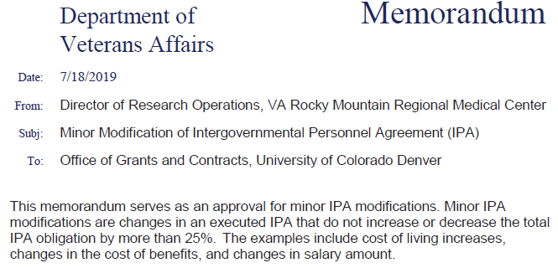
Background
In 2019, Pam Rice signed a blanket Minor Modification Memo allowing UCD to adjust the current budget up to 25% without requiring an official Modification
  Effort to save time and administrative burden
  Allowed leeway for Cost of Living Salary increases and variance in Benefits budget to actual
  Only applicable to VA awards under Pam Rice and Toni Gomez

Slide 5
Update:
  The blanket memo is no longer valid
  The department may still request a Minor Modification Memo in the event actual Salary and/or Benefits increase creating a budget deficit
  Process (As we currently understand, further guidance to follow):
  GADM or IPA Employee emails Pam Rice/Toni Gomez to submit request
    Cc to Pod Team
    Include:
          Amount Requested
          Justification – What caused actual expenses to exceed budget?
        Pam and Toni will review the request and respond to confirm if approved

Slide 6
Update Continued
NOTE:
It is important to be cognizant of timing
Request must be submitted in sufficient time to allow for review, confirmation and processing of final invoice to meet final invoice deadlines
How do I know if my award is with Pam/Toni?
The Employment Office to Which Assignment Will Be Made is VA Eastern Colorado Health Care System or Rocky Mountain Regional VA Medical Center (RMRVAMC)
PO# typically begins with 554D
All other VA divisions will require a fully executed Modification to increase budget

Slide 7
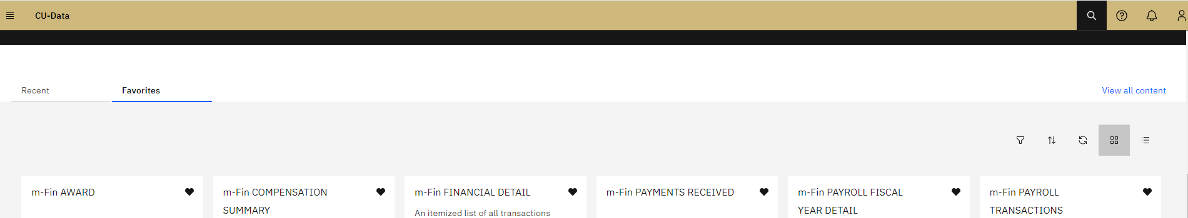
Leveraging Reports (CU-Data and Peoplesoft)

Slide 8
Spending burn Rate
To avoid last-minute cleanup and potentially rejected costs, it is important to track spending throughout the life of an award and know the re-budgeting authority within the contract
Several reports in CU-Data/m-Fin have features to aid in tracking spending by budget category and overall budget

Slide 9
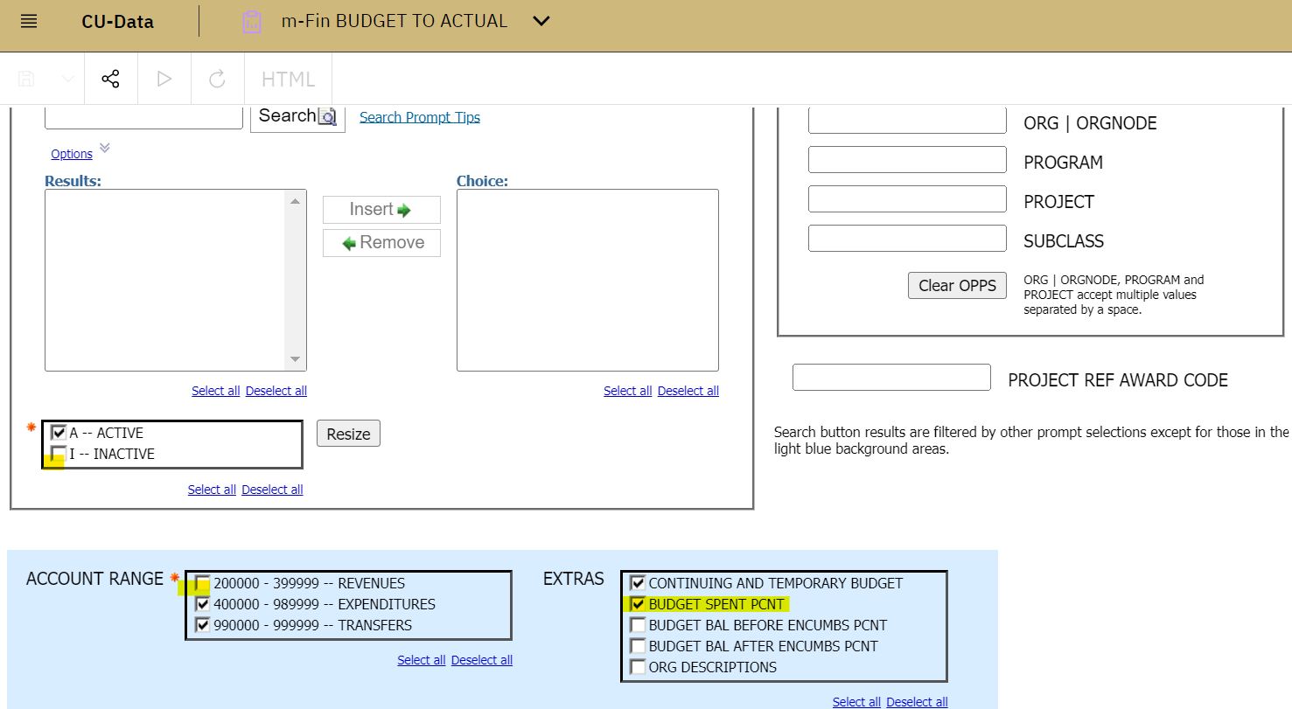
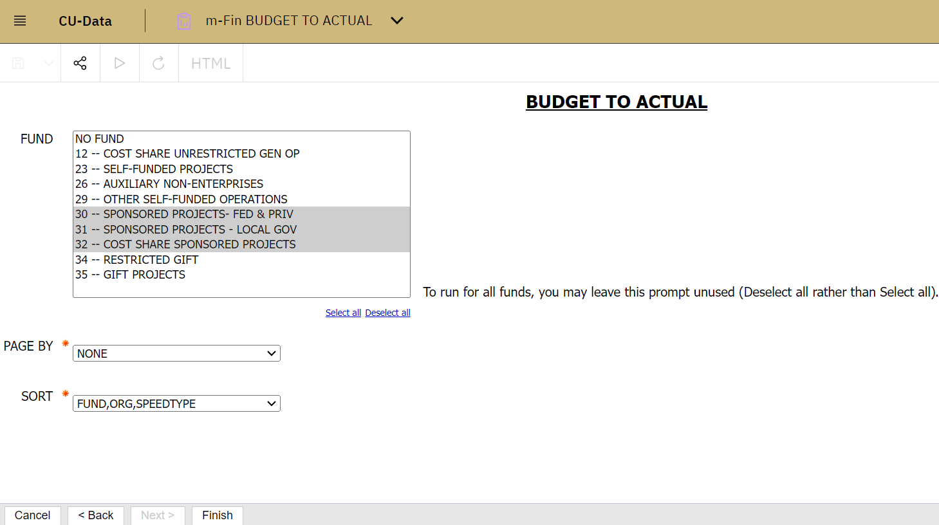
Spending burn Rate
m-Fin Budget to Actual
Pull by Org, Speedtype or Project
Add Extra: Budget Spent Percent
De-Select: Inactive and Revenues

Slide 10
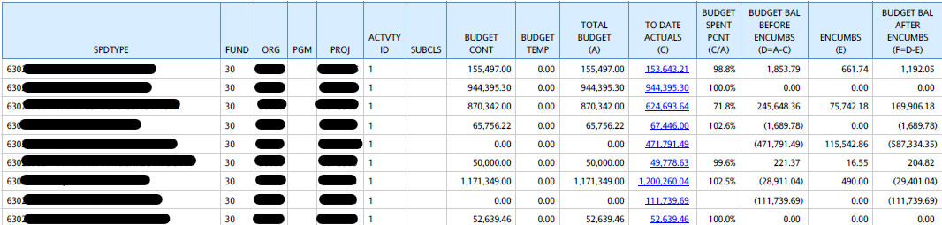
Spending burn Rate
m-Fin Budget to Actual
Report returns selected values including percent of total budget spent

Slide 11
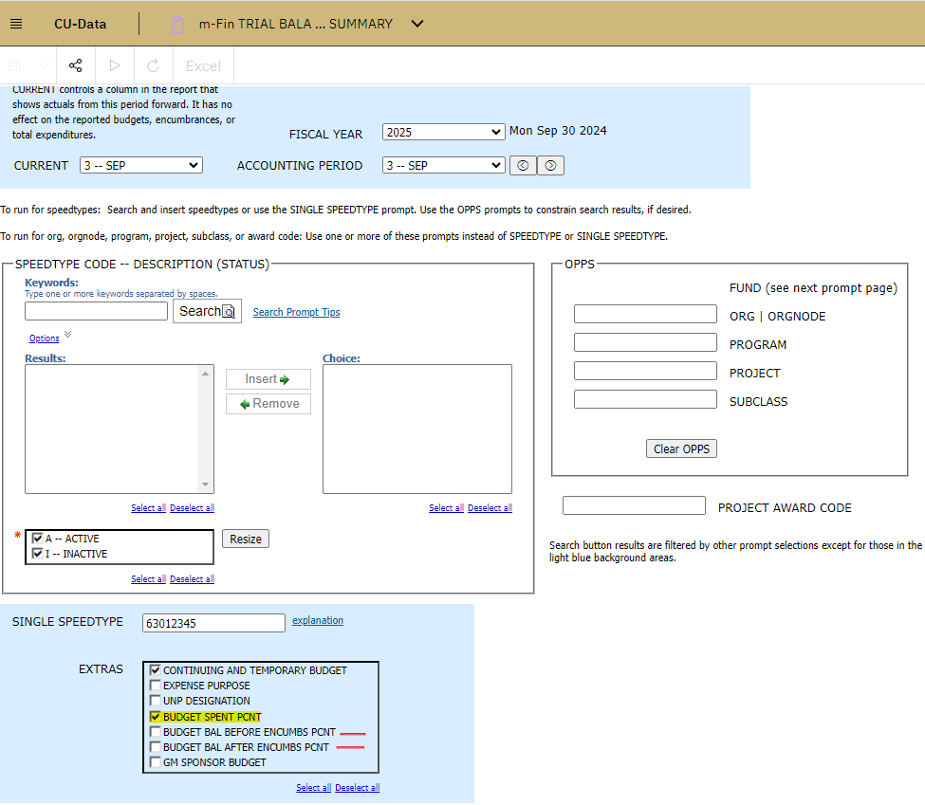
Spending burn Rate
m-Fin Trial Balance Summary
Pull by Org, Speedtype or Project
Add Extra: Budget Spent Percent
De-Select: Inactive and Revenues

Slide 12
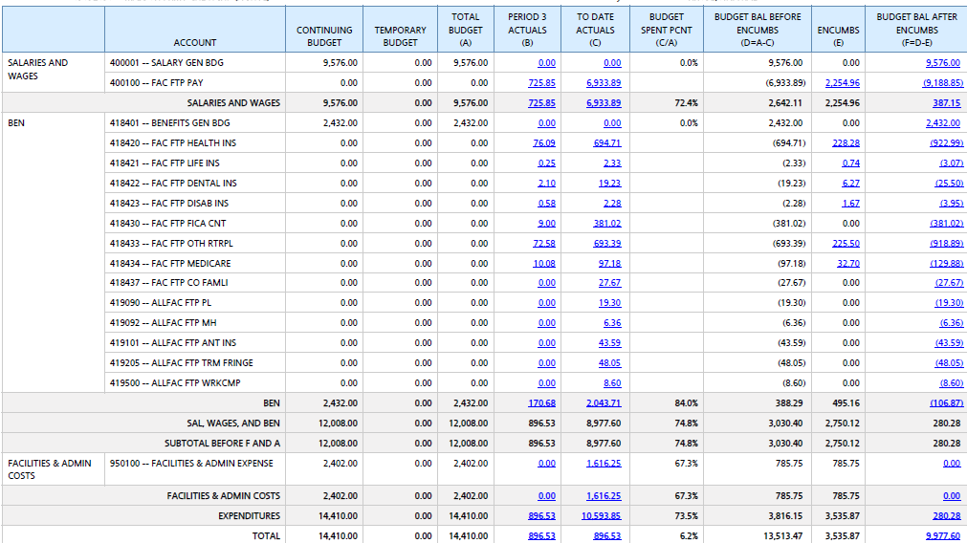
Spending burn Rate
m-Fin Trial Balance Summary
Report returns selected values including percent of budget spent by budget category and total budget

Slide 13
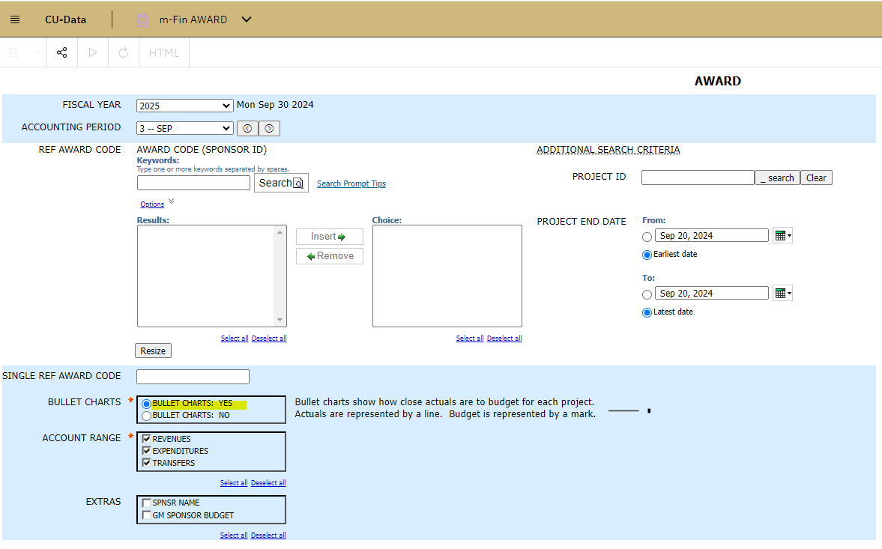
Spending burn Rate
m-Fin Award
Pull by Award ID
  tip- use only serial #, then
  Options ‘Includes any of these’
Add: Bullet Charts: YES

Slide 14
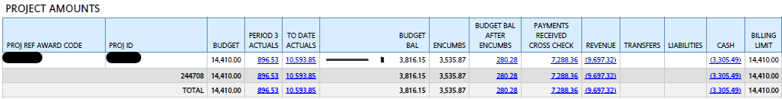
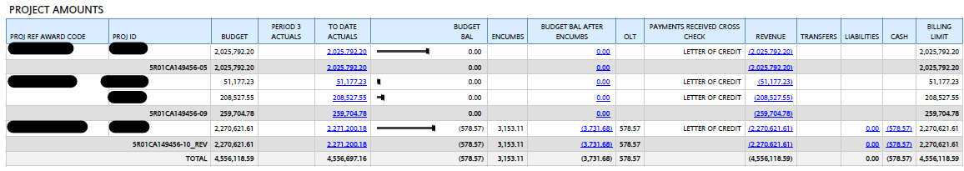
Spending burn Rate
m-Fin Award
Report returns a bullet chart reflecting budget spent to remaining next to Budget Balance

Slide 15
Spending burn Rate
Additional reports in CU-Data/m-Fin with spending tracking:
m-Fin Revenue and Expenditure Summary
m-Fin Revenue and Expenditure Total
m-Fin Project One-Liner * Try running by PI and use Bar Charts
m-Fin Project Spending Trends
m-Fin Project LifeChart
m-Fin Project Financial Status

Slide 16
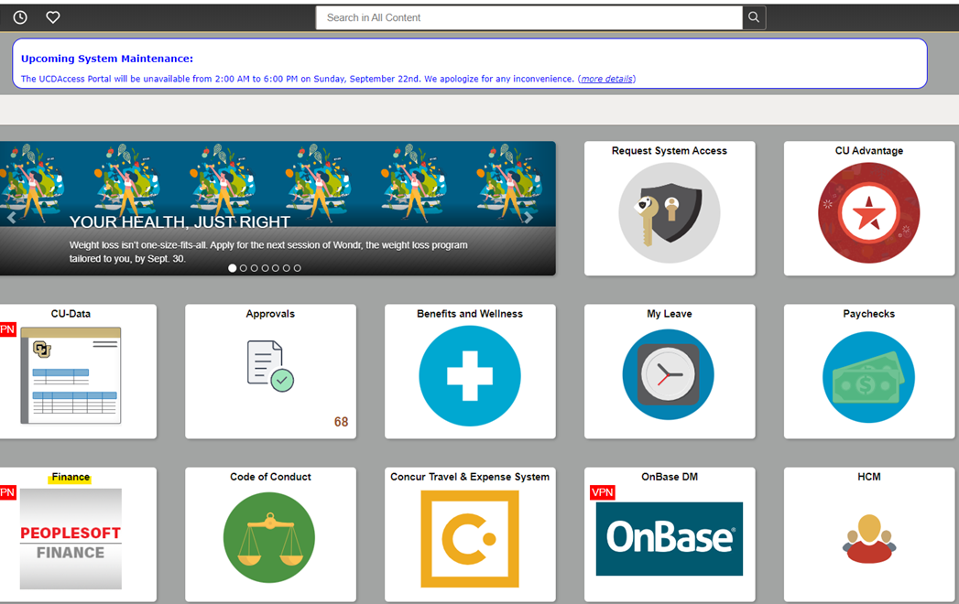
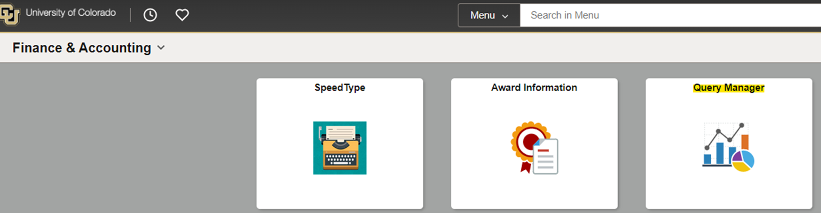
Billing Inquiry
From UCD Home Page, navigate to:
Finance/ PeopleSoft, then
Finance & Accounting Page, then
Query Manager

Slide 17
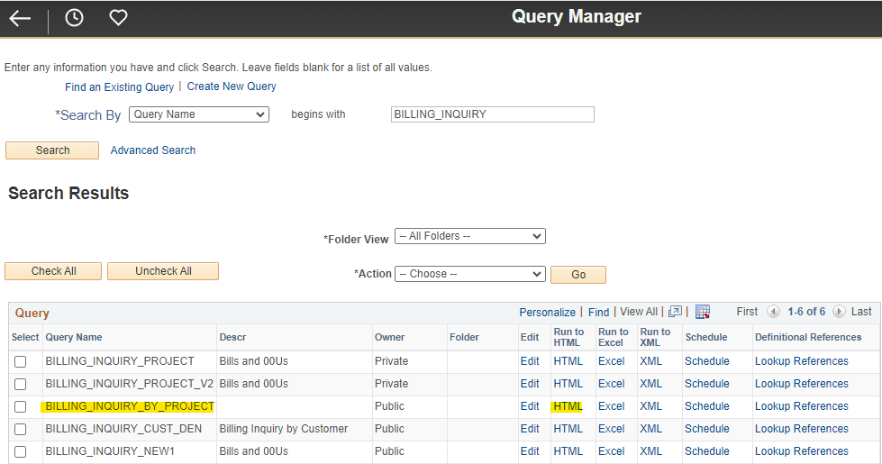
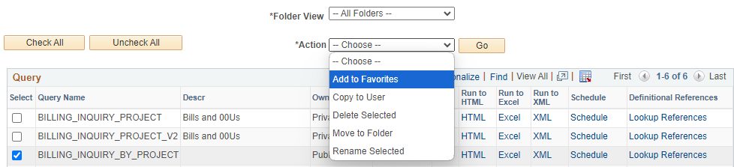
Billing Inquiry (Con’t)
From Query Manager, Search by Query Name
Type: Billing_Inquiry
Select BILLING_INQUIRY_BY_PROJECT
Run to HTML to view onscreen
Run to Excel to export
Add to Favorites for easier future searches

Slide 18
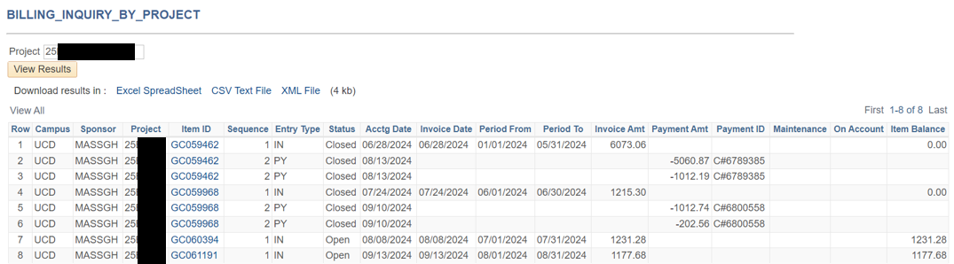
Billing Inquiry to Invoice pdf (con’t)
Click on any invoice with blue highlight
If invoice isn’t highlighted, there is no link to drill-in

Slide 19
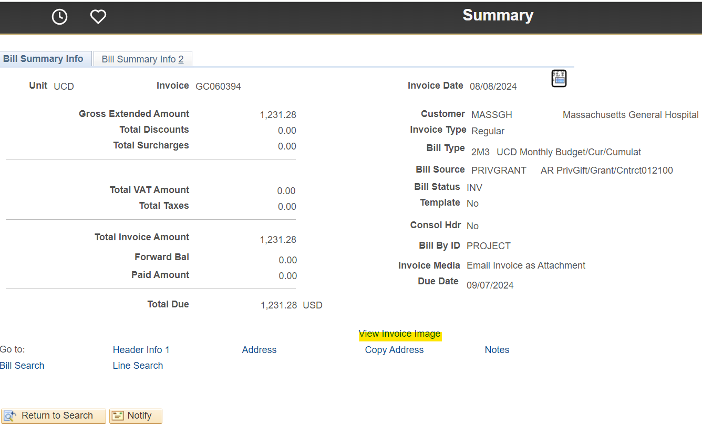
Billing Inquiry to Invoice pdf (con’t)
Drilling into invoice from Billing Inquiry will bring you to the Invoice Summary
  Click on View Invoice Image

Slide 20
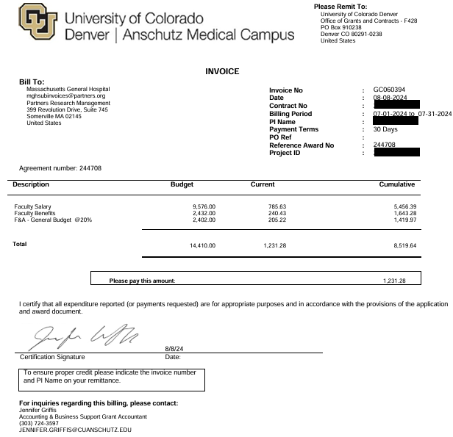
Billing Inquiry to Invoice pdf (con’t)
Drilling into View Invoice Image will open the system invoice pdf
  * Note: Not all system invoices are submitted to the sponsor

Slide 21
Billing Inquiry to Invoice pdf (con’t)
Limitations
System invoice is not always what is submitted to the sponsor
Sponsor requires their template only
Manually merged invoices
View Invoice pdf is not available for the following awards:
Automatic Payments – Ginger is listed as Billing Specialist on Bill Plan
Department Invoices – UCDCT is listed as Billing Specialist on Bill Plan
Invoices prior to implementation of Billing Automation Phase III (NOV 2020)

Slide 22

Event Based Awards
Fixed Rate and Installment Based Contracts

Slide 23
Fixed Rate & Installment Based Awards
How are we getting paid?
Fixed Rate (FR)
  Invoicing terms are Per Unit:
  Milestone
  Patient
  Visit
  Revenue is recognized based on amount invoiced
Installment Based (IB)
  Invoicing terms are typically based on scheduled payments
  Quarterly, Annually
  Also used when effort terms cannot align with GL
  i.e. $200/Hour
    Revenue is recognized based on expenses like cost reimbursable
      Will typically be setup IB if cash residual must be returned to sponsor at end of budget period

Slide 24
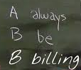
Fixed and Installment Based Awards
  Office of Grants and Contracts maintains billing for all awards except non-federal clinical trials with few exceptions
    Example exceptions:
      Sponsor-generated invoice requiring PI signature
      Portals for which OGC does not have access
  In exceptions where OGC is not invoicing, we still require a copy of the invoice. Please copy your pod team and OGC.Billing@ucdenver.edu on the submission
  For department-billed non-federal clinical trials, copy OGC.4Payments@ucdenver.edu on the submission

Slide 25

Questions?
Thank you!

