Slide 1
OGC Team Talks Cost Transfers
April 19^{th,} 2022

Slide 2
Agenda
Introductions
What is a cost transfer, and what are our campus policy requirements?
Internal Audit Cost Transfer Review
Best Practices for Meeting Campus Requirements
Links, Resources and Questions

Slide 3
Introductions
Today’s presenters
Ginger Acierno – Director of Post Award Financial Services
Barb Hayes – Compliance Manager
Margaux Johnson – Post Award Administrator
*Navigation by Koffi Gnatsidji
Presentation today uses Poll Everywhere
*You can join either by web using the address in image
*You will be able to respond and continue during session for multiple poles.
Stephanie Chandler Thompson - Post Award Manager
Holly Day – Compliance Auditor
Brittany Vits – Post Award Administrator

Slide 4
Notes:
Poll Title: Do not modify the notes in this section to avoid tampering with the Poll Everywhere activity. More info at polleverywhere.com/support What is your role in Post Award Cost Transfers? https://www.polleverywhere.com/multiple_choice_polls/d2V4VkwTocnfdlMsTE8qh?display_state=instructions&activity_state=opened&state=opened&flow=Engagement&onscreen=persist

Slide 5
Notes:
Poll Title: Do not modify the notes in this section to avoid tampering with the Poll Everywhere activity. More info at polleverywhere.com/support What is your role in Post Award Cost Transfers? https://www.polleverywhere.com/multiple_choice_polls/d2V4VkwTocnfdlMsTE8qh?display_state=chart&activity_state=opened&state=opened&flow=Engagement&onscreen=persist

Slide 6
What is a Cost Transfer
Definition A cost transfer is the transfer of a cost incurred initially on one university program/project and subsequently transferred to a sponsored project. A cost transfer does not include items posted to a suspense account or program that are cleared to the appropriate project on a timely basis.

Slide 7
What does our campus policy require?
Cost Transfers on Sponsored Projects, 4-12 Policy number 2018
The transfer of costs to a sponsored project requires the Journal Entry (JE) or Payroll Expense Transfer (PET) preparer to electronically certify that all expenses contained on the JE/PET are true and correct, that costs transferred to a sponsored project (Fund 30 31 FOPPS) are reasonable, allowable, and allocable, and in accordance with award terms. This is completed by submitting a JE/PET.
The transfer should be supported by documentation that contains an explanation of how the error occurred and a certification of the correctness of the new charge by a responsible university organizational official. An explanation that merely states that the transfer was made "to correct error" or "to transfer to correct project" is not sufficient.
Errors not discovered within 90 days of the expense, additional information should be provided in the PET or JE on why the correction was delayed and how the delay will be avoided in the future.
https://www.ucdenver.edu/docs/librariesprovider284/default-document-library/2000-finance/2018---cost-transfers-on-sponsored-projects.pdf?sfvrsn=ff3af9ba_2

Slide 8
How do we determine the entry meets the requirements for approval?
Justification and Attached documentation are reviewed to determine the following....
What are the specific transactions being moved via a cost transfer?
When did the original charge occur, and what FOPPS were they originally charged to?
If a charge is being moved more than twice, the original charge and all subsequent actions should be included.
Why are you completing a cost transfer? Meaning are you correcting an error or allocating a partial charge?
What project/speed type are the charges being moved to, and if a fund 30/31 how do they benefit that award, and are they within the budget dates of the award?
Are they being moved within 90 days of the original charge? If not, why and how will you ensure charges are corrected within 90 days going forward?
If the project has already ended or been reported, are there funds available to support the additional charges?

Slide 9
How do we determine the entry meets the requirements for approval?
Q. How can I show what charges I am moving and when they were charged?
A. You can identify both by including a financial detail as an attachment which shows the original charge.
Best Practice
Narrow the criteria for the financial detail to the transactions in the account code and dates from... for the charge you are moving. (Please do not require the reviewer to go through 40 pages of detail to find the charges)

Slide 10
How do we determine the entry meets the requirements for approval?
Q. Why are you completing a cost transfer? Meaning are you correcting an error or allocating a partial charge?
A. Use the justification to indicate why you are completing a cost transfer. The justification should be used to show both the reason and how the error occurred.
Best Practice
You need to say more than “to correct error”, you should say what the error was and how it was discovered.
If charging two ST’s under the same award, you should indicate this.

Slide 11
How do we determine the entry meets the requirements for approval?
Q. How can I include where I am moving charges to and if it is a fund 30/31 why or how they benefit the project?
A. Supporting documentation should indicate where you are moving charges to and why, meaning how did you determine that the charges belong to the fund 30/31?
Best Practice
If moving charges to a fund 30/31, you should have a justification of why you are moving the charges to that fund. Suggesting you are moving charges related to a deficit on another project are NOT a valid reason.

Slide 12
How do we determine the entry meets the requirements for approval?
Q. What should I add if the original transaction occurred more than 90 days ago?
A. The expectation is that you are reviewing expenses on a regular basis in order to find errors and correct them as soon as they are discovered. If corrections are not made within this acceptable time frame, you should indicate why and how they will be discovered in a timely manner going forward.
Best Practice
Reviewing expenses on fund 30/31 on a monthly basis is a best practice, to ensure if there are errors discovered, that they are corrected quickly.

Slide 13
How do we determine the entry meets the requirements for approval?
Q. How can I show that the project or ST I am moving charges to is correct, the transactions are within the period and the project has budget available to accept the charge?
A. You can include a trial balance for the project/ST you are moving charges to. This will show budget and project begin and end dates, type of project and cash balances.
Best Practice
If you have discovered something that should have been charged to a project, after the end date, you will need to also make sure there is budget and cash available. If the project is cost reimbursable, you may need to work with us to determine if we can still bill or draw the funds for the project.

Slide 14
Cost Transfers and you.....
Notes:
Poll Title: Do not modify the notes in this section to avoid tampering with the Poll Everywhere activity. More info at polleverywhere.com/support I most often find out a cost transfer is needed..... https://www.polleverywhere.com/multiple_choice_polls/JWSLdemSf78OQtDPuXLQK?state=opened&flow=Default&onscreen=persist

Slide 15
Cost Transfers and you.....
Notes:
Poll Title: Do not modify the notes in this section to avoid tampering with the Poll Everywhere activity. More info at polleverywhere.com/support What pain points do you come across when doing cost transfers? https://www.polleverywhere.com/free_text_polls/TvMqphuQ3In6aVxKaQ3yZ

Slide 16
Cost Transfer Review conducted by Internal Audit

Slide 17
Recent Cost Transfer Internal Audit
Internal Audit of cost transfers was conducted from August 2021 to March 2022.
A random sample was selected to review compliance with sponsor and federal guidelines and university policies and procedures.
Review of cost transfers from January 1, 2021, to August 31, 2021
Included both PET’s and JE’s
Final report of results was received by OGC on March 11th, 2022

Slide 18
Cost Transfer Internal Audit Scope
The objective of the audit was to determine whether CU Anschutz has (1) developed and implemented adequate written procedures and controls relating to cost transfers and (2) justified and supported cost transfers in accordance with federal regulations, sponsor terms and conditions, and university policies and procedures.
*Note the selection did not include entries made to Downtown projects, however that may come, and some point and requirements will pertain to both Downtown and Anschutz entries.

Slide 19
Cost Transfer Internal Audit Outcome
There were entries that did not consistently follow requirements.
The inconsistency could result in fines from the federal government, and reputational risk may inhibit the ability to get additional grants going forward.

Slide 20
Cost Transfer Internal Audit Outcome cont.

Slide 21
WHAT DOES THIS MEAN?
We all need to do better.

Slide 22
Actions we are taking as a result....
April Team Talks to recommunicate policy.
Update cost transfer section on OGC Website. (To be updated by May 1)
We will clearly communicate the directive that OGC Postaward Administrators will return a cost transfer or PET if it does not fully comply with Campus Administrative Policy 2018 – Cost Transfers on Sponsored Projects.

Slide 23
Actions we are taking as a result (cont.)
Financial Services – Compliance unit performs periodic sample reviews of both cost transfers and PETs and will continue this review.
Any sample identified as non-compliant will be rectified in a timely manner through communication to the approving OGC Postaward Administrator as well as the OGC Postaward Manager for correction with the department and internally within OGC.
OGC Leadership will work with all Schools/Colleges/Units on developing a report that will be provided to leadership quarterly to summarize PETs and Cost Transfers on a regular basis.
For the specific individuals identified through the entry process or compliance review we will require additional training.
Compliance team will provide additional targeted training as appropriate, including small group refresher sessions as needed.

Slide 24
Actions we are taking as a result (cont.)
Payroll Expense Transfers (PETs) – all PETs submitted in Human Capital Management (HCM) must include a completed PET checklist.
Note this checklist exists today but is not required. Audit found all PETS that included the checklist met the policy requirements 100% of the time.
Cost Transfers – all cost transfers submitted in PeopleSoft Finance via JE must include a completed cost transfer checklist. This is a new checklist that will be required to be submitted as an attachment to cost transfer journal entries.

Slide 25
NEW Cost Transfer Checklist for JE’s
If you are doing a JE that is a cost transfer onto a fund 30/31 sponsored projects the checklist needs to be used.
Checklist is intended to guide user's justifications, in order to meet cost transfer requirements.
Checklist will be available starting May 1, in the cost transfer section of our website and we will send future announcement with links.
Checklist will be required for JE’s that are cost transfers to sponsored projects as of June 1.
After initial usage there will be opportunity for feedback and improvements from department uses for both checklists.

Slide 26
What can be done to reduce the need for cost transfers......
Request Preaward in advance, so that you have your speed type by the start date / payroll funding deadline for the allowable expense period.
Work with staff booking expenses to post to correct speed type at initial charge.
Prioritize setup of funding distributions in order to avoid PETS.
Make timely updates to subsystems that are direct billing your speed types such as IT services, Telecommunications, etc....

Slide 27
What can be done to complete cost transfer timely......
Assign Review for all project financial detail on
monthly basis.
Correct errors immediately when they are found.
Complete allocations monthly.
Work with OGC Postaward to enter and approve
entries throughout the month so that
approvals do not always hit close to month end.
Enter any funding changes as they are needed. Please do not hold known funding changes for sponsored projects, while you are waiting for others. Especially try when funding distribution deadline is approaching. PETS that correct only one funding source are much easier to justify and review then PETS that correct multiple funding sources across many funding periods.

Slide 28
Tips and Best Practices for Entering Cost Transfers via Journal Entries (JE)

Slide 29
Example Cost Transfer Entries

Slide 30
Journal Entry Example #1

Slide 31
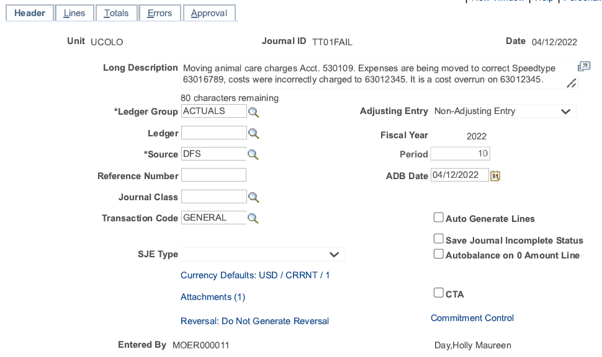
Example #1- Take One
4/1/2021

Slide 32
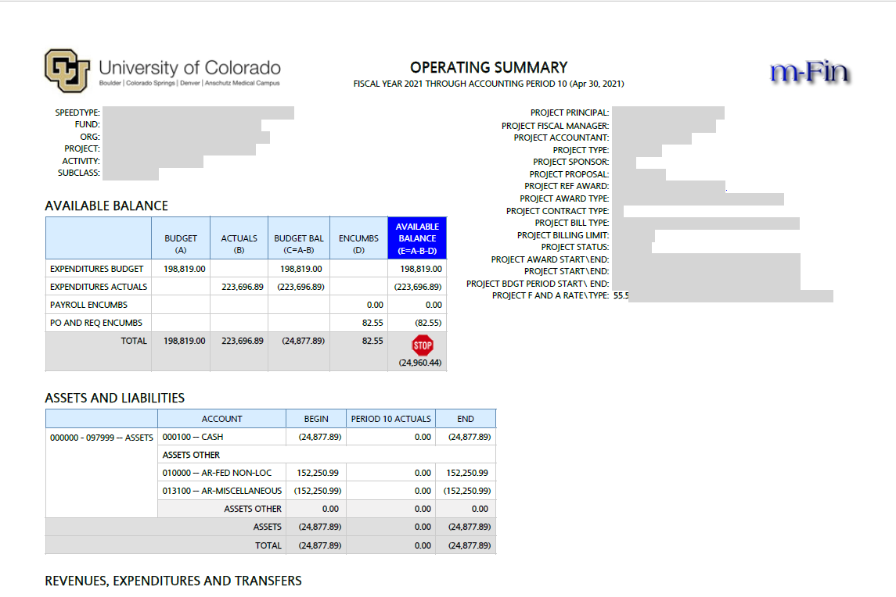
Attachment – Operating Summary Report

Slide 33
Let’s Review the intention of this JE
Attachments Needed
JE Checklist - required for this entry
Documentation of discussion with PI (email)
Financial Detail from month charge was posted through current calendar month
Run for ONLY the account code(s) that have the mischarged transactions
Must include Header of report that has been run to show the period covered

Slide 34
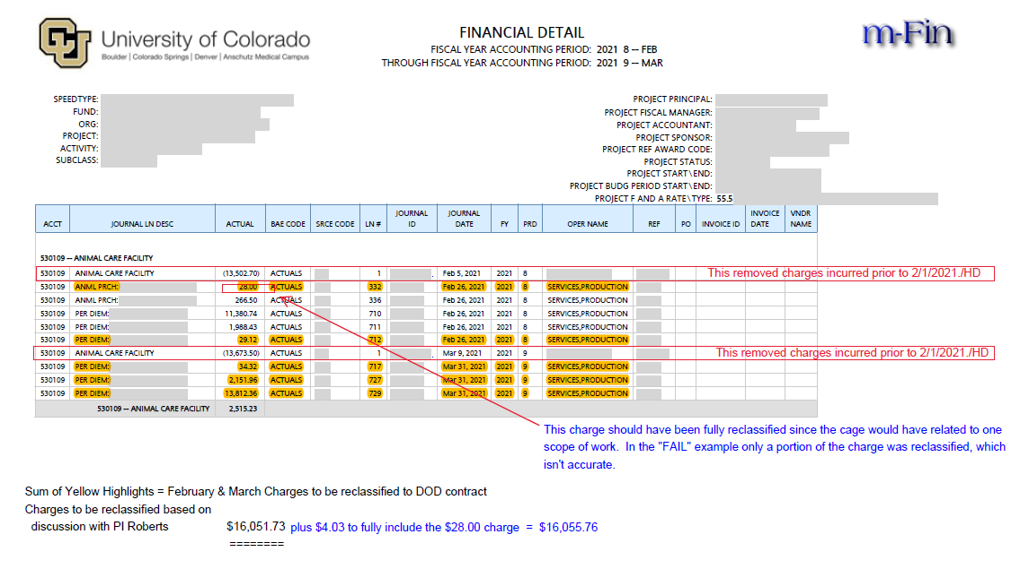
Attachment – Financial Detail Report

Slide 35
JE Checklist Walkthrough

Slide 36
JE Checklist – Submission Message & Email w/PDF
Attach the PDF to the JE!

Slide 37
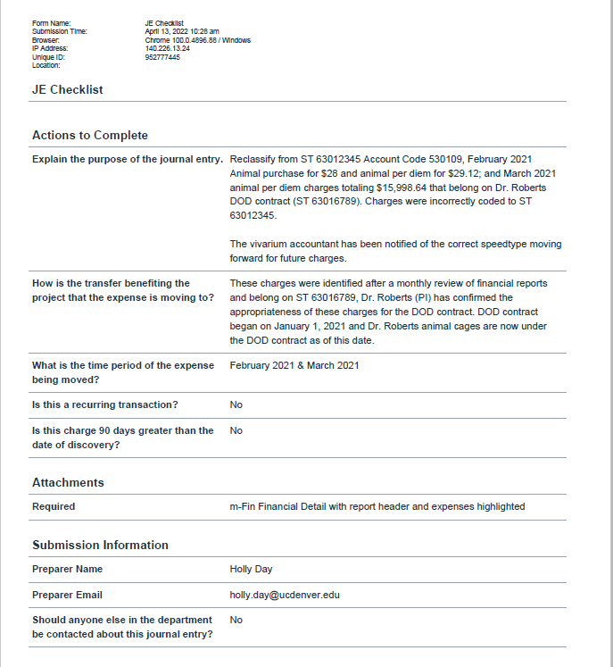
Attachment – JE Checklist

Slide 38
Attachment – Financial Detail Report

Slide 39
Attachment – Communication w/PI (Email)

Slide 40
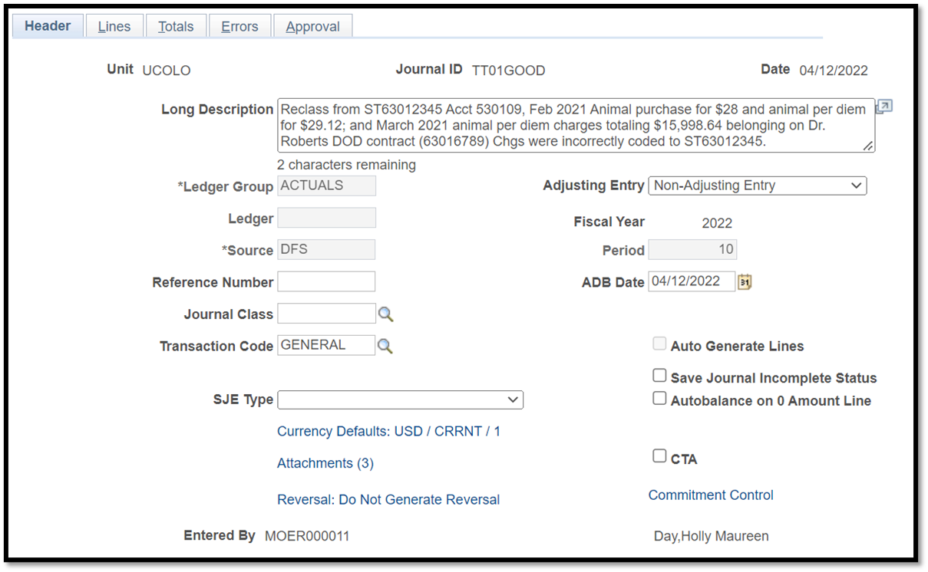
Example #1- Take Two
4/1/2021

Slide 41
Journal Entry Example #2

Slide 42
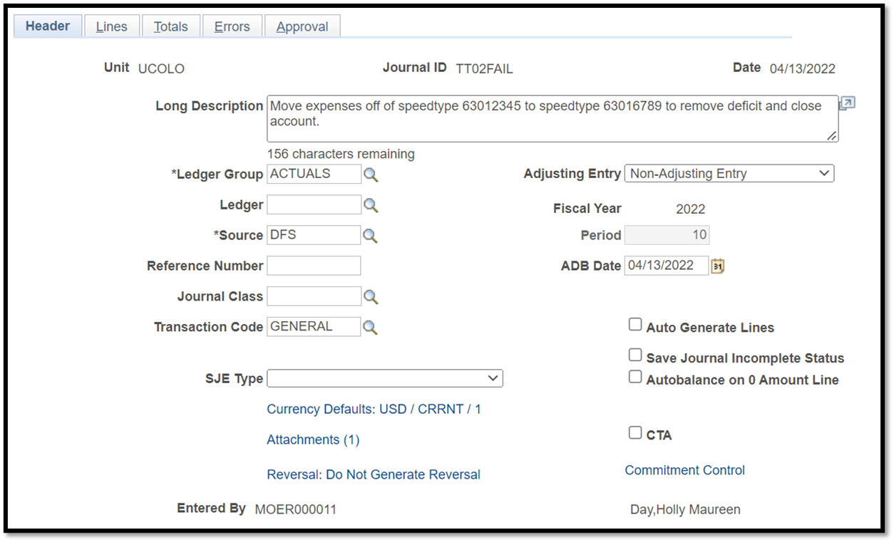
Example #2- Take One
4/14/2021

Slide 43
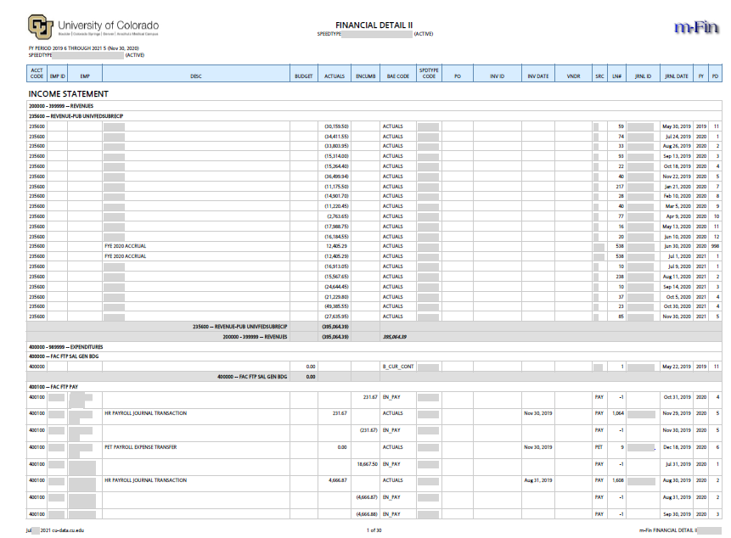
Attachment – Financial Detail II Report (30 Pgs)

Slide 44
Let’s Review the intention of this JE
Attachments Needed
JE Checklist
Documentation of discussion with PI (email)
Financial Detail from month charge was posted through current calendar month
Run for ONLY the account code(s) that have the mischarged transaction.
Must include Header of report that has been run to show the period covered

Slide 45
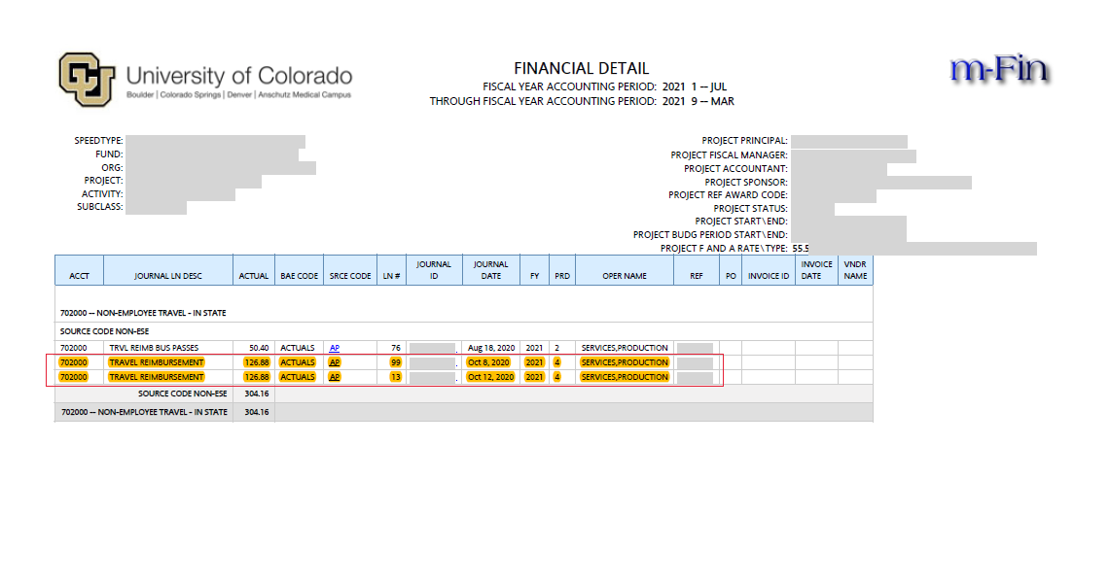
Attachment #1 – Financial Detail

Slide 46
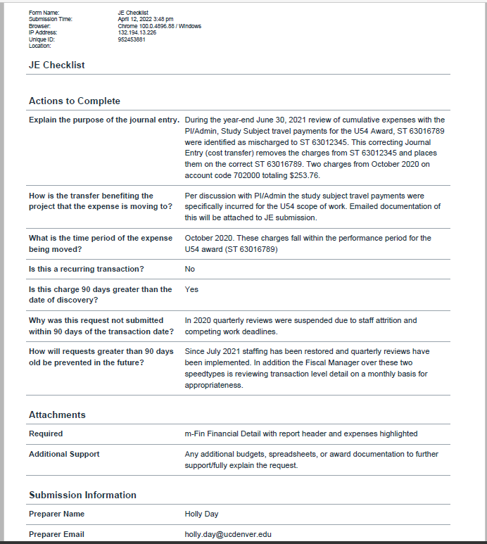
Attachment #2 – JE Checklist

Slide 47
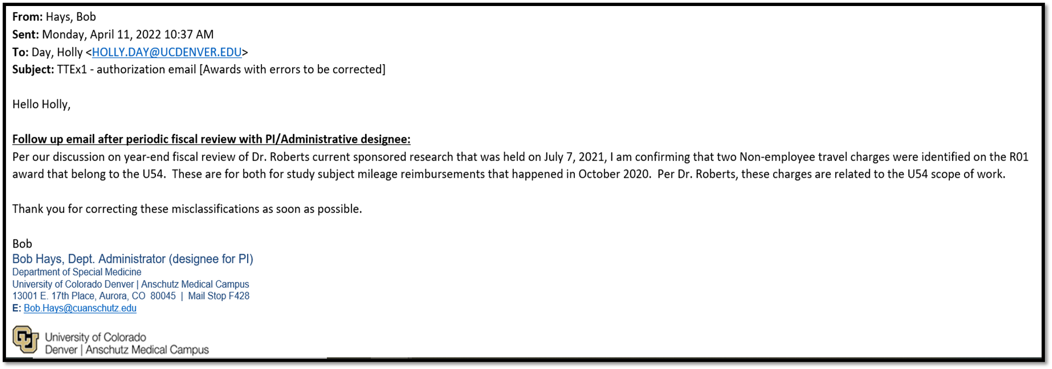
Attachment #3 – Communication w/PI
21,

Slide 48
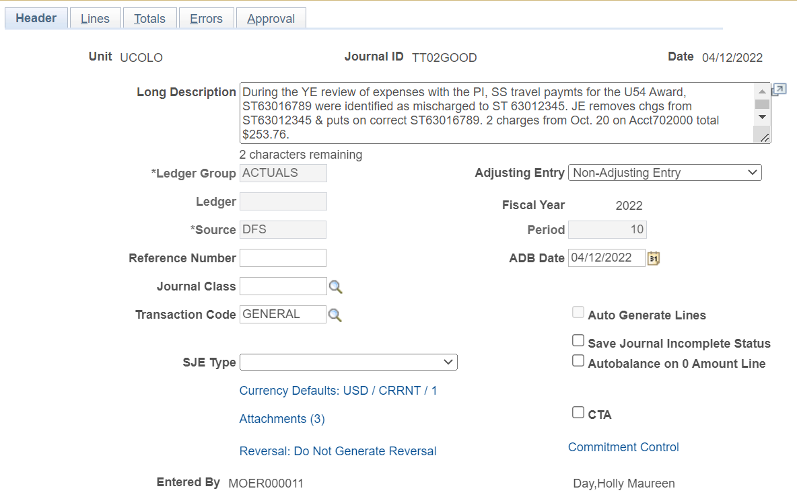
Example #2- Take Two
4/14/2021

Slide 49
Journal Entry Example #3

Slide 50
Example #3- Take One
2021

Slide 51
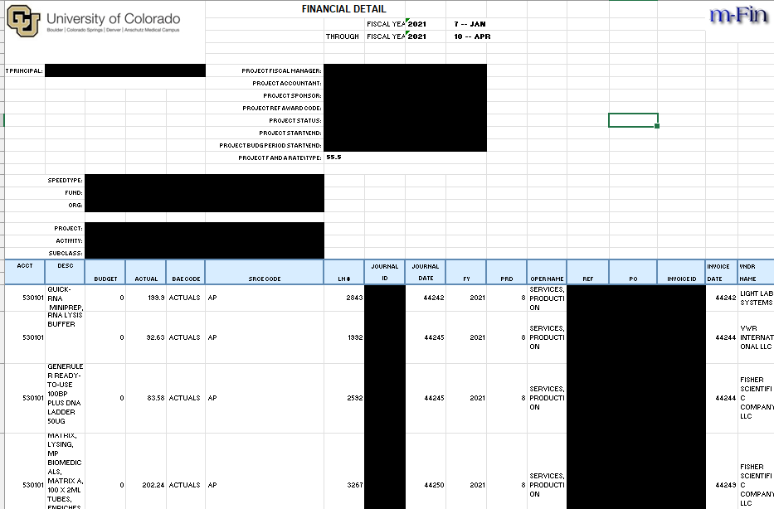
Attachment – Financial Detail Excel

Slide 52
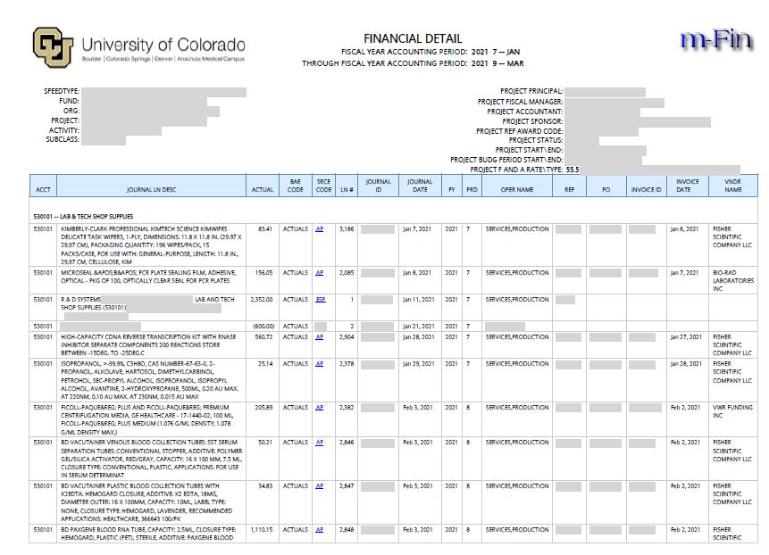
Financial Detail Report

Slide 53
Let’s Review the intention of this JE
Removing charges from fund 30/31 to department speedtype does not require completion of JE Checklist.
This Journal Entry removes overspending that has occurred on the award.
Financial Detail should not be altered to remove information
Attachments Needed
Documentation of discussion with PI (email)
Financial Detail from month charge was posted through current calendar month
Run for ONLY the account code(s) that have the mischarged transaction.
Must include Header of report that has been run to show the period covered

Slide 54
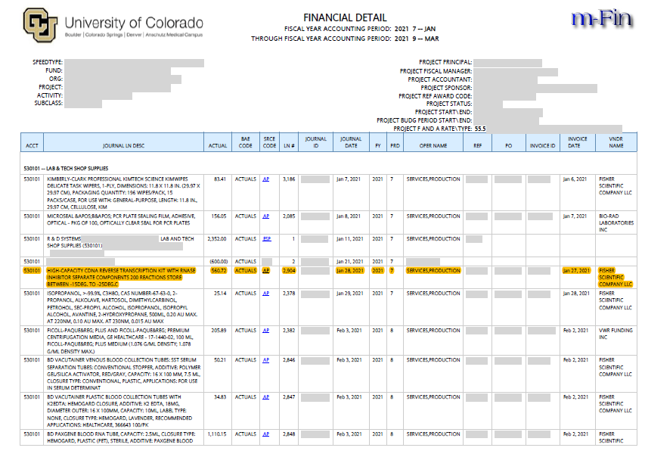
Attachment - Financial Detail

Slide 55
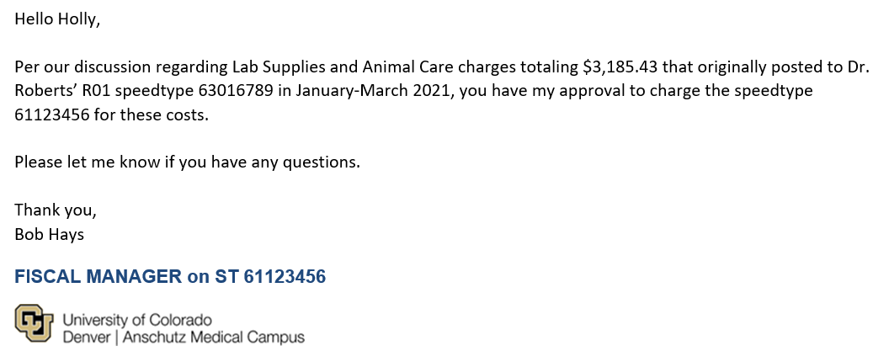
Attachment – Approval from Fiscal Manager to move Expense to dept. ST

Slide 56
Example #3- Take Two
4/12/2021

Slide 57
Tips and Best Practices for Entering Cost Transfers via Payroll Expense Transfers (PETS)

Slide 58
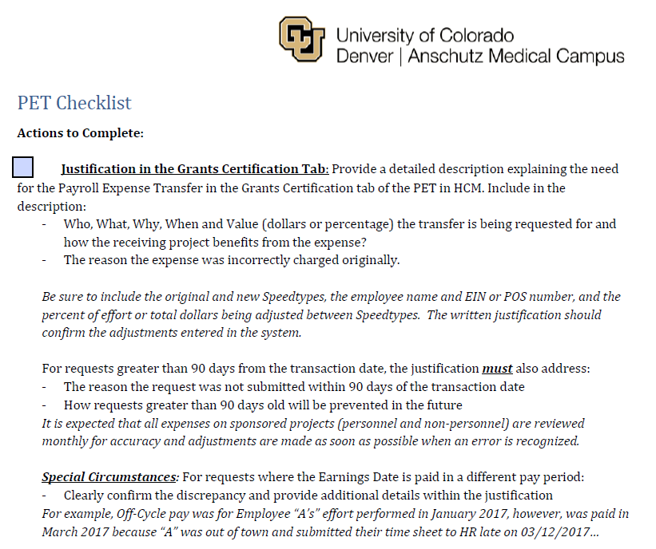
The PET Checklist
Who: Employee Name and ID
What: STs being Impacted by this Cost Transfer
Why: Why is this transfer being completed? Why was it originally incorrect?
When: The Paycheck period being corrected.
Value: What Percent or Dollar of Effort will be transferred
How: How does this cost transfer benefit the Sponsored STs in which the effort is being placed?
Over 90 days: Why is this transfer over 90 days from original post date? How will transactions over 90 days be avoided moving forward?

Slide 59
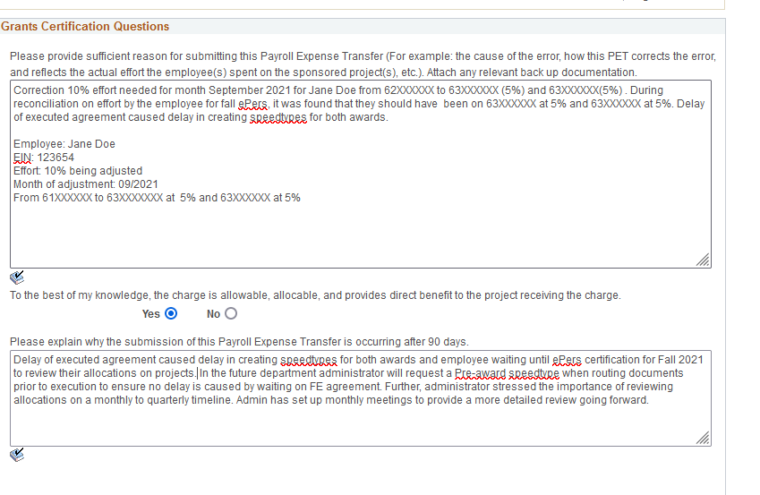
Grant Certification- Allowable Certification Example

Slide 60
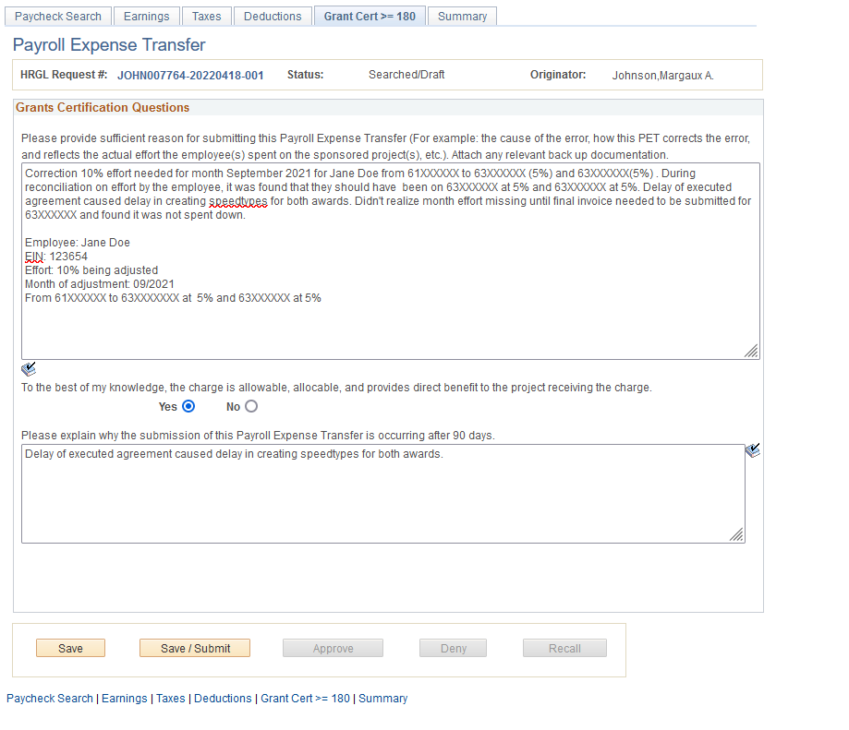
Grant Certification- Unallowable Certification Example

Slide 61
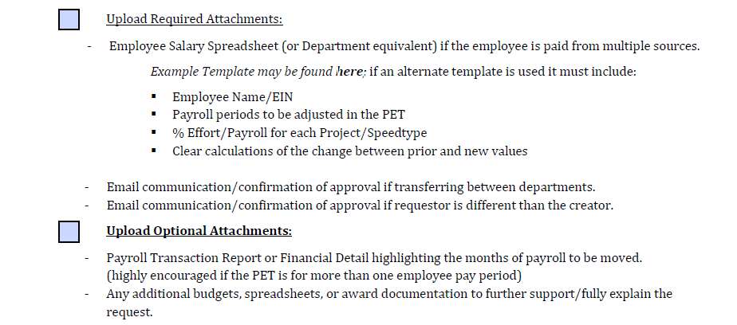
The PET Checklist
Salary Spreadsheet Template:

Slide 62
Links and Resources
University of Colorado Cost Transfer on Sponsored Projects Policy:
https://www.ucdenver.edu/docs/librariesprovider284/default-document-library/2000-finance/2018---cost-transfers-on-sponsored-projects.pdf?sfvrsn=ff3af9ba_2
Office of Grants and Contracts PET Guidance, Calculator, PET Checklist, Salary Spreadsheet Template:
https://research.cuanschutz.edu/ogc/home/award-lifecycle/post-award/cost-transfers/pets
HCM Access and Training:
https://www.cu.edu/hcm-community/hcm-access-training

Slide 63
Notes:
Poll Title: Do not modify the notes in this section to avoid tampering with the Poll Everywhere activity. More info at polleverywhere.com/support Please indicate your biggest takeaway from today? https://www.polleverywhere.com/free_text_polls/PlWZ4u31HtwYw4nKCiuj8

Slide 64
Cost Transfer Policy Reminder

Slide 65
Questions?

