Slide 1
Compliance Focus OGC Team Talk August 24, 2023
Presented By:
Barb Hayes, Compliance Program Manager
Shane Jernigan, Compliance Trainer

Slide 2
TRAINING OVERVIEW
01
Federal Audit Findings
02
Subrecipient Annual Audits Review Findings
03
Compliance Best Practices
04
Courses & CRA Prep

Slide 3
Recent Federal OIG Audits
Role of the Office of Inspector General
To prevent and investigate waste, fraud and abuse of federal assets
As a grant recipient and steward of federal funds, the University has the fiduciary responsibility to protect federal money and to comply with federal regulations and internal University policies and procedures
Importance of OIG Audits
Significantly more robust than annual single audits
Provides additional guidance to grant recipients
Provides guidance to future audits
Most Recent OIG Audits of Universities
HHS (NIH) – St. Louis University
NSF – Ohio State University
NSF – University of North Carolina, Charlotte

Slide 4
HHS (NIH) – St. Louis University
Direct Costs
University did not reconcile payroll and salary charges to the award resulting in $42,315 in associated questioned costs
University charged 3 nights of a hotel stay when the employee only stayed 2 nights
Time and Effort Reporting
University employees failed to certify time and effort reports in a timely manner
Subrecipient Monitoring
The University failed to enhance monitoring based on the subaward risk assessment
The subrecipient terminated the award and the University failed to ask why
Auditors discovered the subrecipient PI had been terminated by their institution for research misconduct

Slide 5
HHS (NIH) – University of St. Louis – Lessons
Payroll Costs - Financial reconciliation must be completed and charges must be accurate
Travel Costs - Follow University Travel Policies and Procedures and ask questions to ensure all travel-related costs are allowable, properly allocated, and necessary.
Time and Effort - Comply with University Time and Effort Policies and ensure all employees certify ePERs on time
Subrecipient Monitoring
Identify potential risks from the subaward risk assessment and develop a monitoring plan to mitigate those risks
Document monitoring activities
Scrutinize subrecipient invoices and activities
Ask for help

Slide 6
NSF – Ohio State and UNCC
Ohio State - late progress reports
UNC Charlotte
Improper allocation of publications – the acknowledgement statement identified nine sources of funding, however, the University charged 100% of the costs to one award
Improper use of gift cards – the University charged the award for gift cards that were not used for the award
Failure to comply with internal travel policy
Lessons
Identify reporting deadlines and ensure all deadlines are met (both internal and external)
Ensure PIs comply with federal acknowledgement statement requirements and charges are allocated properly
Comply with the University’s Gift Card Policy

Slide 7
Summary of Annual Subrecipient Audit Reviews
Requirements for Federal Subawards Audits
Pass-through entities must ensure each federal subrecipient complies with Single Audit requirements
Pass-through entities must review each subrecipient audit
Pass-through entities must take corrective action for any related audit finding
Pass-through entities must update internal records (monitoring plans, monitoring records, subaward agreements)
Review of FY 21 and FY 22 Subrecipient Audits
234 audits reviewed
5 University subrecipients had findings
Oklahoma State University
Portland State University
University of Chicago
Washington State University
Beaumont Heath
Compliance Office also monitors for potential concerns and issues
State of Iowa – Political Restrictions on State Auditor to conduct and certify audits, in violation of 2 CFR 200
Vanderbilt University – HHS Office of Civil Rights is currently investigating infringement on patient privacy
State of Oklahoma (State Agencies – Not Universities) – Failure to post FY21 Single Audit

Slide 8
Subrecipient Audit Findings
Subrecipient | Findings | # of Awards | PI/Dept Actions
Oklahoma State | Subrecipient Payments | 3 | If the subaward to OSU has a third-tier subaward, we need to verify they are paying the subrecipient on-time
Portland State | Suspension and debarment Time and effort | 1 | Verify all procurements over $25,000 comply with 2 CFR 180 and internal policies Verify salary charges are accurate – request detailed internal personnel records Verify 25% rule for any sub-personnel identified on NOA
University of Chicago | Property Management | 3 | Determine if equipment was purchased, identify internal equipment threshold, and verify subrecipient is in compliance
Washington State University | Time and Effort | 13 | Verify salary charges are accurate – request detailed internal personnel records Verify 25% rule for any sub-personnel identified on NOA
Beaumont Health | Suspension and Debarment | 1 | Verify all procurements over $25,000 comply with 2 CFR 180 and internal policies

Slide 9
Other Compliance Concerns
Fly America Act
Employees should use Concur to book travel, if not, verify travel complies with the law
University of Maryland job aid
Indirect (F&A) Cost Rates
Ensure correct F&A is applied to each award
New indirect (F&A) cost rates applicable to NEW COMPETING SEGMENTS
Cost Principles
Allowable under award terms and conditions
Necessary for the project’s success
Allocated properly
Consistency among direct and indirect (F&A) charges
Prior Approval Requirements
Understand and comply with prior approval requirements for each award
25% rule for time and effort
NIH – Prior approval required for equipment over $25,000 that was not included in the award

Slide 10
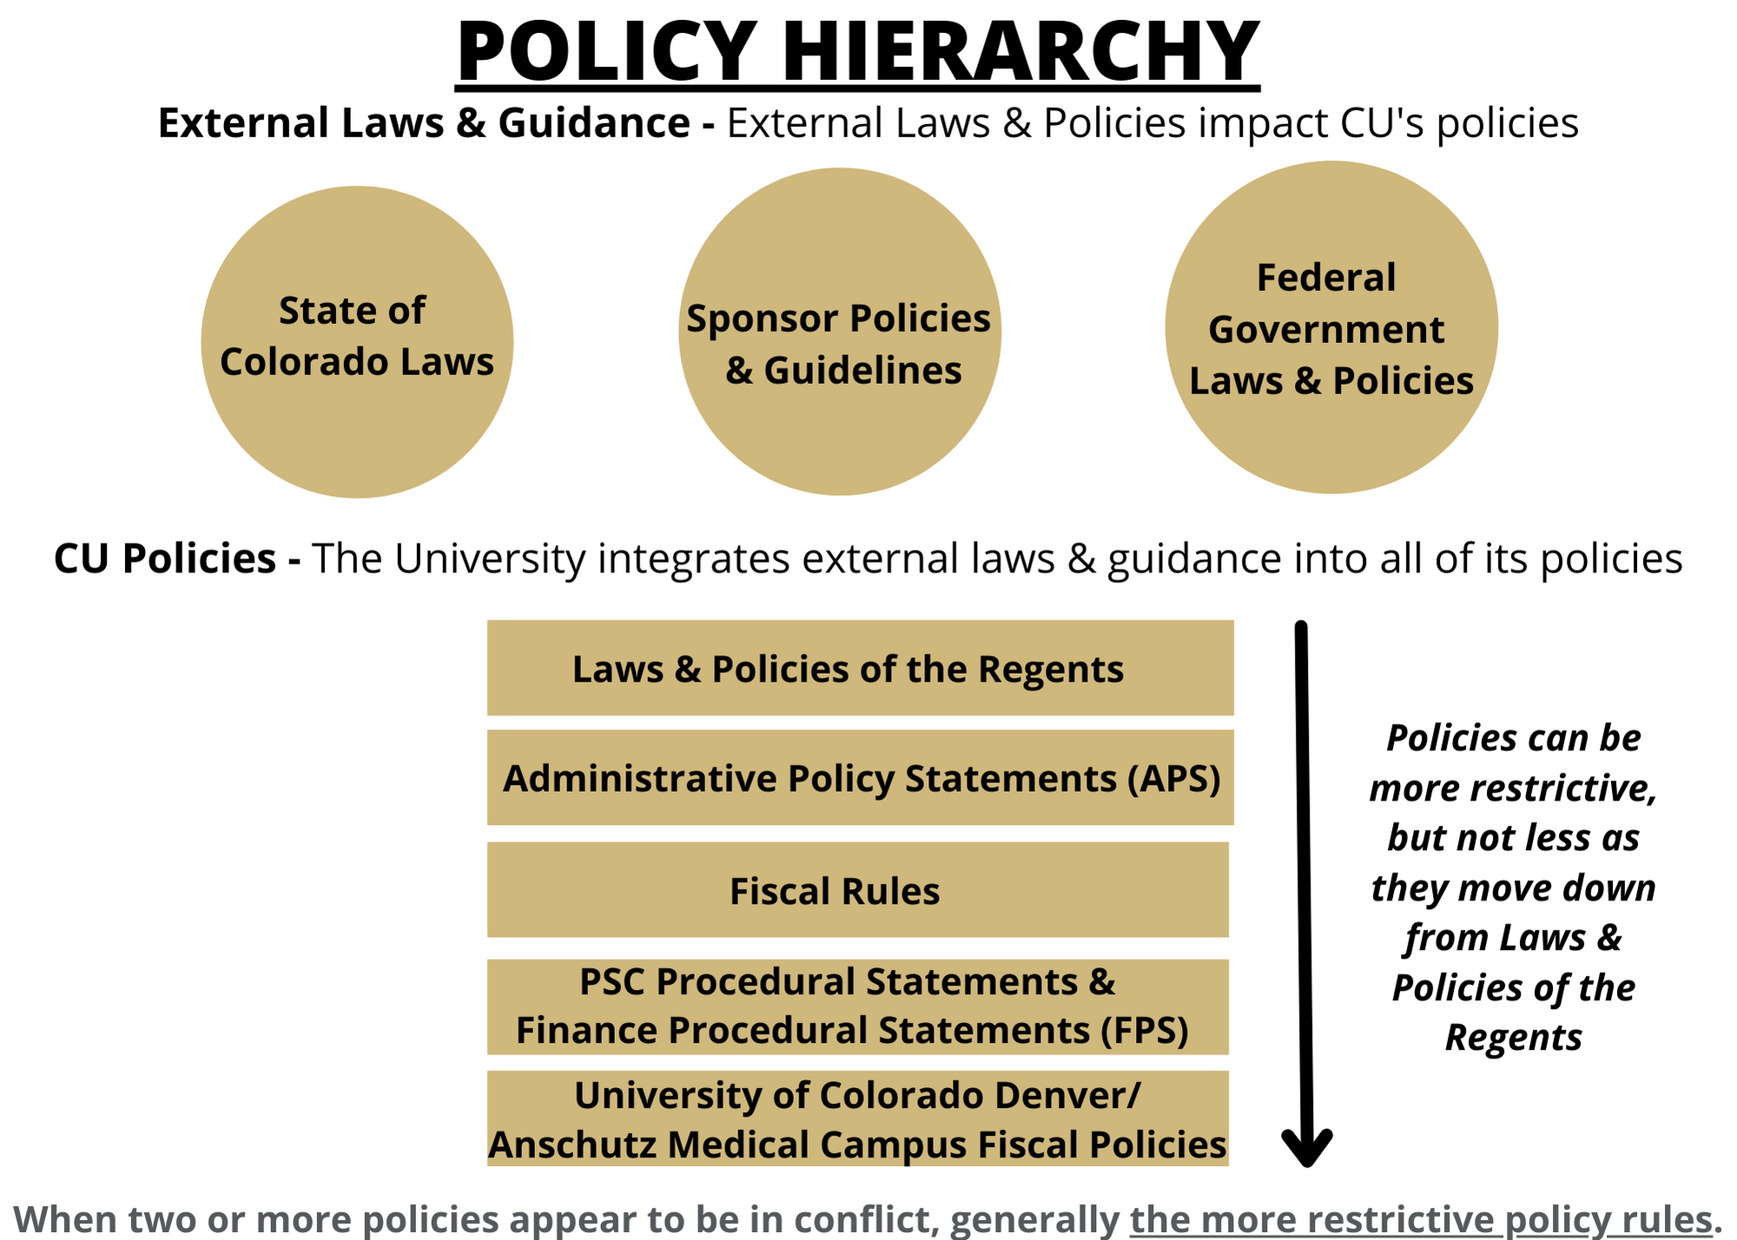

Slide 11
CU System Level (www.cu.edu)
Administrative Policy Statements
Fiscal Roles and Responsibilities
APS 4014
Propriety of Expenses
APS 4015

Slide 12
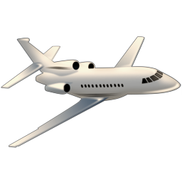
CU System Level (www.cu.edu)
Sensitive Expenses
FPS Sensitive Expenses
Travel
PPS Travel

Slide 13
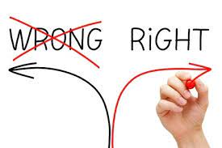
Denver/Anschutz Level
Direct Charges to Federally Sponsored Projects
CAP 2013
Cost Transfers
CAP 2018

Slide 14
Journal Entry Example
Combining Cost Transfer and non-Cost Transfer corrections into one entry.
**All identifying information has been redacted for the purposes of this training.

Slide 15
Review: Long Description & Attachments
Attachments:
JE Checklist
Excel File – outlining expenses & over expenditures at Close Out
Email from PI confirming the movement of travel expenditures
Financial Detail reports for the account codes being corrected.
**All identifying information has been redacted for the purposes of this training.

Slide 16
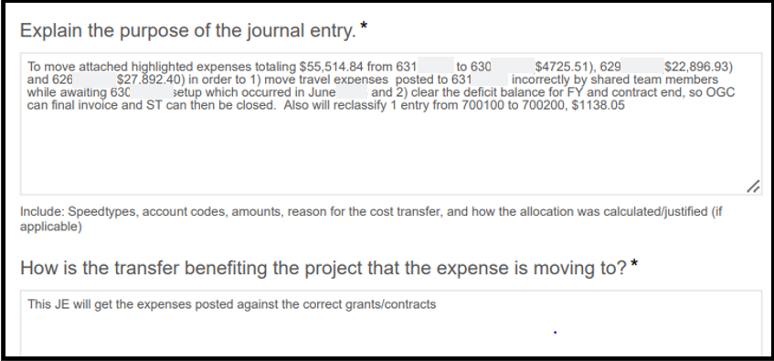
Journal Entry Checklist
**All identifying information has been redacted for the purposes of this training.

Slide 17
Compliance Review & Best Practices
1. Separate out the portion of the entry that is truly a Cost Transfer into its own Journal Entry (movement of expense onto the Fund 30 speedtype) from the portion moving expenses off to departmental/unrestricted funding sources.
2. Reference to delayed set-up of new speedtype – a Preaward Speedtype should have been requested so travel expenses were not being moved 9 months later at close out.
**All identifying information has been redacted for the purposes of this training.

Slide 18
Research Administrator's
Training Roadmap
Financial Administration Workshop:
Pre-Award Focus
Financial Administration Workshop:
Post-Award Focus
Continuing Education
These 4 courses were developed specifically for administrators working on the Pre-Award side of sponsored research and focus on Pre-Award Essentials, Budget Development, InfoEd Routing and RPPRs.
Recommended Timing:
Between 6-12 months
These 6 courses were developed specifically for administrators working on the Post-Award side of sponsored research and focus on Post-Award Essentials, Accounting Basics, Financial Reporting, Closeout, Cost Transfers, and Financial Projections.
Recommended Timing:
Between 6-12 months
.
OGC offers many other opportunities for focused trainings including 8 Team Talks a year, monthly newsletters, CRA Exam Prep, NCURA groups, and adhoc department requests.
Recommended Timing:
Ongoing
Initial Onboarding
Sponsored Project Series
These trainings include campus-wide New Employee Orientation, IT Security, Code of Ethics and other job specific trainings to obtain system access.
Recommended Timing:
First 2-4 weeks
This series of 8 courses offers Sponsored Projects 101 training as well as several advanced courses for those who work in research administration.
Recommended Timing:
Between 1- 6 months
3a
3b
4
1
2

Slide 19
Course Number & Name | Next Session | Course Time
A60014 – SP Introduction to Sponsored Projects | September 11 & 12, 2023 | 12pm – 1pm
A60035 – SP Pre-Award Essentials | September 13 & 14, 2023 | 12pm – 1pm
A60015 – Cost Principles for Sponsored Projects | September 18 & 19, 2023 | 12pm – 1pm
A60036 – SP Budget Development | September 20 & 21, 2023 | 12pm – 1pm
A60026 – Introduction to 2 CFR 200 (Uniform Guidance) | September 25 & 26, 2023 | 12pm – 1pm
A60037 – SP InfoEd Budgeting & Routing | September 27 & 28, 2023 | 12pm – 1pm
A60027 – SP Introduction to the NIHGPS | October 2 & 3, 2023 | 12pm – 1pm
A60038 – SP NIH RPPR | October 4, 2023 | 12pm – 1pm
A60016 – SP Pre-Award Administration for Sponsored Projects | October 9 & 10 & 16 &17, 2023 | 12pm – 1pm
A60039 – SP Post-Award Essentials | October 11 & 12 & 18 & 19, 2023 | 12pm – 1pm
Course Number & Name | Next Session | Course Time
A00101 – Finance Inquiry | October 13, 2023 | 8:30am – 11:30am
A00102 – Finance General Ledger | October 20, 2023 | 8:30am – 12pm
A60017 – SP Post-Award Administration for Sponsored Projects | October 23 & 24 & 30 & 31, 2023 | 12pm – 1pm
A60044 – SP Accounting Basics | October 25, 2023 | 12pm – 1pm
A60040 – SP Financial Reports | October 26, 2023 | 12pm – 1pm
A60042 – SP Closeouts | November 1, 2023 | 12pm – 1pm
A60043 – SP Cost Transfers | November 2, 2023 | 12pm – 1pm
A60030 – SP Subrecipient Monitoring | November 6 & 7, 2023 | 12pm – 1pm
A60041 – SP Financial Projections | November 8, 2023 | 12pm – 1pm
A60024 – SP Contracting at the University | November 13, 2023 | 12pm – 1pm
A60046 – SP CRA Exam Preparation | Contact Shane Jernigan if interested
Courses & CRA Prep
**Register through Skillsoft unless otherwise noted

Slide 20
CRA Exam Prep
Important Dates for Fall 2023
Exam Registration – By 11:59pm on October 4
Exam Window – November 4-18
University Support
12 - hour exam prep course
Begins Tuesday, August 29
100% pass rate
Congratulations to the University’s Newest Certified Research Administrators!
Kate Hoch, Department of Bioengineering
Rochelle Hubbart, Division of Gastroenterology & Hepatology

Slide 21
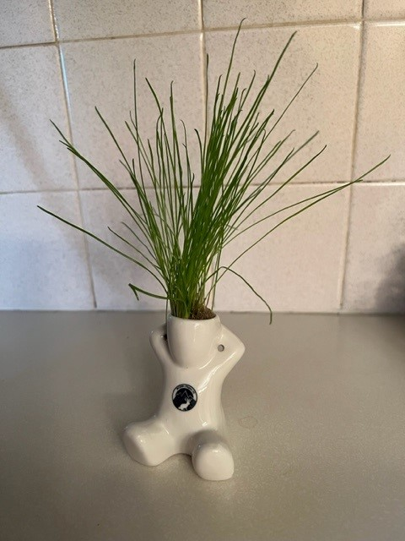
Questions?
NCURA AM65 “Sprout”
Shane Jernigan – shane.jernigan@cuanschutz.edu
Barb Hayes – barb.hayes@cuanschutz.edu
Financial Services Compliance – fs-compliance@ucdenver.edu

