Slide 1
Sponsor (NIH) news and OGC Updates
Office of Grants and Contracts
Thursday, September 25, 2025

Slide 2
Agenda
NIH No Cost Extension Updates.
Pre-award NIH policy Updates.
Project(s) in Pre-Spending notifications.
Federal Government shutdown.
Payroll Expense Transfer (PET) updates for funds 34 and 35.

Slide 3
NIH No Cost Extension Update
Background on the NIH update.
  May 7, 2025, NIH updated its No-cost extension processes, which took away our ability to submit the First No-cost extension automatically via a link.
  During this time, we were submitting the requests via the “prior approval” module.
New No-cost extension process.
  Effective August 7, 2025, NIH has re-enabled the No-cost Extension Functionality in eRA Commons.
  We are now allowed to use the first NCE link to submit the request for certain NIH awards. We are no longer using the “Prior approval” module.
  Link to the NIH update NOT-0D-25-142.

Slide 4
NIH No Cost Extension Update (continues)
“Requests that were previously submitted via the prior approval module will not be reviewed, and recipients will need to initiate the first no-cost extension within the Status module by using the Extension action”.
OGC actions related to the above part of the guidance.
  We went back and resubmitted the requests if the link is still available in the eRA Commons. The link is available within 90 days before the project end date.
  If the link is not available (the project end date has already passed), we are contacting the GMS to inquire about the NCE submitted via the “Prior approval” module.
Please review the OGC No Cost Extensions (NCE Request) webpage for further guidance or reach out to OGC.Postaward@ucdenver.edu for assistance.

Slide 5
Pre-award NIH policy Updates
https://research.cuanschutz.edu/ogc/home/resources/updates-team-talks/ogc-newsroom/nih-policy-updates
The NIH has announced a major policy change for applications involving foreign components - defined as any significant scientific activity conducted outside the U.S. by the recipient or a foreign organization. NIH announcement: NOT-OD-25-155. The primary applicant must be a U.S.-based organization. Leadership must include at least one PD/PI from the U.S. and one from each International Project. We are excited to see what the NIH has to say when they issue a Parent NOFO with detailed guidance.

Slide 6
Project(s) in Pre-Spending notification
This month, the Office of Grants and Contracts (OGC) started sending notifications for projects that have been in a pre-spending status for more than 90 days after the Start Date of the project.
The goal is to bring the projects in Pre-spending to our department administrators’ attention, and we hope that OGC receives an updated status on the award/contract.
The automatic notifications are going to the Grant Administrator GADM on the project(s)
Why is it important to review the email and provide an update?
  We are unable to bill the sponsor.
  We cannot post payment to an existing invoice under the award.

Slide 7
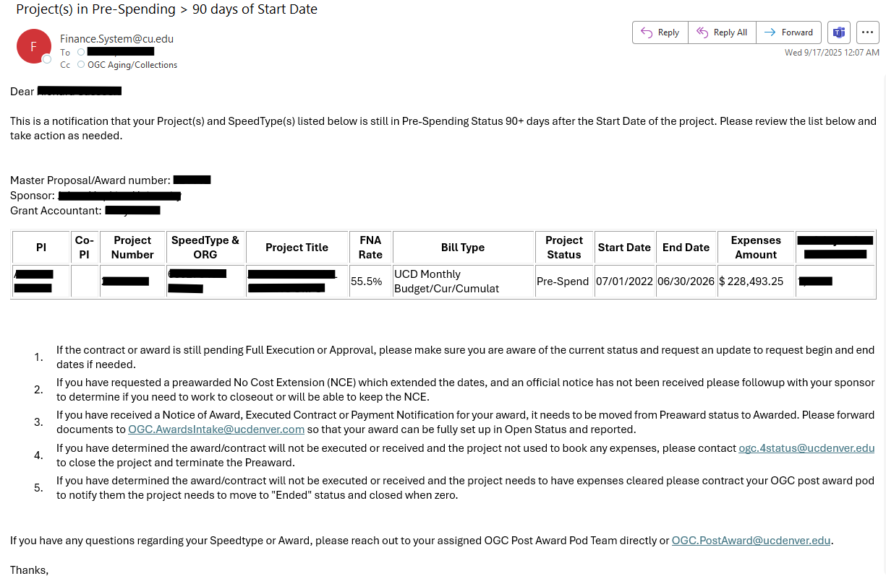
Example of the email notification

Slide 8
Action needed to update the status
The email provides actions that should be taken if needed to update the status.
If the contract or award is still pending Full Execution or Approval, please make sure you are aware of the current status and request an update to request begin and end dates if needed.
If you have requested a pre-awarded No Cost Extension (NCE) which extended the dates, and an official notice has not been received please follow-up with your sponsor to determine if you need to work to closeout or will be able to keep the NCE.
If you have received a Notice of Award, Executed Contract or Payment Notification for your award, it needs to be moved from Pre-Award status to Awarded. Please forward documents to OGC.AwardsIntake@ucdenver.edu so that your award can be fully set up in Open Status and reported.
If you have determined the award/contract will not be executed or received and the project not used to book any expenses, please contact ogc.4status@ucdenver.edu to close the project and terminate the Pre-Award.
If you have determined the award/contract will not be executed or received and the project needs to have expenses cleared please contact your OGC post award pod to notify them the project needs to move to "Ended" status and close when zero.

Slide 9
Potential Federal Government shutdown
The federal government is funded for this current fiscal year through 09/30/2025. If Congress does not pass a continuing resolution (CR) by the end of the month, a government shutdown will occur.
Government Guidance for a shutdown:
  The information in the next few slides has been gathered from federal agency contingency plans posted on the Office of Management and Budget website.

Slide 10
General Government Guidance for a Shutdown
Given the fluid and uncertain state of the federal government at this time, the impacts of a potential federal government shutdown are not clear and may vary from what has occurred during prior government shutdowns. Below are some potential impacts and recommended actions for researchers of federally sponsored projects.
Agencies will likely not be making new awards.
Agencies cannot provide new funding for non-competing segments.
Agencies will accept new proposals but will not be able to review them.
Agencies will not be issuing new funding opportunity announcements (Existing Parent Announcements will continue to govern).
We anticipate federal employees will be on furlough and will not be able to provide assistance or prior approval for existing awards. We will continue to submit request but do not expect to get approval until the federal staff is back working.
Unless otherwise direct by the federal agency, work on existing awards may continue, provided there are enough funds to cover incurred costs.

Slide 11
AGENCY-SPECIFIC GUIDANCE
Each federal agency has posted contingency plans. The following is a summary of the contingency plans for the University’s sponsors. Please note, some of the guidance from the federal government is extremely limited and generic.
Department of Defense (DOD)
  For federal contracts, work may continue up to the limit of obligated funds.
  A stop work order may be issued for some federal contracts.
Department of Education
  Funding for mandatory grants will continue, including student loans.

Slide 12
AGENCY-SPECIFIC GUIDANCE (continues)
Department of Veterans’ Affairs
VA medical facilities are expected to continue operations.
National Science Foundation
Research.gov will continue to function.

Slide 13
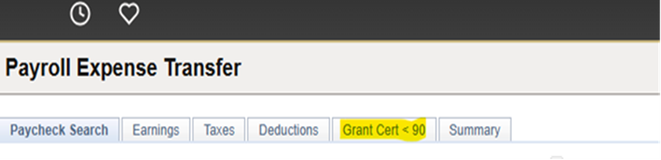
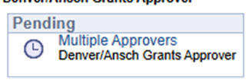
Payroll Expense Transfer (PET) update on funds 34 and 35
Previously, the grants certification statement and grants approval were required for any PETS impacting all 3x FUNDS. These restrictions are now only affecting the funds 30 and 31.
If you have a PET that is moving expenses between fund 10 and fund 34, for example, you do not need to fill out the Grant cert<90 tab, and the PET will not be routed for Grants approval.
What you will no longer see if the PET is only affecting funds 34 and 35.
  “Grant Cert<90
  This approval step will be skipped
If you have any questions, please contact ginger.acierno@cuanschutz.edu

Slide 14

Questions

