Slide 1
Post Award Hot Topics for Sponsored Projects
June 13, 2024

Slide 2
Agenda
Introduction
Prior Approvals (NCE/Carry Forward)
Fiscal Year End
Final Invoices/Templates
FFR Due Dates
Project Closeout

Slide 3
We would like to take this opportunity to thank you all for your patience.
It’s been a year since our post award teams transitioned to the start-to-finish pods. We appreciate everyone’s patience, assistance and insight as our teams grow into the new roles.

Slide 4
No Cost Extension Requests
Definition
Types
Process
Examples

Slide 5
What is a No Cost Extension (NCE)?
NIH defines a no-cost extension (NCE) as an extension of time to a project period to complete the work of the grant; allowing the Signing Official (SO) to request an extension up to 12 months.
Grantees may extend the final period of the project when the following conditions are met:
If no additional funds are required from the NIH awarding office
If there will be no change in the project’s originally approved scope
If there are no terms or conditions of the award that prohibits the extension

Slide 6
Types of NCE Requests
1st no cost extension
2nd and 3rd no cost extension

Slide 7
NIH 1st No Cost Extension Request
The first no-cost extension for NIH grants may be approved by the institution unless otherwise stated in the Notice of Award. NCEs approved by the institution must be submitted by the OGC Signing Official (SO) between 90 and 10 business days prior to the end of the project period.

Slide 8
No Cost Extension (NCE) Request Process
The steps for the 1st no cost extension:
The PI/Department Admin sends an email requesting the NCE to OGC.Postaward@ucdenver.edu containing the following information:
Proposal Number
Brief (2-3 sentence) scientific justification for needing additional time
Project Number
NIH Grant Number
Length of Extension Requested (up to 12 Months)
Signing Official (SO) reviews the NCE request
SO extends the final budget period per the request for the grant via eRA Commons (only the SO can complete this step)
The PI and SO will receive an automated email notification from eRA Commons of the revised project end date
SO forwards the notification of the revised project end date to Awards Intake
Awards Intake updates the project end date in InfoEd and PeopleSoft

Slide 9
Example of the Email Request

Slide 10
eRA Commons Module

Slide 11
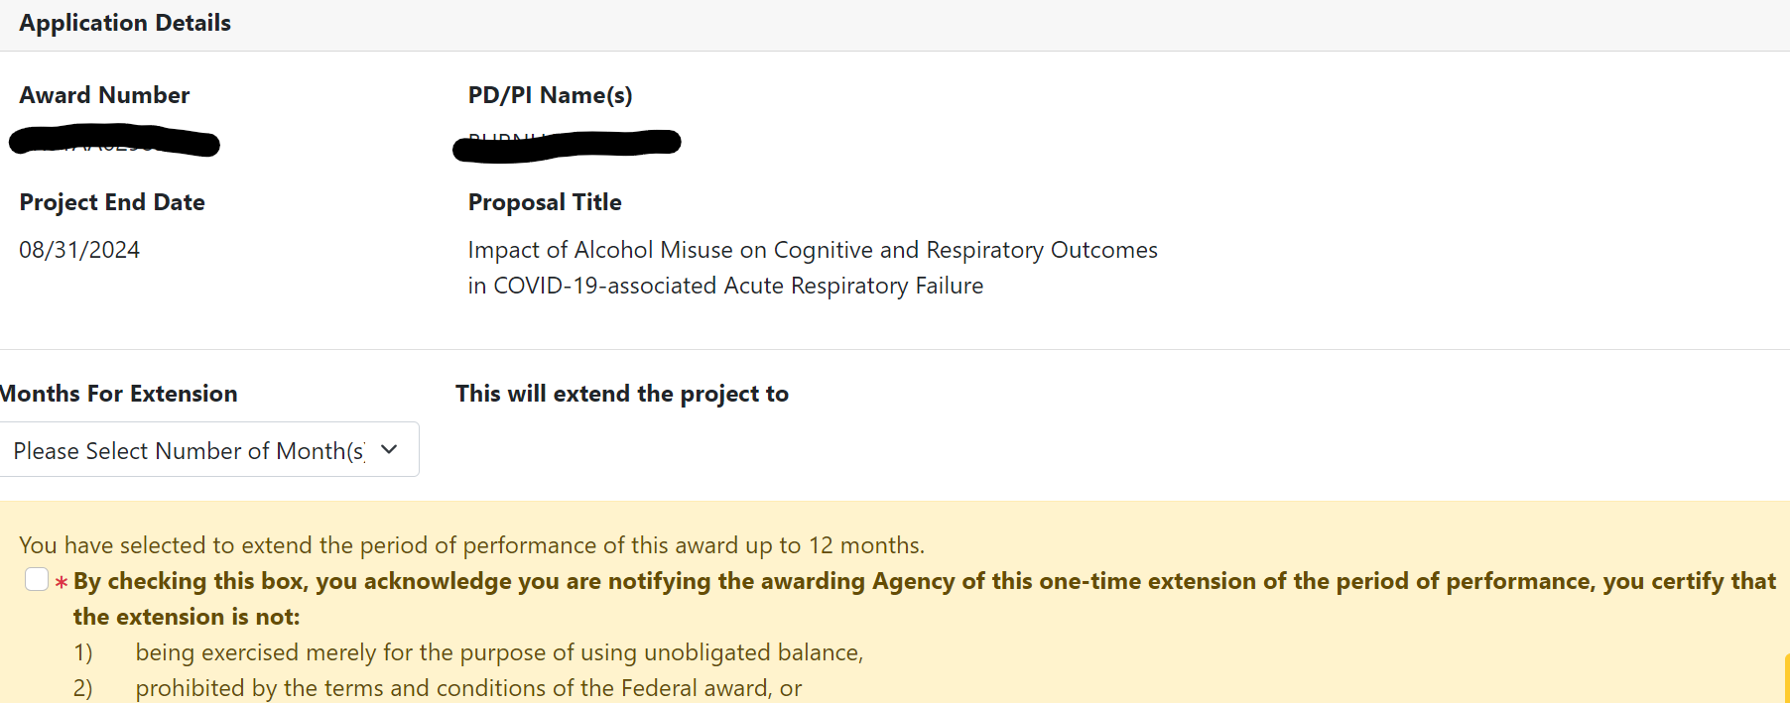
eRA Commons Module

Slide 12
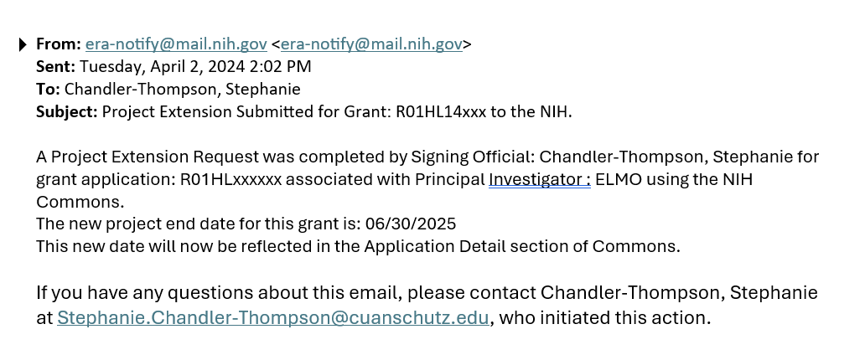
NIH Email Notification of the submitted request

Slide 13
NIH 2nd/3rd No Cost Extension Request
All second and subsequent NIH NCE requests must be submitted through eRA Commons prior approval module by the institution SO.

Slide 14
NIH 2nd/3rd No Cost Extension Request
The request must be submitted to the sponsor by the SO between 90 and 30 calendar days prior to the end date of the current extension or budget period to prevent a possible disruption in spending. PI or Department Administrator prepares each NCE document (PDF format) and emails the NCE request to OGC.Postaward@ucdenver.edu for processing:
Official letter requesting the reason and the amount of time needed
Progress report
Detailed budget for unobligated balance on PHS 398 Page 4 with PHS398 checklist page
Scientific Justification (memo format with PI signature)
SO reviews the NCE request documents.
SO submits the NCE request to the sponsor via eRA Commons or the provided sponsor contact for non-NIH requests. The SO will copy the PI and any requested department staff on applicable email submissions. eRA Commons submissions will generate an automated email to the SO, and Principal Investigator (PI).
Sponsor reviews NCE request and provides notification of decision
Sponsor forwards notification of revised project end date to Awards Intake
OGC Accounting updates the project end date in InfoEd and PeopleSoft. An email notification will be sent to the department staff when this step is completed

Slide 15
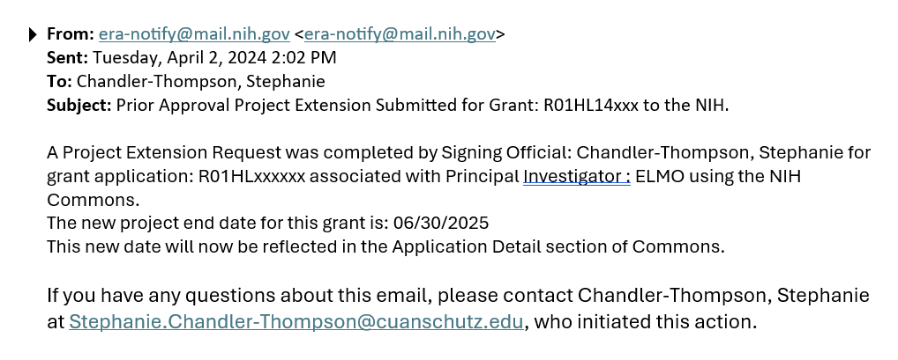
No Cost Extension (NCE) Request
Example of a 2nd/3rd NIH NCE submission notification:

Slide 16
eRA Commons-Prior Approval Module

Slide 17
No Cost Extension (NCE) Request
Non-Federal requests
All other sponsor requirements vary by the sponsor terms and conditions of those awards and should be reviewed prior to creating/submitting a NCE request. The submissions can be done via email or the sponsors portal.

Slide 18
Carryover
What is a carryover and the process?

Slide 19
What is Carryover?
Carryover is a process through which unobligated funds remaining at the end of the budget period may be carried forward to the next budget period. The carryover of funds allows the Grantees to use the unused prior year funds in the current budget period.
Grantees are allowed to carryover funds automatically if they have the expanded authority for their application for all others, Grantees need to submit a carryover request to their respective Grants Management Specialists and Program Officials who will review their request

Slide 20
NIH-Carryover Documentation Required
PI or Department Administrator prepares the carryover request and emails the request to OGC.Postaward@ucdenver.edu for processing:
Official letter requesting the reason and amount to carry forward to the new budget period
Progress report
Detailed budget for unobligated balance on PHS 398 Page 4 with PHS398 checklist page
Scientific Justification (memo format with PI signature)
SO/Postaward Administrator reviews the request documents to ensure that amount being requested is accurate.
SO submits the request to the sponsor via eRA Commons or the provided sponsor contact for non-NIH requests. The SO will copy the PI and any requested department staff on applicable email submissions. eRA Commons submissions will generate an automated email to the SO, and Principal Investigator (PI).
Sponsor reviews the request and provides notification of decision and the account is updated

Slide 21
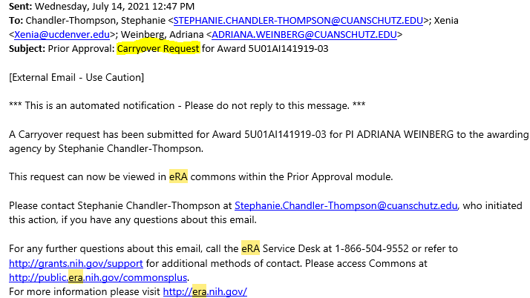
Example of a Carryover Submission Notification

Slide 22
eRA Prior Approval Module

Slide 23
2023 NCE and Carryover Statistics

Slide 24
Fiscal Year End

Slide 25
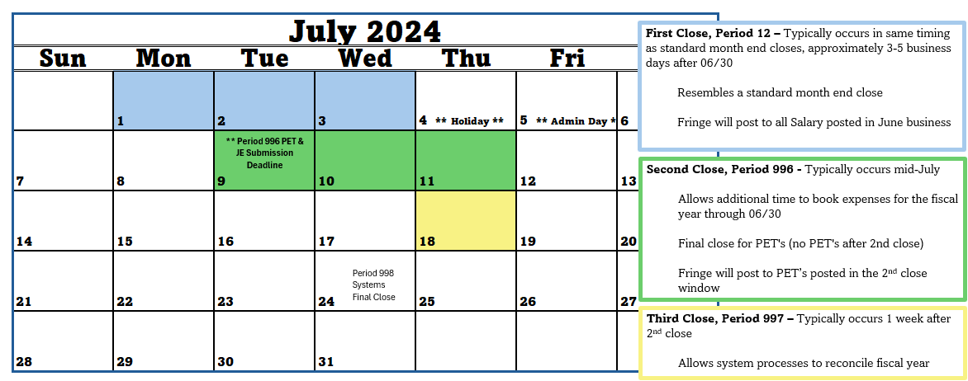
2024 Fiscal Year End Calendar

Slide 26
Preparing for Fiscal Year End
In June:
Familiarize yourself with Finance’s FY Year-End Deadlines and Memo
Coordinate with OGC pod team for deadlines
Prioritize review of projects with short deadlines
All expenses have posted and are allowable/allocable/reasonable
Confirm all vendor and subrecipient invoices are submitted timely
Ensure all JE’s and PET’s are properly documented
In July:
OGC typically begins billing after 2nd close
Exception- short-deadline Final Invoices
Final Invoice confirmation requests for all other projects will be sent after 2nd close
Historically we have 150+ projects with June end dates
Be Aware of Accruals- end-of-period adjustment that records revenue or expenses in the proper period
Ensure all JE’s and PET’s are properly documented

Slide 27
Final Invoices

Slide 28
Final Invoices
The final invoice deadline is a contractual obligation, typically 30, 45 or 60 days after the budget end date.
Contracts team will negotiate for 60 days unless sponsor will not allow
Crucial for department to closely monitor expenses for awards with short final invoice deadlines, especially at fiscal year end
Financial Detail is a great tool when reviewing expenses
Refer to 90/60/30 Day Report to monitor approaching end dates

Slide 29
Final Invoice Drafts
After the budget period end date, the OGC pod team emails a request to confirm final invoice figures after month end closes
Provides reminders and deadlines
All the allowable expenses need to be posted prior to the final invoice due date
PET’s, as needed, must post in month prior to final deadline to include fringe benefit. Fringe benefit allocation only runs at month end close.
All Unallowable expenses need to be removed one month prior to final invoice due date for the same reasons
Budget deficits must be cleared prior to final invoice deadline
We are unable to generate an accurate invoice when a cost reimbursable project is over-spent

Slide 30
Final Invoices
No Manual invoices. All the invoices must be generated from the system. This means all expenses must be posted to the general ledger prior to billing.
Last-minute invoices where all the transactions are not posted to the GL on time will not be allowed. It is VERY important all transactions are complete prior to the final invoice deadline
Exceptions can be made in rare instances and require a mutually agreed upon timeline for GL cleanup
In instances of no response and/or pending expenses, it is OGC procedure to submit the final invoice based on the current general ledger to meet the final invoice deadline. This ensures funding can be secured for all allowable expenses
It is an audit risk to invoice expenses outside of the general ledger

Slide 31
Sponsor Invoice Templates

Slide 32
Sponsor Invoice Templates
Our volume of sponsor template invoices is growing
Currently there are ~80 cost reimbursable projects monthly requiring allocation to sponsor invoice templates
Over half of these have a May or June end date
Many of these sponsors require monthly invoicing
We’re unable to combine months
Contract performance is evaluated based on timely invoice submissions
Significance of this is time requirements to complete the forms and necessity for timely submissions
Invoice templates mirror contract approved budget. Must secure prior approval if an expense will be incurred outside of the approved budget
Unlike system invoices, our team is typically unable to submit a sponsor invoice template without department confirmation of allocations

Slide 33
FFR Due Dates
Best Practice for Federal Financial Reports

Slide 34
Most Common Federal Agencies
U.S. Department of Health & Human Services (HHS)
National Science Foundation (NSF)
U.S. Department of Education (ED)
National Aeronautics and Space Administration (NASA)
*HHS has 11 operating divisions/agencies
National Institutes of Health (NIH) 27 institutes and Centers (NIDDK, NCI, NHLBI, NIAID, NCATS, NIGMS etc.)
Centers for Disease Control and Prevention (CDC)
Agency for Healthcare Research and Quality (AHRQ)
Administration for Community Living (ACL)

Slide 35
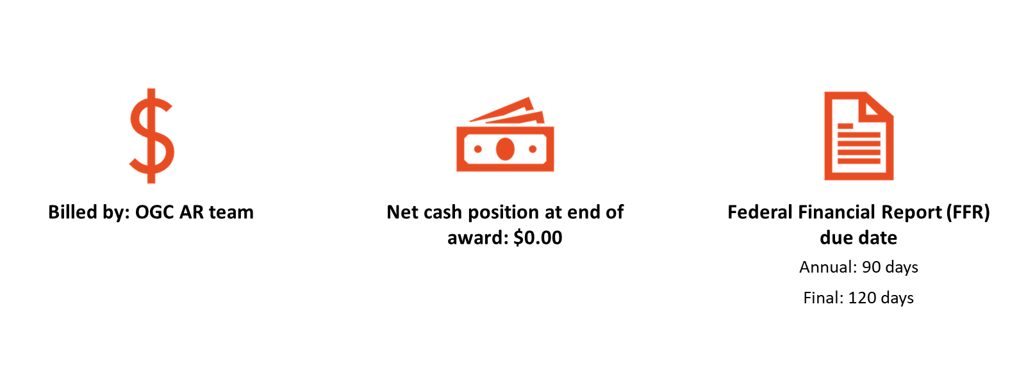
Federal Reporting Due Dates
Draw-down completed in Payment Management System (PMS), or agency portal
Payment posted within 7 days of draw-down

Slide 36
Federal Letter of Credit Best Practices for Closeout
Before End Date
Work to make sure all expenses are posted by project end date, with only exceptions posting in the end period or final subcontract invoices.
Review all Salary and make sure all PETS are completed prior to ended status. In ended status you risk meeting a final DRAW date.
If you have multiple project numbers make sure budgets and expenses are aligned. One project may be over budget and utilizing authorization from that award total in error.
Review cash position via m-FIN Trial Balance Summary and make sure prior payments have been drawn.
with FFR due at 120 days. have been drawn.

Slide 37
Federal Letter of Credit Risk/Issues
Late payroll or PETS- Late payroll posted in same month funds expire does not allow time for fringe allocations which only run at month end.
Allowing late subcontract invoices- If we hold our final for a subcontract, we may risk not being able to draw. *Note – Our Subcontract final invoice terms are typically within 60 days after our award end date.
Late expenses – Allowing late expenses to post in Ended and Reporting Status’ may not be finalized in time for regular draw process. OGC draws once per week. Expenses booked to project >90 days after end date must be coordinated with post award to ensure they are drawn before moving to expired funds.
Sponsors moving funds to expired before FFR is due- ACF, HRSA, and AHRQ cut off draws at 90 days even with FFR due at 120 days.

Slide 38
Closeouts
Do you have a Process for Reviewing your awards for Timely Closeout?

Slide 39
Agenda
What is my Project Status?
What is my Project Type?
When does my Closeout Begin?
What can I do to prepare for closeout?
Closeout Checklists: Before and After the end date

Slide 40
Project Status
30 Days
60 Days
90 Days

Slide 41
What is your Project Type?
◦ CR – Cost reimbursable awards
Billed by OGC –
Assist in following up with sponsor on outstanding invoices.
Ensure no deficits for proper and timely invoicing.
◦ LC – Letter of Credit awards
Drawn by OGC –
Ensure no deficits for proper and timely invoicing.
◦ IB – Installment Based awards
Paid/Invoiced based on a Pre-determined Schedule.
Ensure all payments are received by viewing the m-FIN Payments Received report.
◦ FR – Fixed Rate agreements
Invoiced by OGC based on Milestones/Tests/Patients or Deliverable met. *Exception Non-Federal Clinical Trial
Dept notifies POD when milestone completed.
Ensure all payments are received by viewing the m-FIN Payments Received report.
◦ HY – Hybrid agreements
This type encompasses awards with both a CR and FR component.
Work with your POD to ensure that the CR and FR are both up to date in your Monthly meetings.

Slide 42
Cost Reimbursable Closeout - Best Practices
Before End Date – GM 01 Report
90 Days
Know your final invoice due date
Do you need and Extension?
Reconcile and Post All Operating Expenses
Reconcile and Post all Salary prior to ended (E) status.
Review cash position via Summary Trial Balance and Billing Inquiry (via PS query) to make sure invoices to date have been paid.
60 Days
Complete 90 Day tasks
Ensure all Equipment has been incurred
30Days
Complete 90 Day tasks
Request Pre-activation for subsequent year
Clear all Deficits
Ensure all Subcontracts are received and submitted for payment
After End Date GM 02/03 Report
Close all encumbrances
Close all AR/AP items
Work with your OGC POD to review and approve Final Invoice Draft before due date.
Review EPERS by Project Report in CU Data to ensure all available Epers have been certified.
Follow up on final invoices to ensure invoice is received and paid promptly.
See Closeout Checklist for Full detailed information. LINK

Slide 43
Letter of Credit (LC) Closeout - Best Practices
Before End Date – GM 01 Report
90 Days
Know your final report due date
Do you need and Extension?
Reconcile and Post All Operating Expenses
Reconcile and Post all Salary prior to ended (E) status.
Review cash position via Summary Trial Balance and Billing Inquiry (via PS query) to make sure invoices to date have been paid.
60 Days
Complete 90 Day tasks
Ensure all Equipment has been incurred
30Days
Complete 90 Day tasks
Request Pre-activation for subsequent year
Clear all Deficits
Ensure all Subcontracts are received and submitted for payment
After End Date GM 02/03 Report
Close all encumbrances
Close all AR/AP items
Work with your OGC POD to review and approve Final Report Draft before due date.
Review EPERS by Project Report in CU Data to ensure all available Epers have been certified.
Follow up on final invoices to ensure invoice is received and paid promptly.
See Closeout Checklist for Full detailed information. LINK

Slide 44
Installment Based (IB) Closeout - Best Practices
Before End Date – GM 01 Report
90 Days
Know your final report due date
Do you need and Extension?
Reconcile and Post All Operating Expenses
Reconcile and Post all Salary prior to ended (E) status.
Review cash position via Summary Trial Balance and Billing Inquiry (via PS query) to make sure invoices to date have been paid.
60 Days
Complete 90 Day tasks
Ensure all Equipment has been incurred
30Days
Complete 90 Day tasks
Request Pre-activation for subsequent year
Clear all Deficits
Ensure all Subcontracts are received and submitted for payment
Project future expenses to understand if you will have a cash balance at end of project for refund.
After End Date – GM02/03 Report
Work with your POD to ensure all expenses are complete and final report ready to go by due date including subcontracts.
Ensure Final Progress reports are submitted.
If you are in deficit, remove deficit prior to report deadline.
If you have a positive cash position to resolve
Initiate communication with your POD to:
Return funds
Carryforward funds
Request Small Residual Retention from Sponsor
Review EPERS by Project Report in CU Data to ensure all available Epers have been certified.

Slide 45
Fixed Rate (FR) Closeout - Best Practices
Before End Date – GM 01 Report
90 Days
Know your project end date
Note Not all Fixed Rate Awards have a due date. Notify your POD when study is complete.
Do you have an end date? Do you need and Extension?
Reconcile and Post All Operating Expenses
Reconcile and Post all Salary prior to ended (E) status.
Review cash position via Summary Trial Balance and Billing Inquiry (via PS query) to make sure invoices to date have been paid.
60 Days
Complete 90 Day tasks
Ensure all Equipment has been incurred
30Days
Complete 90 Day tasks
Request Pre-activation for subsequent year
Clear all Deficits
Ensure all Subcontracts are received and submitted for payment
Project future expenses to understand if you will have a cash balance at end of project to submit your request to close form to your POD.
After End Date
Close All encumbrances
Close all AR/AP items
All reports and outcomes are submitted
Review EPERS by Project Report in CU Data to ensure all available Epers have been certified.
All Payments have been received
Initiate closeout with your POD by submitting the Request to Close Form in a timely manner to move any cash balances.

Slide 46
Summary - Best Practices for Closeout
Review cash balance frequently – Recommended Monthly (m-Fin TBS/ Operating Summary)
Review expenditures regularly and submit cost transfers in a timely manner
All PETs should be completed within 30 days after the project end date. As a general practice salary should be reviewed and corrected within 90 days of a pay period date.
Meet with your Post Award Administrator on a regular basis - Recommended Monthly
Know your Due Dates – Invoice, Financial Report, and Project/ST Closeouts all have due dates

Slide 47
Summary - Closeout Tools
Monthly report burst to the GACT and GADM on the project.
GM01 Report BEFORE END DATE
GM02 and GM03 Report AFTER END DATE
CU Data Reports
Trial Balance Summary
Payments Received Report
EPERS status by Project CU Data
People Soft Query
Billing Inquiry by Project
Website
https://research.cuanschutz.edu/ogc/home/ogc-teams/post-award/closeout-procedures

Slide 48
Questions

Slide 49
Thank You for Attending
Todays Presenters in order of Presentation....
Koffi Gnatsidji
Stephanie Chandler-Thompson
Julie Burger
Margaux Johnson
Brittany Vits

