Slide 1
Postaward Updates
May 19th 2025

Slide 2
Agenda
NIH Update for NCE Requests
NIH Closeout Policy Reminder
Closeout of Sponsored Speedtypes/Projects
HHS and Other Sponsor Payment Request Update
Terminations and Final Payment/FFR

Slide 3
Updated NIH Processes for No-Cost Extensions
This notice alerts the extramural community that NIH has temporarily disabled the No-Cost Extension functionality in eRA Commons. The Director of NIH has directed NIH staff to review all existing grants and cooperative agreements to ensure that NIH awards do not fund off-mission activities or projects. Therefore, temporarily disabling the NCE functionality in eRA Commons will allow NIH staff to review and assess all NCE requests to confirm that the activities proposed during the extension align with the NIH mission and agency priorities.
At this time, all requests for NCEs must be submitted as a prior approval request in eRA Commons, by OGC Signing Official (SO) for NIH review and approval. Requests for activities that do not align with the NIH mission and agency priorities will not be approved.
https://grants.nih.gov/grants/guide/notice-files/NOT-OD-25-110.html
We are requesting that the process begins between 90 and 60 business days prior to the end of the project period.

Slide 4
Prior Approval Process
1st No Cost Extension (NCE) - Update
Currently both the 1st and 2nd No Cost Extension requests need to be submitted as a Prior approval NCE. Previously this was only required for 2nd NCE.
https://research.cuanschutz.edu/ogc/home/ogc-teams/award-set-up/no-cost-extensions
  Progress Report that covers last year of work
  Scientific Justification on need for NCE on dept/school
  Budget for NCE
  In the Email:
    How many months being requested
    Is the PI maintaining measurable effort
    Last IRB/IACUC approval
Please continue to send your request with the above documents to the OGC.Postaward@ucdenver.edu

Slide 5
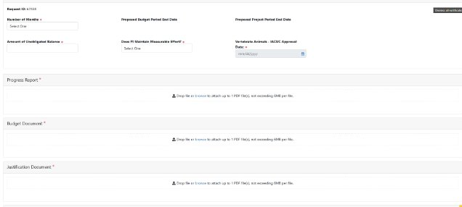
NCE Prior Approval Module

Slide 6
NIH Award Closeout - Policy
NIH mandate to process closeouts in timely manner on NIH Segment.
NIH policy has long indicated closeout at 120 days from end date. They began releasing notices regarding closeout timelines in 2017 to enforce 120 day closeout (NOT-OD-24-055)
  NIH is committed to addressing and reducing grant closeout delays and to enhance compliance with Federal regulations and NIH policies.
  NIH will strictly enforce its closeout policies.
  When recipients fail to submit timely reports, NIH will initiate unilateral closeout. If a recipient does not submit all required closeout reports within a year of the period of performance end date, NIH will unilaterally close the award and report the recipient's failure to comply with the terms and conditions of award in SAM.gov.
  Failure to correct recurring reporting problems may cause NIH to take one or more actions that may include, but are not limited to, per Section 8.5.2 of the NIH GPS.
    Corrective actions
    Withholding of further awards
    Suspension
    Termination

Slide 7
NIH Award Closeout - Impact
NIH mandate to process closeouts in timely manner on NIH Segment.
  Late expenses –
  Allowing late expenses to post in Reporting Status’ may not be finalized in time for regular draw process.
  Expenses booked to project >90 days after end date must be a unique occurrence and must be coordinated with your OGC POD.
      Payment requests are at risk and payment may not be granted.
    Expenses booked to project > 120 days will not be able to be requested for payment due to expired funds.
  Late payroll or PETS -
      When late payroll posts in same month that funds expire i.e.>90 days after the end date, this does not allow time for fringe allocations to post for reporting. Fringe allocations only run at month end close.
        Department will have to cover all fringe allocations for salary booked in same period the FFR is due if an exception is made to allow the late PET charges.
  Late Subcontract invoices -
    If we allow a hold on our FFR for a subcontract, we may risk not being able to draw.
      Our Subcontract final invoice terms are typically within 60 days after our award end date.
      It is the responsibility of the PI dept to ensure invoices are received and paid by 90 days after the end date to ensure we can request payment for the expense.
  HHS direct awards cuts off draws at 90 days even with FFR due at 120 days. FFR due at 120 days.
  Sponsors with shorter FFR deadlines will be result in funds moving to expired sooner.

Slide 8
Timely Closing of Sponsored Project Speedtypes
GM01 GM 02 and GM03 Grant Management Reports
  Closeout begins 90/60/30 Days prior to end date
  Reporting begins 30/60/90 Days After the end date
    The GM reports provide details on the General ledger for Departments to reconcile for Reporting and Closeout.
Roles and Responsibilities
  It is the responsibility of the Department to prepare the sponsored ST for closeout
    The Closeout Checklist provides details on what is needed to properly closeout the Speedtype in a timely manner.
      Closeout Checklist
DFA Communications on Past due Closeout numbers
  Past due is defined as projects over 180 days after end date and not yet closed
  Koffi will be reaching out to communicate and work on past due closeouts.
  Prepare a plan to share on how to cover deficits
Closeout Web page
Closeout Policy Link

Slide 9
HHS Payment Request (LOC Draw)- Update
Implemented based on Executive Order 1422
Implementing the President’s Executive Order- DOGE "Department of Government Efficiency" Cost Efficiency Initiative, a new process has been created to enhance transparency and accountability for federal funding.
As of March 17th, the Payment Management System (PMS) has introduced a new, mandatory payment justification field on the payment request screen. Justifications should include a brief description of how the requested funds were/will be used. The agency will review these justifications to assess whether costs are reasonable and appropriate. If more information is needed, OGC receives a message from DefendTheSpend@hhs.gov requesting clarification; the specific information being requested will be available after clicking through the link in the message.
Payment justifications may be made public. For this reason, we recommend discussing activities at a high level of generality and in a manner to protect personally identifiable, sensitive, or proprietary data or information.

Slide 10
HHS Payment Request (LOC Draw)- Impact
1000 Characters field for Payment Request Justification
    We are now required to provide a justification for each award we are drawing for in a mandatory 1,000-character comment field. If further clarification is required, we will receive and email from “Defend the Spend” which will require we submit additional details via a link to the doge.gov website.
Based on Agency we may be required to provide:
    Program title
    Claim period for the expenses
    Expense Summary by budget category
    Justifications for Expenses included in Payment Request
    Increased requirements for CDC who also require Federal Opportunity Number and A Justification by expense category.
    NIH, AHRQ are requiring only a justification comment and are not requiring a summary at this time, however we expect each agency to adjust requirements.
Due to the new requirements the timing of the draws may are impacted.
  These agencies are now being drawn monthly, this started in April for most and will start for NIH in May.
  We are also seeing large delays in HHS/NIH draws. Payment request to receipt has been taking 2-3 weeks for the last mass draw requests.

Slide 11
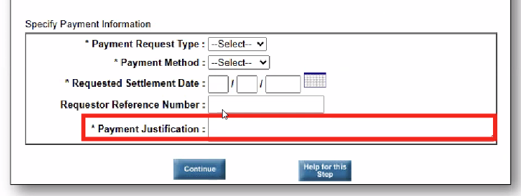
Other Sponsors - Payment Requests
Automated Standard Application for Payments (ASAP)
    Bureau of Land Management (BLM)
    Department of Energy (DOE)
    Department of Justice (DOJ)
    Department of Interior (DOI)
    US Geological Survey (USGS)
    Economic Development Administration
    National Institute of Standard (NIST)
    National Park Service (NPS)
    Joint Fire Science Program
  University Impact
    Effective Monday, May 19, 2025, all payment requests submitted in ASAP.gov require a justification.
    This field is mandatory and will be required in the first step of the payment request process.
    This new field will allow you to submit a justification that is no longer than 300 characters.
    OGC may reach out to obtain payment justification from department partners.

Slide 12
Terminations - NIH
Work with OPERA (Office of Policy for Extramural Research Administration) on Final Draws
Recipients are required to request approval from OPERA before any draw that occurs after the termination. The request must include details related to human subjects or animal welfare and provide supporting documentation. These are the only approvals that will be issued. After approval is issued, the recipient can request the drawdown in PMS. Note: Any other costs that are not related to human subject protection or animal welfare will not be approved. No exceptions.
For costs incurred on or before the date of the termination, as well as approved closeout costs, with supporting documentation, OPERA will work with PMS to lift the restriction as appropriate.
When recipients draw funds in PMS, they normally request funds from multiple awards within a single draw request. For awards terminated as a result of agency priorities and HHS authorities, recipients cannot request funds from multiple awards within a single draw request. Each draw request must contain only one terminated award.
Prepare to provide financial details for final draws and justification for all expenses.

Slide 13
TERMINATIONS – NSF
30 Days
  Notification: NSF sends a termination email for an award to the awardee institution. This is the email that says: “In accordance with your award terms and conditions, you have 30 days from the termination date to furnish a summary of progress under the award and an itemized accounting of allowable costs…”
  Action: Working with your SRO/AOR, there are 30 days to drawdown, providing an itemized accounting of allowable costs. Email these to dgafinalcosts@nsf.gov. See FAQ 14. The language “summary of progress” is related to the financial drawdown. See PAPPG 24-1 p. XII-1, for context and check with your SRO. Note that the “summary of progress” is not the Final Report on award activities.

Slide 14
QUESTIONS?
Presented by
Ginger Acierno
Margaux Johnson
Brittany Vits

