Slide 1
RAIN Meeting
February 20, 2020
Agenda:
RAIN Updates
Updates to 2 CFR 200, Subcontracts Process Updates, RAWC/training updates
COMIRB – Critical Knowledge

Slide 2
RAIN Core Objectives
Share
Best practices and procedures.
Job-related educational opportunities and resources to enhance University-wide knowledge base.
Facilitate
Communication among Research Administrators and stakeholders.
Build a Community for Research Administrators

Slide 3
RAIN Steering Committee
Teresa Cochran - ACCORDS
Michelle Haynes – College of Architecture & Planning, UCD Downtown Campus
Kaitlynn O’Leary – Department of Pharmacology
Brittany Vits – Office of Grants and Contracts
Natalie Buys – Department of Family Medicine
2 OPEN SPOTS – (Apply by FEBRUARY 28, 2020)

Slide 4
2019 Accomplishments
Cohosted OGC Open House
RAIN added to the OGC website
Listserv Implemented (RAIN@lists.ucdenver.edu) – 251 subscribers and growing!
RAIN Logo

Slide 5
2020 Goals
Find effective way to ensure all research administrators on the Anschutz Campus are aware of RAIN.
Work with the downtown campus to expand knowledge of RAIN and increase participation.
Expand knowledge of RAIN more broadly to leadership on the Anschutz Campus.
Host networking opportunities.
SUGGESTIONS?

Slide 6
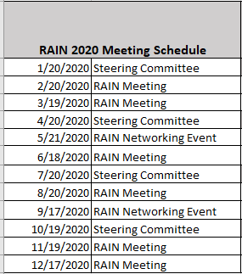
2020 Schedule
6 Regular Meetings
2 Networking Events
4 Steering Committee Meetings

Slide 7
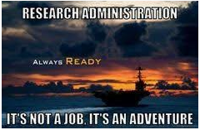
Questions?
Thank you for all of your support!
Contact Natalie.Buys@cuanschutz.edu with ideas/suggestions

