Slide 1
NSF Graduate Research Fellowship Program
Ryan Holland
Director
PreAward and Contracting Services

Slide 2
Agenda
Proposal Preparation in Fastlane
Proposal Routing Requirements
www.fastlane.nsf.gov
Notes:
- DOD proposal instructions tend to be very literal

Slide 4
Notes:
- View and edit all pre‐applications, full applications, and associated files for their organization, along with post
award responsibilities associated with funded applications.
- Manage Organization Affiliates to view details of all active affiliates, manage user requests for affiliation, and
invite/deactivate users to affiliate with their organization.
- We require AORs approve affiliation requests
- To serve as alternate submitter, must be registered as a Principal Investigator and named in pre‐application
contacts as the alternate submitter

Slide 5
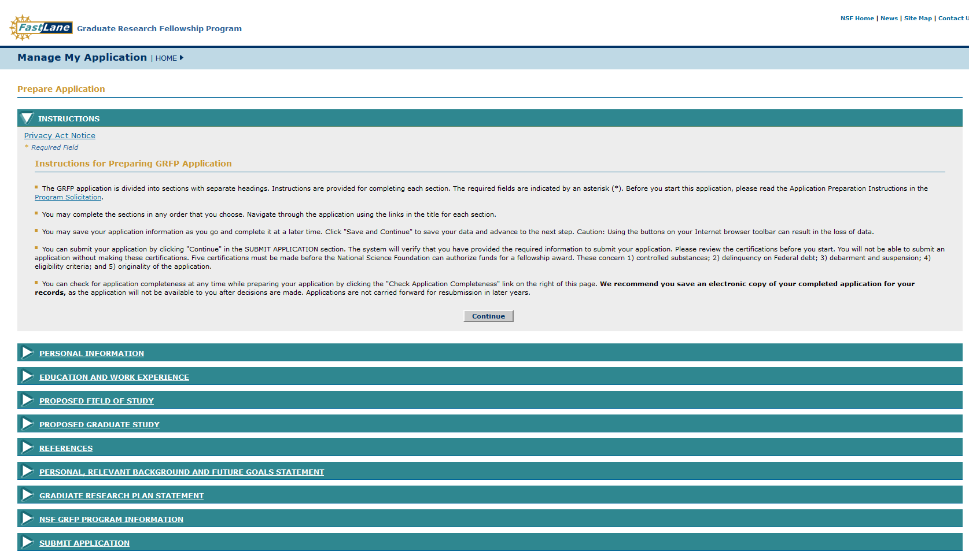

Slide 6
Key Information
Personal Information Tab
- Enter personal information here.
- Use department mailing address
Education and Work Experience
-Be sure to select the correct Institution
-Search University of Colorado at Denver
- Org ID 0001289000

Slide 7
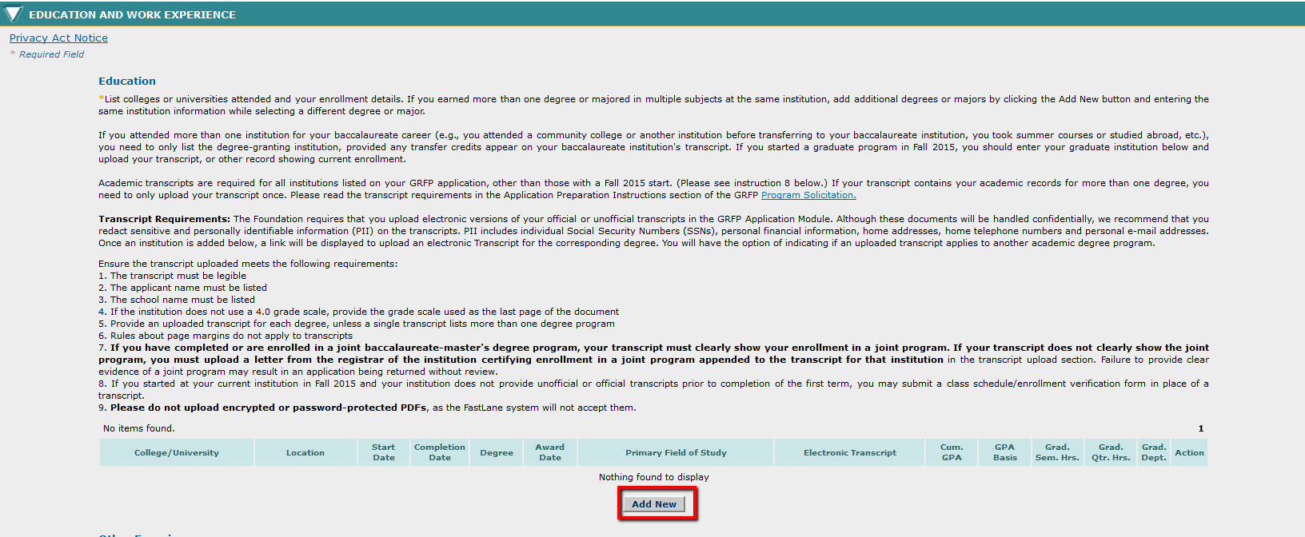
Notes:
Review OGC website for full notes

Slide 8
Notes:
See eBRAP User Guide pages 20-26

Slide 9
Key Information
Proposed Field of Study
- Enter field of study that applies to your application
Proposed Graduate Study
-Select University of Colorado at Denver
Reference
-Add Reference List and Contact Info
- References will receive notification to submit reference letter

Slide 10
Key Information
Personal, Relevant Background and Future Goals Statement
- Follow checklist located under tab
- 3 page limit
Graduate Research Plan Statement
- Follow checklist located under tab
- 2 page limit
NSF GRFP Program Information
- Add Academic Advisor

Slide 11
Submit Application via FastLane
Applications do not require submission by OGC
Fellow can submit on their own behalf
Once submitted to NSF there will be no more opportunities for application revisions

Slide 12
Route Application via InfoEd
https://era.cu.edu/
Application should be received by OGC 5 full business days prior to applicable deadline.
With the assistance of your department grants administrator route you application via InfoEd
Download and attach PDF copy of application to InfoEd file

