Slide 1
Types of NIH Submission Systems
Jenna
PreAward Specialist
And
Garrett Steed PreAward Manager

Slide 2
NIH Submissions:
Changed/Corrected Applications
ASSIST and ASSIST HSCT
RPPRs
I-RPPRs
Close out (F-RPPR, FIS, FFR)
PRAMS/FRAMS
Notes:
Jenna Slide

Slide 3
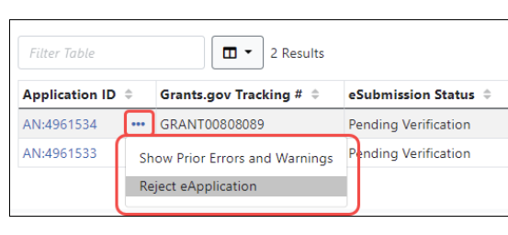
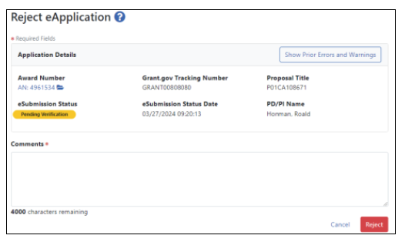
When Is A Changed/Corrected Application Used?
Changed/corrected applications are most often submitted to correct errors and/or warnings listed in eRA Commons and can also be used to address other issues (e.g., discovered wrong version of an attachment was used).
Changes/Corrections to applications ideally should be made within the two-business-day application viewing window.
If you decide to make additional changes within this window, you must reject your application if the title or PI change and then submit a changed/corrected application.
SOs can request to reject the eSubmission of an application using the Reject eApplication screen.
Only signing officials have this option, and the application must not have been previously verified or rejected by the SO.
Notes:
Jenna’s Slide

Slide 4
Two-Day Review Window
Application Viewing Window:
The PD/PI, delegated Assistants, Administrative Officials (AOs) and Signing Officials (SOs) have 2 business days to view the assembled application in eRA Commons - just as a reviewer would see it.
The application viewing window is linked to the time of submission, not the due date. It begins the day after the assembled application image is posted in eRA Commons and excludes weekends and Federal holidays.
Outside the two-day review window, but before the deadline, proposals will need to be rejected from eRA Commons before they can be resubmitted.
Notes:
Jenna’s Slide

Slide 5
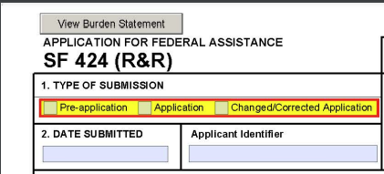
How To Select:
Notes:
Jenna’s Slide

Slide 6
Proposal Submission
Changed/Corrected vs Resubmission
What is the difference?
A "Changed/Corrected Application" submitted if the eRA systems have already processed the application and edits need to be made.
A resubmission is an unfunded application that has been modified following initial review and resubmitted for consideration.
Notes:
Jenna’s Slide

Slide 7
ASSIST and ASSIST HSCT
What are the differences what is in common
What is ASSIT HSCT
What can the AOR do for ASSIST and ASSIST HSCT
When to do you do your ASSIT HSCT Submission

Slide 8
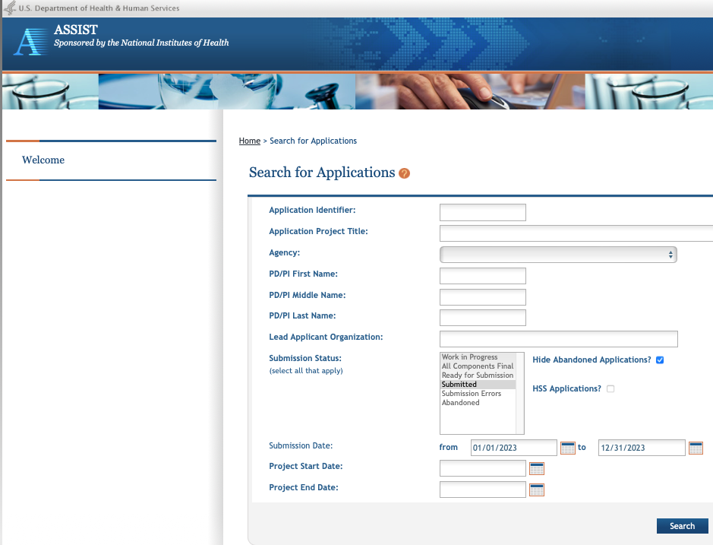
ASSIST and ASSIST HSCT: differences vs in common
ASSIST HSCT is for submission of human subject data to NIH during the RPPR process
ASSIST is for submission of proposal to the NIH during the application phase
Both system share the same back-end architecture, but ASSIST HSCT does NOT submit via grants.gov
Last year OGC summitted about 300 ASSIST & HSS submissions

Slide 9
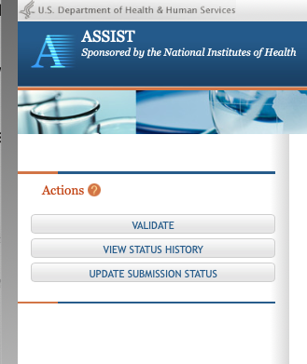
ASSIST
AOR at the applicant institution can
Manage application access for other users
Manage application status all the way to Ready for Submission status

Slide 10
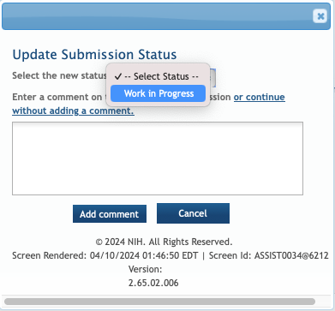
ASSIST
AOR at the applicant institution can
Delegate Access Maintainer and Status Maintainer authority to other users within CU Denver | AMC
Access the Submit action, Update the status to Work In Process
ASSIST NIH Online Help: https://www.era.nih.gov/erahelp/ASSIST/Content/About_Help_System_ASSIST.htm

Slide 11
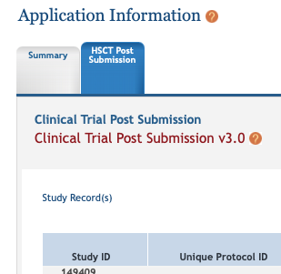
ASSIST HSCT: What is HSCT
What is ASSIST HSCT: The ASSIST HSCT - HSS system is a shared system that enables grant recipients to electronically report and update their data on human subjects and clinical trials to NIH; and for NIH agency staff to monitor and manage the data
The ASSIST HSCT is automatically populated by human subjects and clinical trial data entered by the principal investigator (PI) on the Human Subjects and Clinical Trial Information form in applications

Slide 12
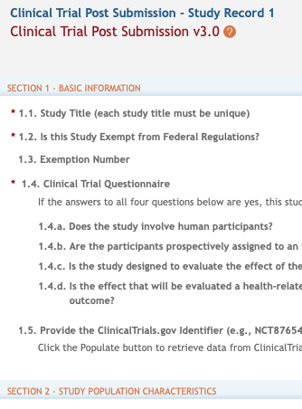
ASSIST HSCT: what can we do?
The UC Denver | AMC team can
Add/update study information
Create new enrollment reports or view/edit/update existing enrollment data
Make off-cycle corrections or updates after application or Research Performance Progress Report (RPPR) submission
Convert a delayed onset study to a full study record, once detailed study information is available
Provide interim data as requested by NIH staff, in the funding opportunity announcement, or in the terms and conditions of award
AORs can mark a record and WIP and resubmit

Slide 13
ASSIST HSCT: What Can the NIH Do
For NIH staff:
Depending on their roles and privileges, NIH staff can use the Human Subjects System to:
View and compare study records
For networked awards, associate projects to allow one primary project to report study information for other projects within the network
Receive notifications
Make corrections to study-level codes
Delete duplicate or unfunded studies

Slide 14
ASSIST HSCT - HSS
HSS is used to view and maintain human subjects data, including inclusion and clinical
trial data, associated with your grant(s). HSS can be accessed in one of two ways, both
through the eRA Commons system: via the Status module –or– via the RPPR Section G.
Special Reporting Requirements.

Slide 15
When should I submit my HSCT Record
Before or after RPPR
RPPR validation takes into account issues and errors on the HSCT record.

Slide 16
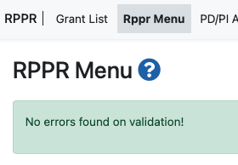
Research Performance Progress Report (RPPR) :
What is an RPPR?
The is the progress report form used by grantees to submit progress reports to NIH.
The RPPR documents grantee/recipient accomplishments and compliance with the terms of the award.
There are three types of RPPRs, all of which use the NIH RPPR Instruction Guide: the Annual RPPR, the Final RPPR and the Interim RPPR
Once an RPPR is submitted it cannot be unsubmitted unlike the ASSIST and ASSIST HSCT system.
When are they due (First and Fifteenth)?
Notes:
Jenna’s Slide

Slide 17
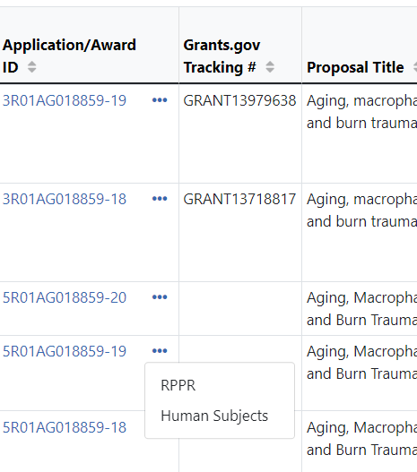
How and When You Can Submit:
How:
The Annual and Interim RPPR links can be accessed through the Commons Status tab.
When:
The Interim RPPR link will appear one day after the project segment end date, but before it has moved to closeout.
The Final RPPR link will become available through the closeout module once the grant is eligible for closeout.

Slide 18
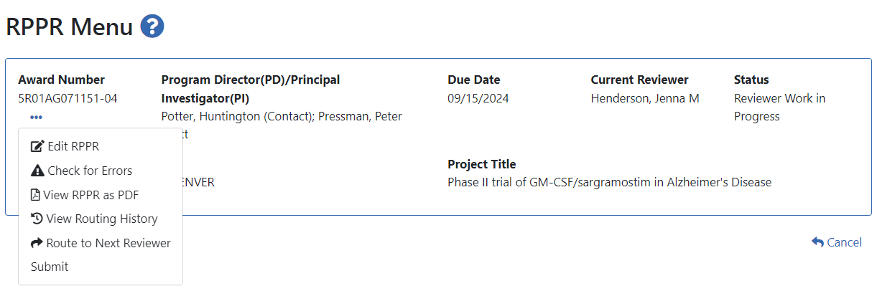
When Can We Review, Route, and Submit?
We have limited capabilities with the RPPR functions in Commons:
Only the project PD/PI or their PD/PI delegate can initiate RPPRs in eRA Commons.
We can recall the RPPR from another Reviewer/AOR to review and/or submit but we cannot recall an RPPR from the PD/PI before it is assigned to us.
We can only submit an RPPR once it has been routed to an AOR.

Slide 19
After Submission:
After Submission, we can only view the status of an RPPR.

Slide 20
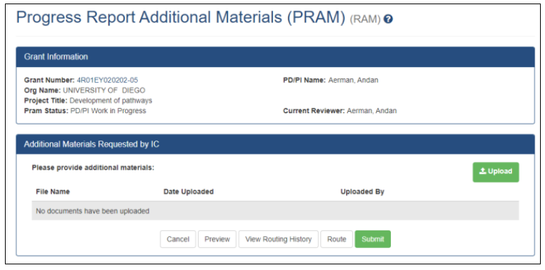
PRAM
What is a PRAM?
Progress Report Additional Materials (PRAM) is often sent to resolve follow up questions on RPPR materials or when there are non-compliant publications
Notes:
Jenna’s slide

Slide 21
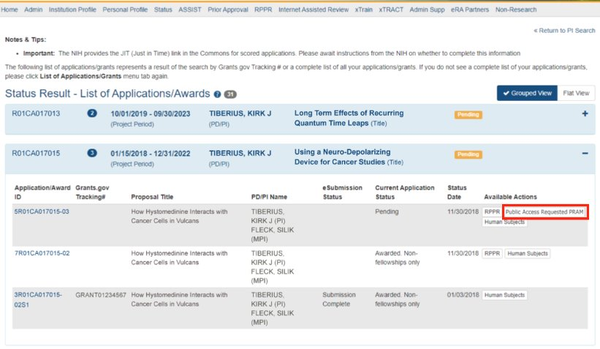
Who Can Submit a PRAM?
When the PRAM is in Reviewer Work in Progress status, the signing official (SO) can submit it to the agency.
PD/PIs may also submit the information if they have been delegated Submit Progress Report authority by the SO. Otherwise, they would have to route it to the SO for submission.

Slide 22
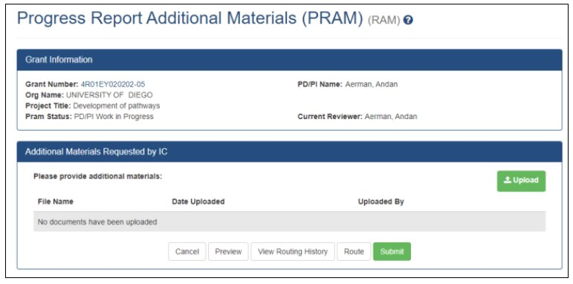
How to Submit a PRAM:
To submit a PRAM, use the Status module to search for an award, select Agency Requested PRAM from the three-dot ellipsis menu or Action column, upload the requested materials, and then click the Submit button.

Slide 23
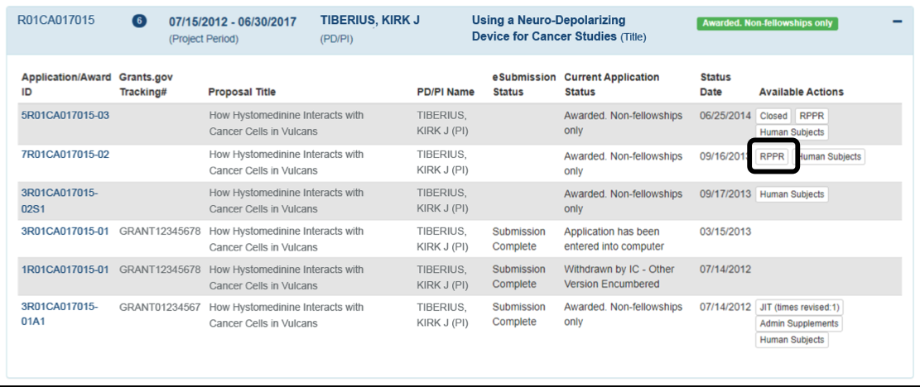
I-RPPRs
What is an I-RPPR: Interim RPPR – The interim RPPR is used when a competing renewal (Type 2 application) has been submitted.
When do they occur: If the competing renewal is not funded, the Interim RPPR will serve as the Final RPPR for the project and no other report is required.
If the renewal application is funded, the Interim RPPR will serve as the annual RPPR for the final year of the previous competitive segment.
What can an AOR do: we are limited to the same functions as an RPPR we rely on the PD/PI or their delegate to initiate this function.

Slide 24
Close Out
Final-RPPR (F-RPPR)
Final Invention Statement (FIS)
Final Financial Report (FFR)
Final Progress Report Additional Materials (FRAM)

Slide 25
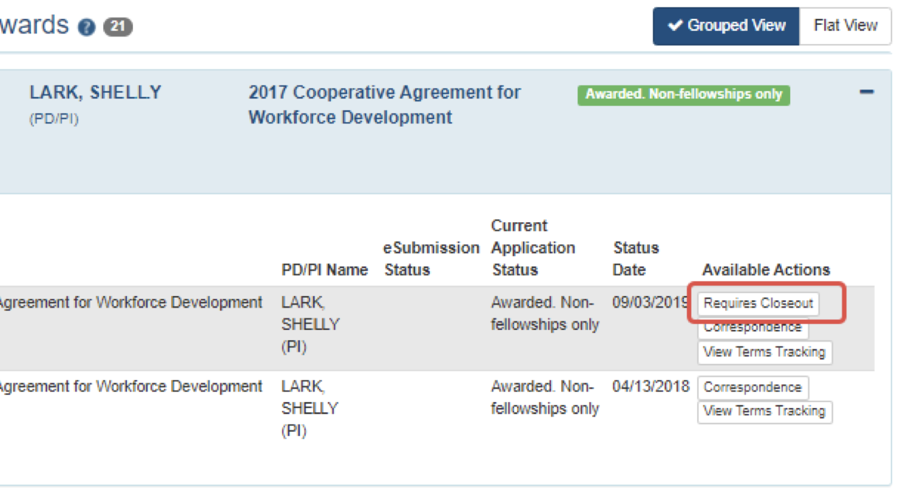
F-RPPR and FIS
The Final RPPR, FIS and FFR are used as part of the grant closeout process to submit project outcomes.
They are due 120 days from period of performance end date for the competitive segment.
The department and PI holds the primary responsibility for entering information into the F-RPPR, and FIS forms in eRA Commons and then routing to OGC for submission. The FFR is handled by OGC Post Award.
The Final RPPR is initiated by the PI or Deligate and routed to an AOR
The FIS can be initiated by OGC with an approving email from the department, but it is more correct to begin with the department.

Slide 26
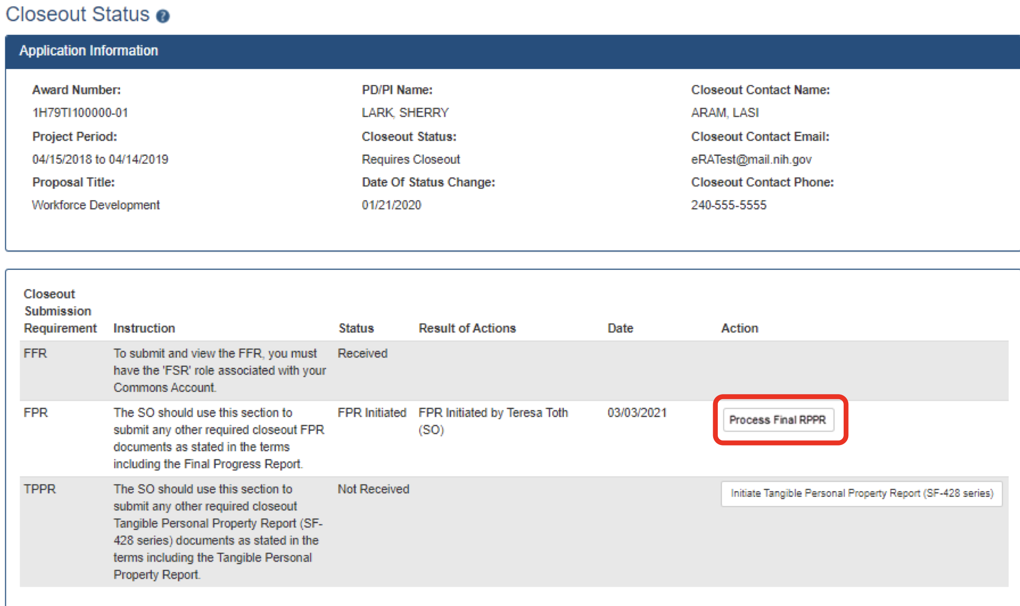
F-RPPR and FIS
The Final RPPR is only available as part of the Closeout process and the Process Final RPPR link only
appears on the Closeout Status screen.

Slide 27
Close out: Final Financial Report
They are due 120 days from period of performance end date for the competitive segment.
Submitted by OGC with data from the Department
Submitted via PMS

Slide 28
Close out: FRAM
While reviewing a submitted Final RPPR, the PO might determine that additional materials related to the submitted report are required. In this case, the PO submits a request for this information referred to as a FRAM request.
Final Progress Report Additional Materials (FRAM) link provides a means for awardees to enter, review, route, and submit information in response to specific request(s) by the Program Official (PO) for additional information related to the Final RPPR
Only a AOR can submit the report; the PD/PI can upload, preview, delete and save the closeout report submission package, but cannot complete the final step to submit.
When a FRAM request is made, the PI is notified via email; Final RPPR status on Closeout Status is updated to FRAM Requested; and a FRAM Update link appears in the Closeout Status screen.
The link is located as an action on the Final RPPR Report line for Closeout Submission Requirement.

Slide 29
Questions?

