Slide 1
Finding Funding Opportunities

Slide 2
SPIN – Sponsored Projects Information Network
Searchable database for federal and non-federal sponsors
Accessible through InfoED
Advantages of SPIN:
Many, many ways to search
Save searches
Create funding alert notices

Slide 3
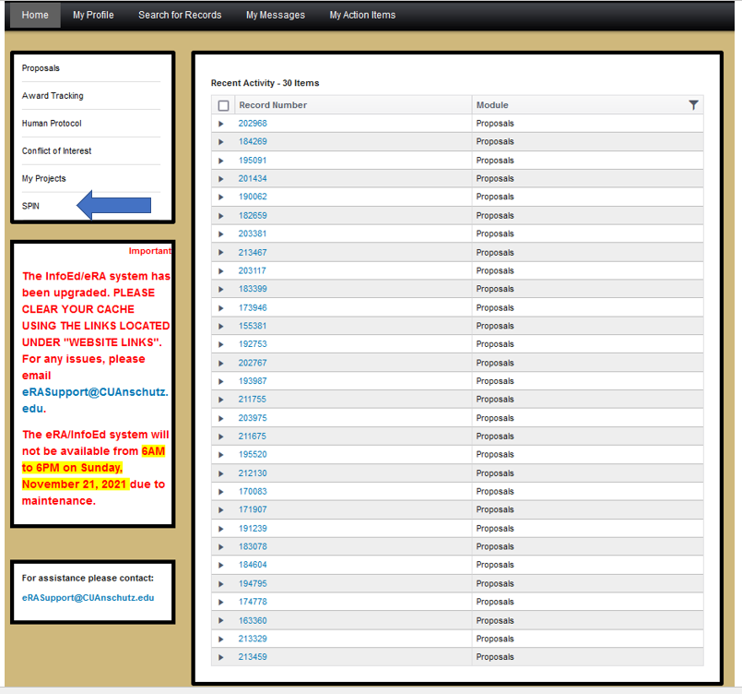

Slide 5
Types of Searchers
Text Search
Basic function as a search engine
Keyword Search
Select from a proprietary list of keywords to perform search
Advanced Search
Multiple options to tailor a search
Pre-Populated Searches
Search by a pre-determined selection from SPIN

Slide 6
Note: Skip the Federal Register

Slide 7
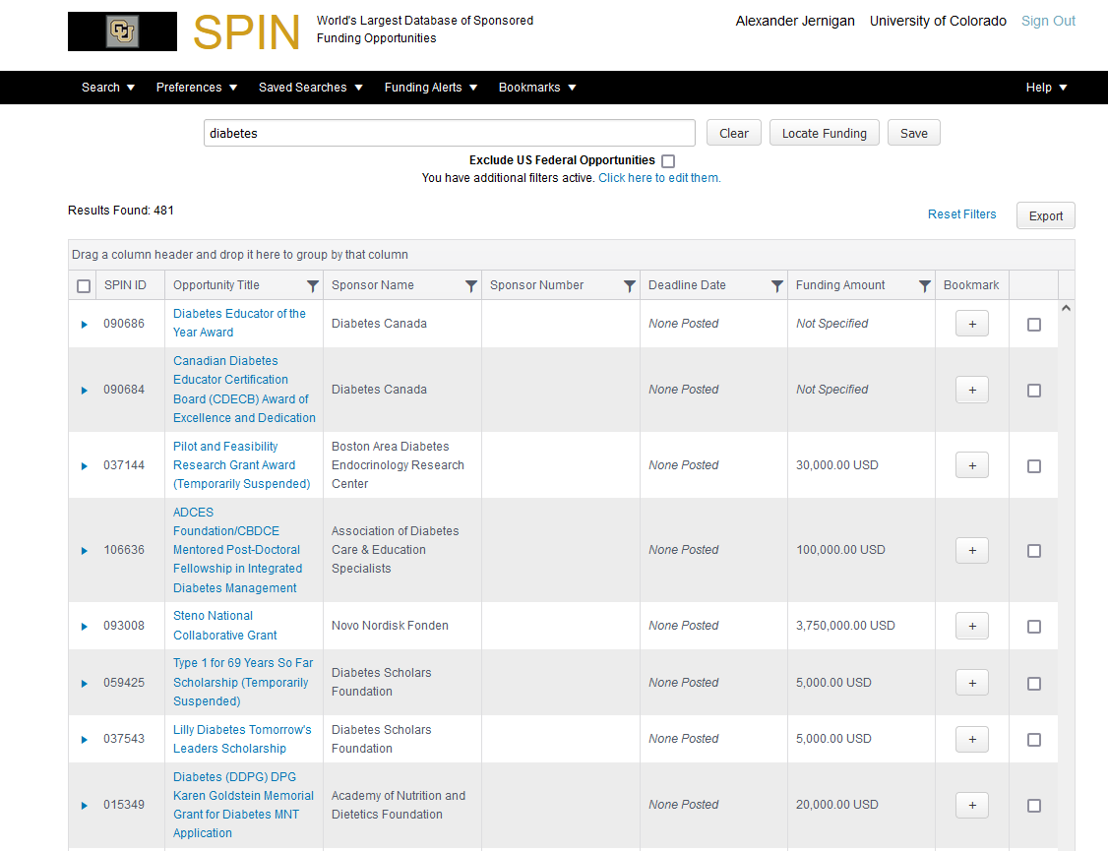
Text Search

Slide 8
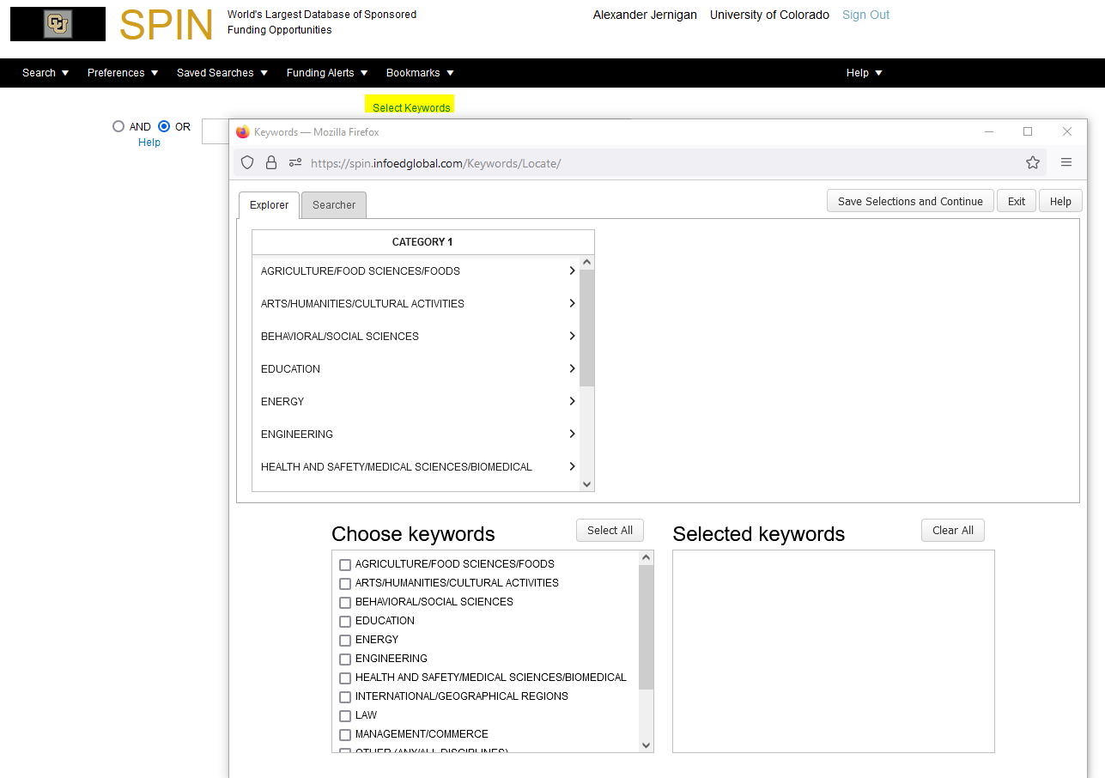
Keyword Search
Click “Select Keywords” first
From the pop-up window, select your keywords

Slide 9
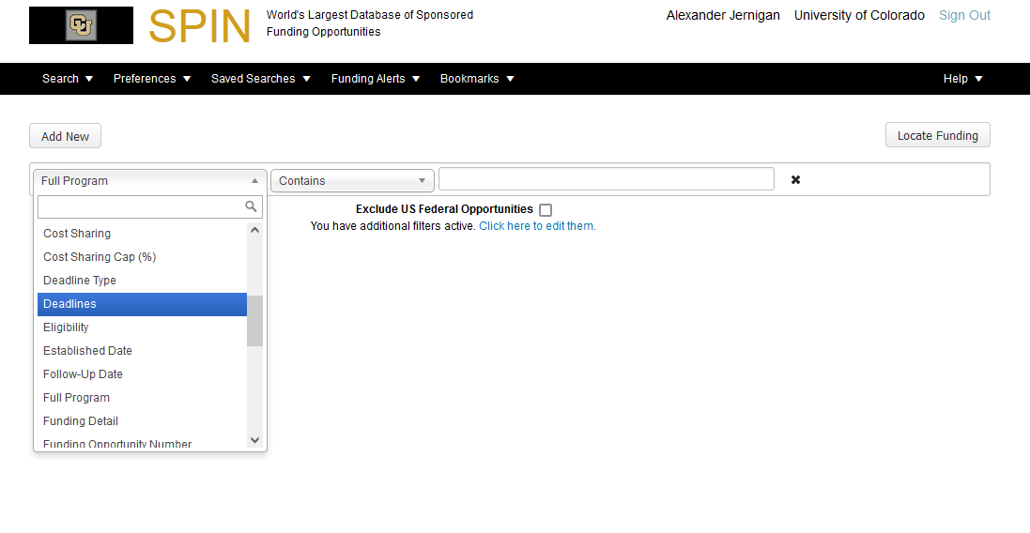
Advanced Search

Slide 10
Additional Features
Select and Save Preferences
Save Searches
Create Funding Alerts
Bookmark Funding Opportunities

Slide 11
Other Resources for Federal Funding Opportunities
Federal Grants
Grants.gov
Agency websites
Federal Contracts
SAM.gov

Slide 12
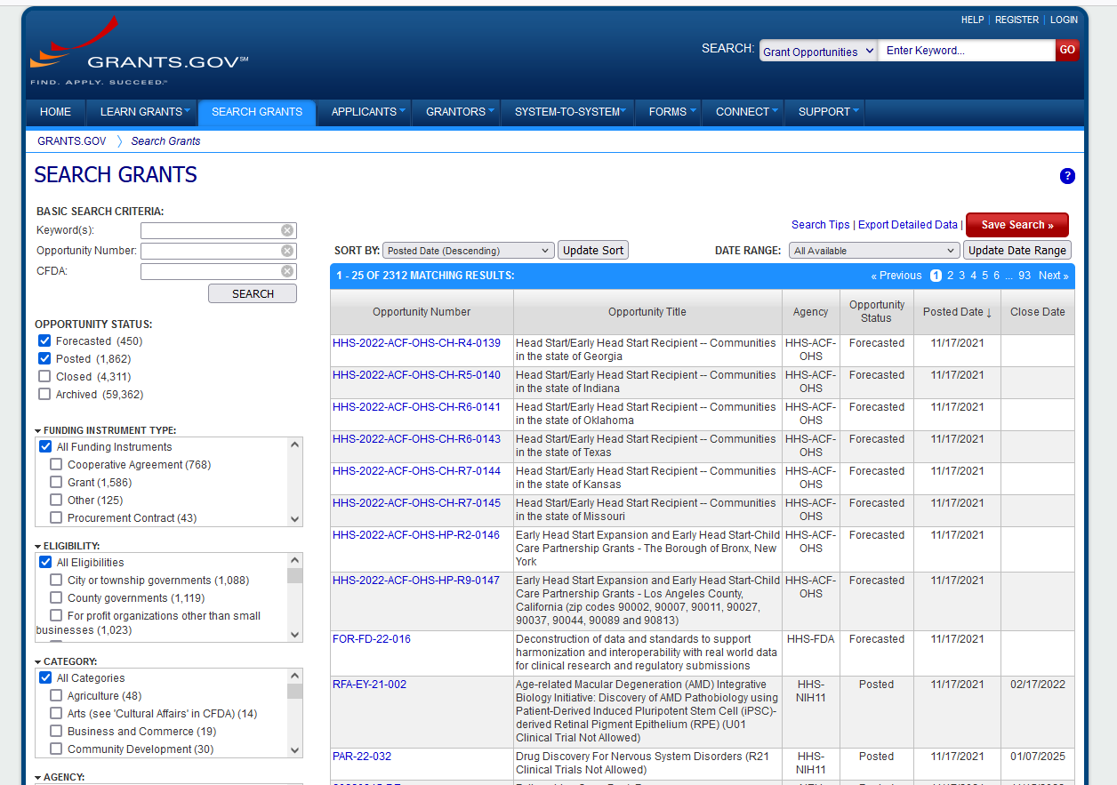

Slide 13
