Slide 1
F&A RATES

Slide 2
History of F&A
Universities and the federal government have a long-standing and successful partnership that grew out of World War II.
The federal government relies on universities to conduct research in the Nation’s interest.
Health and Welfare
Economic Growth
National Defense
Performing research on behalf of federal agencies incurs a variety of costs that would not otherwise exist for universities.
Universities – not the federal government – assume the risk of building the necessary infrastructure to support this research.
Universities are anticipating that their research faculty will successfully compete for federal research grants.
Awarded university will be reimbursed for a part of the associated infrastructure costs.

Slide 3
Federal Funding for Research
Direct costs – personnel, supplies, equipment and travel
Facilities and administrative costs - the cost of research facilities including debt to build buildings and maintenance, compliance, and the administration of a grant throughout its lifecycle.
These costs cannot be viewed separately; together they represent the total cost of performing research.
Notes:
Debt is the largest dollar figure when considering F&A cost

Slide 4
What are Facilities and Administration (F&A) Costs
F&A is also referred to as follows:
Indirect Costs (IDC)
Overhead
Indirect Cost Recovery (ICR)
Operating Costs

Slide 5
What are Facilities and Administration (F&A) Costs
F&A costs are those research operating costs incurred by all awards.
Research institutions provide the physical space where research is conducted.
Construction and maintenance of advanced research facilities and the resources necessary to conduct research.
Debt to build research buildings
Building maintenance
Utilities
Internet/Data storage
Libraries
Housing for research animals
Hazardous waste disposal
Insurance/Security
Human Resources
Accounting
Other compliance and oversight activities

Slide 6
Administrative and Compliance Costs
Financial management, billing, letter of credit draws
Accountability for research time charged to federal awards (ePERS)
Procurement and Accounts Payable activities
Management of grant budgets and financial reporting
Human protection programs and institutional review boards for human subjects research institutional animal care and use programs for animal research
Radiation and chemical safety and biosecurity
Implementing and tracking federally required training and education
Conflict of Interest oversight and management
Export controls oversight and management
Ensuring timely and accurate reporting of research progress;
Financial closeout
The institution, as the grantee, takes on the responsibility and risk of a grant, and provides both the facilities and compliance support necessary for the investigator to conduct research.

Slide 7
How Does F&A Work
The Federal government funds only that portion of F&A costs, including the costs of research space, incurred in conducting federal research.
The mechanism for reimbursement is a negotiated F&A rate between the federal government and each individual research institution to ensure appropriate costs.
To prevent inequity to federal sponsors when non-federal sponsors impose limitations on F&A reimbursement, OMB rules require that a university calculate its F&A rate by allocating F&A costs across all research, not just federally-sponsored research.
Single research F&A rate
Cost of conducting all sponsored research
Ensures that the federal government does not subsidize the F&A costs for research sponsored by private foundations and charitable organizations

Slide 8
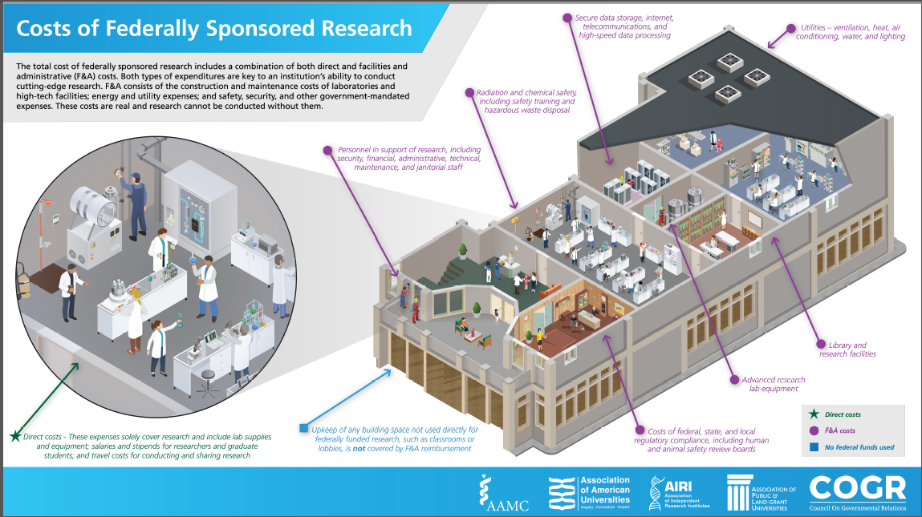

Slide 9
Additional F&A Facts
The administration portion of an institution’s negotiated rate is capped at 26%.
Irrespective of the institution's actual administration costs for sponsored research
With this cap, the University’s full administrative costs is not covered
Reason the off campus rate is 26%
According to federal data, institutions’ own funds now constitute more than 24% of higher education research & development (R&D) activities.
$16.7 billion in FY15
$4.8 billion in the form of unreimbursed F&A
Over $1.3 billion in cost sharing
Federal spending on higher education R&D was just under $37.9 billion in FY 2015, or 55% of R&D.

Slide 10
University of Colorado Denver|Anschutz Medical Campus Federally Negotiated F&A Rate
On-Campus – on basis of Modified Total Direct Cost (MTDC)
55.5% Organized research
42% Instruction
26% Public service/other activity
Off-Campus – on basis of Modified Total Direct Cost (MTDC)
26% For all types of activities

Slide 11
Research Types
Organized Research - Research and scholarship activities include the rigorous inquiry, experiment or investigation to increase the scholarly understanding of the involved discipline.
Instruction - Sponsored instruction and training means specific instructional or training activity established by grant, contract, or cooperative agreement. Does not include research training.
Other Sponsored Activities - All other activities, programs and projects financed by Federal and non-Federal agencies and organizations which involve the performance of work other than sponsored research or instruction.
Editorships
Conferences
Travel Awards
Health Service Projects
Community Service Programs

Slide 12
On Campus Vs Off Campus
On Campus – More than 50% of the work takes place at an on campus location.
On Campus List
Off Campus – More than 50% of the work takes place at an off campus location.
Off Campus List
Location is most likely off campus if not listed.

Slide 13
University of Colorado Denver|Anschutz Medical Campus Federally Negotiated F&A Rate
Modified Total Direct Cost (MTDC) means certain expenses are exempt from F&A including --
Subcontract expenses over $25,000
Equipment over $5,000
Patient care
Scholarships/tuition

Slide 14
Industry Clinical Trials
Private Pharmaceutical/private for-profit companies
F&A - 28% on total direct expenses – all expenses including patient care
Majority of patient care is occurring in hospital

Slide 15
Industry Clinical Trials Definition
Use NIH definition of clinical trial --
A research study in which one or more human subjects are prospectively assigned to one or more interventions (which may include placebo or other control) to evaluate the effects of those interventions on health-related biomedical or behavioral outcomes.
A "health-related biomedical or behavioral outcome" is defined as the pre-specified goal(s) or condition(s) that reflect the effect of one or more interventions on human subjects’ biomedical or behavioral status or quality of life.

Slide 16
Industry Clinical Trials Definition
Examples include:
Positive or negative changes to physiological or biological parameters (e.g., improvement of lung capacity, gene expression);
Positive or negative changes to psychological or neurodevelopmental parameters (e.g., mood management intervention for smokers; reading comprehension and /or information retention);
Positive or negative changes to disease processes;
Positive or negative changes to health-related behaviors; and
Positive or negative changes to quality of life

Slide 17
Industry Clinical Trials Definition
The FDA has two definitions of a clinical trial depending on whether the item under investigation is a drug or device:
Clinical investigation means any experiment in which a drug is administered or dispensed to, or used involving, one or more human subjects. For the purposes of this part, an experiment is any use of a drug except for the use of a marketed drug in the course of medical practice.
Investigation means a clinical investigation or research involving one or more subjects to determine the safety or effectiveness of a device.

Slide 18
Examples of research that would not be considered a clinical trial
Human subjects research that would not meet the definition of a clinical trial would be clinical research –
Not subject to FDA oversight
NIH funded research that is limited to data collection
Other human subjects research that may collect data and/or specimens and is intended to provide material for work on various research questions

Slide 19
Private companies research (non-clinical trials)
July 2017 – changed the F&A charged to private companies to be more aligned with other Universities’ practice and equitable with federal government.
Approval by Dean Reilly, VC Research Dr. Traystman, Chancellor Elliman and Executive VC Administration & Finance | CFO, Terri Carrothers
Presented at SOM Executive meeting as well as other forums including SOM Administrators
Research/ sponsored funding with private companies (not clinical trials) require the budget to include the appropriate federally negotiated F&A rate.

Slide 20
Private companies research (non-clinical trials)
Equitable treatment between federal gov’t and private companies
Federal government has concerns if other sponsors are paying less than federal gov’t
Examples of Universities charging private companies at their federal F&A rate –
Oregon Health Sciences University
University of North Carolina
University of California San Francisco
University of Minnesota
University of Nebraska (require on TDC not MTDC)
The University of Alabama at Birmingham

Slide 21
Private companies research (non-clinical trials)
Examples of Universities charging private companies more than their federal F&A rate –
Johns Hopkins University – 72%, 8.25% higher than federal, on TDC
Northwestern University – 69.64%, 11.64% higher than federal
University of Pittsburgh – 61.5%, 5% higher than federal

Slide 22
Additional Guidance for Application of F&A

Slide 23
Private Industry Sponsored Research
Any variance in the rate requires a waiver.
Must be submitted through respective Dean’s office first
Must be well justified
Approval rate is low
Waiver must be submitted even if:
There is a published rate in the FOA/RFP,
there is a rate published in a policy,
Or the sponsor provides an email/letter stating a rate that varies CU Denver | AMC F&A Policy
On Campus = 55.5%
Off Campus = 26%
Notes:
This must go to a committee to consider

Slide 24
Private Industry Clinical Trial
Any variance in the rate requires a waiver.
Must be submitted through respective Dean’s office first
Must be well justified
Approval rate is low
Waiver must be submitted even if:
There is a published rate in the FOA/RFP,
there is a rate published in a policy,
Or the sponsor provides an email/letter stating a rate that varies CU Denver | AMC F&A Policy
On Campus = 28%
Off Campus = 28%

Slide 25
Federal / State Agreements
Any variation from the institution F&A rate or sponsor published F&A requires a waiver.
Must be submitted through respective Dean’s office first
Must be well justified
Approval rate is low
Exceptions:
Sponsor consistently applied published policy
Indirect cost rate is listed in the RFP/FOA
A letter or email from an official of the sponsor noting the F&A rate for the opportunity will suffice in place of a waiver (These instances should be verified with the PreAward or Contracts Manager).
No clear indication of an F&A rate is published on the sponsor website or within the funding announcement.
On Campus = 55.5%
Off Campus = 26%
Notes:
Since we do allow the exceptions, request are rare and only in the instances of the PI is asking to drop the rate from what the sponsor is willing to pay.

Slide 26
Non-Profit Foundations and Associations
Any variation from the institution F&A rate or sponsor published F&A requires a waiver.
Must be submitted through respective Dean’s office first
Must be well justified
Approval rate is low
Exceptions:
Sponsor consistently applied published policy
Indirect cost rate is listed in the RFP/FOA
A letter or email from an official of the sponsor noting the F&A rate for the opportunity will suffice in place of a waiver (These instances should be verified with the PreAward or Contracts Manager).
No clear indication of an F&A rate is published on the sponsor website or within the funding announcement.
Sponsor consistently applied policy or:
10% de minimus rate if no policy
Notes:
Since we do allow the exceptions, request are rare and only in the instances of the PI is asking to drop the rate from what the sponsor is willing to pay.

Slide 27
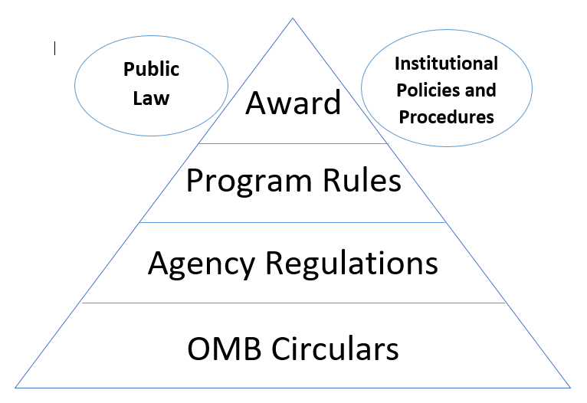
Precedence of Compliance - NCURA
Various regulations complement one another to guide the implementation of awards.
Notes:
OMB Circulars form the basis for all of federal grant guidance.
Agency Regulations govern the way a particular agency wants its awards executed. Like how it generally treats cost sharing or program income.
Program rules are particular to the way a particular program within an agency wants its awards executed. Like limitations on training awards or fellowships.
The award (and FOA) guides what and how measureables should be achieved on a given award. What are you measuring? The number of trainees? A Research outcome? The number of business starts/capital accessed/long-term clients/business expansions – those were my measureables on a Small Business Development Center Grant sponsored by the SBA.
Probably the most important ideas in the diagram. We are still guided by public law – how many have read an award document where they reference various acts – like the Civil Rights Act or the Americans with Disabilities Act.
The most important inference for a public institution is the fact that we are guided by our own policies and procedures. In many places in the OMB Circulars it refers users to the institutional policies – like in procurement or human resources.
All of this fits together – we must be mindful of a lot of different rules and regulations and policies and procedures to properly execute grants faithfully.
As a director of grant accounting we found that when we failed to follow our own policy, we received findings more readily.
Why am I referring to this? It is imperative that all divisions within an institute understand that we receive grants because and not in spite of policies and procedures. We have to follow internal policies and procedures to remain compliant on grants.

