Slide 1
Journal Entry Example #1

Slide 2
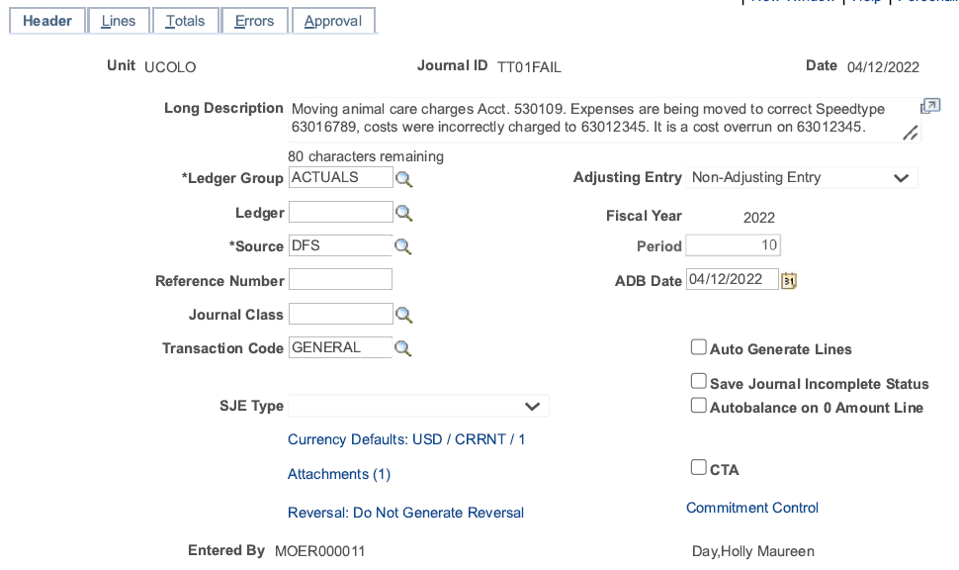
Example #1- Take One
4/1/2021

Slide 3
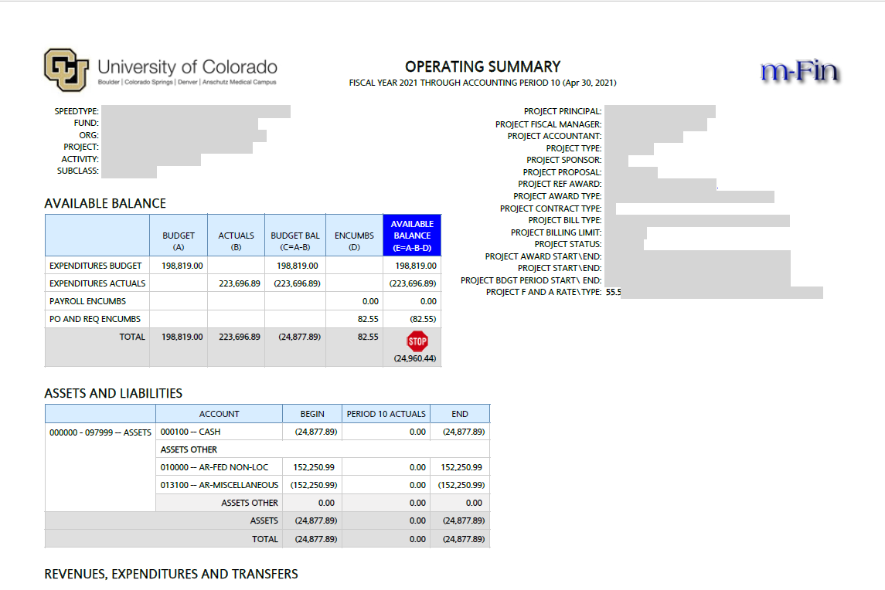
Attachment – Operating Summary Report

Slide 4
Let’s Review the intention of this JE
Attachments Needed
JE Checklist - required for this entry
Documentation of discussion with PI (email)
Financial Detail from month charge was posted through current calendar month
Run for ONLY the account code(s) that have the mischarged transactions
Must include Header of report that has been run to show the period covered

Slide 5
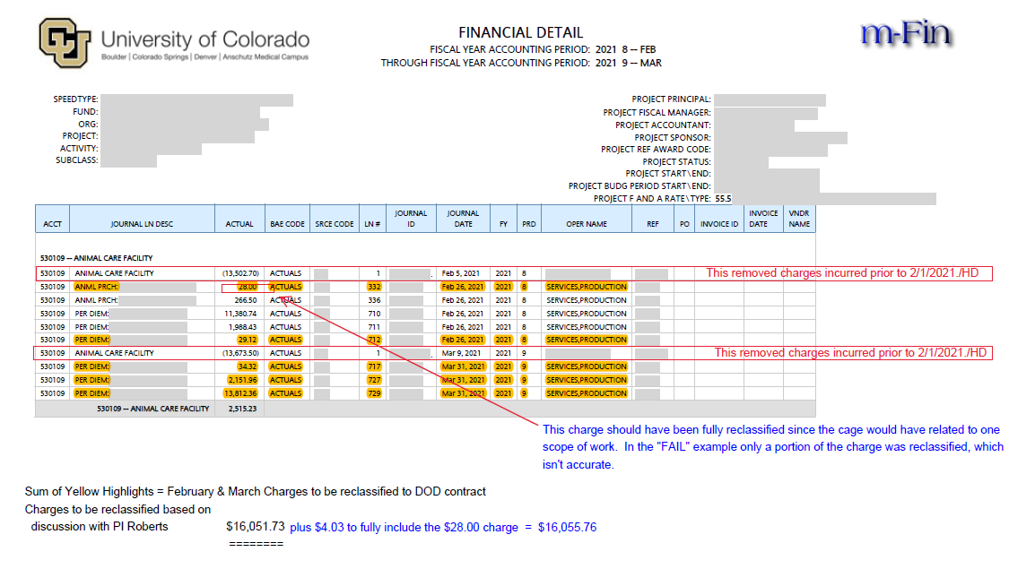
Attachment – Financial Detail Report

Slide 6
JE Checklist Walkthrough

Slide 7
JE Checklist – Submission Message & Email w/PDF
Attach the PDF to the JE!

Slide 8
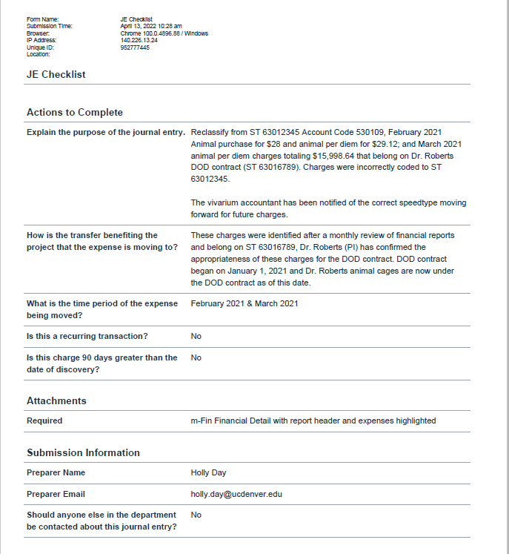
Attachment – JE Checklist

Slide 9
Attachment – Financial Detail Report

Slide 10
Attachment – Communication w/PI (Email)

Slide 11
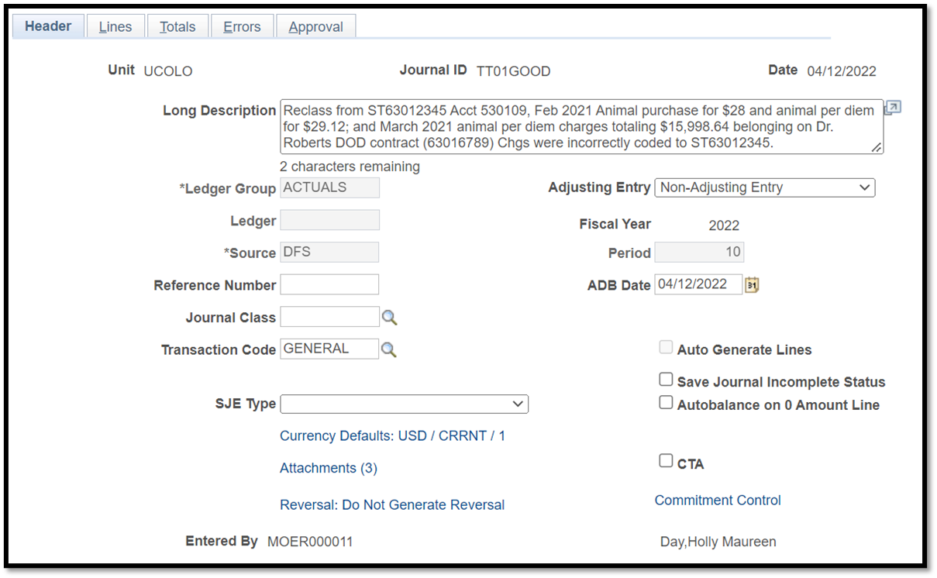
Example #1- Take Two
4/1/2021

Slide 12
Journal Entry Example #2

Slide 13
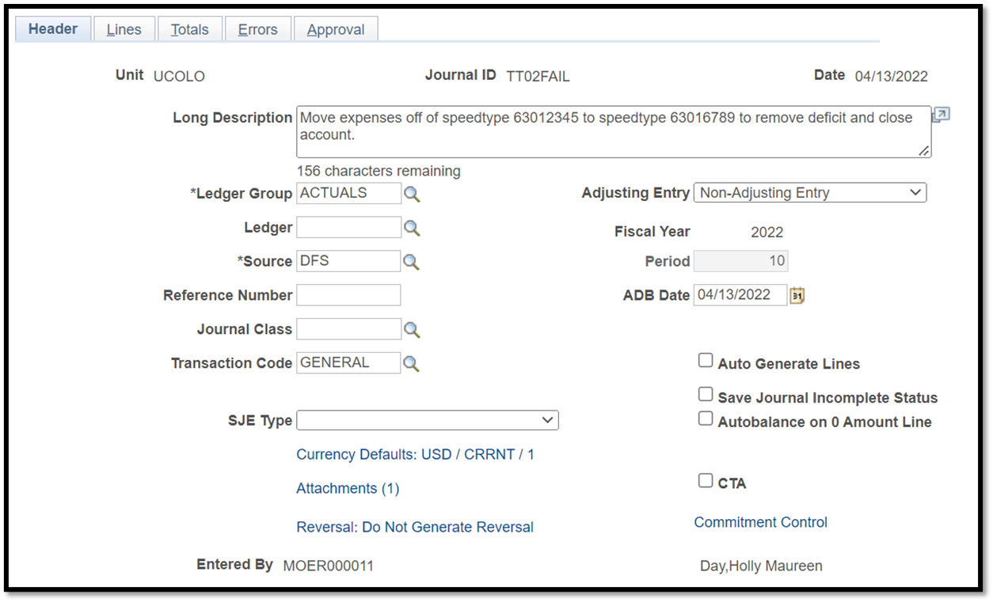
Example #2- Take One
4/14/2021

Slide 14
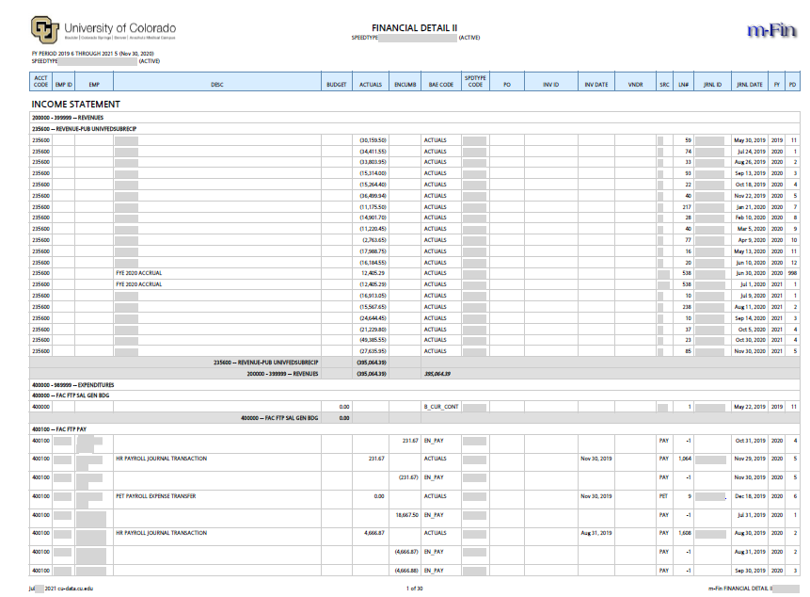
Attachment – Financial Detail II Report (30 Pgs)

Slide 15
Let’s Review the intention of this JE
Attachments Needed
JE Checklist
Documentation of discussion with PI (email)
Financial Detail from month charge was posted through current calendar month
Run for ONLY the account code(s) that have the mischarged transaction.
Must include Header of report that has been run to show the period covered

Slide 16
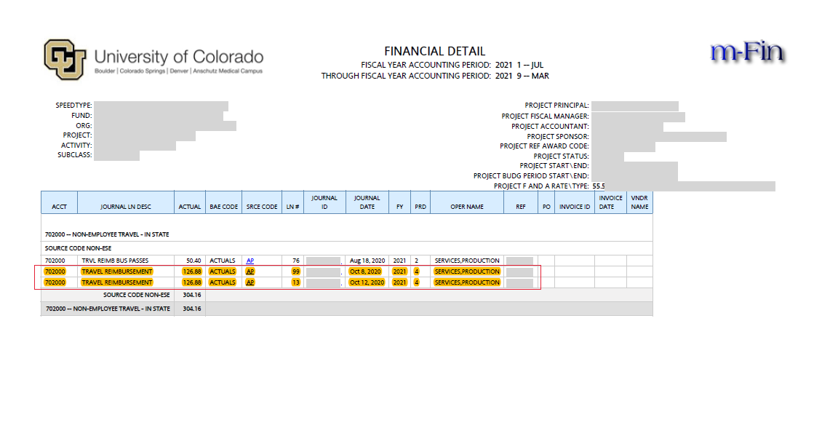
Attachment #1 – Financial Detail

Slide 17
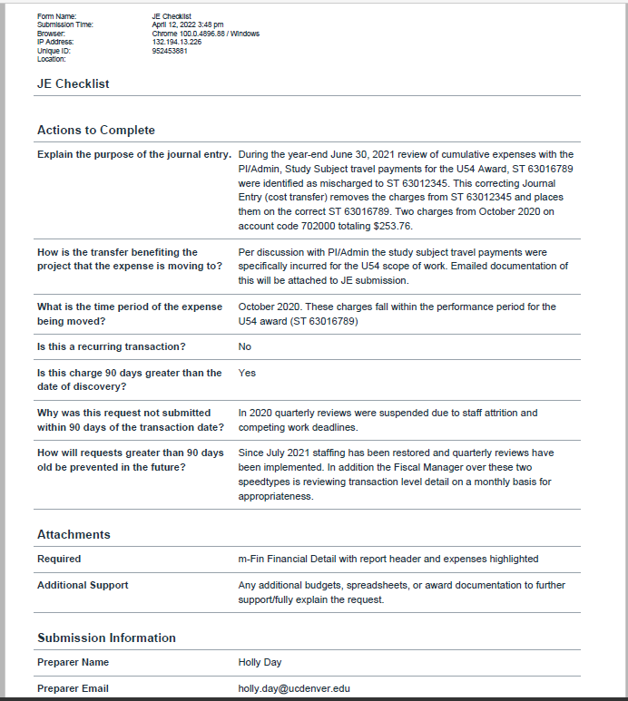
Attachment #2 – JE Checklist

Slide 18
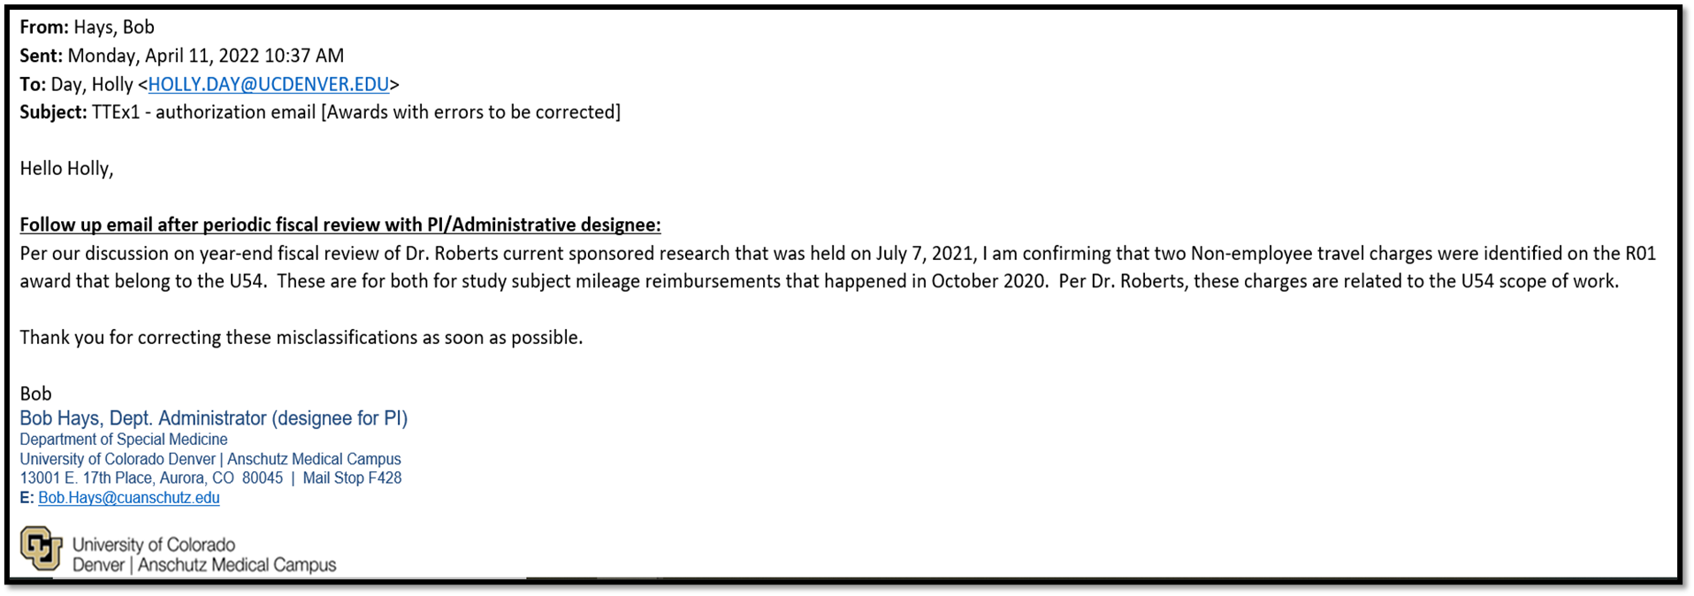
Attachment #3 – Communication w/PI
21,

Slide 19
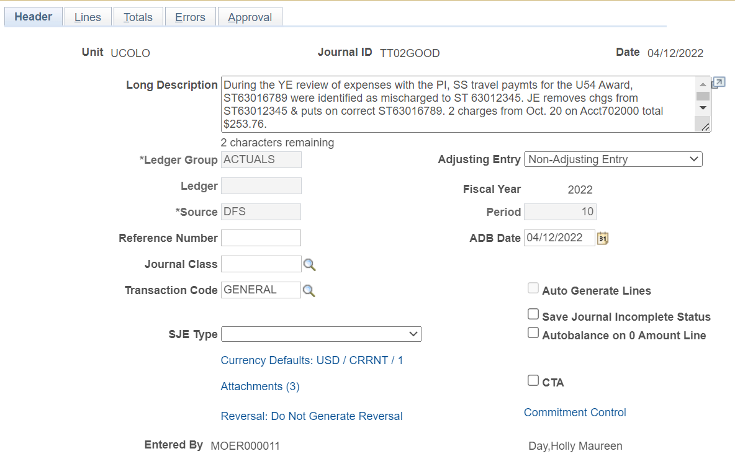
Example #2- Take Two
4/14/2021

Slide 20
Journal Entry Example #3

Slide 21
Example #3- Take One
2021

Slide 22
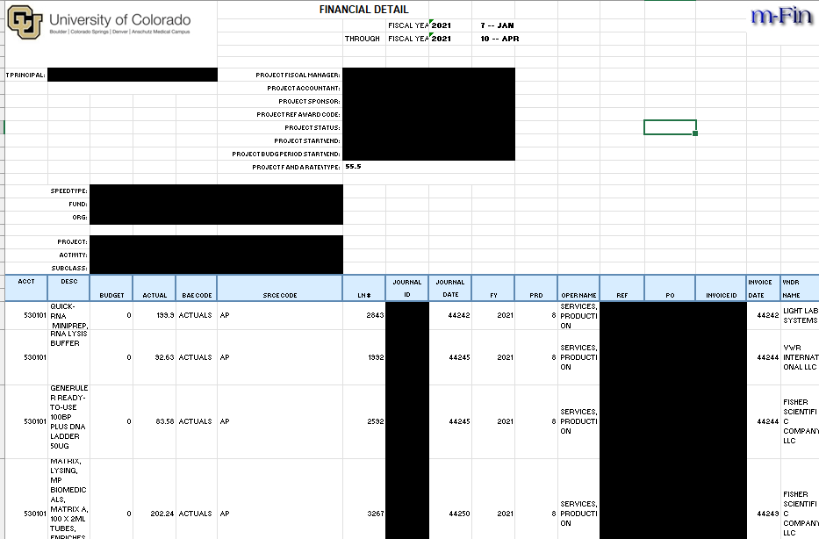
Attachment – Financial Detail Excel

Slide 23
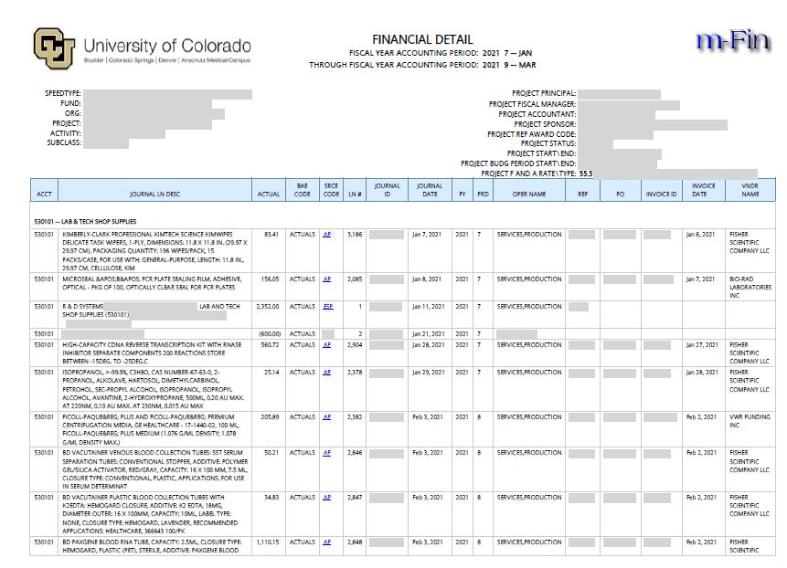
Financial Detail Report

Slide 24
Let’s Review the intention of this JE
Removing charges from fund 30/31 to department speedtype does not require completion of JE Checklist.
This Journal Entry removes overspending that has occurred on the award.
Financial Detail should not be altered to remove information
Attachments Needed
Documentation of discussion with PI (email)
Financial Detail from month charge was posted through current calendar month
Run for ONLY the account code(s) that have the mischarged transaction.
Must include Header of report that has been run to show the period covered

Slide 25
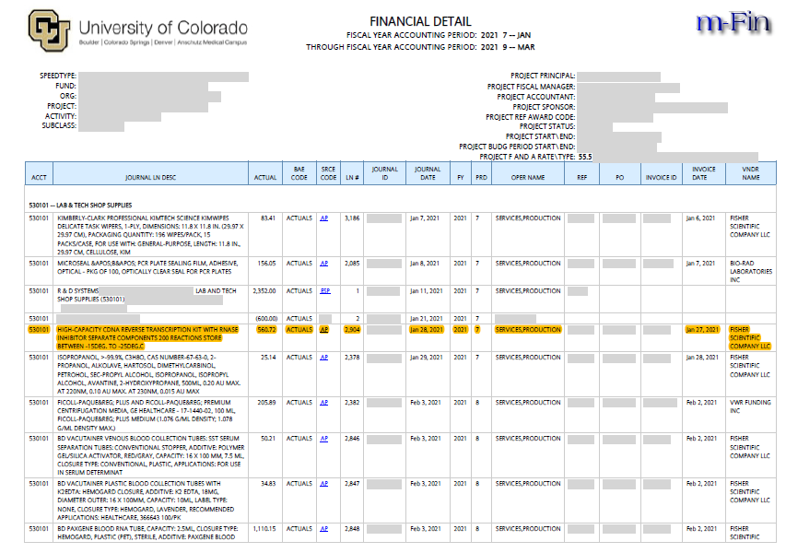
Attachment - Financial Detail

Slide 26
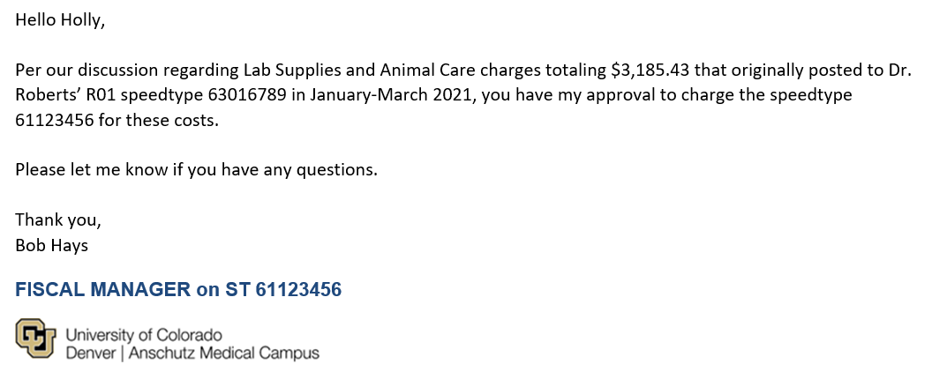
Attachment – Approval from Fiscal Manager to move Expense to dept. ST

Slide 27
Example #3- Take Two
4/12/2021

