Slide 1

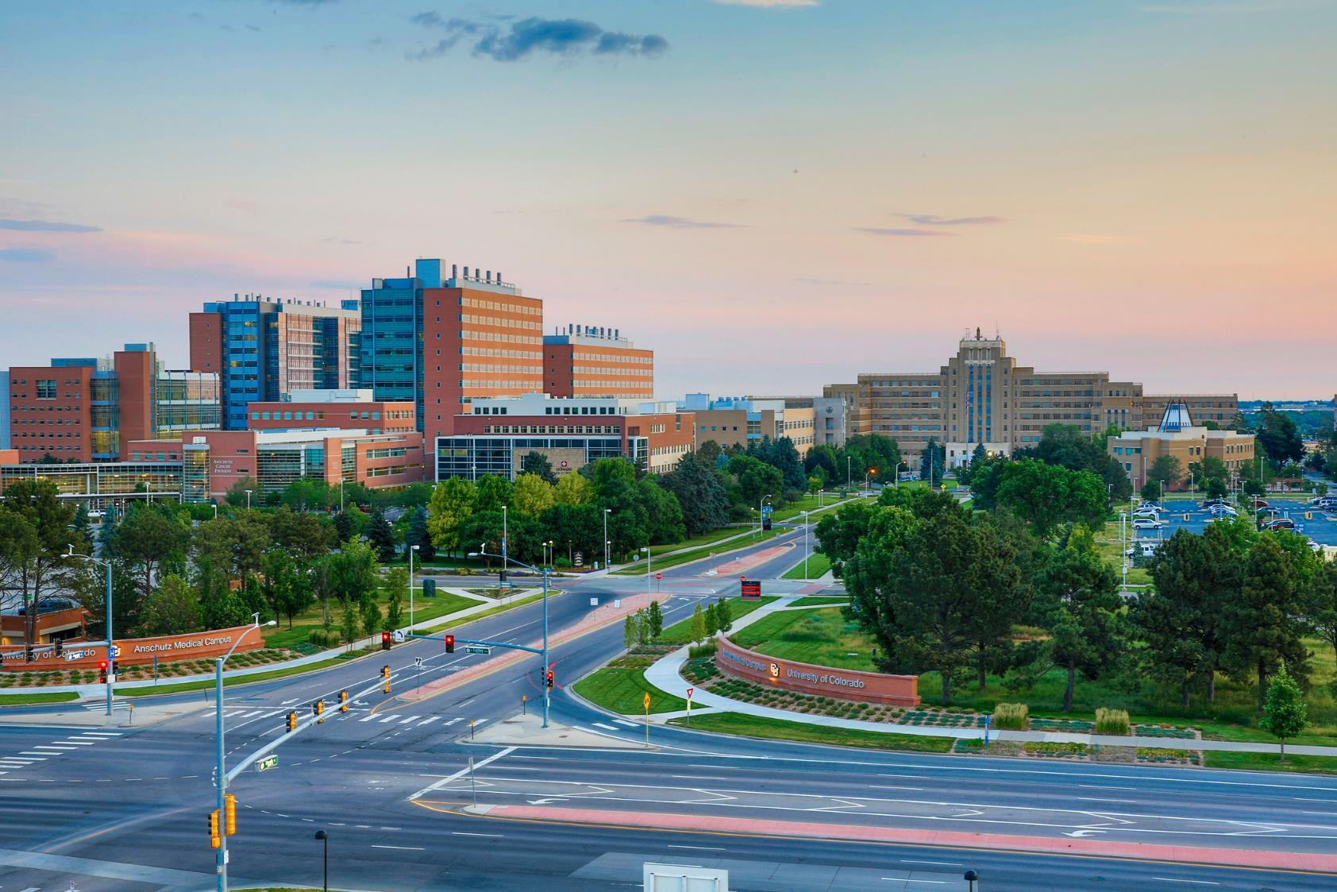

OnCore Support
DEPARTMENT ADVISORY MEETING
Mercedes Zirbes
CTMS Program Build Manager
May 13th, 2025

Slide 2






STRUCTURE
Review of previous items
Definitions
Review of new items
Reminders and FYIs
Questions
Reminder! Submit agenda items

Slide 3
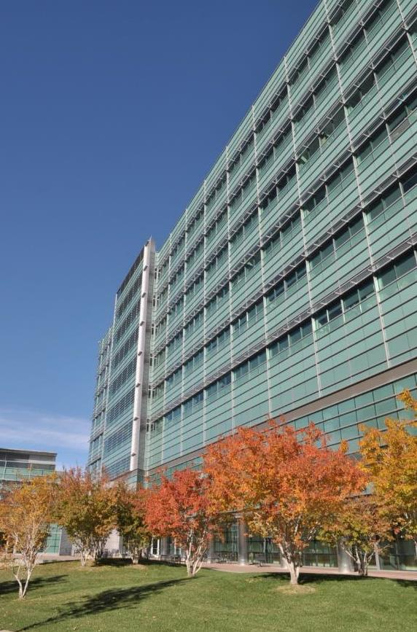
REVIEW OF PREVIOUS ITEMS
Study Monitors added in Staff Tab by UCH
UCHealth Research Administration will now add monitors to the OnCore staff tab in order for them to have access to study-related info in Epic. Study team should not modify monitor information and monitors will not have access to log in to OnCore.
Human Subjects Research Portal and sIND/sIDE Portal Merge
The Human Subjects Research (HSR) Portal was updated 4/7/25 to accommodate different types of submissions.

Slide 4
REVIEW OF PREVIOUS ITEMS
Updated UCHealth Research Fee Schedules
UCHealth System Wide Research Fee Schedules effective July 1, 2025 have been published on our website.
Advarra One Go-Live
OnCore was updated to the new cloud environment on 4/18/25. If you have not registered a new account yet, you will need to reach out to OnCoreSupport@ucdenver.edu to get a new account creation email.
The new URL is: https://one.advarracloud.com

Slide 5

DEFINITIONS – CHANGES VS PROPOSALS
Change
Study team approval not required
Will be implemented immediately
Affected parties are notified prior to and after implementation
  Newsletter
  Department Advisory Meeting
Proposal
Planned change
Requires review and approval from one or a combination of:
  Study Teams
  Research Administration Staff
  Change Control Board

Slide 6

CHANGE: UCHealth Research Essentials Annual Competency
UCHealth Research Essentials Annual Competency Requirement
To maintain ongoing training and ensure research staff competency in accordance with UCHealth policies and procedures, completion of the annual Research Essentials competency assessment is required.
Impact
Eligible research personnel will be assigned this brief assessment on July 1, with a completion deadline of August 30.

Slide 7

REMINDERS AND FYIs
eReg/EDC Updates
  Going forward, all new studies in eReg will be added as multi-site. All current active users have updated multi-site capabilities.
  eReg and EDC will be switching to Advarra SSO in June!
    This is the same as the current OnCore login process.

Slide 8


QUESTIONS?

Slide 9


THANK YOU
OnCore Support
•••
•••
•••
•••
•••
5/13/2025

Slide 10
REVIEW OF PREVIOUS ITEMS
Item 1
Details and updates
Item 2
Details and updates
Item 3
Details and updates

Slide 11
CHANGE: TITLE OF CHANGE
Change
Details of change
Impact
Impacted parties, downstream effects, etc.
Future Considerations
If applicable

Slide 12
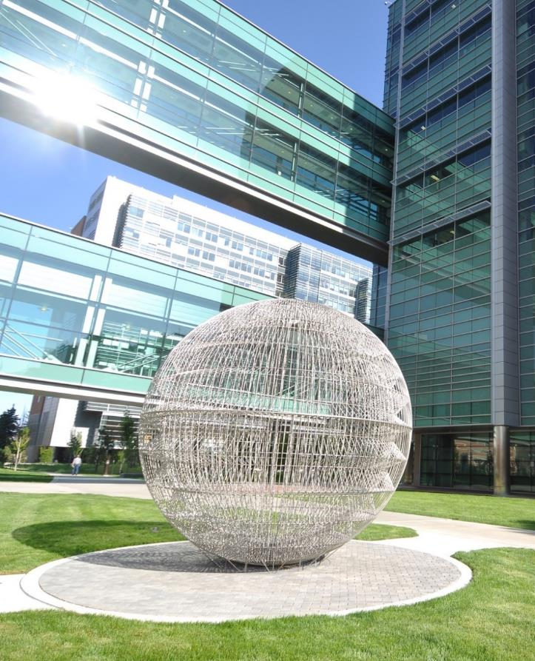
PROPOSAL: TITLE OF PROPOSAL
Proposal
Proposal details
Impact
Impacted parties, downstream effects, etc.
Future Considerations
If applicable

Slide 13
REMINDERS AND FYIs
Reminder
List any reminders as applicable

Slide 14













ICON LIBRARY – Cut and paste icons for use in your PowerPoint
Notes:
TIP: Once you have copy and pasted the icons you like onto your presentation slides, you may delete this page out of your presentation.

