Slide 1

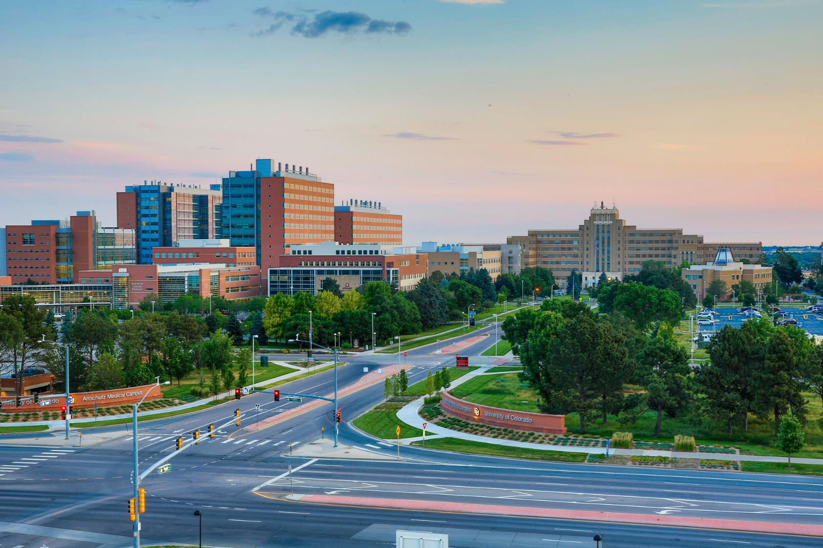

OnCore Support
DEPARTMENT ADVISORY MEETING
Mercedes Zirbes
CTMS Program Build Manager
April 8th, 2025

Slide 2






STRUCTURE
Review of previous items
Definitions
Review of new items
Reminders and FYIs
Questions
Reminder! Submit agenda items

Slide 3
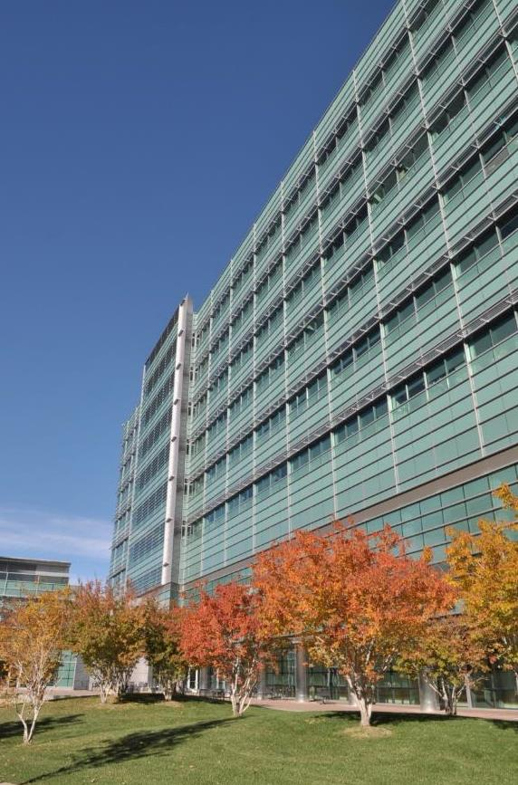
REVIEW OF PREVIOUS ITEMS: PI Attestation
UCHealth PI Attestation Overview
Clinical trials that meet the qualifying criteria will receive Medicare coverage of routine costs after the trial’s lead PI certifies that the trial meets the criteria per NCD 310.1
Some studies are automatically deemed to meet the desirable characteristics. The PI will not receive an attestation survey if the study is federally funded, or has an IND or is IND exempt, or is designated IDEA-A or IDE-B

Slide 4
REVIEW OF PREVIOUS ITEMS: OnCore Requirements Dashboard
UCHealth OnCore Requirements Dashboard
Shortly, UCHealth will launch a study specific requirement dashboard.​
Access will be announced in the UCHealth Research Newsletter.​
​

Slide 5
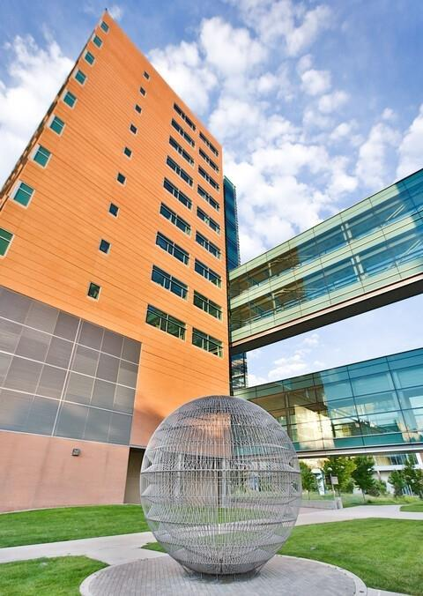
DEFINITIONS – CHANGES VS PROPOSALS
Change
Study team approval not required
Will be implemented immediately
Affected parties are notified prior to and after implementation
  Newsletter
  Department Advisory Meeting
Proposal
Planned change
Requires review and approval from one or a combination of:
  Study Teams
  Research Administration Staff
  Change Control Board

Slide 6
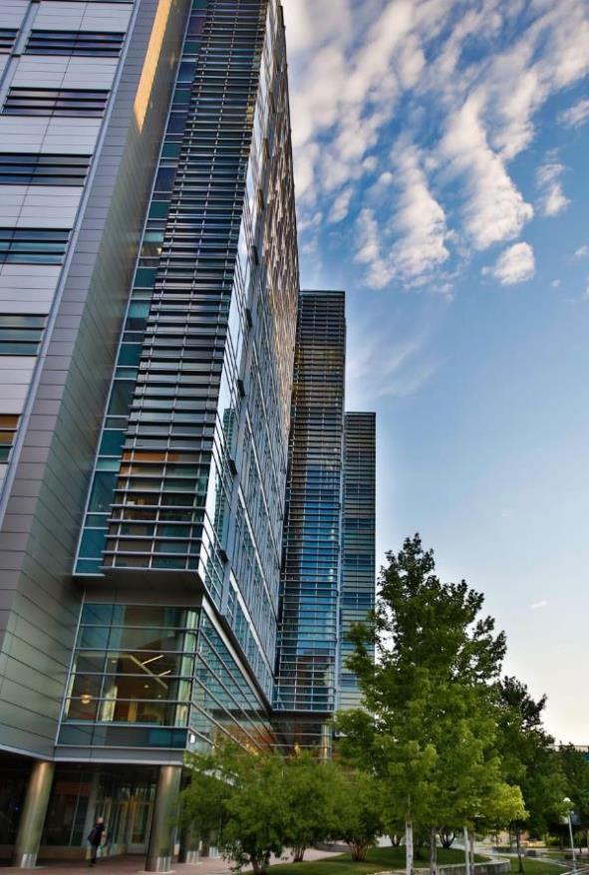
CHANGE: Study Monitors in Staff Tab
Change
UCHealth Research Administration will now add monitors who have requested access to UCHealth Epic to the staff tab in OnCore
Impact
This will ensure study monitors have appropriate access to study-related information in Epic
Study team should not add stop dates or remove monitors from staff tab
Monitors will not have access to log in to OnCore
If you have any questions, please reach out to UCH-ResearchAdmin@uchealth.org

Slide 7
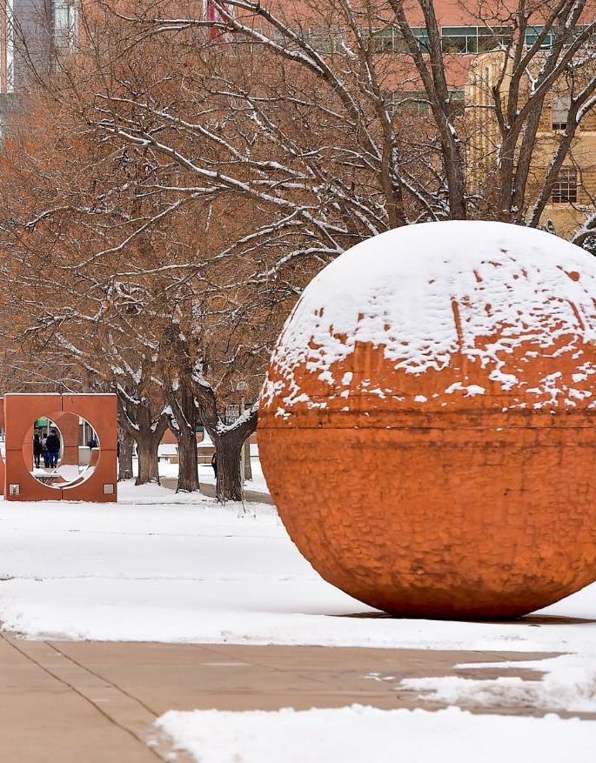
REMINDERS AND FYIs: HSR & sIND/sIDE Portal Update
Human Subjects Research Portal and sIND/sIDE Portal Merge
Effective April 7, 2025, the Human Subjects Research (HSR) Portal will be updated to accommodate different types of submissions.
To improve flexibility and streamline the submission process, we have added a new question to better categorize project types. This update ensures that non-Human Subjects Research submissions require only the most relevant questions.

Slide 8
REMINDERS AND FYIs: HSR & sIND/sIDE Portal Update
Human Subjects Research Portal and sIND/sIDE Portal Merge
When submitting:
  If your project is a single-patient IND or IDE, select “Expanded Access Protocol (single patient, intermediate, treatment).”
  If your project requires an HSR Portal Clearance letter for submission to COMIRB for a QI determination, select “This is being submitted for a COMIRB decision of QI vs. HSR.”
This update replaces the existing sIND/sIDE portal. To submit to the Human Subjects Research Portal, please use this link: https://redcap.ucdenver.edu/surveys/?s=CF49MR9EEAAHRDHY.

Slide 9
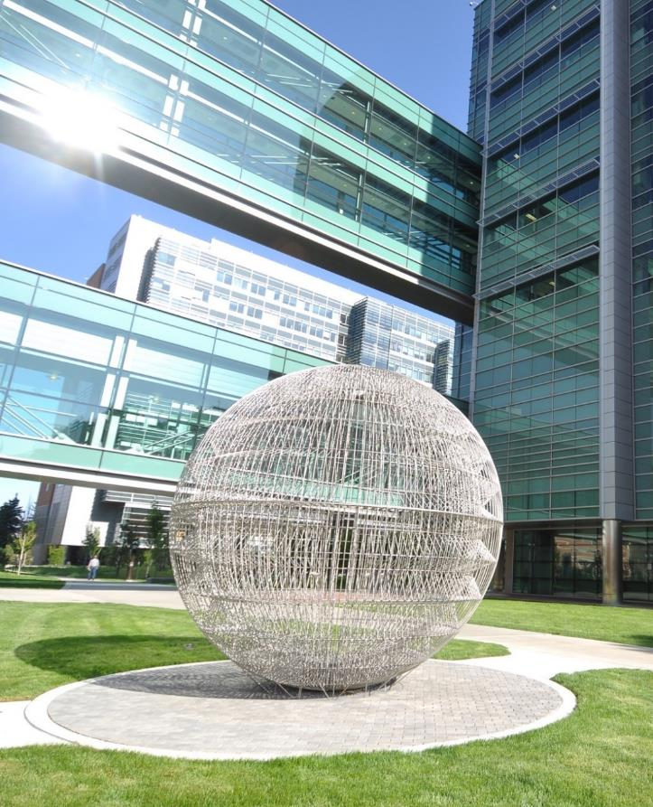
REMINDERS and FYIs: UCHealth Research Fee Schedule Update
Updated UCHealth Research Fee Schedules
UCHealth System Wide Research Fee Schedules effective July 1, 2025 have been published on our website.
These fees are applicable for studies submitted to the Human Subjects Research Portal on or after July 1, 2025.
Ancillary Services Fee Schedule
  Includes Laboratory, Radiology, and Nuclear Medicine Investigational Radiopharmaceuticals
    Investigational Drug Services
    UCHealth Research Administration
  Include protocol initiation and maintenance fees and Medicare Coverage Analysis fees
    University of Colorado Apheresis Fee Schedule
    University of Colorado Hospital 11th Floor Fee Schedule

Slide 10
REMINDERS and FYIs: Advarra One Go-Live
Advarra One Go-Live
We are in the middle of a migration and our on-premises environments will be offline Wednesday, April 16th at 4pm.
Our environments will be offline all day on Thursday, April 17th for study teams.
The cloud environment will be back online the morning of Friday, April 18th.
We will use the newsletter to communicate about these outages and when OnCore is back online.
Everyone will automatically receive an email invitation from Advarra on Friday with account creation instructions

Slide 11
REMINDERS and FYIs: Advarra One Go-Live
Logging into Advarra One for the first time:
Look for an Advarra product invitation email from no-reply@advarracloud.com and click the "Create Account" link in the email body.
Fill in the required fields on the next screen, then Accept and Create Account.
This will bring you to the sign-in screen. Please log in with your institutional email address and password. Going forward, sign into Advarra One with the same email address.
The new URL is: https://one.advarracloud.com

Slide 12
REMINDERS and FYIs: Advarra One Go-Live
From: To: Subject: Date:
no-reply@advarracloud.com
Researcher, Jane
Advarra product invitation
Friday, November 15, 2024 10:39:15 AM
[External Email - Use Caution]
Create Your Advarra Account
Hello Jane Researcher,
You've been invited to access the following Advarra products:
- OnCore
Click "Create Account" below to complete the setup process. This invitation is valid for a limited time.
    Create Account
Alternatively, if this does not work for you, copy and paste this URL into your browser:
https://invitation.advarracloud.com?invitation-token=-AmeF0m5ziyVPvHGq9PEnnD6Mg14lkB0 91FLYsAvfba_y8kqH_jY3y_KQJwA1fHGcndFrJTf0kII0mwRfMX4A1l889HOoBqwIDBA6KmfTASEBT GuXh5vlnOGPH71R7nt
After you’ve activated your account, bookmark https://one.advarracloud.com for ongoing access.
If you think this invitation was sent by mistake please contact: Longboat users — support@longboat.com
Login Support for OnCore Users —
OnCoreSupport@ucdenver.edu
© 2024 Advarra

Slide 13
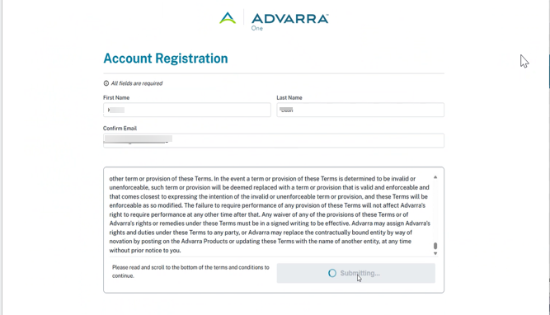
REMINDERS and FYIs: Advarra One Go-Live

Slide 14
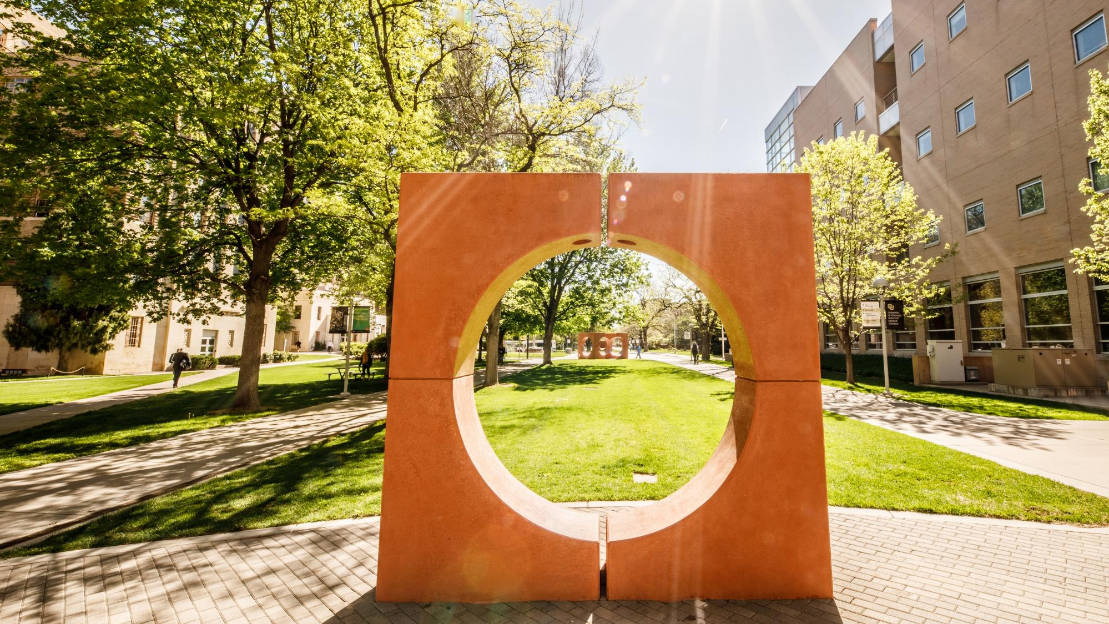

QUESTIONS?

Slide 15
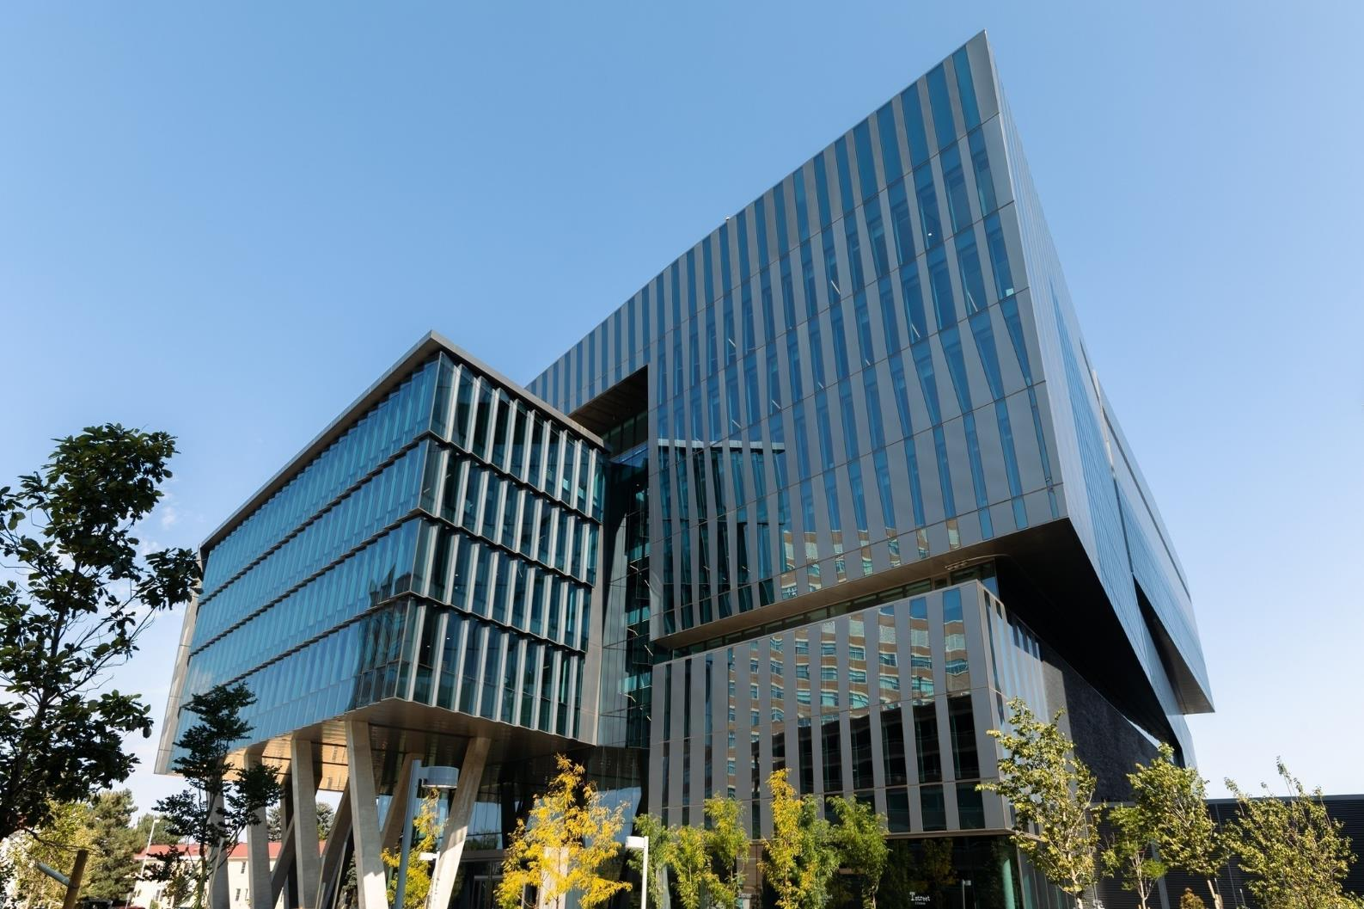

THANK YOU
OnCore Support
•••
•••
•••
•••
•••
4/8/2025

Slide 16
REVIEW OF PREVIOUS ITEMS
Item 1
Details and updates
Item 2
Details and updates
Item 3
Details and updates

Slide 17
CHANGE: TITLE OF CHANGE
Change
Details of change
Impact
Impacted parties, downstream effects, etc.
Future Considerations
If applicable

Slide 18
PROPOSAL: TITLE OF PROPOSAL
Proposal
Proposal details
Impact
Impacted parties, downstream effects, etc.
Future Considerations
If applicable

Slide 19
REMINDERS AND FYIs
Reminder
List any reminders as applicable

Slide 20













ICON LIBRARY – Cut and paste icons for use in your PowerPoint
Notes:
TIP: Once you have copy and pasted the icons you like onto your presentation slides, you may delete this page out of your presentation.

