Slide 1

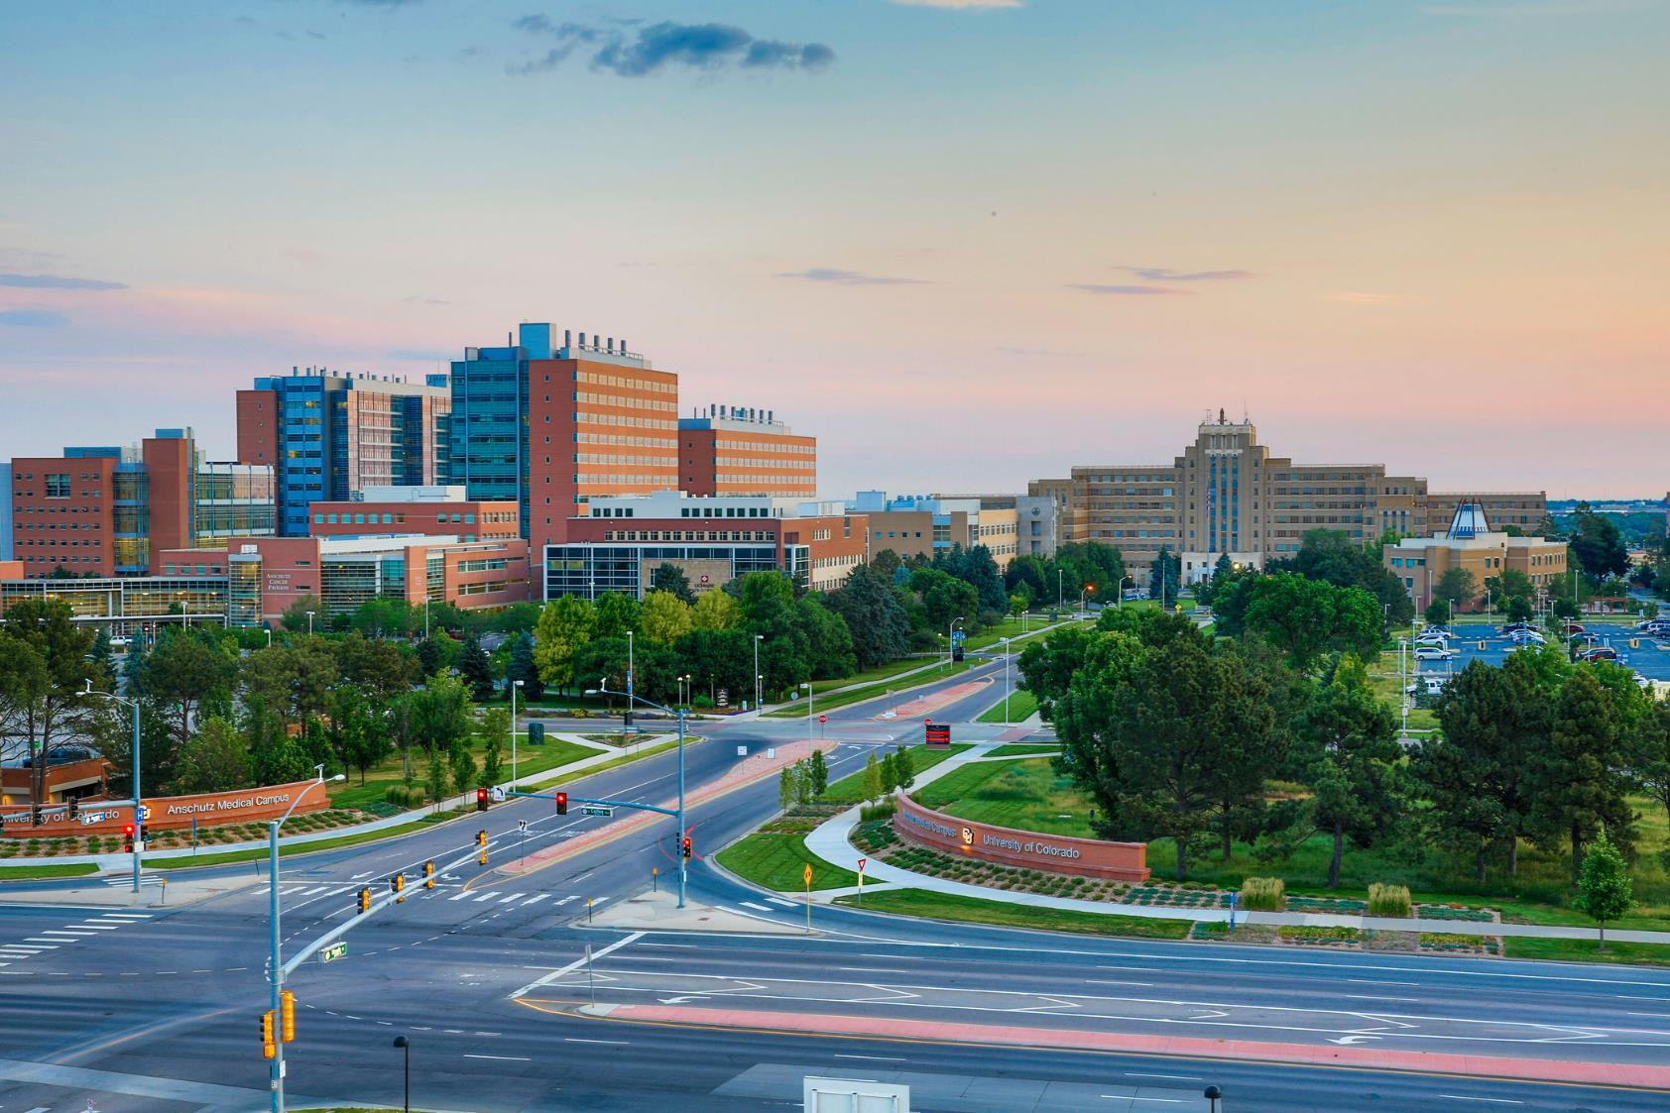

OnCore Support
DEPARTMENT ADVISORY MEETING
Kellie Sinn
Research Facilitator and Trainer
March 11th, 2024

Slide 2






STRUCTURE
Review of previous items
Definitions
Review of new items
Reminders and FYIs
Questions
Reminder! Submit agenda items

Slide 3

REVIEW OF PREVIOUS ITEMS
Brain Imaging Center (BIC) Site Name and Workflow Update
When a participant has a visit at the Brain Imaging Center, the images may or may not be read locally. If the images are read locally by CU Medicine, then the participant must be registered with the UCHealth Epic MRN to ensure the participant is not billed for the read.

Slide 4
REVIEW OF PREVIOUS ITEMS
Process Update to to “As Needed” Functionality in OnCore
Project Analysts will now be marking procedures “As Needed” by simply attaching a footnote. This footnote looks nearly identical to the previous method. Project Analysts will continue to update procedures to Pass Thru manually when a contract indicates a procedure as invoiceable at certain timepoints. This will not negatively affect billing compliance and should in fact improve it by causing less changes.

Slide 5

DEFINITIONS – CHANGES VS PROPOSALS
Change
Study team approval not required
Will be implemented immediately
Affected parties are notified prior to and after implementation
  Newsletter
  Department Advisory Meeting
Proposal
Planned change
Requires review and approval from one or a combination of:
  Study Teams
  Research Administration Staff
  Change Control Board

Slide 6
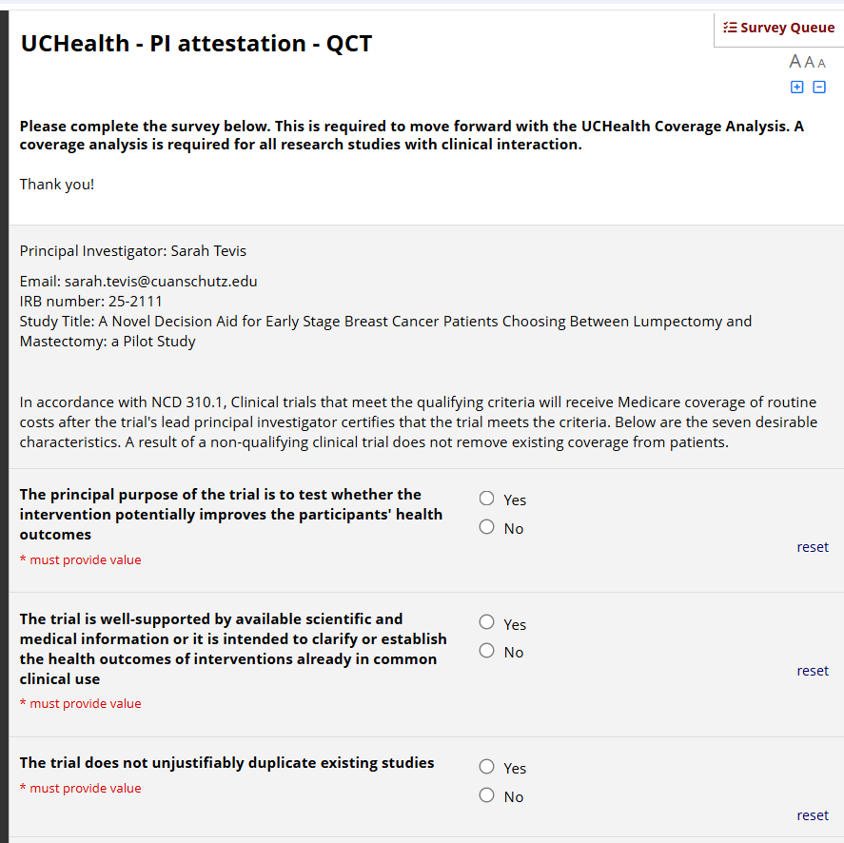
UCHealth PI Attestation
What is the PI attestation?
A PI attestation confirms whether or not a study meets the seven desirable characteristics required by CMS for coverage of routine costs.
Why is a PI attestation required?
Clinical trials that meet the qualifying criteria will receive Medicare coverage of routine costs after the trial's lead principal investigator certifies that the trial meets the criteria per NCD 310.1.
When will a PI receive an attestation survey?
Some studies are automatically deemed to meet the desirable characteristics. The PI will not receive an attestation survey if the study is federally funded, or has an IND, or is IND exempt, or is designated IDE-A or IDE-B.

Slide 7
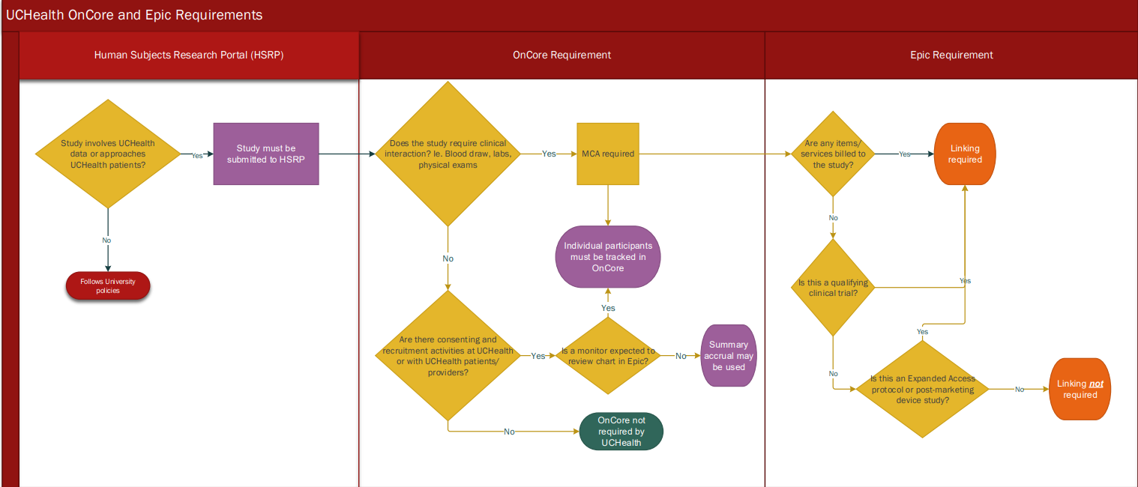
UCHealth OnCore Requirements Dashboard
UCHealth requirements for study activation and operations can be found on our website
To assist teams in understanding these requirements, we had previously posted the process requirement diagram.

Slide 8
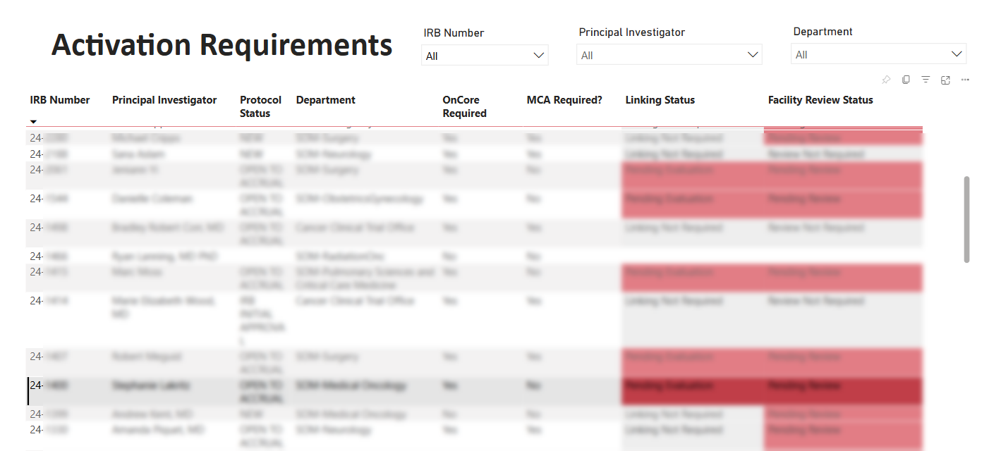
UCHealth OnCore Requirements Dashboard
Shortly, we will launch a study specific requirement dashboard.
Access will be announced in the UCHealth Research Newsletter.
Future features are coming, let us know what you’d like to see by emailing Marissa.Macri@uchealth.org

Slide 9
Advarra One Demo
https://one.advarracloud.com

Slide 10
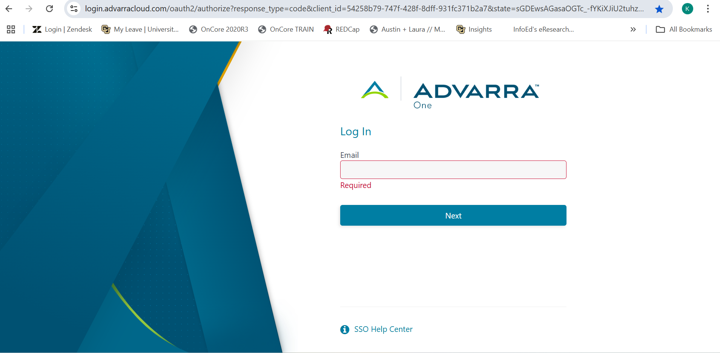
The Advarra One portal is a single point of access that will allow you to select from the environments you have access to.

Slide 11
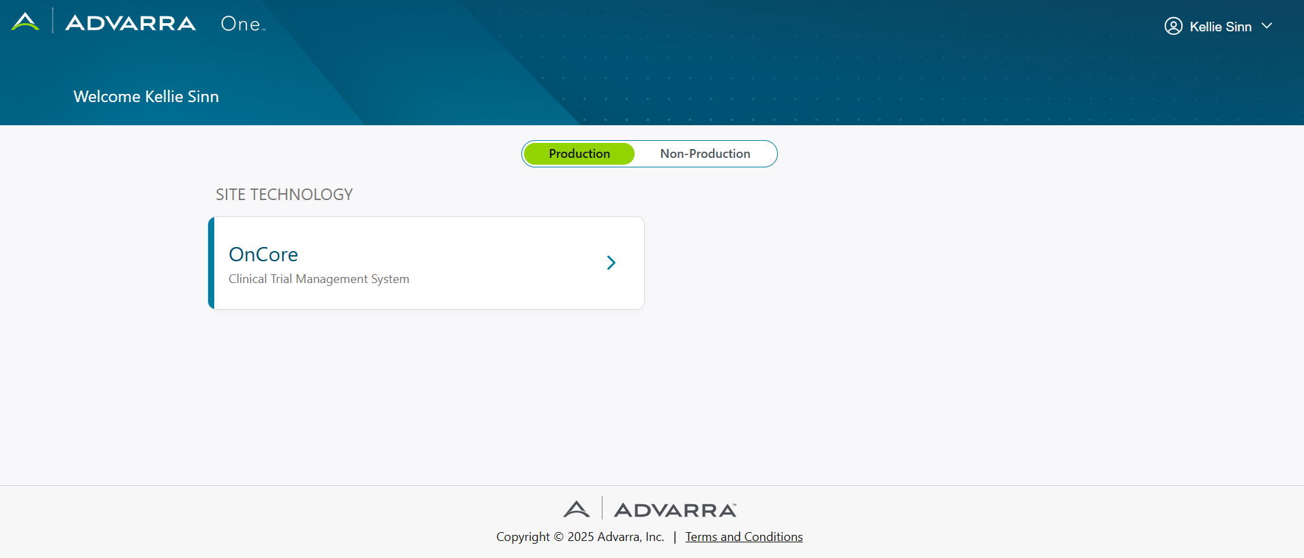

Slide 12


QUESTIONS?

Slide 13


THANK YOU
OnCore Support
•••
•••
•••
•••
•••
3/11/2025

Slide 14
REVIEW OF PREVIOUS ITEMS
Item 1
Details and updates
Item 2
Details and updates
Item 3
Details and updates

Slide 15

CHANGE: TITLE OF CHANGE
Change
Details of change
Impact
Impacted parties, downstream effects, etc.
Future Considerations
If applicable

Slide 16

PROPOSAL: TITLE OF PROPOSAL
Proposal
Proposal details
Impact
Impacted parties, downstream effects, etc.
Future Considerations
If applicable

Slide 17

REMINDERS AND FYIs
Reminder
List any reminders as applicable

Slide 18













ICON LIBRARY – Cut and paste icons for use in your PowerPoint
Notes:
TIP: Once you have copy and pasted the icons you like onto your presentation slides, you may delete this page out of your presentation.

