Slide 1

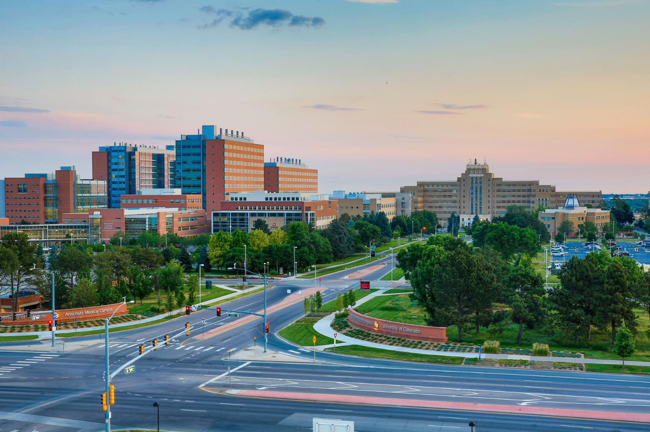

OnCore Support
DEPARTMENT ADVISORY MEETING
Kellie Sinn
Research Facilitator and Trainer
December 10th, 2024

Slide 2






STRUCTURE
Review of previous items
Definitions
Review of new items
Reminders and FYIs
Questions
Reminder! Submit agenda items

Slide 3
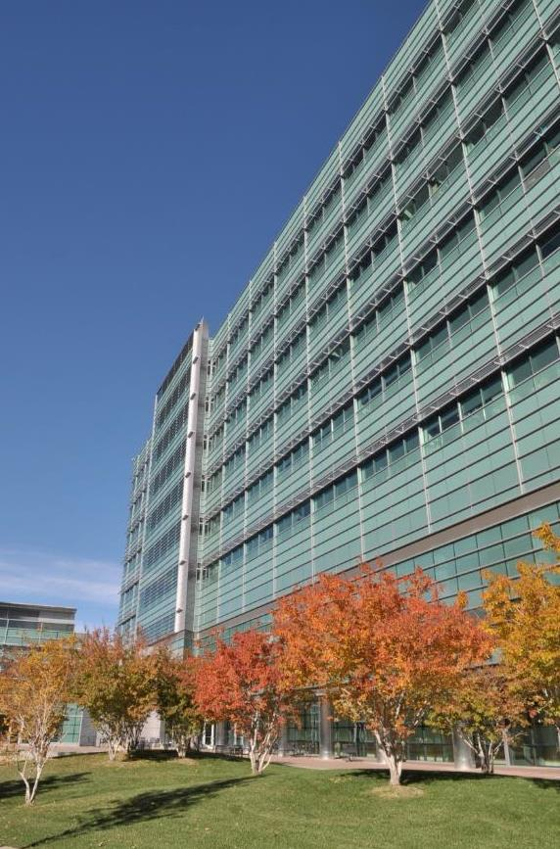
REVIEW OF PREVIOUS ITEMS
Provide CRA Access to Financial Attachments
Expanded permissions to the CRA role so CRCs can pull Beaker Build forms from under Financial Attachments in OnCore.
Additional ICF Slots and Other Slots Added as Document Options
Added 10 additional ‘Informed Consent Form (ICF)’ slots and 5 ‘Other’ document slots to the IRB Reviews tab to accommodate larger studies with multiple ICF’s and Other documents.

Slide 4
REVIEW OF PREVIOUS ITEMS
UCHealth Family Practice Medicine- Westminster Site Added
This is available as a study site under UCHealth Metro Denver in the Institutions Tab of the PC Console.
UCHealth Northern Colorado Family Medicine Management Group Added
This is available as a management group under the Management Tab of the PC Console and in end user profiles within OnCore.

Slide 5
REVIEW OF PREVIOUS ITEMS
NCORP:| NCI Community Oncology Research Program and CSRN: Cancer Screening Research Network (NCI) Added
This has been added to the Network Options List in OnCore for Cancer Center purposes to indicate related sites, protocols, and rosters.

Slide 6

DEFINITIONS – CHANGES VS PROPOSALS
Change
Study team approval not required
Will be implemented immediately
Affected parties are notified prior to and after implementation
  Newsletter
  Department Advisory Meeting
Proposal
Planned change
Requires review and approval from one or a combination of:
  Study Teams
  Research Administration Staff
  Change Control Board

Slide 7

CHANGE: Study Site Name and Workflow for BIC
Brain Imaging Center (BIC) Site Name and Workflow Update
When a participant has a visit at the Brain Imaging Center, the images may or may not be read locally. If the images are read locally by CU Medicine, then the participant must be registered with the UCHealth Epic MRN to ensure the participant is not billed for the read.

Slide 8

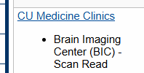
CHANGE: Study Site Name and Workflow for BIC
In the HSR Portal, you will be asked:
If you indicate yes, then the following will populate:
The institution tab will show the following study site:

Slide 9
CHANGE: Process Update To As Needed Functionality
Process Update to "As Needed " Functionality in OnCore
• Previously, we used a built-in OnCore functionality where we simply check if a procedure is “As Needed” and it adds a specific footnote to the procedure either at the procedure level or per visit if the procedure is only As Needed at specific visits.
• The problem with this functionality is that it’s set up to change a procedures designation automatically to “Pass Thru” at the time points it is indicated as needed.

Slide 10
CHANGE: Process Update To As Needed Functionality
Project Analysts have been reverting designations back to “Milestone” or to what designations the coverage analysts had previously indicated if this was done after coverage analysis (such as during initial calendar review by the study team).
Project Analysts only update designations to pass thru if they have financials that indicate a procedure is invoiceable. As a result of this automatic modifying of designations, this has created a duplicative work and sometimes mistakes when procedures were not properly returned to their correct designation after an “As Needed” update.

Slide 11
CHANGE: Process Update To As Needed Functionality
Project Analysts will now be marking procedures “As Needed” by simply attaching a footnote. This footnote looks nearly identical to the previous method. Project Analysts will continue to update procedures to Pass Thru manually when a contract indicates a procedure as invoiceable at certain timepoints. This will not negatively affect billing compliance and should in fact improve it by causing less changes.
This is a change going forward and will not involve re-doing already finished calendars. If at a calendar amendment an update to As Needed is part of the changes, all of the procedures will be updated to match the new footnote methodology at that time.

Slide 12
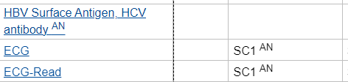
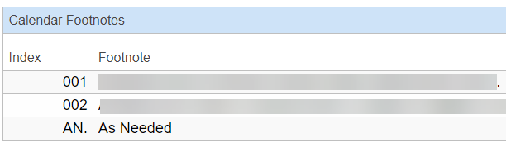
CHANGE: Process Update To As Needed Functionality
We previously used the built-in As Needed OnCore functionality which looked like this on the calendar:

Slide 13

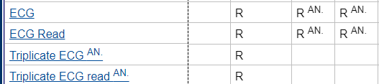
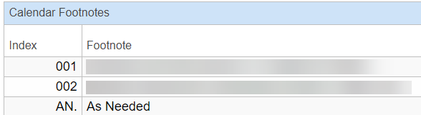
CHANGE: Process Update To As Needed Functionality
We are now using the As Needed functionality as a footnote, which looks like this on a calendar:

Slide 14
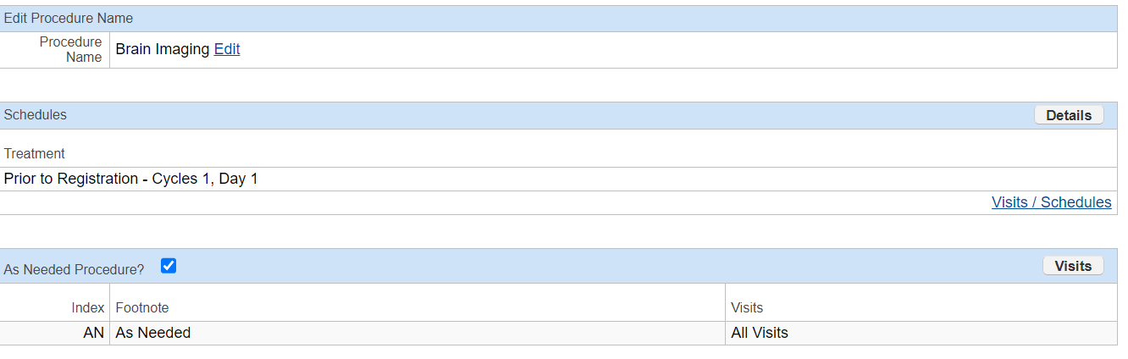
CHANGE: Process Update To As Needed Functionality
At the procedure level (if you clicked into the blue hyperlink of the procedure on a calendar) this is what it looked like before:

Slide 15
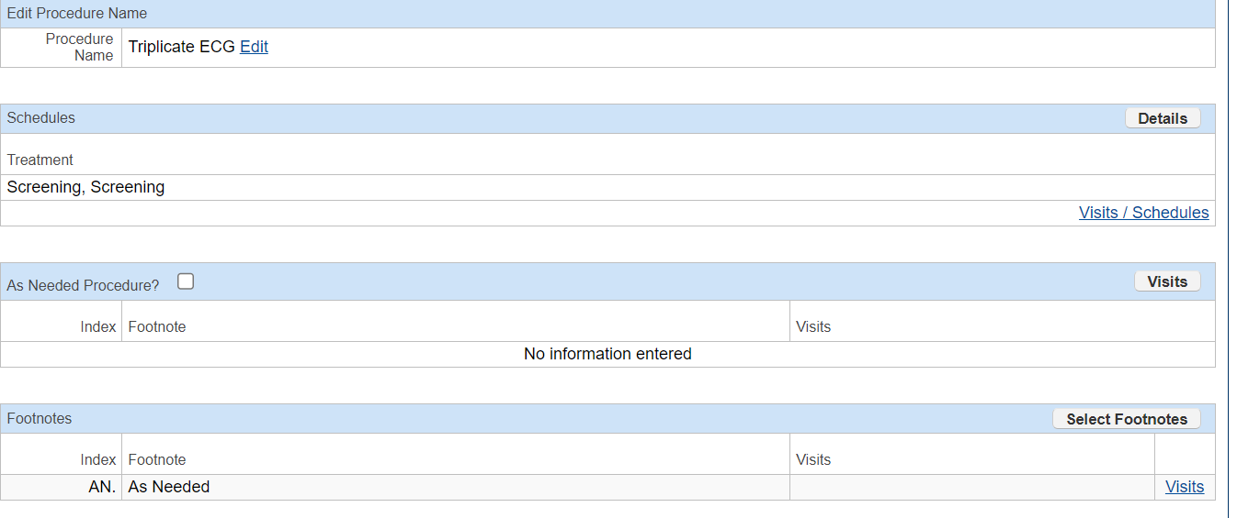
CHANGE: Process Update To As Needed Functionality
This is what it looks like now with As Needed as a footnote:
The “Visits” section will list the specific visits if it is only As Needed at specific visits (instead of at all of them).

Slide 16
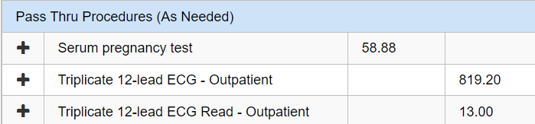
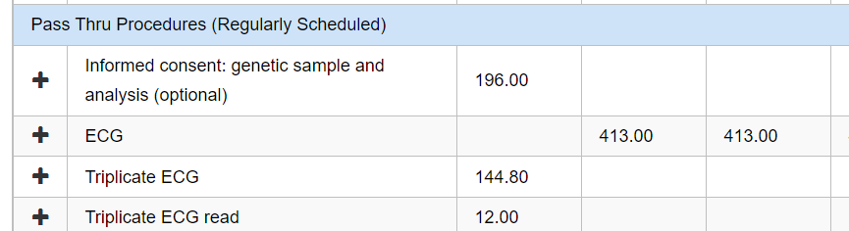
CHANGE: Process Update To As Needed Functionality
In the budget calendar there is now no Pass Thru Procedures (As Needed) section:
But there is still Pass Thru Procedures (Regularly Scheduled) that will now list all the pass thru costs and scheduling:

Slide 17


QUESTIONS?

Slide 18


THANK YOU
OnCore Support
•••
•••
•••
•••
•••
12/9/2024

Slide 19
REVIEW OF PREVIOUS ITEMS
Item 1
Details and updates
Item 2
Details and updates
Item 3
Details and updates

Slide 20
CHANGE: TITLE OF CHANGE
Change
Details of change
Impact
Impacted parties, downstream effects, etc.
Future Considerations
If applicable

Slide 21
PROPOSAL: TITLE OF PROPOSAL
Proposal
Proposal details
Impact
Impacted parties, downstream effects, etc.
Future Considerations
If applicable

Slide 22

REMINDERS AND FYIs
Reminder
List any reminders as applicable

Slide 23













ICON LIBRARY – Cut and paste icons for use in your PowerPoint
Notes:
TIP: Once you have copy and pasted the icons you like onto your presentation slides, you may delete this page out of your presentation.

