Slide 1
OnCore Department Advisory Meeting
August 8th, 2023

Slide 2
Structure
Review of previous items
Review of new items
Reminder! Submit agenda items
Definitions
Questions
Reminders and FYIs
Notes:
We have created a survey for submission of agendas items, questions, suggestions, etc. Take this to your respective groups and send us items as you see fit.
Please ask questions via chat. We will have immediate responses as time permits. Otherwise, all questions will be answered/sent by end of the day.

Slide 3
Review of Previous Items
New UCH Quality Assurance Signoff Task List
  For UCH-involved studies during initial & amendment submissions requiring signoffs
  This will be added & completed by the party performing QA signoff
  After calendar signoffs are started, Study teams can look at this task list to see what items are keeping QA signoff from being performed. They will still be notified separately if there are outstanding items needing their review.
“University of Colorado – Denver” cost center name changed to “CU-AMC”
Task List editing update for Affiliate CRM role
  Affiliate Research Manager can now edit UCH contracts task list. Previously, only Clinical Research Manager had this ability (not Affiliate).

Slide 4
Definitions – Changes vs. Proposals
Change
Proposal
Study team approval not required
Will be implemented immediately
Affected parties are notified prior to and after implementation
  Newsletter
  Department advisory meeting
Planned change
Requires review and approval from one or a combination of:
  Study teams
  Research administration staff
  Change control board

Slide 5
Change: HRH - CU Medicine Clinic Added
CHANGE
  To capture CU Medicine clinics at UCHealth Highlands Ranch Hospital, CU-Medicine Clinic added as an institution.
IMPACT
  HRH – CU Medicine will be visible in the PC Console’s Institutions tab if applicable for a study.
FUTURE CONSIDERATIONS
  HRH-CU Medicine will also be added as an option in the REDCap HSR portal.

Slide 6
Proposal: Update Health Affairs OTA Notice
Add Finance Specialist as an additional recipient to default Open to Accrual Notice
  This would only be for protocols in the Health Affairs library. These protocols utilize UCH or CU or BDC but are not required to be in the Oncology library (cancer studies).
  Current personnel notified are Regulatory Coordinator, Clinical Research Manager, Affiliate Clinical Research Manager, and Principal Investigator
IMPACT
  Anyone listed as a Finance Specialist in the staff tab for the specific protocol will receive a notification when the Protocol Status is changed to Open to Accrual. Study teams would not need to customize the notification to add these personnel.
  Receiving this notification would indicate to the Finance Specialist that they can invoice the startup/initial fees out of OnCore.
  Any notifications that are already customized would not be affected by this update.
Notes:
BDC – Barbara Davis Center
CU – Anschutz non-hospital specific departments/clinics

Slide 7
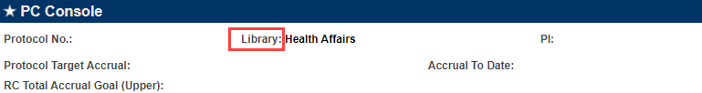
How do I know what Library my protocols utilize?
Navigate to your protocol in the PC Console. The Library is listed at the top:
The options are: Health Affairs, Oncology, and CHCO

Slide 8
Current Staff Notifications sent for OTA status
These are the staff roles that already receive the default OTA notice (sorted by Library):
Health Affairs | Oncology | CHCO
Regulatory Coordinator | Regulatory Coordinator | Regulatory Coordinator
Clinical Research Manager | Clinical Research Manager | Clinical Research Manager
Principal Investigator | Principal Investigator | Principal Investigator
Affiliate Clinical Research Manager | Affiliate Clinical Research Manager
 | Finance Specialist
 |  | Clinical Research Coordinator

Slide 9
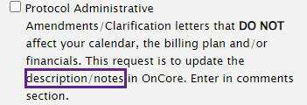
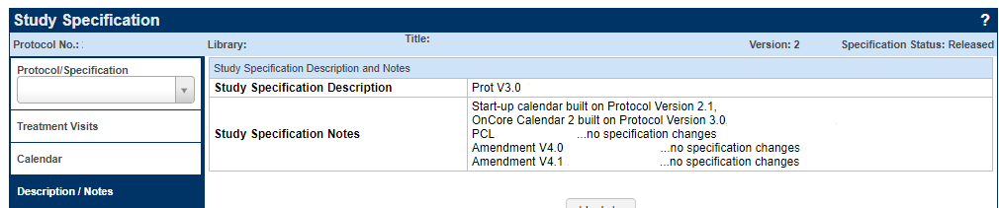
Proposal: Updating Protocol Versioning in Footnote
BACKGROUND
  The longstanding OnCore process for protocol updates that do not affect calendar/billing plan is to only update the description/notes in the Specifications Console within OnCore.
  The 001 calendar footnote & Study Specification Description stays labeled with the protocol version that was used to create the calendar.

Slide 10
Proposal: Updating Protocol Versioning in Footnote
PROPOSAL
  In addition to the description/notes, update the calendar footnote with each new protocol administrative letter/version regardless of if it actually changed the calendar/billing plan. This does not require a new calendar version.
IMPACT
  001 Footnote is visible in the Subject Console and coordinators can check that the calendar they are using is consistent with the currently active protocol. This is in the event they do not realize the additional protocol versions did not adjust the calendar.

Slide 11
Proposal: Updating Protocol Versioning in Footnote
IMPACT
  Possible confusion in the case of an administrative/protocol update that actually changed the calendar but study team did not initially realize when they submitted the amendment. (Version of protocol in footnotes would not accurately reflect calendar.)
  Possible confusion in budgeting when downloading calendar version for same reason as above.
  001 Footnote could become lengthy and unclear depending on how footnote is updated. Footnote could be updated to only give current protocol version (losing versioning history of which protocol the calendar was actually created with) or it could include each protocol update that did not affect the calendar after the version it was created on.
    Ex: “Calendar represents calendar version 4.1” VS “Calendar built on Protocol Version 3.0. Protocol V4.1 caused no specifications changes.”

Slide 12
Proposal Voting
For voting after the meeting,
  OTA Status Update: please complete this form.
  001 Footnote Update: please complete this form.
Notes:
Do the zoom poll at this point
Mention that you will email these links & they will be clickable in the uploaded slides

Slide 13
Reminders and FYIs – Oncore User Agreement
Please read the UCD APS 6001 - Providing and Using Information Technology policy document and sign the updated OnCore User Agreement at this link as soon as possible.
All active OnCore users must complete the OnCore Updated User Agreement by 9/26/2023.

Slide 14
Reminders and FYIs – Amendment Submissions
When submitting an amendment with calendar or budget changes, be explicit in what changes need to be made to the OnCore calendar/billing grid as a result of the amendment.
  Examples of common types of updates (not all encompassing):
    adding or removing arms/treatments, procedures, visits
    updating timepoints that a procedure happens
    changing cost of an invoiceable/study visit
  Reference page numbers in the protocol (tracked or clean) where the Project Analyst can verify these changes
Do NOT copy and paste the summary of changes from the protocol. This is often not clear on what changes need to be made within OnCore and includes changes that don’t affect the calendar or billing plan (e.g. updating inc/exc criteria).

Slide 15
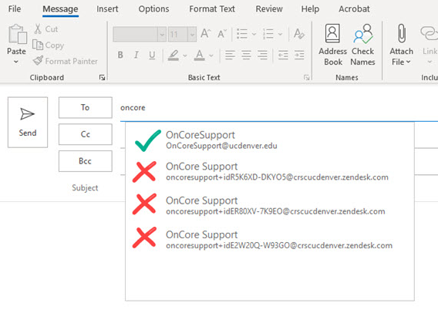
Reminders and FYIs – Emailing OnCore Support
When sending a new email to OnCore Support, please ensure the correct email address is being utilized – OnCoreSupport@ucdenver.edu. If you send a new email to an address with the format oncoresupport+id123456@crscucdenver.zendesk.com, that will not create a new ticket, but will instead thread your email into an existing ticket. This can lead to confusion and delays in responses.

Slide 16
Questions?
Notes:
We will send out the slides after this meeting. Please submit topics for discussion via the survey.
We’ll see you next month!

