Slide 1
OnCore Department Advisory Meeting
July 11th, 2023

Slide 2
Structure
Review of previous items
Review of new items
Reminder! Submit agenda items
Definitions
Questions
Notes:
We have created a survey for submission of agendas items, questions, suggestions, etc. Take this to your respective groups and send us items as you see fit.
Please ask questions via chat. We will have immediate responses as time permits. Otherwise, all questions will be answered/sent by end of the day.

Slide 3
Review of Previous Items
CMOCO Cost Center Added
  Colorado Molecular Correlates Laboratory
  This cost center will be utilized when services are provided by CMOCO (for example, next gen sequencing)
Updated CRA Role Permissions
  Team members with the CRA role in OnCore (typically Clinical Research Coordinators) now have the ability to update the staff tabs within their own management group.
Updated Manager Role Permissions
  Team members with the Manager role in OnCore (such as Clinical Research Managers) now have the ability to view attachments within the Financials Console

Slide 4
Definitions – Changes vs. Proposals
Change
Proposal
Study team approval not required
Will be implemented immediately
Affected parties are notified prior to and after implementation
  Newsletter
  Department advisory meeting
Planned change
Requires review and approval from one or a combination of:
  Study teams
  Research administration staff
  Change control board

Slide 5
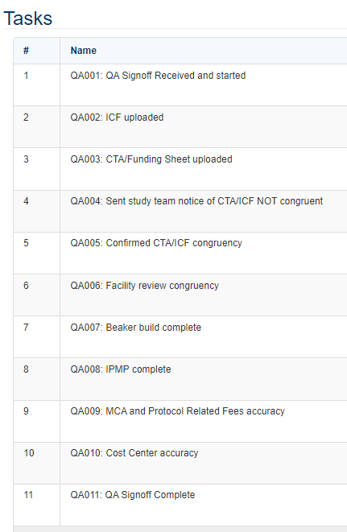
Change: New Task List for UCH QA Signoff
New UCH Quality Assurance Signoff Task List
  Only for UCH-involved studies
  For both initial & amendment submissions
  This will be added by the party performing QA signoff
IMPACT
  UCH will continue to notify study teams when items are outstanding that will keep them from performing QA signoff.
  After calendar signoffs are started, Study teams can look at this task list to see what items are keeping QA signoff from being performed.

Slide 6
Change: Update Name of Cost Center
“University of Colorado – Denver” cost center name changed to CU-AMC
  Cost center name updated to more accurately reflect institution involved
IMPACT
  Events utilizing University of Colorado Anschutz Medical Campus as a site will have the cost center read CU-AMC instead of University of Colorado-Denver

Slide 7
Change: Update to Affiliate CRM Role
Task List editing update for Affiliate CRM role
  Affiliate Research Manager can now edit UCH contracts task list. Previously, only Clinical Research Manager had this ability (not Affiliate).
  Other Task List templates were reviewed and affiliate positions were added to match the role permissions of their primary counterparts.
IMPACT
  Staff added with role of “Affiliate Research Manager” in staff tab for a protocol can edit UCH Contracts task list as needed.

Slide 8
Reminders and FYIs – OnCore Upgrade
OnCore PROD Upgrade – Completed 5/31
  Notification issue for signoffs should now be resolved. Please let us know if you encounter any errors or performance issues – reach out to OnCoreSupport@ucdenver.edu
    Make sure you are on latest browser version
OnCore TRAIN Upgrade – Completed 6/6

Slide 9
Questions?
Notes:
We will send out the slides after this meeting. Please submit topics for discussion via the survey.
We’ll see you next month!

Slide 10
Review of Previous Items
ITEM 1
  Details and updates
ITEM 2
  Details and updates
ITEM 3
  Details and updates

Slide 11
Change: Title of Change
CHANGE
  Details of change
IMPACT
  Impacted parties, downstream effects, etc.
FUTURE CONSIDERATIONS
  If applicable

Slide 12
Proposal: Title of Proposal
PROPOSAL
  Proposal details
IMPACT
  Impacted parties, downstream effects, etc.
FUTURE CONSIDERATIONS
  If applicable

Slide 13
Reminders and FYIs
REMINDER!
  List any reminders as applicable

