Slide 1
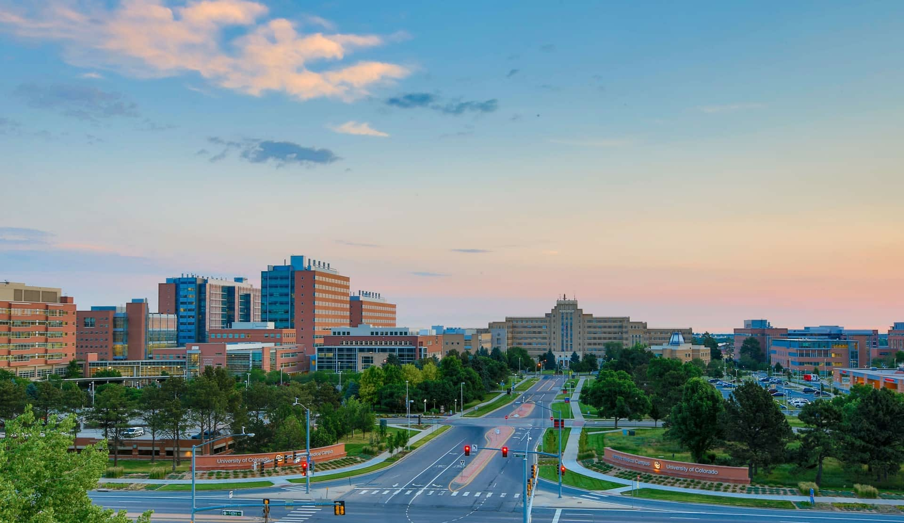
Ethan Carter, PhD
Director, Environmental Health & Safety
8 January 2025
TRANSLATIONAL RESEARCH ETHICS
RESPONSIBLE CONDUCT OF RESEARCH
- Cells to Animals to Humans -

Slide 2



Expectations
  Silence personal devices.
  Stay muted when not talking.
  Set up in a quiet location.
  Remain attentive. Avoid checking email/phone/web.
  Use the Chat function to ask questions or get technical help.
  Use your full name, not an alias.
Receiving credit for attendance:
To satisfy the NIH Requirement for Instruction in the Responsible Conduct of Research, the following are required to receive credit for attendance:
      Attend the full 90 minutes of the training. Attending any 8 out of the 9 RCR seminars we offer will satisfy the NIH requirement.
      Keep your video camera on throughout the session. NIH requirements for RCR training specify face-to-face discussion.
      Participate interactively throughout the session. Engage in discussion through the chat, come off mute, or raise your hand.

Slide 3
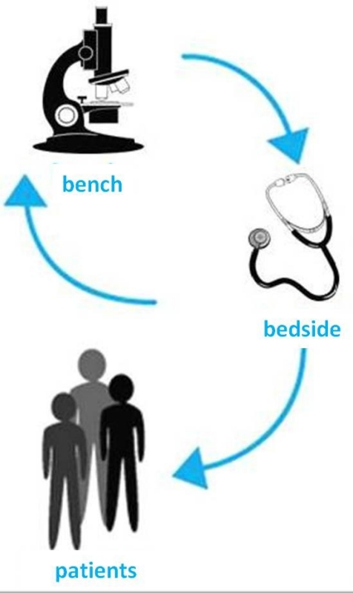
Objectives & Agenda
By default, nearly all research being conducted at the Anschutz Medical Campus is translational.
Agenda
Definitions
Framing the problem
Case studies
Decision Trees
Institutional Resources
Notes:
TIP: Switch out the image on the right to something relevant to your presentation by deleting image and clicking picture icon to insert new image.

Slide 4
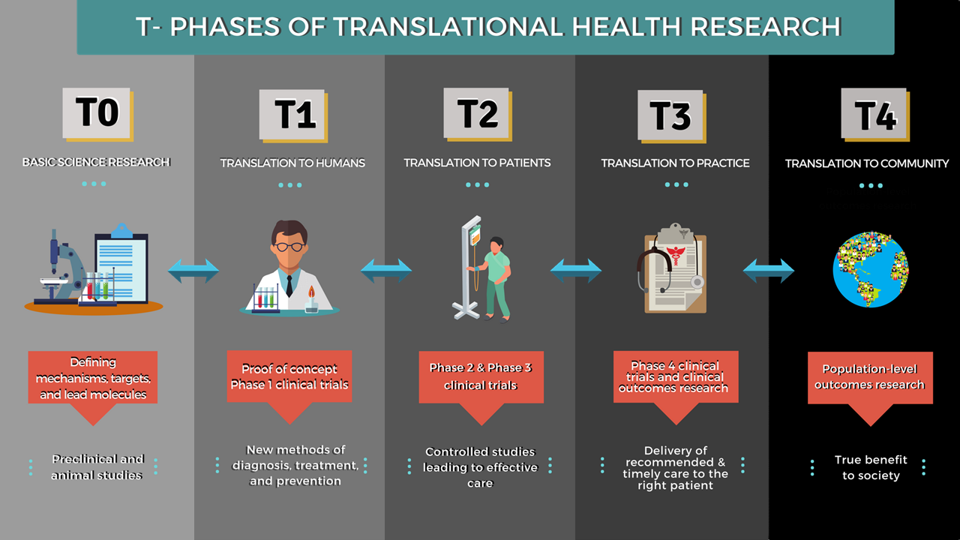

Slide 5
Translational research poses ethical dilemmas
"I am the principal investigator for a clinical trial and would like to recruit subjects for this study from my practice. What precautions need to be taken to address potential conflicts of interest?“
"What are the potential ethical issues associated with putting a human neuronal stem cell into the brain of a developing mouse embryo?“
"I have completed a study looking at genetic variants associated with coronary artery disease. These variants are not routinely evaluated by cardiologists but may impact the health of volunteers in my study. Should I share these findings with my research subjects and, if so, what's the best way to contact them?"

Slide 6

Why is RCR Important in Translational Research?
Regulations and compliance are critical, but more challenging are the ethical principles and practices when conducting translational research. When bridging the gap between basic science discoveries and their application in clinical practice, the safety and well-being of research participants while upholding scientific integrity throughout the process is essential.
Key Objectives
Maintaining public trust: Maintaining public trust in research by ensuring ethical practices and transparent reporting of results.
Upholding scientific validity: Upholding rigorous research methods to produce reliable and meaningful results.
Participant protection: Minimizing potential risks and maximizing benefits for research participants.
TRANSLATIONAL RESEARCH
Notes:
TIP: Switch out the image on the right to something relevant to your presentation by deleting image and clicking picture icon to insert new image.

Slide 7
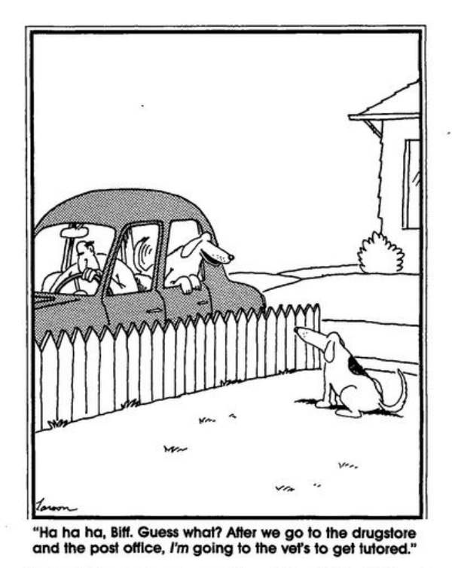
Know the ground rules,
Know what you are getting into
With respect to translational research…….
It is important to understand what you are getting into – translational research is governed by:
Regulations & compliance
Ethical & philosophical mores

Slide 8

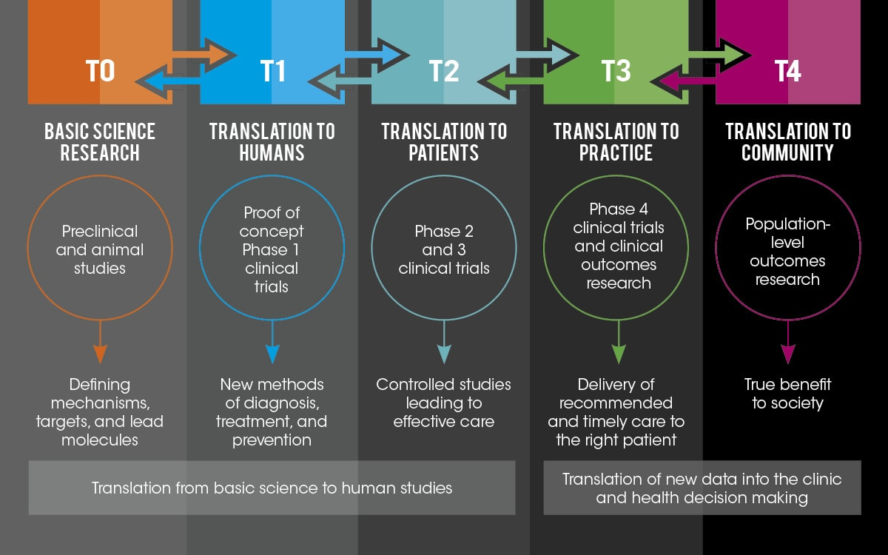
What is Translational Research?
The purpose of translational research is to test, in humans, novel therapeutics strategies developed through basic research and experimentation
Translational Research
This is the foundation of the NIH’s Bench-to-Bedside Awards which encourage the collaboration between clinicians and basic scientists.
NIH launched the Clinical and Translational Science Award (CTSA) Consortium in 2006.
Our institution has been a CTSA awardee since 2008.
Translational research can occur in these formal, structured environments or in informal collaborations
Notes:
TIP: Switch out the image on the right to something relevant to your presentation by deleting image and clicking picture icon to insert new image.

Slide 9
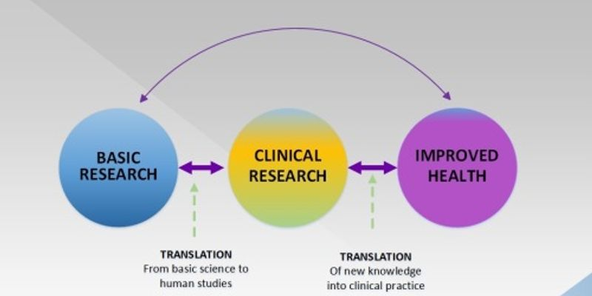
CTSA Objectives
“Speed discoveries to improved patient care..”
Develop a distinct discipline for clinical and translational science at institutions
Provide opportunities and resources for original research on novel methods
Develop translational technologies and a knowledge base for the full spectrum of clinical and translational science
Synergize partnerships with industry, foundations, and community physicians
Train the interdisciplinary teams who will conduct the clinical and translational research of the future
Notes:
TIP: Switch out the image on the right to something relevant to your presentation by deleting image and clicking picture icon to insert new image.

Slide 10
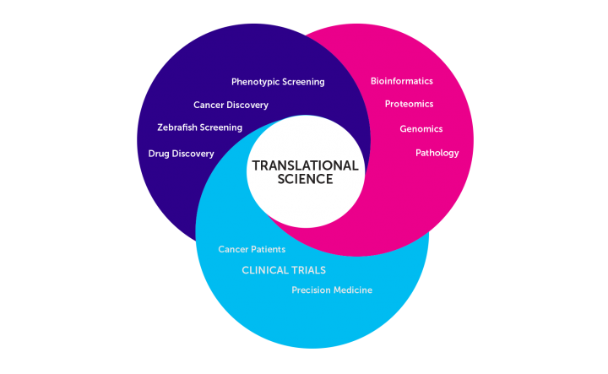
Why Conduct Translational Research?
Complexity. Basic mechanisms of disease must be studied in more simple forms – cells and animals.
Expertise. No one person or research group possesses all of the skills required.
Safety. Novel modalities must be tested safely before being used in humans.
Efficiency. Well-coordinated translational research can conserve resources and speed the delivery of treatments and cures to human disease.

Slide 11
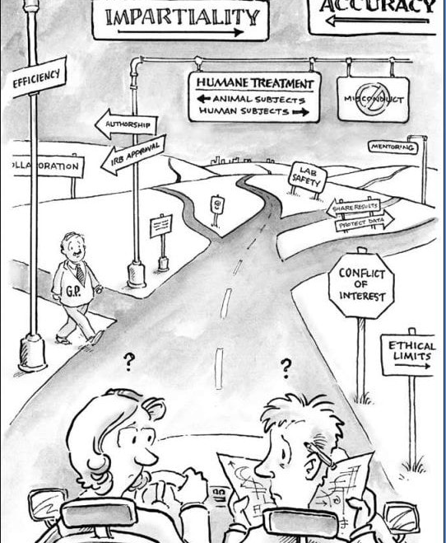

Translational research as an RCR topic?
The foundation of translational research is to foster and promote multi-investigator and multi-institutional collaboration and sharing.
Multiple methods and technologies are used.
Numerous federal regulations, institutional policies and best practices govern cell, animal, and human research.
Federal regulations – CFRs
FDA regulations
HHS privacy (HIPAA)
Export controls & shipping
Conflict of Interest (COI)
NIH Grants Policy
Inter-entity material transfer agreement
Institutional oversight cmte’s
Industry agreements
Notes:
TIP: Switch out the image on the right to something relevant to your presentation by deleting image and clicking picture icon to insert new image.

Slide 12
Translational Research & Compliance
Institutional Oversight of Translational Research
Colorado Multi-Institutional Review Board (COMIRB) – reviews all human subjects research
Radiological Safety Committees – review all research using radiological materials
Institutional Animal Care and Use Committee (IACUC) – reviews all research using animals
Institutional Biosafety Committee – reviews all research using rDNA, Select Agents, Dual-use Research and infectious material
Department of Environmental Health and Safety
Office of Regulatory Compliance – oversees DURC, EC, COI and HIPAA compliance; Clinical Research Support Center (CRSC)
Clinical Research Administration Office (CRAO)– oversees the protection of intellectual property and material transfer agreements (MTAs)
Colorado Clinical & Translational Sciences Institute (CCTSI) – has a Regulatory Knowledge & Support Core (RKSC)

Slide 13
Translational Research & Compliance
Review of several scenarios and hypothetical case studies that represent commonly occurring situations in translational research
Reminder: To participate in discussions, raise your hand.
Click “Participants” at the bottom of your screen.
Click “Raise Hand” (click “Lower Hand” when done).
Sign the Attendance Sheet now by
clicking the link in the Chat.

Slide 14
Research Considerations
Translational research could include situations where a researcher faces ethical dilemmas related to transitioning findings from basic science to clinical trials, such as: (1) conflicts of interest arising from industry collaborations, (2) issues with informed consent in patient recruitment, (3) data manipulation to achieve desired results, (4) concerns about sharing preliminary data with potential funders, or (5) navigating authorship disputes when transitioning between different research phases; all while ensuring the integrity of the research process and prioritizing patient well-being throughout the translation process.

Slide 15
Data manipulation pressure:
A research team discovers unexpected negative results in a late-stage clinical trial but feels pressure from the funding agency to manipulate the data to present a more positive outcome. How should they navigate this situation while upholding ethical research practices?
Early data sharing with funders:
A researcher is considering sharing promising preliminary data from a translational research project with potential funders before the research is fully validated. What are the potential ethical concerns associated with early data dissemination?
Authorship disputes:
A team transitioning from pre-clinical to clinical trials faces a disagreement about authorship contributions, with some members from the initial basic science team feeling their work is not adequately recognized in the clinical trial publications. How should the team address this issue fairly?
Specific scenario examples:
Industry collaboration conflict:
A researcher developing a promising new cancer treatment receives significant funding from a pharmaceutical company with a vested interest in the drug's success. How should they balance the need to maintain scientific integrity with the pressure to generate positive results for the company?
Patient recruitment challenges:
A clinical trial is struggling to recruit patients from diverse backgrounds, potentially impacting the generalizability of the study results. What ethical considerations should the researchers take into account when attempting to address this recruitment gap?

Slide 16
Key ethical considerations in translational research:
Informed consent:
Ensuring patients fully understand the risks and benefits of participating in a clinical trial and have the ability to withdraw at any time.
Patient privacy:
Protecting patient data and maintaining confidentiality throughout the research process.
Benefit-risk analysis:
Carefully weighing the potential benefits of a new treatment against the risks to patients.
Conflict of interest management:
Disclosing and appropriately managing any potential conflicts of interest related to industry collaborations or financial incentives.
Scientific rigor:
Adhering to established research methodologies and data analysis practices to ensure reliable and reproducible results.

Slide 17
Scenario #1
You are the PI of an industry-sponsored trial investigating the effectiveness of several new drugs in mitigating tumor growth. CU Anschutz is a high-enrolling site of this multi-center trail. Published work in mice (from the study sponsor) demonstrates that all of the treatment drugs were equally effective in tumor shrinkage and survival.
After 6 months of accrual, with initial results coming in you notice that your results differ from those of the sponsor.
What do you do? What are your options?

Slide 18
Scenario #1 - Discussion
Do you publish your results locally? At CU Anschutz, our industry-sponsored contracts have a provision for PIs to publish their local results.
How will publishing the results locally, basically splitting off from the sponsor’s original intent affect your career and relationship with the sponsor?
What about staying silent? Will that cause you moral injury?
Reference: https://www.ucsf.edu/news/2000/10/97405/ucsf-harvard-team-publishes-major-hiv-therapy-study-over-objections-sponsor

Slide 19
Scenario #2
You are conducting SARS-CoV-2 / COVID-19 diagnostic testing on symptomatic people using the nasal pharyngeal swab (NPS) collection method. A colleague has been working on a COVID-19 detection method using saliva and asks you if you can have the patients spit into a collection cup during their testing so that she can determine if she can detect a viral load and compare it to your NPS sample results.
What, if anything, needs to be done for you add this collection method to your test?

Slide 20
Scenario #2 - Discussion
A revised informed consent may be required.
It is possible that this extra collection can be readily done under the auspices of Quality Improvement (QI)
If a method, such as the saliva method in the early days of the epidemic is not FDA approved for the detection of SARS-CoV-2 and diagnosis of COVID-19, therefore the results from the saliva test can not be shared with the patient or published.

Slide 21
Scenario #3
You have an approved IACUC protocol to investigate cardiovascular function in aging rats. Five drugs were approved for use in this protocol.
A clinical colleague, who has had very interesting observations in some of her patients using a different FDA-approved drug, approaches you about treating your rats with what she has used.
What, if anything, needs to be done for you to treat your rats with this drug and give your colleague the hearts and aortas from these rats?

Slide 22
Scenario #3 - Discussion
If the goals of the colleague’s work are the same as your own, you must file an IACUC amendment requesting to add this additional drug to your protocol. No work can begin until this protocol is approved.
If the colleague’s goals are distinctly different, she will have to submit her own protocol for review. No work can begin until this protocol is approved.
What if your colleague just needs the untreated tissue for controls?

Slide 23
Scenario #4
A colleague at University of Iowa developed a novel monoclonal antibody and has agreed to share this with you. You want to use this antibody to evaluate protein expression and localization in macrophages you have collected from bronchiol-alveolar lavage fluid from patients.
What, if anything, needs to be done for you to receive this probe and use it in your studies?

Slide 24
Scenario #4 - Discussion
Because the antibody is the intellectual property of the University of Iowa investigator, a Material Transfer Agreement (MTA) will need to be executed between the two institutions.
If the gene and protein of interest in the macrophages was previously covered in the informed consent with COMIRB, no additional action is needed. If not, COMIRB should be contacted.
In general, our institutional policy is that an MTA must be executed for the exchange of ALL scientific material with external entities.

Slide 25
Scenario #5
You have purchased a stock of kidney (MDCK) cells from American Type Cell Culture (ATCC). In addition to experiments on untransfected cells, you will also be transfecting these cells with various sodium channel constructs.
Your colleague across the bench would like a couple of plates of these cells to conduct their own, unrelated research.
What, if anything, needs to be done for you to give him several plates of cells?

Slide 26
Scenario #5 - Discussion
Per our Institutional Materials Transfer Agreement (MTA) with ATCC, material purchased from ATCC may only be used by the purchaser.
Exception: Transfer of material is authorized if the collaborator is doing work directly tied to the original purchaser’s project.

Slide 27
Scenario #6
You are interested in studying the pathogenicity of the influenza and SARS-CoV-2 viruses, to include exploring the mechanisms that could enhance human to human transmission.
Published work from University of Florida and Beijing University indicate possible collaborators on this project. You have secured space in our BSL-3 lab for this work.
What, if anything, should be your considerations for this work?

Slide 28
Scenario #6 - Discussion
Research involving the manipulation or enhancement of the pathogenicity of infectious agents may fall under federal “Dual Use Research of Concern” (DURC). DURC regulations include a variety of other areas, as well.
In addition to DURC, shipping material such as high path influenza also falls under new federal regulations pertaining to “Export Controls”.
Finally, if biological materials will be shipped between collaborating institutions FAA/IATA shipping training must be taken by the shipper.

Slide 29
RCR Decision Trees
Several decision trees will be placed on the RCR website
Overall Translational Research
Cellular Research
Animal Research
Human Subjects Research
Bio-Banking
https://research.cuanschutz.edu/EHS

Slide 30
Summary
Translational research can be a formal or informal process.
Translational research is complicated with a multitude of compliance decision points.
Safely and ethically navigating translational research is both a regulatory challenge and a moral and ethical challenge.
Numerous institutional resources exist to facilitate the research and collaboration.

Slide 31
Institutional Resources
Office of the Vice Chancellor for Research
Other Departments/Resources
Office of Regulatory Compliance
AVC Alison Lakin, PhD
Environmental Health & Safety
Ethan Carter, PhD, Director
Office of Research Committee Support (ORCS)
  IACUC, IBC, Radiation Safety
    Mark Douse, PhD, Director
Office of Laboratory Animal Resources (OLAR)
AVC Jori Leszczynski, DVM, Institutional veterinarian
Colorado Multi-Institution Review Board (COMIRB)
John Heldens, Director
Dual Use Research of Concern and Export Controls
  Christine Ahearn, JD
Office of Grants & Contracts
  AVC Amy Gannon
1. Clinical Research Administration Office
crao_contracts@ucdenver.edu
303-724-1111
2. CCTSI
https://cctsi.cuanschutz.edu/

Slide 32


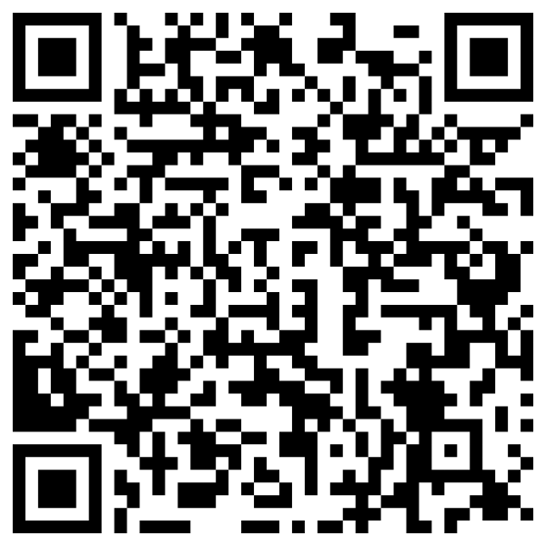

Resources
  If you have questions about RCR, email ClinicalResearchSupportCenter@ucdenver.edu
Documentation:
      Certificates of completion are sent out at the end of the academic year, for each person who has attended and signed-in for at least 8 of the 9 sessions.
      A Course Evaluation survey will be sent to you after the session. Complete the 3-minute anonymous survey so we can best understand your experience and improve future courses.
      Slides are available on our website. Scan the QR code and scroll towards the bottom of the
      page to the "Course Content" section.

