Slide 1
ClinicalTrials.gov Registration
User’s Guide
July 27 2021

Slide 2
Caveats
This user guide is a collaborative effort on the part of ClinicalTrials.gov administrators at 11 academic medical centers around the nation to share efficient, best practices for most registrations based on our experience within our institutions.
The recommendations within it should not be seen as necessarily required by law in all cases. The vast variety of circumstances for different registrations cannot be fully encompassed within a single slide set.
Notes:
Institution-specific slides have been marked with a green box in the upper left corner, to recommend that the screen shot presented be replaced with one filled in with information for that institution, e.g. IRB contact information in order to be of most utility to the end user who will actually be creating the registration.

Slide 3
Tips and Recommendations
Chrome and Firefox are more likely to let you “expand” text boxes to see more
Do not use first or second person. Replace “I” and “we” with “the investigator”; replace “you” with “participants”
Typos and spelling errors are not acceptable
Define all acronyms
Use notes provided by PRS system to guide you (suggestions/reminders; not mandatory)
The Draft Receipt function provides a copy of your record as it appears in PRS

Slide 4
Validation Messages
As you enter information, system validation (error, warning and note) messages may appear and disappear.
Start by entering information for all required data elements.
Note that some data elements are required, while others are conditionally required (based on information entered for other data elements).
Finish by addressing all remaining validation messages.
Complete all required fields before checking/stressing on validation.

Slide 5
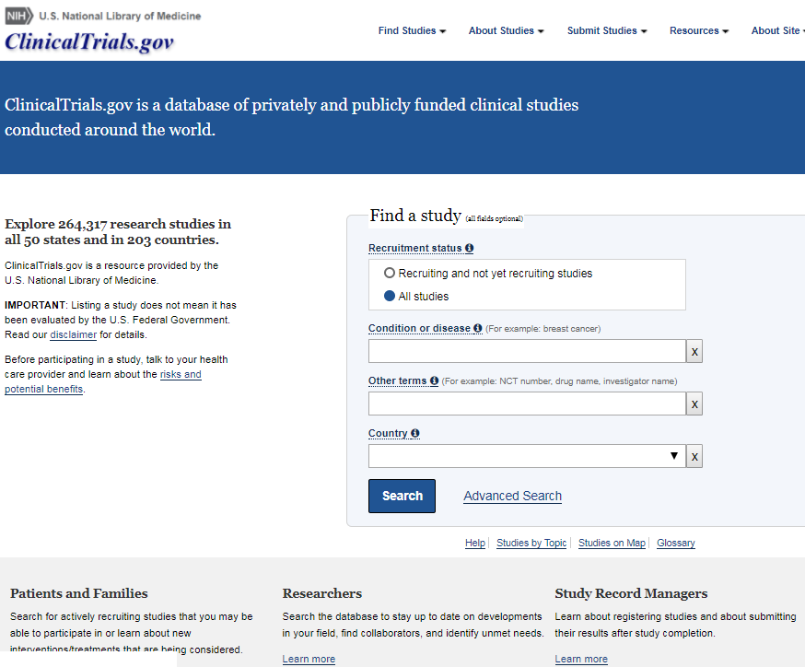
Public Site

Slide 6
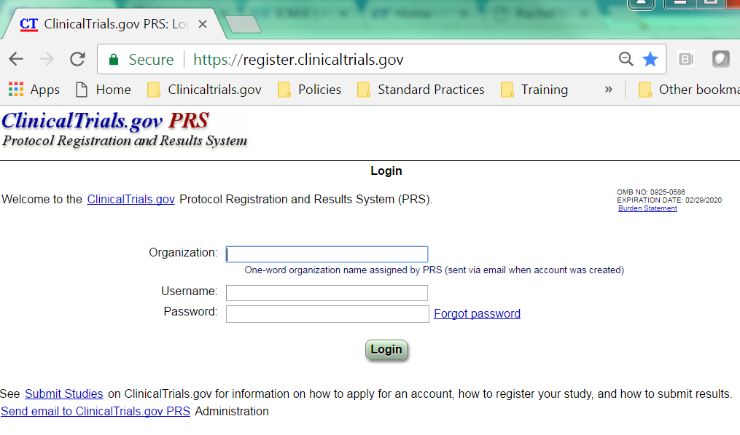
Institution specific slide
Protocol Registration and Results System
Organization Name: UColorado. To obtain a new ClinicalTrials.gov user account, please contact ClinicalResearchSupportCenter@ucdenver.edu
Notes:
Institutions can add their own text in these slides to guide local users e.g. Organization name.
Insert organization name and provide link to or email for institution’s clinicaltrials.gov administrator.

Slide 7
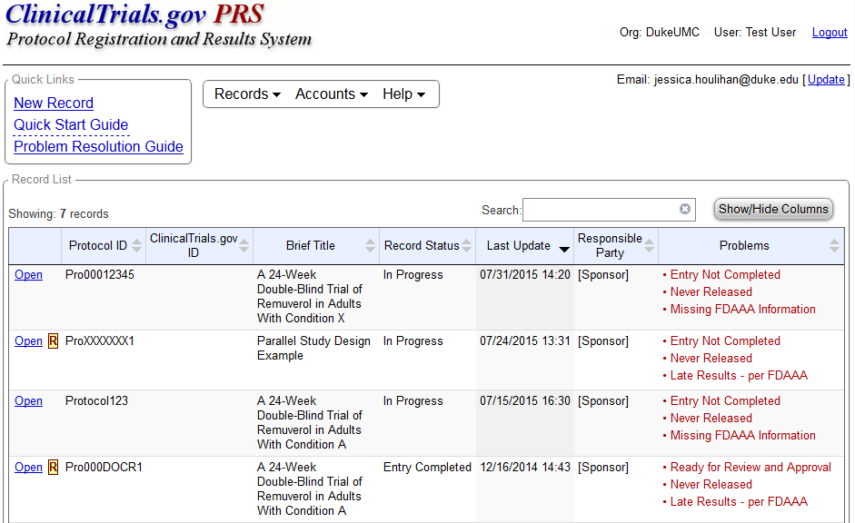
To create a new record, click the New Record link or use the Records drop down menu
The system flags records with problems to be addressed

Slide 8
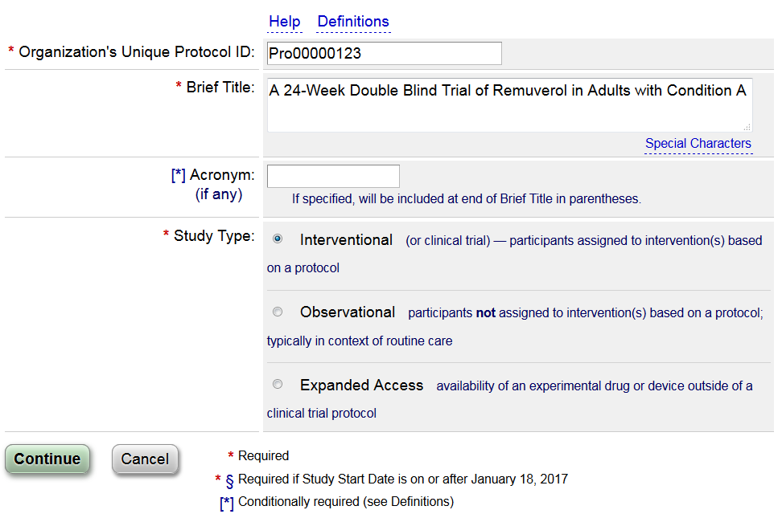
The COMIRB Protocol #
This title will be displayed in search results
Expanded Access records should only be created by the product manufacturer
More explanations for this stage on next screen

Slide 9
The Help link contains examples and data entry tips
The Definitions link contains the meaning of terms. CHECK OFTEN! Fields may not be descriptively named

Slide 10
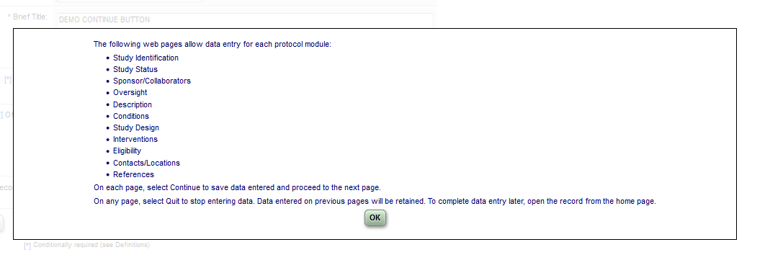
After you click “Continue”, you will see this dialog box
Select OK

Slide 11
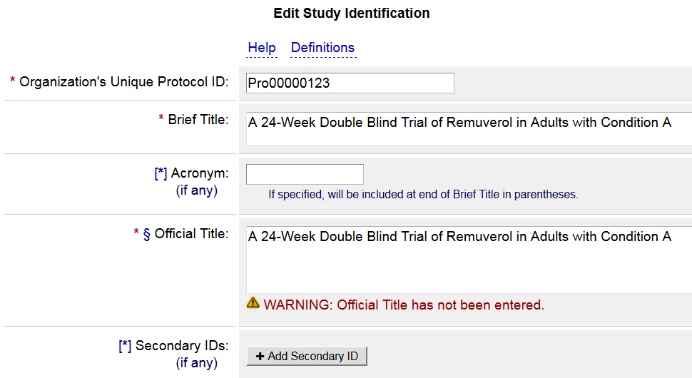
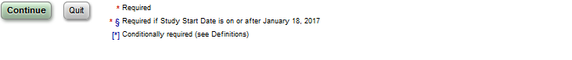
Study Identification
Required by ICMJE; should be consistent with formal IRB title
IMPORTANT! If the clinical study has any Federal funding (e.g. NIH, VAORD), you must enter the grant or contract number as a Secondary ID. (Example NIH Grant #: R01CA654321)
Choose Quit to save work from previous screens, then Continue
Notes:
The NIH Grant number should consist of an activity code (3 or 4 numbers & letters, such as R01), institute code (2 letters), and a 6 digit serial number. It is possible that the 6 digit number on the end could have a dash (-) and suffix.
Note: Sometimes the link with the NIH RePORTER doesn’t work properly, and an error will flag that its’ not a recognized NIH grant number. When this happens, ClinicalTrials.gov recommends using “Other” and putting in the NIH grant number manually. When the next update is made (or a few weeks later), this can be fixed back to an NIH grant number without the error.
Ask Rebecca to confirm if Secondary ID will change further for NIH flag;

Slide 12
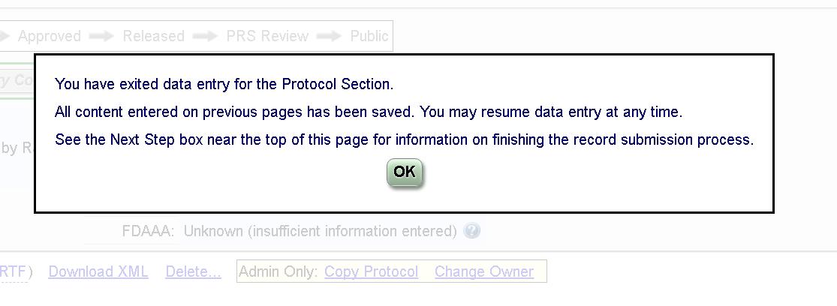
After you click “Quit”, you will see this dialog box
Select OK

Slide 13
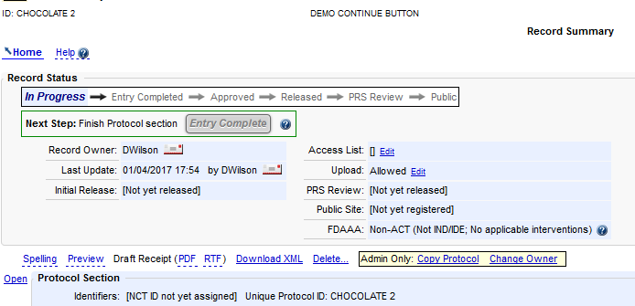
Record Summary Page
PI can share access with study team members and support staff by adding them to the Access List.
PI is legally responsible for record accuracy, compliance, and maintenance.
The Record Owner is the primary contact for the record. This should always be the PI for CU studies. To change this (e.g. if a PRA created the record for the PI), contact ClinicalResearchSupportCenter@ucdenver.edu

Slide 14
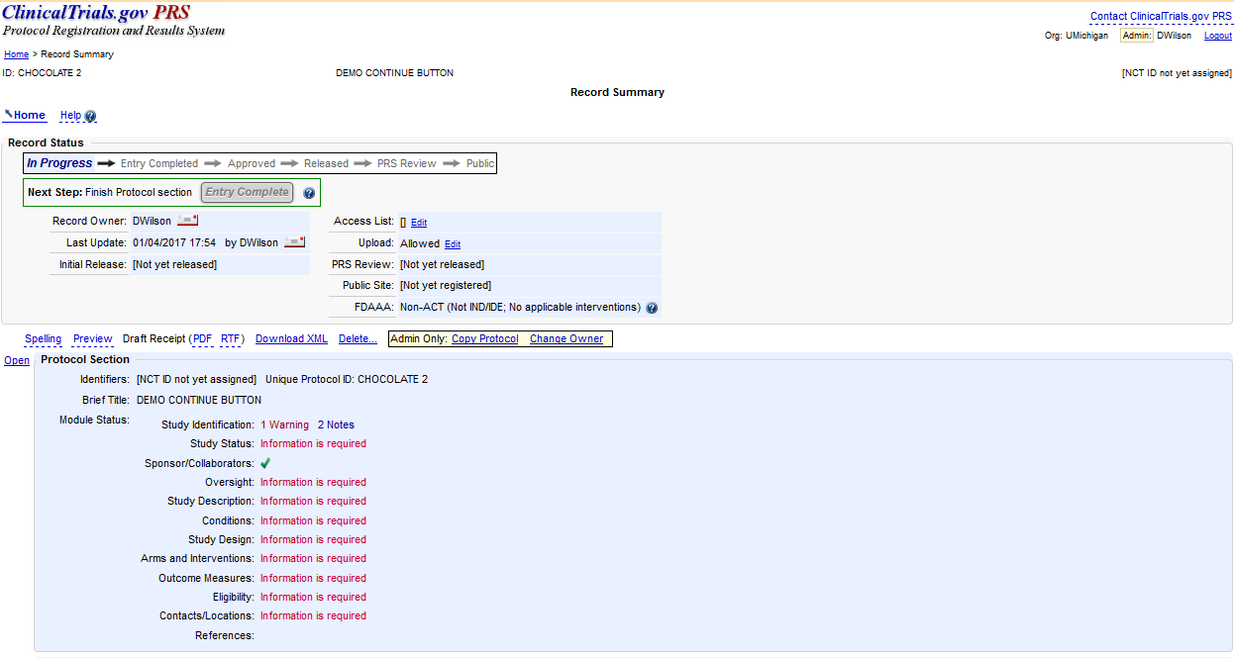
Record Summary Page
Click Open
to edit information section by section

Slide 15
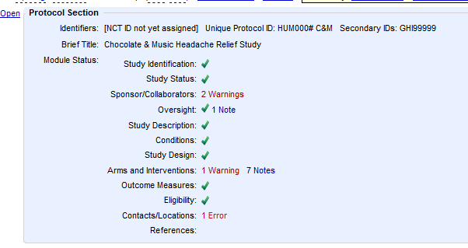
Record Summary Page
As you fill in more information, the Record Summary will show your progress

Slide 16
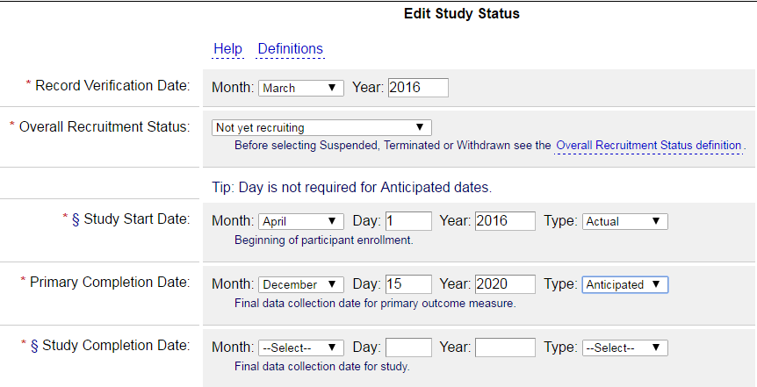

Study Status Section
The last time the record was updated & reviewed for accuracy. If this date is more than 1 year old, the record will generate a “Not Recently Updated” error.
IMPORTANT! Only use “Active, not recruiting” if data are still being collected/study visits are ongoing. If data collection is complete, the status should be Completed or Terminated.
Select Actual once date has occurred
Select Anticipated for projections
Save button is always at bottom of each page
Notes:
Overall Recruitment Status: This field refers to patient contact and data collection, not data analysis or status of the study with the IRB. The “active, not recruiting” status is defined as: “study is ongoing (i.e., patients are being treated or examined), but participants are not currently being recruited or enrolled.”
Completion Dates: These dates are VERY IMPORTANT, especially for ACTs. They drive the time line for results entry.

Slide 17
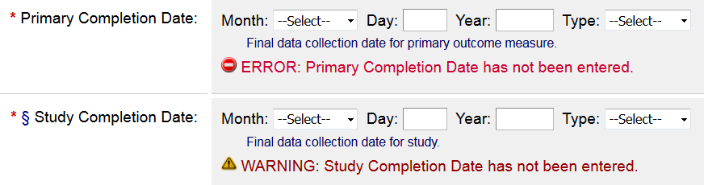
Primary and Study Completion Dates
Completion Dates are based on data collection
They are NOT based on:
data analysis
database lock
publication
IRB closure
If you use these as Completion Dates, you may have LATE RESULTS

Slide 18
Primary and Study Completion Dates: Definitions
Primary Completion Date *
Definition: The date that the final participant was examined or received an intervention for the purposes of final collection of data for the primary outcome, whether the clinical study concluded according to the pre-specified protocol or was terminated..
  Once the clinical study has reached the primary completion date, the responsible party must update the Primary Completion Date to reflect the actual primary completion date.
Study Completion Date *§
Definition: The date the final participant was examined or received an intervention for purposes of final collection of data for the primary and secondary outcome measures and adverse events (for example, last participant’s last visit), whether the clinical study concluded according to the pre-specified protocol or was terminated.
  Once the clinical study has reached the study completion date, the responsible party must update the Study Completion Date to reflect the actual study completion date.
Usually, these dates are THE SAME (unless you have longer term follow up for secondary outcome measures) and are the LAST PARTICIPANT’S LAST STUDY VISIT. It is extremely important that these dates are accurate. Depending on the type of study, getting these wrong can lead to late results, and fines/Notices of Noncompliance from FDA, or denial of future funding and/or grant recovery actions from NIH/federal funders

Slide 19
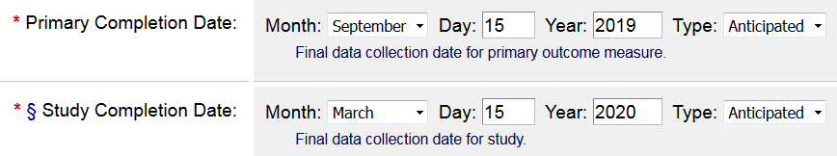
Primary and Study Completion Dates
Remember: Results for the primary outcome measure(s) are due within one year of the Primary Completion Date. Results for the secondary outcome measures are due one year after the completion date for that outcome.
In this example, Primary Outcome results are due by September 15, 2020. All study results must be entered by March 15, 2021. Some secondary results may be due earlier depending on data collection time frames.

Slide 20
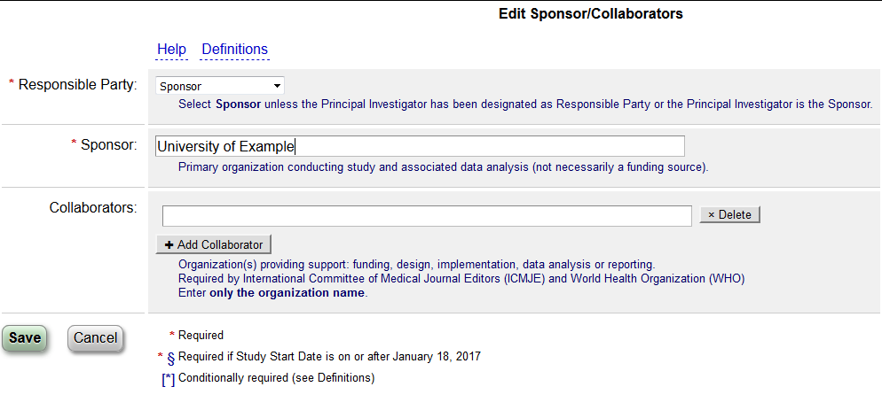
Sponsors/Collaborators
For our studies, the Responsible Party is the Sponsor, and the Sponsor will be University of Colorado Denver
If the study is NIH or federally funded, include the NIH Institute or other federal agency as a Collaborator.
Collaborators include other funders, etc. Add as many as necessary

Slide 21
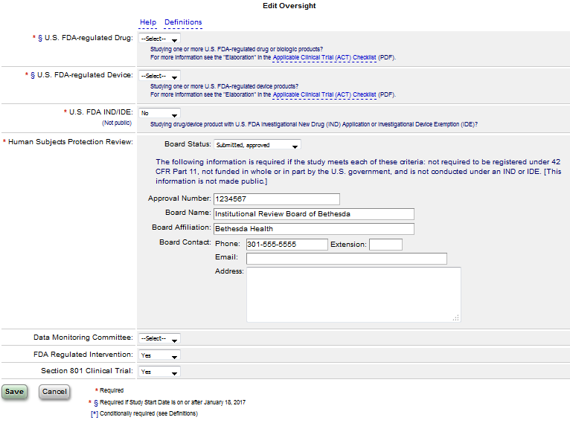
Oversight
Refer to definitions and linked Checklist for these sections
If this is “Yes”, the IND/IDE information is required
The IRB (e.g. COMIRB) information goes here. The approval number is the IRB protocol number.
These fields are not required. You can leave them blank.
Notes:
“Plan to Share Data” = individual participant data, not publication in a journal.
Neither the FDA regulated intervention nor the Section 801 data elements are pulled by the algorithm that tells you whether it looks like the study is an ACT, based on the information provided.
The last two questions have effectively been replaced by the first two and are no longer required. Leaving them at “select” is fine, unless your organization has a different policy. Some organizations rely on them for internal reporting.

Slide 22
Oversight
COMIRB Standardized Contact Information
Board Name: Colorado Multiple Institutional Review Board (COMIRB)
Board Affiliation: University of Colorado, Denver
Phone: 303.724.1055 Email: comirb@ucdenver.edu
Address:
  COMIRB/UCD, Mail Stop F490
  Anschutz Medical Campus, Bldg 500
  13001 E 17th Place, 3rd Floor, Room N3214
  Aurora, CO 80045

Slide 23
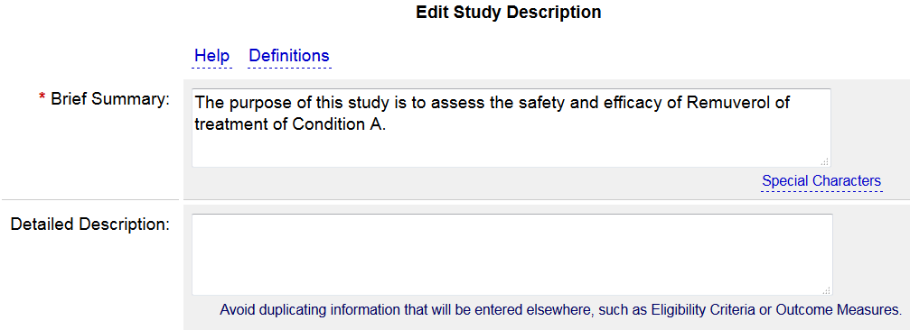
Study Description
Describe the study hypothesis in terms understandable to the lay public.
It can be adapted from the informed consent, but omit any and all personal pronouns, (e.g. we, you).
This field is optional and can be left blank. It does not have to be in lay language
It can be adapted from the background or aims section of the protocol, but do not copy and paste the entire protocol. This field cannot contain promotional language.
Where applicable, explain uncertainties or exploratory nature of study. If there are any parts of the trial, which the public cannot know about while the study is ongoing without affecting scientific integrity, such as deception research or inclusion/exclusion criteria which could be easily faked in order to join a study (e.g. pain levels in order to have access to a controlled substance), it would be good to explain here, e.g. “Some inclusion/exclusion criteria are purposely omitted at this time to preserve scientific integrity. They will be included after the trial is complete.”

Slide 24
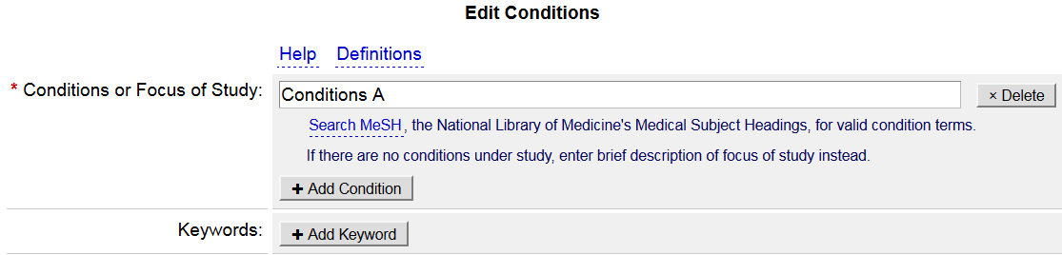
Conditions
Enter each study condition, one per line.
Use Search MeSH link to verify the correct condition term
Keywords help users find studies in the database. Good for recruitment!

Slide 25
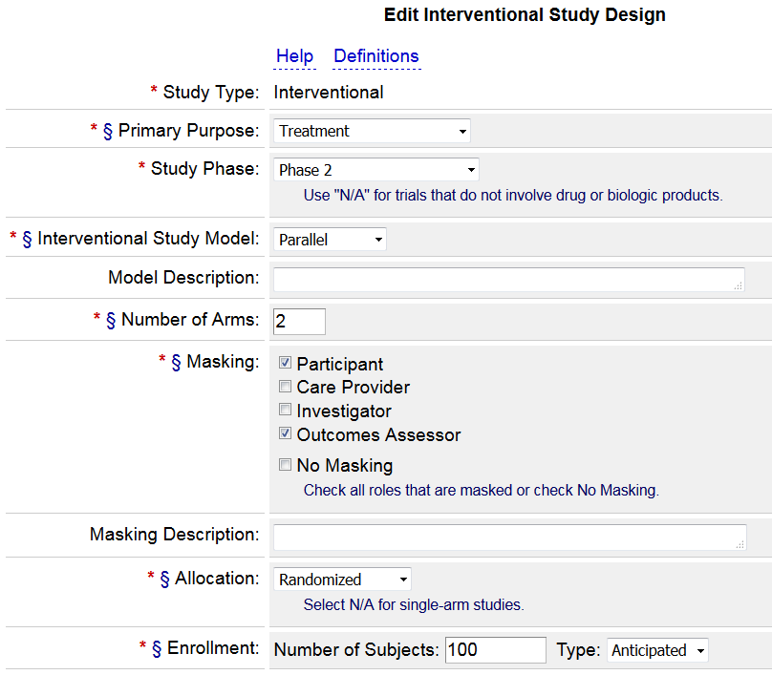
Study Design
Give an honest estimate for anticipated enrollment (based on consent, not completion)
Check the “definitions” link

Slide 26
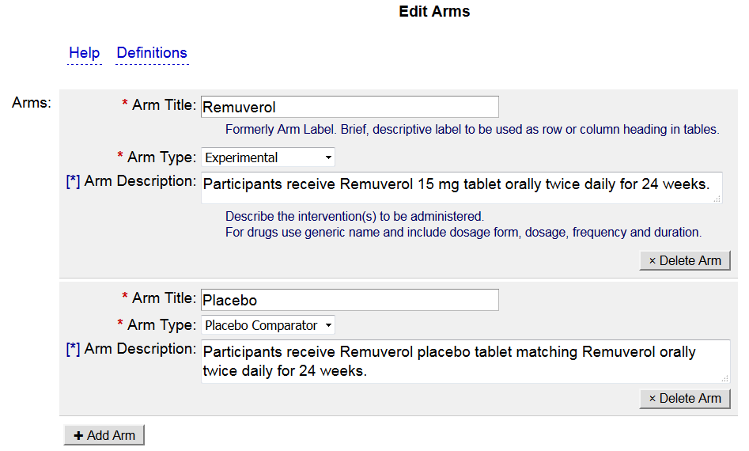
Arms
Arms may not pre-exist based on how many arms you defined in the previous section. You must add each arm. Do not title your arm as Intervention or Arm 1. Arm title should be more descriptive.

Slide 27
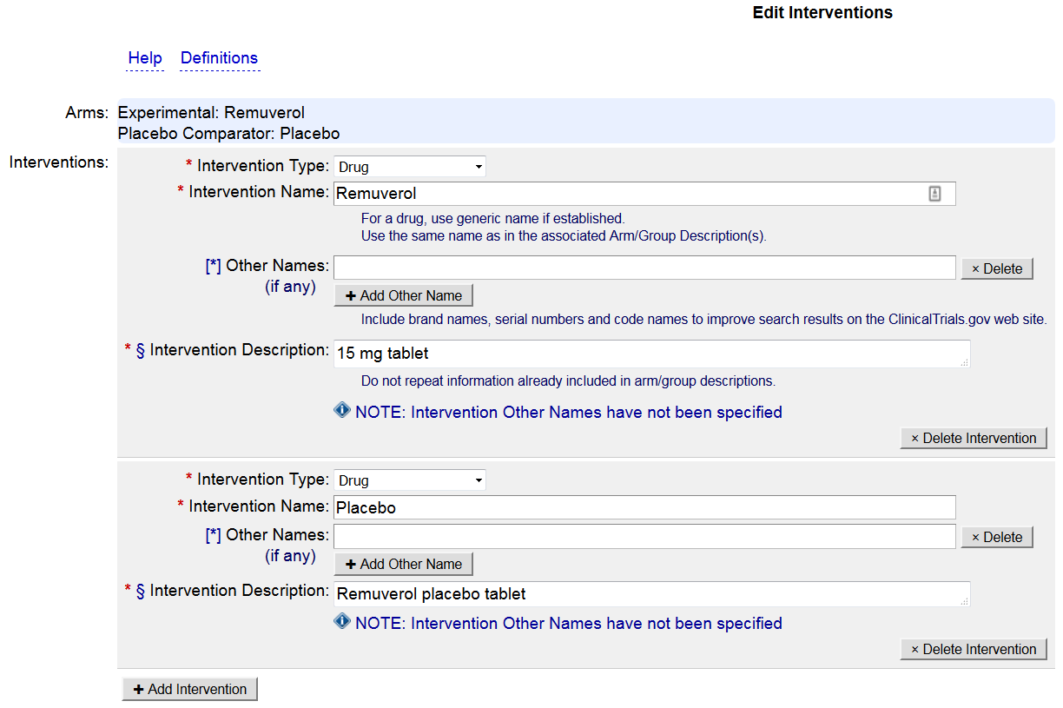
Interventions
List Placebo as a Drug intervention
Notes:
Studies using multiple doses of the same drug can list the drug as one intervention. The doses should then be listed as separate arms

Slide 28
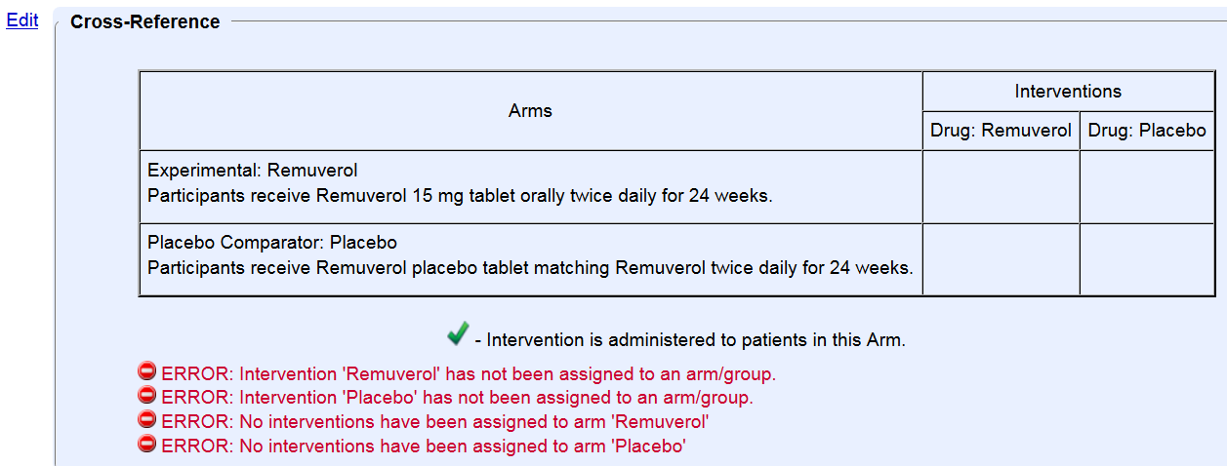
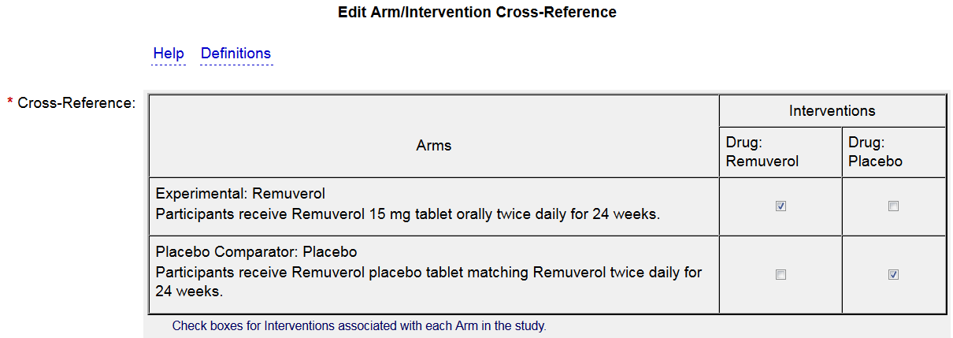
Errors must be fixed to move on.
Click edit to resolve these Errors
Cross-Reference tables will not exist for single arm studies. For multiple arm studies, you must link arms and interventions even when it seems that it’s obvious that Arm A does intervention A and Arm B does intervention B.

Slide 29
Outcome Measures
Protocol/statistical analysis plan must be submitted with results and will be public for studies with a primary completion date of 1/18/2017 or later
  Ensure coherence among protocol and registration for primary, secondary and “other” outcomes
  PRS reviewers may assume all outcomes are primary or secondary unless they are specified in the protocol as other or exploratory
Include all PRIMARY and SECONDARY outcomes (tertiary/exploratory are optional)
Label outcomes as “primary” or “secondary” per the protocol
  Can list more than one primary if applicable
Notes:
42 CFR 11.10(a) Definitions:
Primary Outcome Measure:
Outcome measure(s) of greatest importance specified in the protocol, usually the one(s) used in the power calculation
Secondary Outcome Measure:
Outcome measure of lesser importance than primary outcome
Part of pre-specified analysis plan
Not specified as exploratory or other

Slide 30
Outcome Measures
More registrations get rejected for inadequate Outcome Measure precision or inaccurate or multiple time frames than anything else.
Outcome Measures should be specific and indicate what is being measured and is (or planned to be) reported.
Remember the mantra: Outcome Measures must be measurable outcomes.
Refer to the Outcome Measure Tip Sheet for help avoiding QC comments and registration delays! Contact clinicalresearchsupportcenter@ucdenver.edu for a current version
Notes:
Link to Figure 1: https://www.ncbi.nlm.nih.gov/pmc/articles/PMC3066456/figure/F1/
Zarin DA, Tse T, Williams RJ, Califf RM, Ide NC. The ClinicalTrials.gov results database—update and key issues. N Engl J Med. 2011;364(9):852-60.

Slide 31

Outcome Measure Tips: Title
Include the metric (i.e. scale, score, number, percentage)
  Ex: Safety
  Ex: Safety, as measured by number of subjects with at least one AE
Be clear and concise; omit verbs
  Ex: To determine the maximum tolerated dose of Drug A in patients with breast cancer.
  Ex: Maximum Tolerated Dose of Drug A in patients with breast cancer
List outcomes separately
  Ex: All-cause mortality, hospitalizations, ER visits
  Ex: Number of hospitalizations, Number of ER visits, All-cause Mortality. Should be listed as 3 separate outcomes
Exception: if a composite score of multiple measures will be used
  Example: Count of individuals who experience any of the following: all-cause mortality, hospitalizations, and emergency room visits
Notes:
Tip: Enter WHAT will be measured, not why
It's important to note that this would be acceptable because they specify a score is being reported - if they simply listed this as "composite of all-cause mortality..." then reviewers will comment that this is multiple.

Slide 32
Outcome Measure Tips: Time Frame
Be specific (e.g. # of minutes, weeks, months)
  Ex: Baseline, week 2
  Ex: During hospitalization, approximately 5 days
  Ex: Post-intervention, week 12
If multiple time points are included:
  If measuring change between the time points, add the word “change” to the title, e.g. “Change in Systolic Blood Pressure”
  If not measuring change, each time point needs to be listed as a separate outcome measure, e.g. “Systolic Blood Pressure at Baseline”, “Systolic Blood Pressure at Week 2”.
    Tip: Write one, then use the (tiny) “Copy Outcome” button for the rest, then edit the title and time frame.
Remember that completion dates should reflect completion of data collection for your outcome measures. Refer back to study status section.
Average time, expected average time, or max assessment time would all be acceptable when the protocol cannot specify precise time frame
Notes:
For data that is collected and then analyzed at a later time point (for example, imaging), the time frames should usually be when the data were collected. So, if you are collecting CT images from a single CT, usually the length of the scan is an acceptable time frame.

Slide 33
Outcome Measure Tips: Description
If a scale will be used, include the full unabbreviated name of the scale, what it measures, the range of possible scores, and the meaning of the scores
  Template: The [FULL NAME OF SCORE/SCALE] measures [WHAT IT MEASURES]. Scores range from [MINUMUM] to [MAXIMUM], with higher scores indicating a [BETTER/WORSE] outcome.
  Example: The Hamilton Depression Rating Scale measures the severity of depressive symptoms. Scores range from 0 to 50, with higher scores indicating a worse outcome (greater severity of depression).
If a scale is not linear (e.g. logarithmic), that would be good to note as well.
Notes:
No longer optional

Slide 34
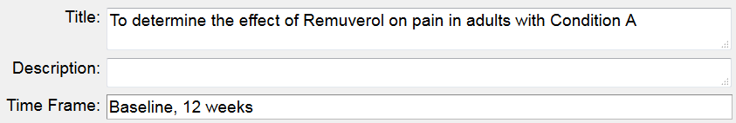
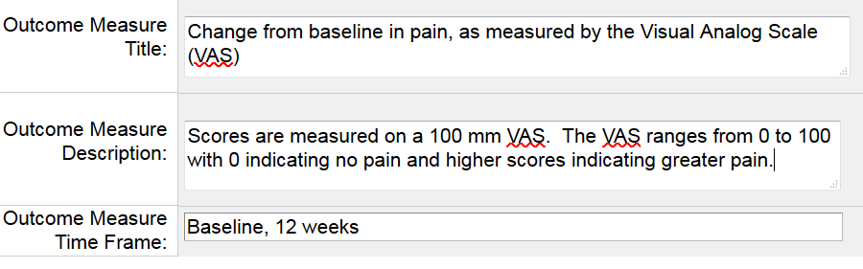
Outcome Measures: Example 1
There are 2 time points, so the word “change” is added to the title
The Title includes the scale that will be used to assess change in pain
The Description includes the range of the scale and what the scale means
Notes:
NEW SCREEN SHOT FOR INDICATING

Slide 35
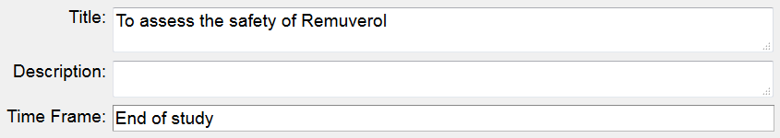
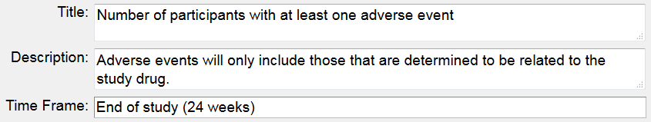
Outcome Measures: Example 2
The title includes the metric
The Time Frame includes the specific length of time
The Description defines “adverse events”

Slide 36
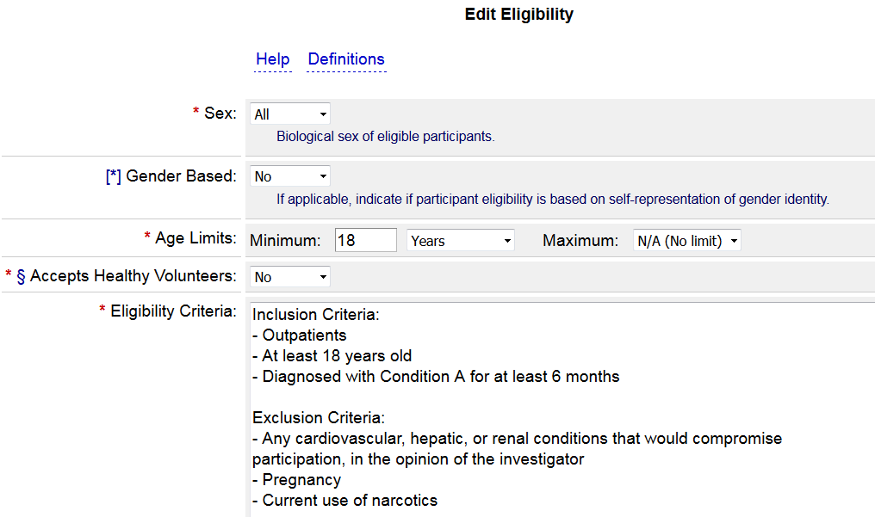
Eligibility
Use Inclusion / Exclusion Criteria with colon followed by dashed list format
No paragraphs
Make sure that all criteria you post are appropriate for the public to see.
Match informed consent more than protocol, if something might need to be masked from participants.
If necessary, use Detailed Description field to flag that the eligibility criteria are deliberately incomplete to preserve the scientific integrity of the study
Notes:
Copy text from Diane’s version

Slide 37
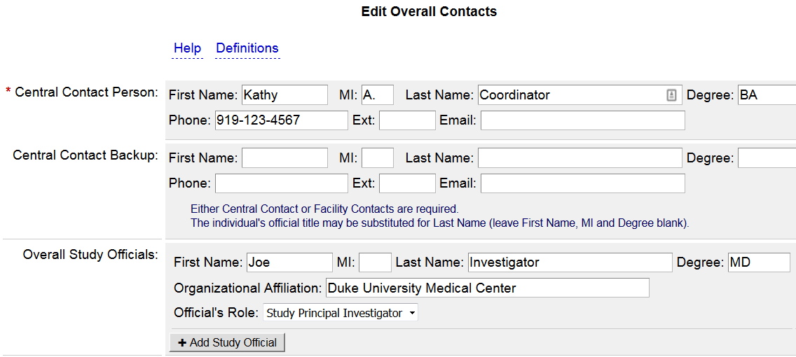
Contacts/Locations
Add the PI as a Study Official

Slide 38
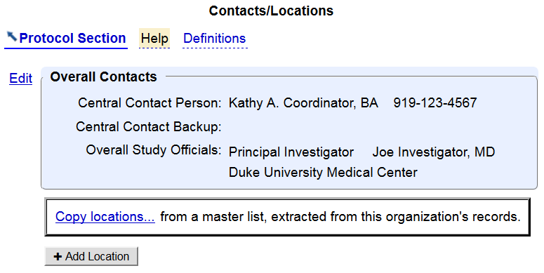
Contacts/Locations
Overall contact may be used to differentiate a study coordinator or administrator from the study official.
All sites should be added for multi-site studies, only after the IRB has approved that location
Notes:
For multi-site studies, all sites should be entered. – required by the final rule

Slide 39
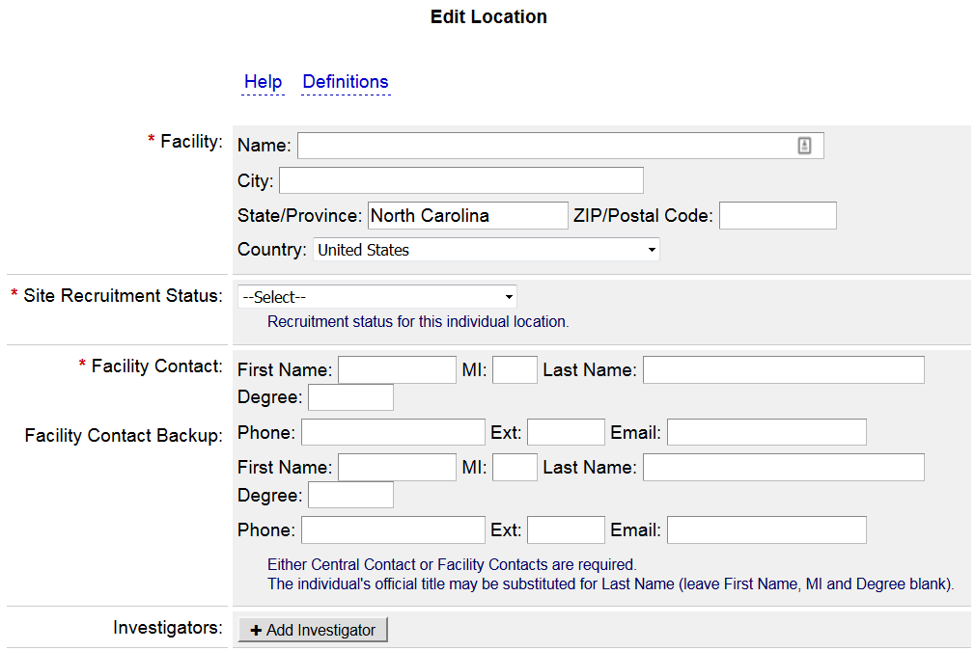
Contacts/Locations
Site recruitment status must be consistent with overall recruitment status; if overall recruitment is not recruiting, no site can be recruiting
Notes:
If you have entered a central contact, an individual facility contact is not required, but may be helpful if a potential subjects calls/emails about the study. You still need to enter the Facility Name and Recruitment Status.

Slide 40
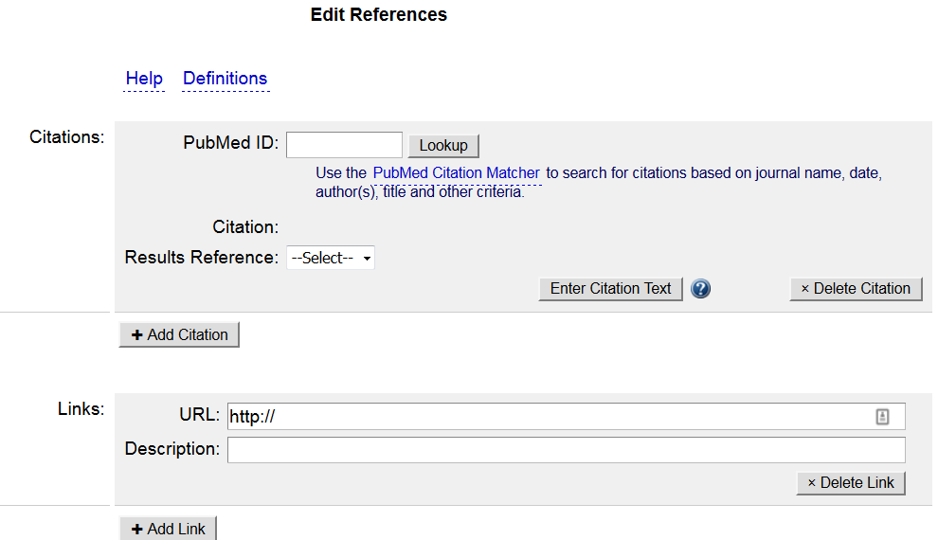
References
Studies available in PubMed are linked automatically if the NCT# was included in the publication. Others need to be added manually
Indicate if the reference provided reports results from this study

Slide 41
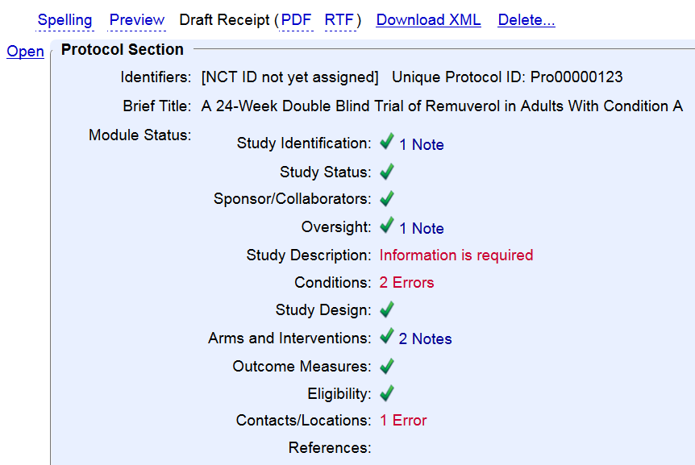
The Record Summary
Errors must be addressed before releasing the record
Warnings indicate potentially serious issues that should be reviewed and addressed as needed
Notes indicate other potential issues; address as needed
Click the Spelling link to review spelling errors and unexpanded acronyms
When the Record Summary shows all green checks, the PI should carefully review the record. False statements are criminal under the regulations! For new registrations, the PI should read each section carefully
Notes:
Now we’ve gone through the entire record. The Record Summary page will show us which sections still need attention. Also remember to click the Spelling link to address spelling errors and unexpanded acronyms, which may result in PRS comments if not resolved.
CHECK PRS USER GUIDE FOR WARNING LANGUAGE

Slide 42
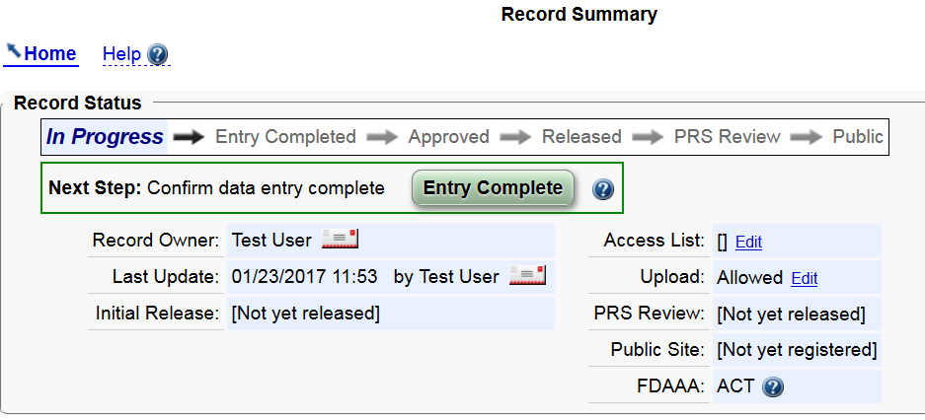
The Record Summary – to complete
Click Entry Complete to send the record to the Responsible Party for Approval and Release
This study appears to be an ACT and is subject to federal regulations
The reasons why your trial is considered ACT will be displayed
Notes:
Until you click Entry Complete, the record remains “In Progress” (in draft). Once you click Entry Complete, it automatically goes onto the list for the Responsible Party to Approval and Release.

Slide 43
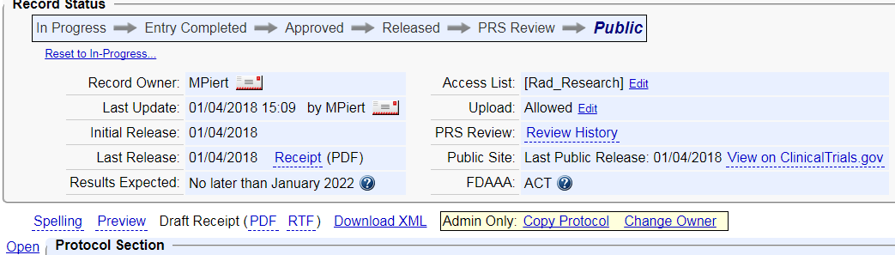
The Record Summary – User Information
The Record Owner is the primary contact for the record. Only an administrator can change the Record Owner
Add the PI and anyone else who should have edit rights. The Record Owner can do this
Initial Release date displays on the public site. This is important for FDAAA and ICMJE
Notes:
Note: Whoever initiates the registration is automatically assigned as the Record Owner, but this can be changed if needed. The Record Owner should add the PI and anyone else on the study team who needs to edit the record to the Access List.
ADD TITLE for reminders

Slide 44
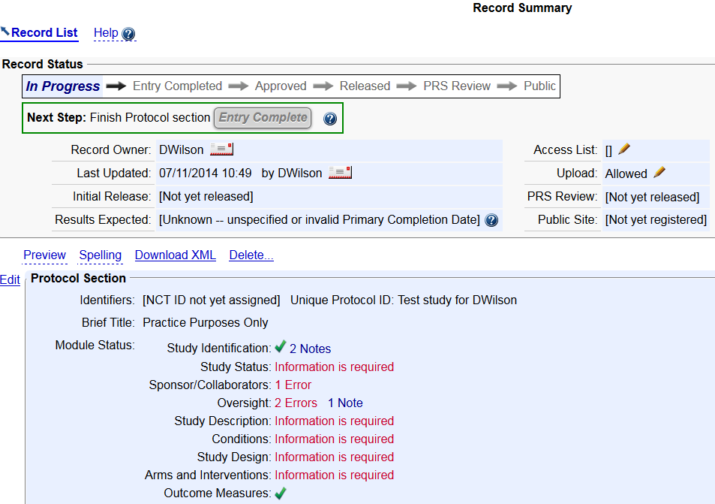
Can a Study Record be Deleted?
Only if the study record has never been published on ClinicalTrials.gov
Otherwise, No.
ClinicalTrials.gov serves as a long-term public registry. Once a study record is published, it remains in the system even after a trial has closed.
If you find a duplicate, or if your un-published record needs to be deleted, contact clinicalresearchsupportcenter@ucdenver.edu
Notes:
A clinicaltrials.gov record that has been released to the public can never be deleted. It can likely be revised, or transferred, but not deleted.

Slide 45
PRS Review
  Once the record is released, ClinicalTrials.gov conducts a manual review
  If major issues are identified, the record owner and RP will receive notification from ClinicalTrials.gov with comments
  The study will be reset to In Progress
  Study Owner/RP must correct the issues and re-release it within 15 calendar days (new in 42 CFR 11)
  If no major issues are identified, the study is assigned an NCT number and published on the public side of the database (clinicaltrials.gov)
  This process takes about 2-5 business days
  Even if its published, (yellow) advisory comments may be posted. Corrections are not mandatory

Slide 46
Ongoing Responsibilities of Record Owners
Records can be transferred to other user accounts as staff change
Records must be updated every 12 months and within 30 days of Recruitment Status changes or amendments that affect information in clinicaltrials.gov record, especially recruitment status, location and contact information
Always update the Record Verification Date to indicate that you have updated or reviewed the record
Records must be updated within 30 days after the completion date (last data collection)
Failure to update information on ClinicalTrials.gov can result in penalties. There are more specific update requirements in 42 CFR 11.64
Notes:
The law requires updates every 12 months. ClinicalTrials.gov uses the “Record Verification Date” as the trigger for determining the next 12 month update.
No recruitment can take place without IRB approval

Slide 47
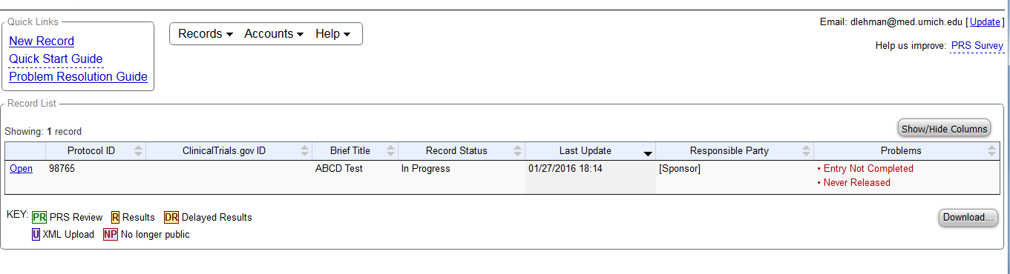
Checking your Problem Records
PRS System identifies current ‘Problem Records’
  Records that have not been marked as completed
  Active studies that have not been updated (or the Record Verification Date has not been updated)
  Records missing one or more FDAAA-required data elements:
    Responsible Party
    Study Start Date
    Primary Completion Date
    Primary Outcome Measure
  Records that appear to be overdue for FDAAA results reporting
Notes:
Additionally, RPs and Record Owners will receive emails every 6 months about records with Problems. Lack of updating of Verification Date is a very common problem.

Slide 48
Do You Need to Submit Results?
All Applicable Clinical Trials (ACTs) are required to submit results
All NIH-funded trials begun on after 1/18/2017 and applied for on or after 1/18/2017 must report results, whether ACTs or not
Other grantors may require results submission
Based on registration information entered, the system will assess whether the trial appears to be:
An ACT with results required by law
A Non-ACT: results not required by law, though NIH policy (if so funded) or other funders’ policies (e.g. VAORD) may still require results reporting
3) Older trials may be designated Probable ACT or Probable Non-ACT
Note: There is no reminder flag for NIH-funded trials! Be aware of your results deadlines!
Notes:
These assessments rely on data entered by RP. If any data is not correct then PRS assessments may not be correct.

Slide 49
Acknowledgements
This slide set was developed collaboratively by contributors from
Beth Israel Deaconess Medical Center,
Boston University
Cambridge Health Alliance
Duke University
Fred Hutchinson Cancer Research Center
Harvard University
Mayo Clinic
Partners
Rutgers State University
University of Michigan
University of Pittsburgh
University of South Florida
Special thanks to:
Isabel Chico Calero
Niem Tzu Chen
Melanie Chladny
Wendy Duncan
Patrick Fawcett
Eleanor R. Greene
Jessica Houlihan
Odette Lobo
Linda Mendelson
Cynthia Monahan
Carolyn Peterson
Diane Wilson

