Slide 1
VA Innovation and Research Review System (VAIRRS)
Eastern Colorado HealthCare System
SUBMISSION AND APPROVAL platform for RESEARCH STUDIES
Basics for researchers and Research personnel

Slide 2
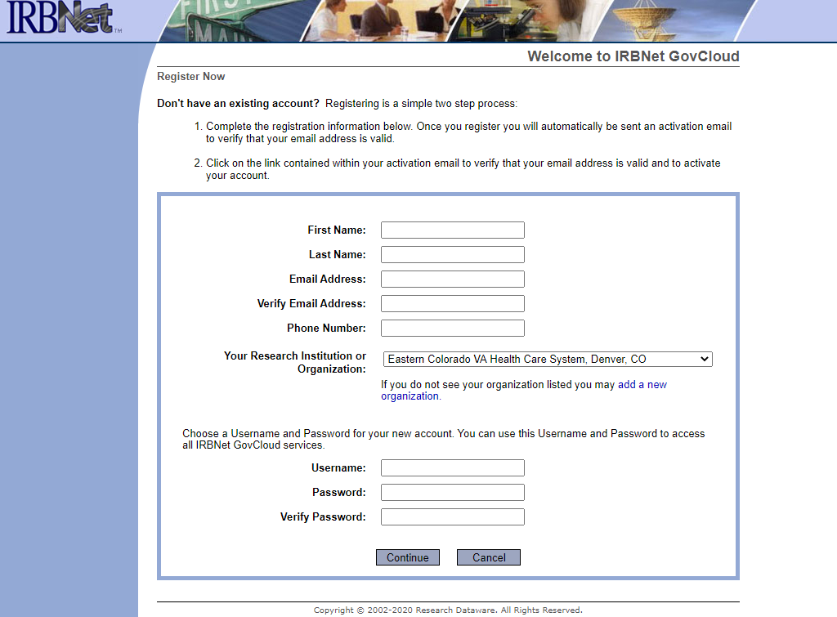
VAIRRS runs on the IRBNET platform
Register as a new user at:
GOV.IRBNet.org
Name
Contact information
  Use your VA or affiliate email address (you will receive login verification codes at this email)
Institution
Eastern Colorado VA Health Care System
Username
Password
----------------------------------------------------
CONTINUE
----------------------------------------------------
The next page will be the “Terms of Use Agreement”
Accept these terms to complete registration
*After registering, you will be able to log in using your PIV badge while on the VA network.

Slide 3
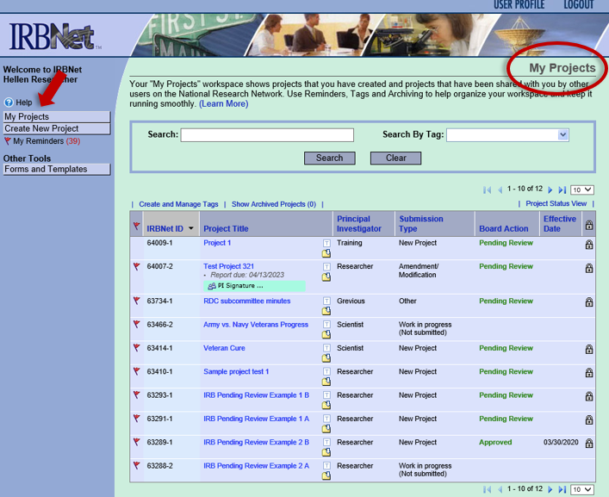
My projects page
This is the first screen seen when logging into IRBNet
Can also be accessed using the “My Projects” tab on the left
Your submitted projects will appear on your “My Projects” page
To the far right, you will see a lock symbol showing that your project is locked after submission
  Changes can not be made without emailing vhaechresearchadmin@va.gov
From here you can see the “Board Actions”
  This shows any actions taken by reviewers

Slide 4
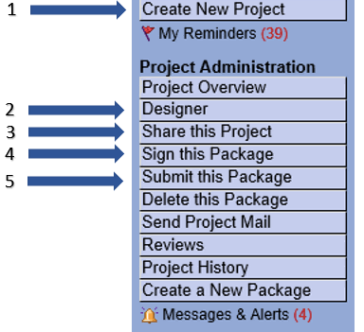
Submitting research
There are 5 steps to submitting a study

Slide 5
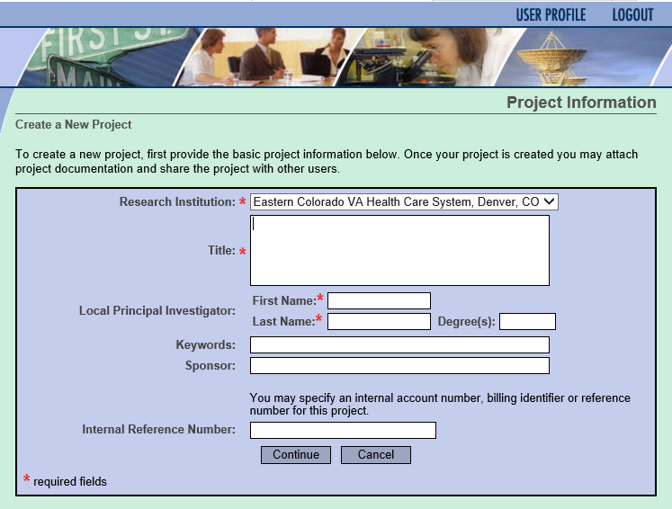
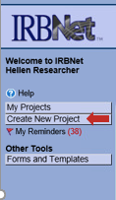
1. Create new project:
Keywords none required
Sponsor if applicable
Internal Reference Number
Enter your COMIRB study number

Slide 6
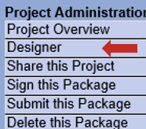
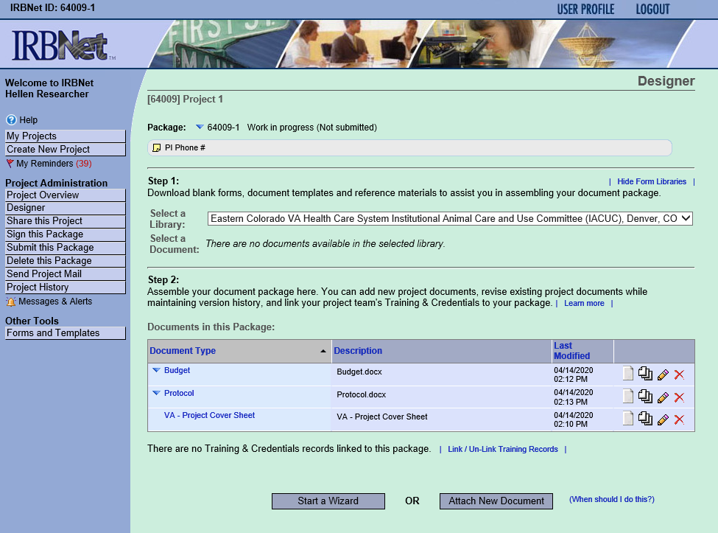
2. Designer
The “Designer” is where you add documents
At the top of the designer you can add a note for the project
Step 1 is where you can access a library of all ECHCS Research Administration template documents to download, including your checklist for submission
Step 2 is where you will upload your documents
  “Attach New Document”—upload filled forms here, (COMIRB application, etc.)
  “Start a Wizard” – for new studies (will be required starting Oct. 2020)
    Wizard forms will take the place of select local forms. Check the most recent Checklist for Submission in the ECHCS Research Administration library to determine your study requirements, and for further instructions.

Slide 7
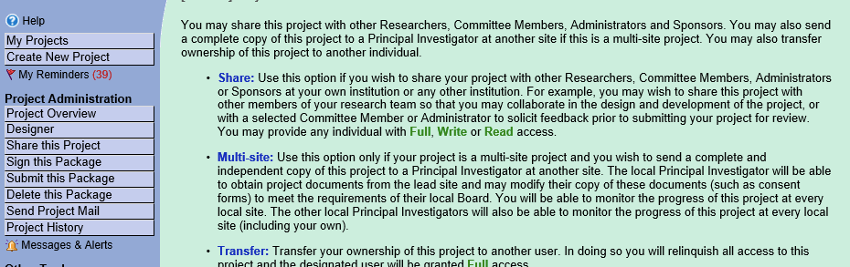
3. Share this project
connect your study with other members of your research team or collaborating sites
You will only be able to add other research staff that have created an account on gov.irbnet.org

Slide 8
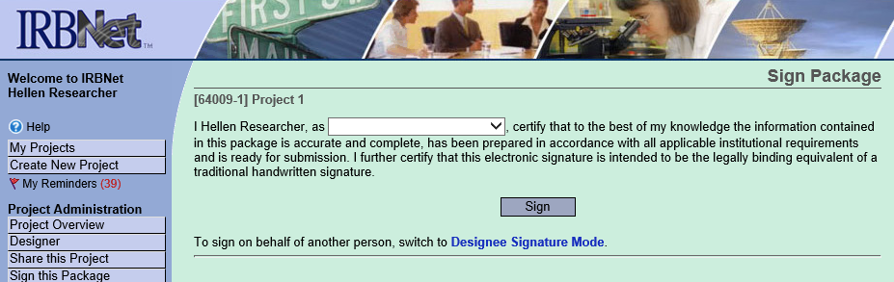
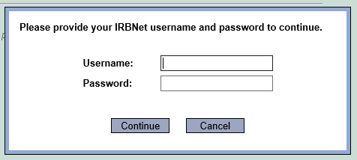
4. Sign this Package
You will use your username and password to verify your
e-signature

Slide 9
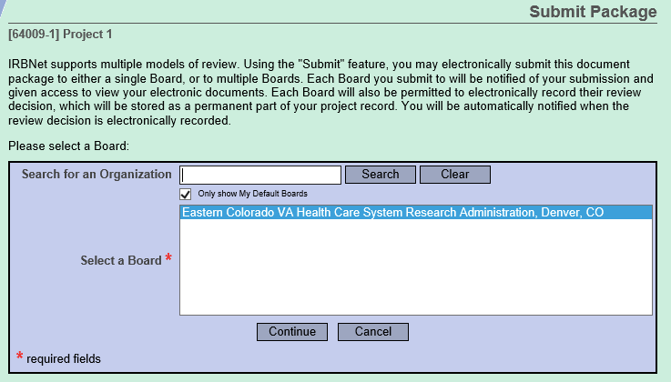
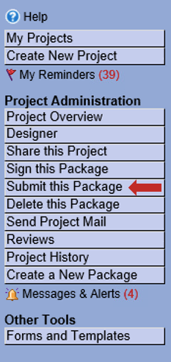
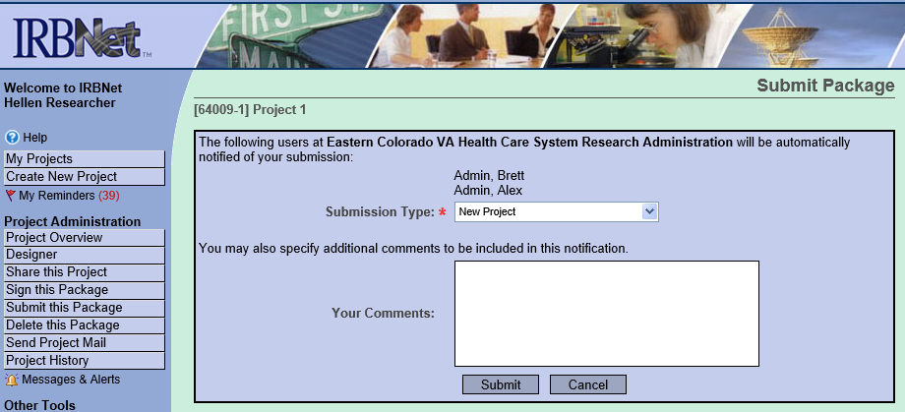
5. Submit this Package
Submit to “Eastern Colorado VA Healthcare System Research Administration”
Specify submission type:
  Under “Human Subjects Research”
    New Project,
    Amendment
    Continuing Review
Beginning Oct. 2020, CR and Amendment submission to VAIRRS will be required PRIOR to submission to COMIRB
Once submitted, this package will be “locked” to further edits
You will be notified by email when your project has been reviewed, or new approval documents are added

Slide 10
Study Review and approval process on IRBNet
RESEARCH ADMIN
Submit to ECH Research Administration for pre-review and SRS committee review
PRE-REVIEW:
Once your study has been pre-reviewed, you will receive a message alerting you of the outcome/edits required
The status of your project will be updated
Any edits will require submission of a new “package” within the same project
COMIRB
Once VA Clearance issued, you will submit separately to COMIRB through InfoEd
RESEARCH ADMIN
Once COMIRB submission is approved, submit a new “package” to Research Administration
New package to include COMIRB approval letter and any modifications
SUBCOMMITTEE ON RESEARCH SAFETY (SRS COMMITTEE)
Once SRS committee approves, and COMIRB approval uploaded to VAIRRS, Research Administration will advance your study to RDC for final approval
RESEARCH AND DEVELOPMENT COMMITTEE (RDC)
Once you receive your RDC final approval, you can begin your study
Commence Research

Slide 11
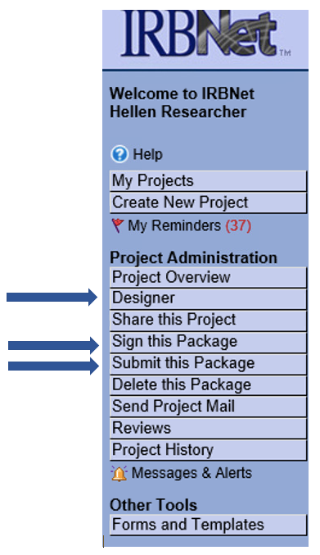
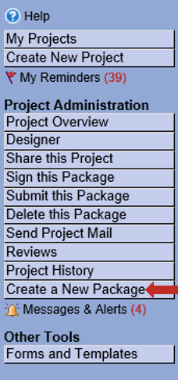
Amendments create new package
If you need you submit an amendment or make any modifications to your submission, you will create a new “package” for your study.
You should do this PRIOR to submission to the IRB.
You will be notified when you can submit your amendment to the IRB
2
1
The steps are similar to initial submission: 1.Create a New Package
2. Designer to upload or modify documents
3. Sign this Package
4. Submit this Package
3
4

Slide 12
Resources
Research Administration Help:
Questions about submission process, forms, regulatory requirements, training, Privacy and Information Security, personnel:
VHAECHResearchAdmin@va.gov
ECHCS Research Administration intranet site:
https://vaww.denver.va.gov/clinical/Research.asp
ECHCS Research Administration internet site:
https://www.denver.va.gov/services/research.asp
VA ORD (Office of Research and Development) VAIRRS website:
www.research.va.gov/programs/orppe/vairrs/default.cfm
IRBNet technical support:
Issues with logins, technical support
govsupport@irbnet.org

