Slide 1
FINANCE
Journal Entries

Slide 2
WELCOME
This course is part of a suite of courses required for Financial System access at CU. It complements the online Blackboard course, Financial-General Ledger, but also offers trainees:
the opportunity to create journal entries in a practice database
the ability to ask questions specific to individual department environments
additional resources
You'll be able to view it online any time you need a refresher; you need not be at a campus computer. Once you're ready to get started, and to progress page by page through the tutorial, click to move forward.

Slide 3
Course Overview
The General Ledger course is fundamentally about creating journal entries (JEs). Here's a look at what we'll be covering:
COURSE OVERVIEW
INTRODUCTION | DEBITS AND CREDITS | NAVIGATION | PRINTING | ROUTING | RESOURCES
JE Purposes Cost Transfers Gift Fund JEs | Debit & Credit Behavior CU's Account Codes | Journal Types Journal Requirements Error Handling | In Finance System In Reporting System | Back-up Documentation Deadlines Routing Methods | Links

Slide 4
JE Purposes
Financial transactions appear on CU's financial statements via journal entry. Subsystems feed transactions to the general ledger as journals:
Payroll (HCM),
Marketplace,
Concur,
Student system,
Printing services,
Information systems,
Building maintenance,
etc.
Types of journals:
Actual Journal Entries
  Regular Journal Entries
  Interdepartmental Charges
  Cash Transfer Journal Entries
Budget Journal Entries
Encumbrance Journal Entries (subsystem created)

Slide 5
Actual Journal Entries
When actual financial transactions need to be recorded and cannot be recorded through a subsystem feed, they are processed as an manual journal entry. The most common reasons for actual journal entry processing at the campus departmental level are:
Recording of interdepartmental (IN/ID) revenue and expense
Correcting financial transactions
Accruals for
  accounts receivables and revenue,
  allowance for bad debts and bad debt expense,
  inventory adjustments, etc.
Actual journal entries must be balanced between debits and credits.

Slide 6
Budget Journal Entries
Budgets are recorded or adjusted by entering transactions into one of the Finance System budget ledgers:
B_INI_CONT (Budget Initial Continuing)
B_INI_TEMP (Budget Initial Temporary)
B_CUR_CONT (Budget Current Continuing)
B_CUR_TEMP (Budget Current Temporary)
The INITIAL budget ledgers, B_INI_CONT and B_INI_TEMP, are entered by Budget Office staff. At the beginning of each fiscal year, the Budget Office records the initial budget for speedtypes within the General Fund (fund 10), Auxiliary Funds (funds 20-29), and Renewal/Replacement Funds (funds 71-72) using the appropriate INITIAL ledger. Fund 30 budgets are input by the Office of Grants and Contracts.
The CURRENT budget ledgers are available to certain Finance System users having the proper security authorization. The CURRENT ledgers are used throughout the fiscal year for making budget adjustments.
The distinction between Continuing and Temporary budget ledgers relates to carryover from one fiscal year to the next. Each year at fiscal year end, budgets recorded in the B_INI_CONT and B_CUR_CONT ledgers will roll forward from one fiscal year to the next, while budgets recorded in the B_INI_TEMP and the B_CUR_TEMP ledgers will not roll forward.
Budget journal entries are single-line entries and are not balanced between debits and credits.

Slide 7
Payroll Expense Transfer Journal Entries
Payroll expense transfer journal (PET) entries are created in the Human Capital Management System. For more information on the PET process, see: the HCM Training Documents.

Slide 8
Debits and Credits
Debits (traditionally recorded as positive numbers) and credits (traditionally recorded as negative numbers) affect dollar balances differently depending on which account code range they are recorded against:
ACCOUNT | DEBITS | CREDITS
ASSETS - Account codes 000000 – 099999 | Increase | Decrease
LIABILTIES - Account codes 100000 - 199899 | Decrease | Increase
NET ASSETS - Account codes 199900 – 199999 | Decrease | Increase
REVENUE - Account codes 200000 – 399999 | Decrease | Increase
EXPENSES - Account codes 400000 – 989999 | Increase | Decrease
TRANSFERS IN – Account codes 995000 – 995999 or 990000 – 990999 | Decrease | Increase
TRANSFER OUT – Account codes 997000 – 997999 or 992000 – 992550 | Increase | Decrease

Slide 9
Cost Transfers
A cost transfer is the journal entry (transfer) of a cost incurred initially on one university program/project to a sponsored project (funds 30/31). There are only certain conditions under which cost transfers may be accepted as charges to sponsored projects.
Any project direct expense should be charged to the project(s) that is/are benefited by the expense, so long as this type of expenditure is reasonable and is allowable by:
The Sponsor
Cost Accounting Standards
Uniform Administrative Requirements, Cost Principles, & Audit Requirements for Federal Awards
  OMB Circular A-21 Cost Principles for Educational Institutions
  OMB Circular A-110 Uniform Administrative Requirements for Grants and Agreements With Institutions of Higher Education, Hospitals, & Other Non-Profit Organizations
If a direct expense has been charged to an incorrect project number, this error should be promptly corrected via a Journal Entry (JE) or Payroll Expense Transfer (PET). Any such JE/PET that includes a speedtype that is contained in Funds 30 or 31 will incorporate a Cost Transfer Certification Statement. This certification statement requires that all expenses contained on the JE/PET are true and correct, that cost transferred to a sponsored project (fund 30 or 31 FOPPS) are reasonable, allowable, allocable, and in accordance with award terms.

Slide 10
Back-up Documentation
JE should be:
  Supported by documentation that contains a full explanation of how the error occurred and a certification of correctness of the new charge by a responsible CU Denver organizational official.
Sufficient supporting documentation will:
  Be Legible
  Include where, how and/or why
  Include calculation
  Demonstrate that the charges are reasonable, allowable, allocable, and in accordance with award terms (for contracts).
Notes:
Essentially, any documents you use to help prepare the IN/JE should be copied and forwarded with the IN/JE form or the JE.
Promote understanding of why the JE is required
Include how and/or why
Include computation calculation
Describe why it is appropriate
Without complete, sufficient, and legible supporting documentation, Finance Office or OGC may not be able to determine whether the journal entry is allowable, allocable, reasonable, consistent, and timely.
Each journal entry must stand on its own for audit purposes. For example, a year from now, if a journal entry is selected, the auditor should be able to understand exactly why the journal was done from the available documentation attached to the entry.

Slide 11
Journal Entry Descriptions
The “long description” or “Business Purpose” of the journal entry should include:
  Only 254 characters
  What the JE is meant to do
  Why the entry is being made (the “because” rationale)
  Details of individual journal lines
  If JE is a Cost Transfer or Correcting Entry
    Cause of the error
    How the expense is necessary to complete the scope of work
JE Description Email
http://www.ucdenver.edu/about/departments/finance/Documents/JE%20Description%20Guidance.docx
Notes:
What the JE is meant to do
Why the entry is being made (the “because” rationale)
Details of individual journal lines (Speedtype info, type of supplies, department info, grant/contract info)
Please refer to the JE description email I sent on January 22, 2013. A copy of this document is also included on the Finance website under JE Description Guidance.

Slide 12
Journal Entry Descriptions
Inadequate journal entry descriptions lead to audit questions such as:
  Is the department just trying to use up funds?
  Does this journal entry have a legitimate purpose or is the department trying to cover up fraud?
  Is the expense truly related to this project?
  As part of extracting journal entries to test, auditors will frequently search for key words such as “plug” or “net to zero”. Your description could raise a red flag to ensure being tested in an audit.

Slide 13
Journal Entry Descriptions
Inadequate Description:
  “To move charge to appropriate speedtype”
Suggested Description:
  “Speedtype 61003298 was charged in error when allocating expenses. Expense transferred to appropriate funding source.”

Slide 14
Journal Entry Descriptions
Inadequate Description:
  “To move lab supplies from one speedtype to the new project speedtype where they should’ve been reported.”
Suggested Description:
  “To transfer lab supplies from ST63022723 NIH training grant to ST63033345. Lab supplies were required by ST63033345 in order to complete INUITRO studies for the grant. Expenses were originally booked wrong due to a miscommunication in lab order request.”

Slide 15
Journal Entry Descriptions
Inadequate Description:
  “To redistribute expenses in order to close out and balance speedtypes”
Suggested Description:
  “To Transfer expenses from Adolescent Research (ST 6306789) to Adolescent Research (new segment and new ST 63010293). Expenses were incurred during budget period of new segment, but purchase was not updated to new speedtype.”

Slide 16
Journal Entry Descriptions
Inadequate Description:
  “To transfer income/expenses from HRSA grant”
Suggested Description:
  “To transfer salary expenses from HRSA sponsored project (ST 63054321) that is over budget due to personnel costs being greater than planned. Expenses transferred to an allowable unrestricted departmental funding source (ST62612345).”

Slide 17
Navigation
FIN 9.2 Learning Resources:
http://www.cu.edu/controller/fin-92-learning-resources

Slide 18
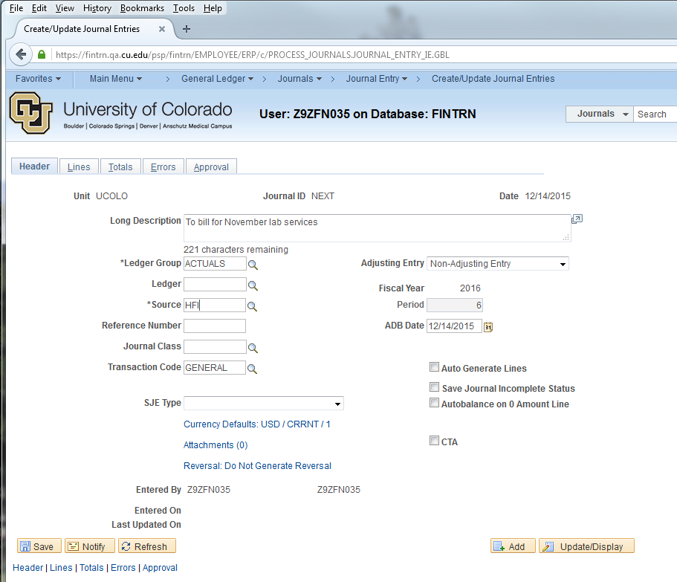
Adding Attachments
Verify legibility before submission.

Slide 19
Auto-balancing

Slide 20
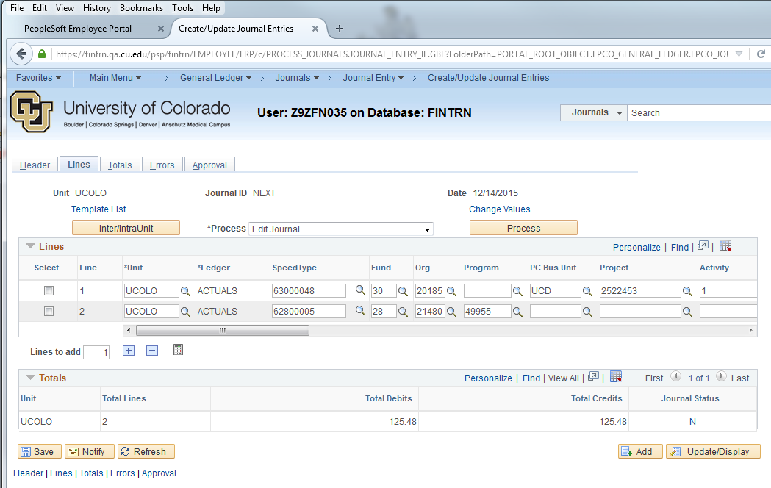
Auto-balancing

Slide 21
Personalizing Journal Line Fields

Slide 22
Analysis Type
In Journal Entry, the ANALYSIS TYPE (An Type) code is required for every journal line with a project SpeedType.
The Analysis Type value affects what is billed for the project and must be accurate.
In actual journal entries, enter:
GLE if the Account ChartField value is an expense (between 400000 and 989999)
GLR if the Account ChartField value is a revenue (between 200000 and 399999)
BAL if the Account ChartField value is a balance sheet transaction (<= 199999)
In budget journal entries, enter BUD.

Slide 23
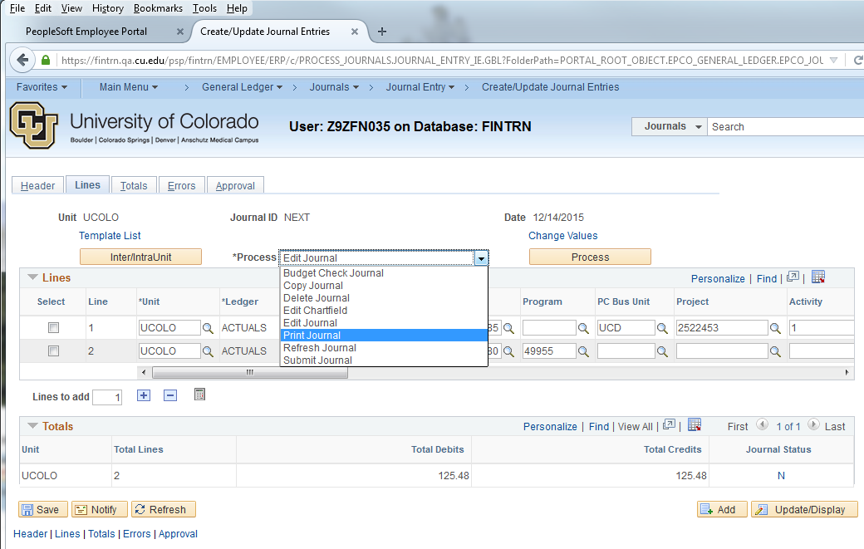
Process Menu

Slide 24
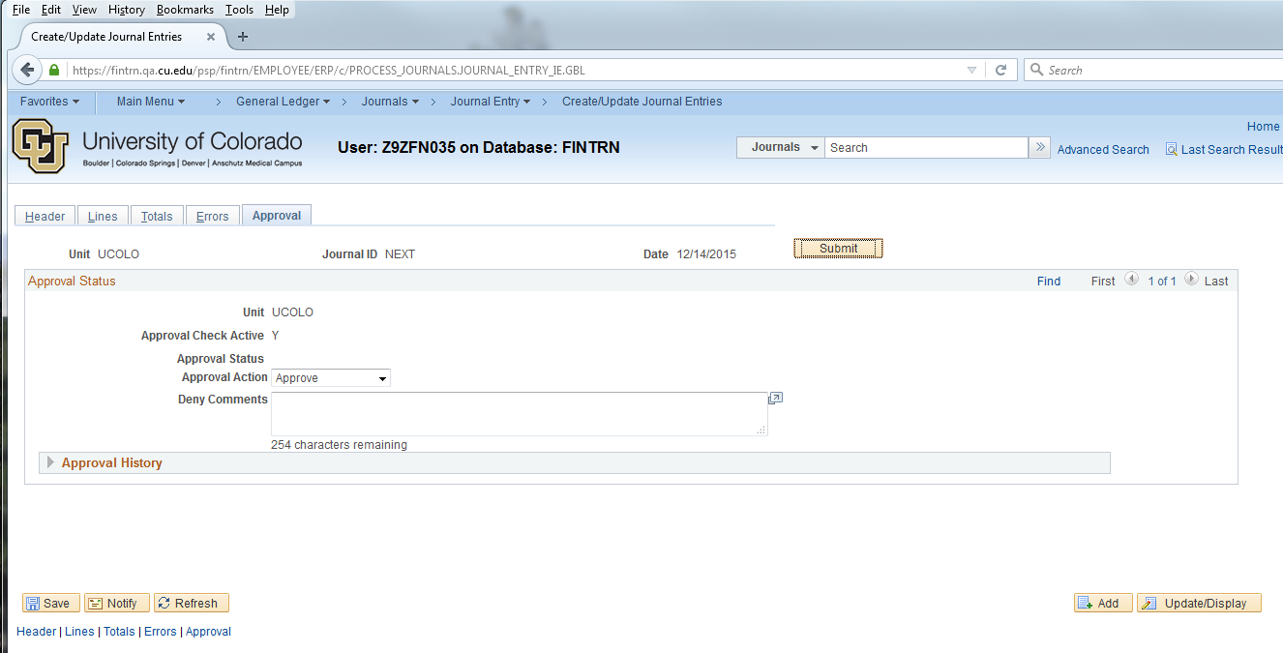
Submitting Journal Entries
Or submit from the process menu.

Slide 25
Reversing

Slide 26
Spreadsheet Journal Upload
Videos, step-by-step guides, and spreadsheet templates:
http://www.cu.edu/controller/finance-system-learning-resources-journals

Slide 27
Create New Journal Entries:
Do you have the following?
Justification of creating a journal entry
Speedtype(s)
Analysis Type
Account Code(s)
Amount (Debit/Credit)
Supporting document

Slide 28
Journal Entry Examples
Journal Entry Example #1 – Cost Transfer
Journal Entry Example #2 – Accruing Revenue and AR
Journal Entry Example #3 – Interdepartmental Revenue/Expense
Journal Entry Example #4 – UPI Revenue
Journal Entry Example #5 – Cash Transfer

Slide 29
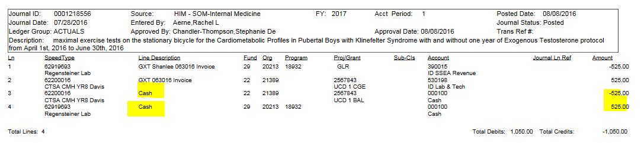
Should I put a Debit or Credit in a JE Line?
Whatever speedtype is getting a credit will increase its cash balance.
Whatever speedtype is getting a debit will decrease its cash balance.

Slide 30
JE Practice Problems
1. Booking revenue for providing lab service to Dr. Smith of Surgery in Dec. 2016.
  My lab operation speedtype: 62022512 (390015)
  Dr. Smith’s speedtype: 63077320 (530198)
  The IN number is 10B-066 and the charge is $550
2. The $900 lab supply charge was incorrectly allocated to ST61020848 with account code 530101. It should have been allocated to ST63432598.
3. Surgery is transferring $100,000 from their reserve account (67213688) to their general fund (61024246) to fund a special faculty start-up program (hint: account codes 997100/995100).

Slide 31
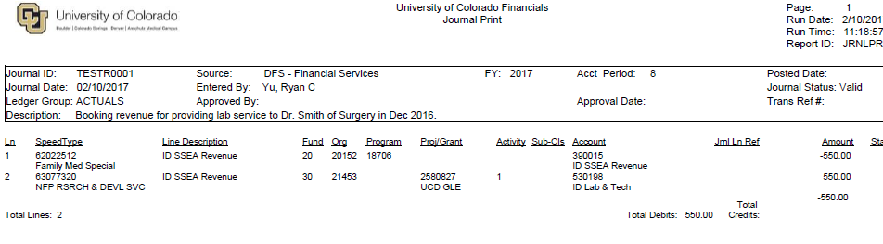
JE Practice #1: Answer

Slide 32
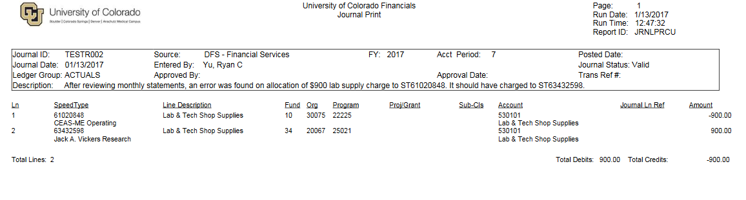
JE Practice #2: Answer

Slide 33
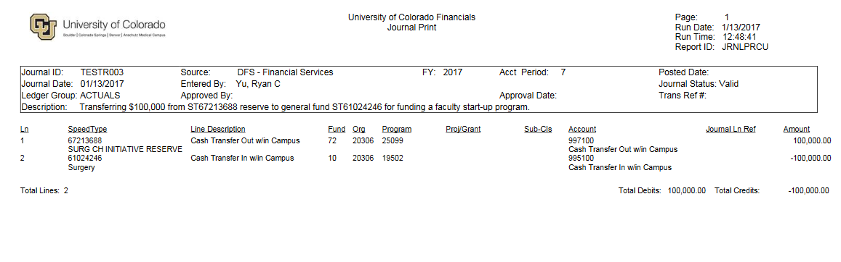
JE Practice #3: Answer

Slide 34
Resources
Presenters:
    Barb.Hayes@UCDenver.edu 303-724-2276; Caroline.Kirkwood@UCDenver.edu 303-315-2286;
Help:
    Finance.AccountingHelp@UCDenver.edu 303-724-9610
    FinProHelp@cu.edu 303-837-2161

